Slide 1
Identifying Other Users Actions
Master O-A through O-G

Slide 2
Session Four Objectives
Identifying vehicle condition and performance clues
Identifying clues to changes in vehicle movement
Identifying driver clues
Identifying motorcyclist clues
Identifying bicyclist clues
Identifying pedestrian clues

Slide 3
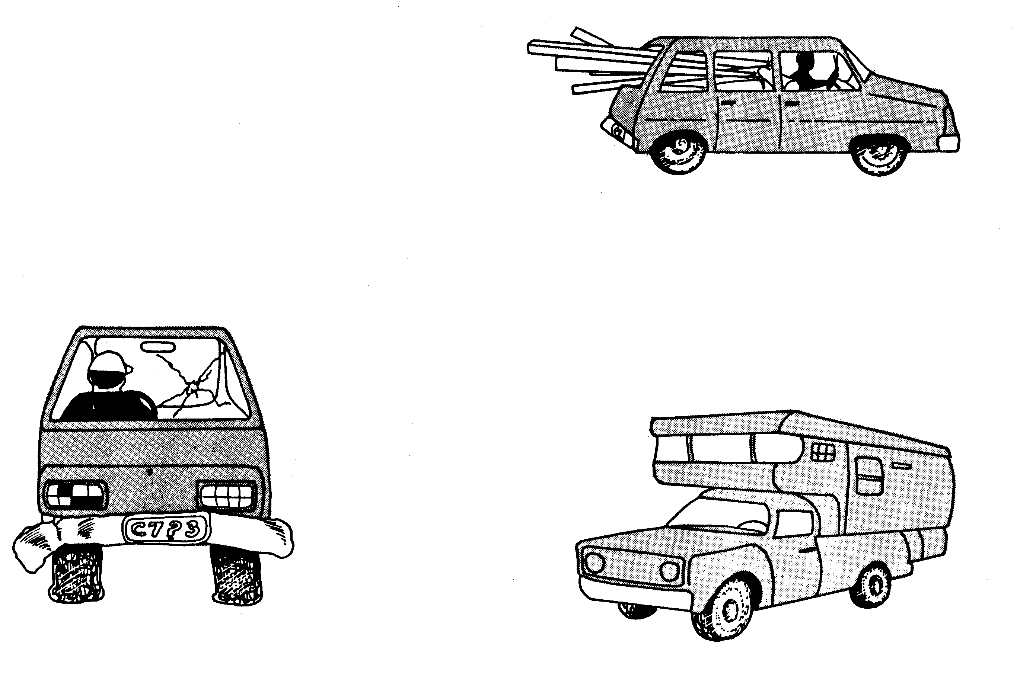
Vehicle Condition and Performance
Body Condition or Out-of-State License High or Low Performance
Improper or Overloaded

Slide 4
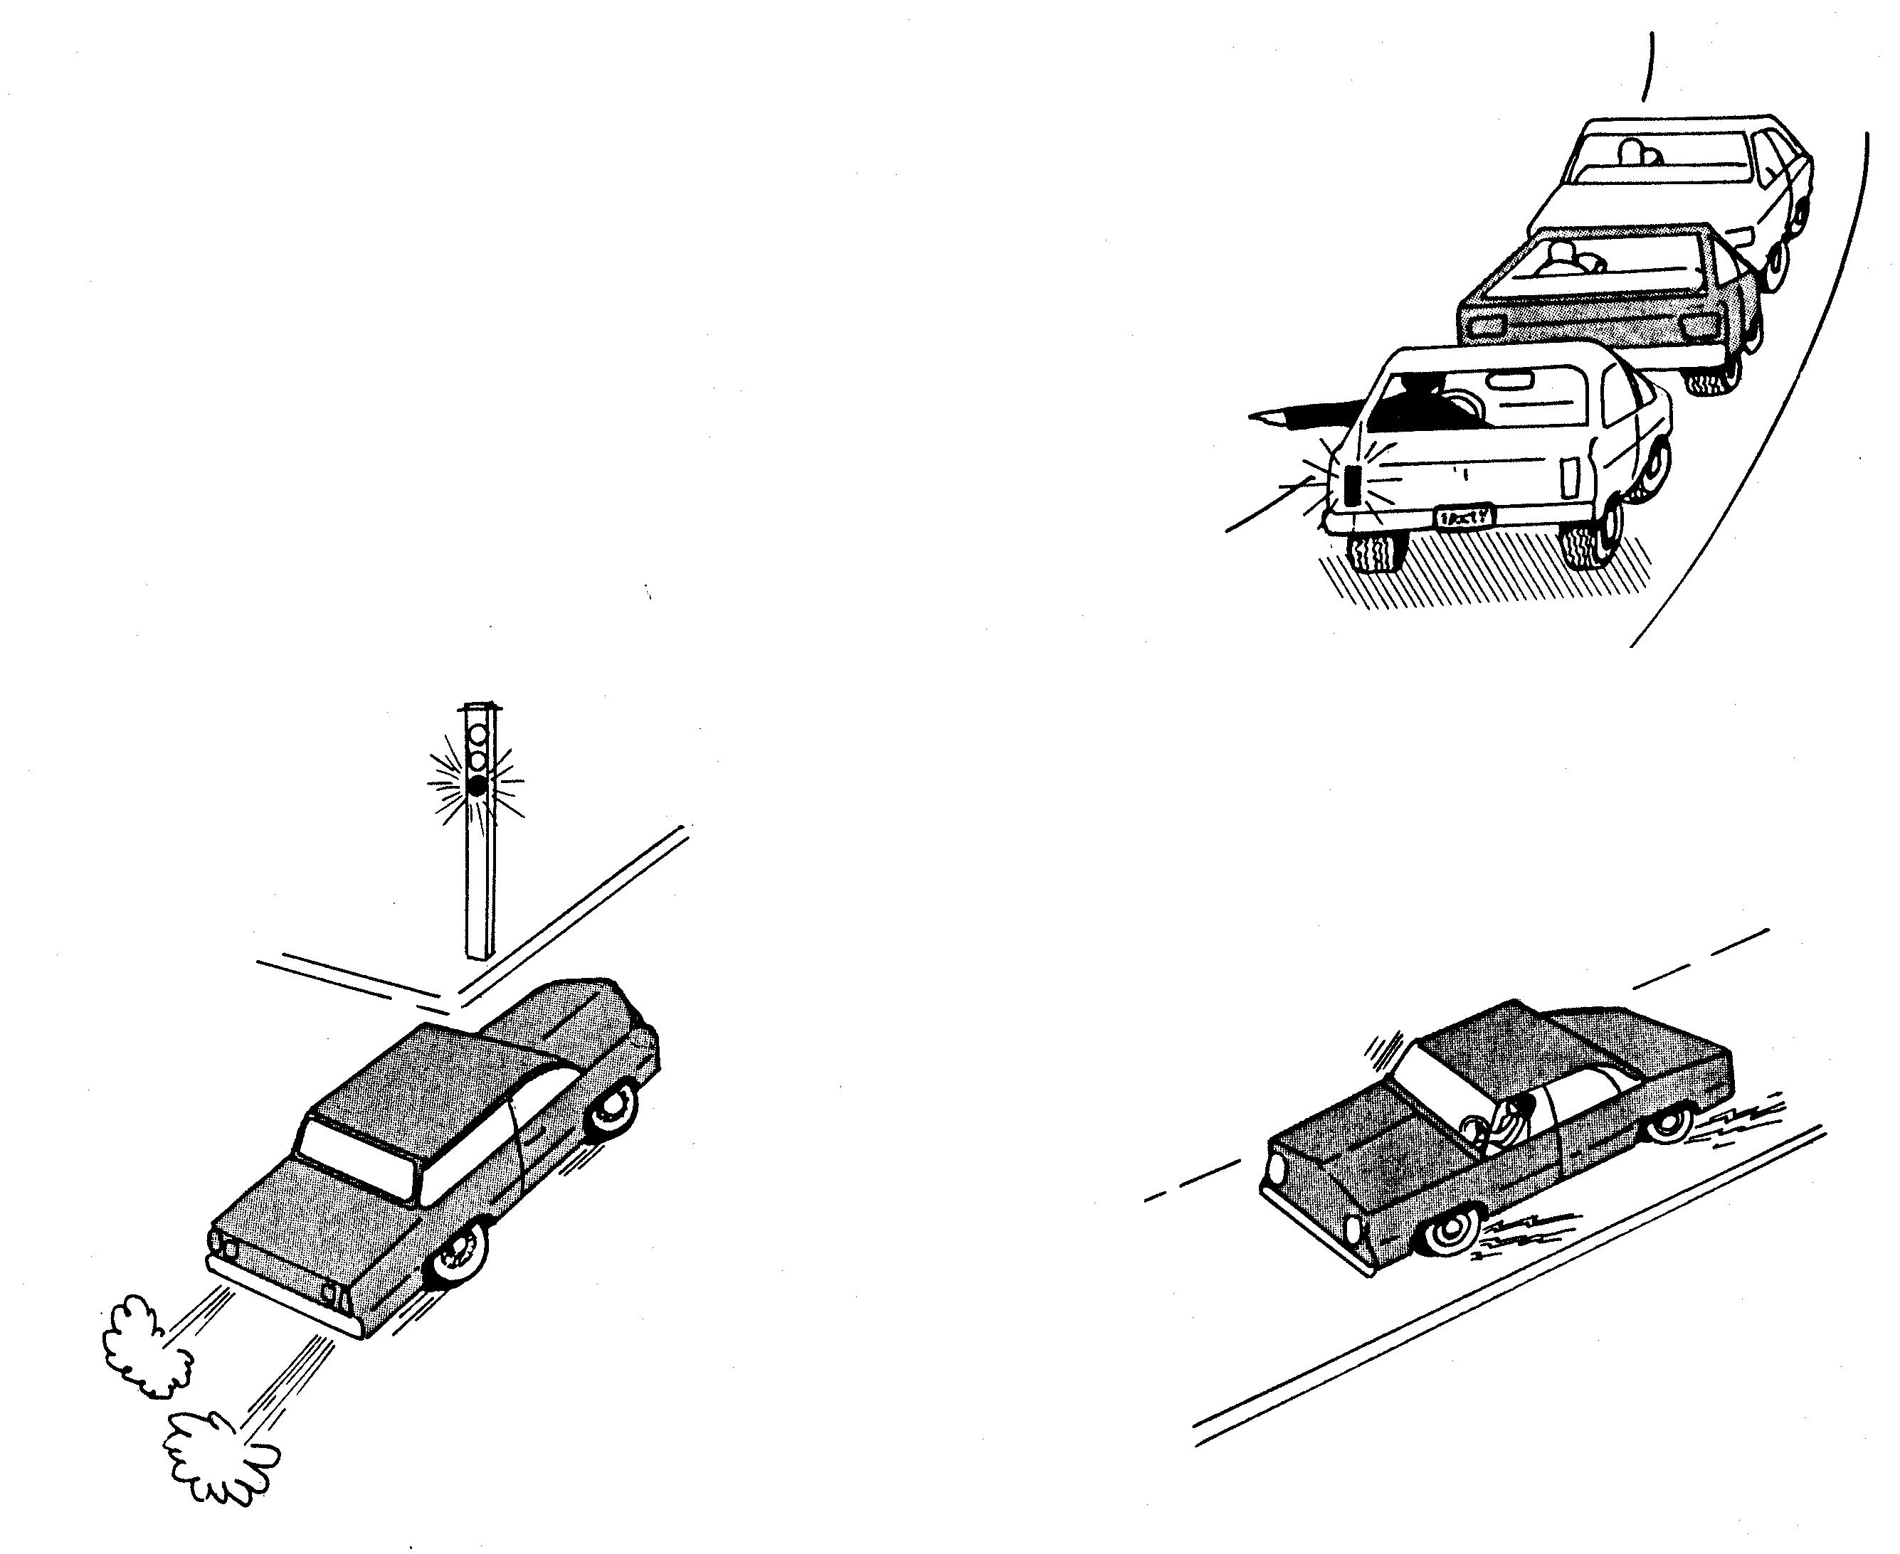
Clues to Change to Vehicle Movement
Changes in Acceleration
Change in Direction
Changes in Deceleration

Slide 5
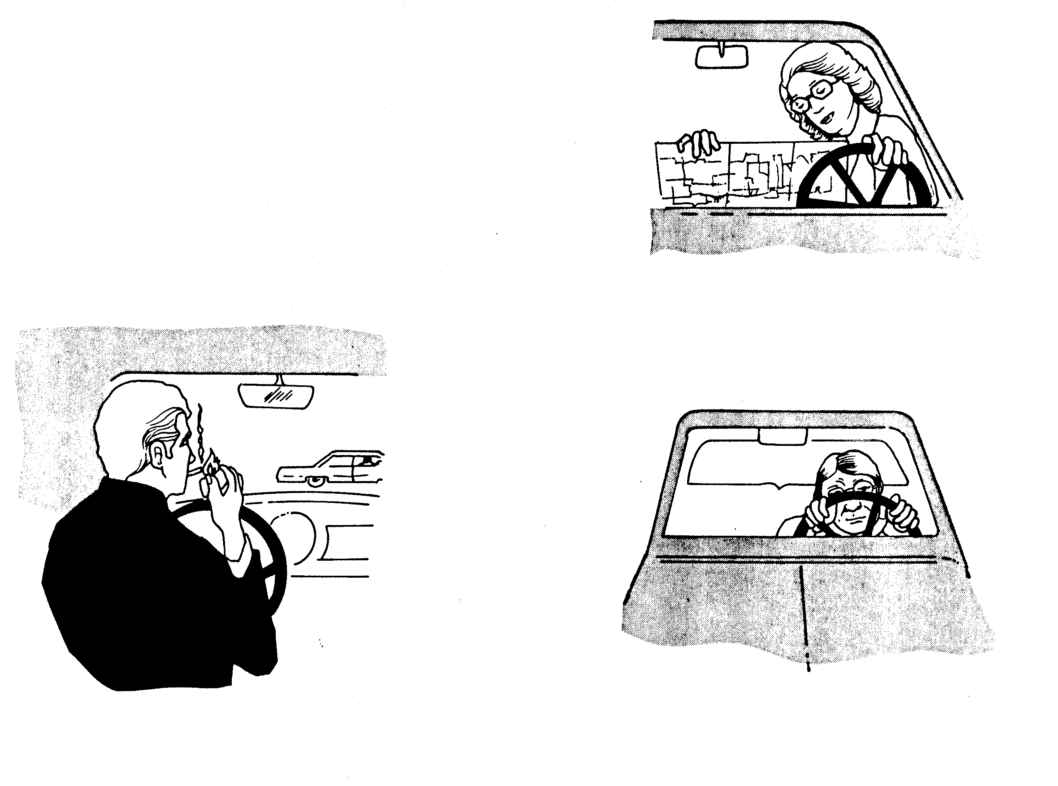
Driver Clues to Probable Actions
Condition of Driver
Activity of Driver
Age or Posture of Driver

Slide 6
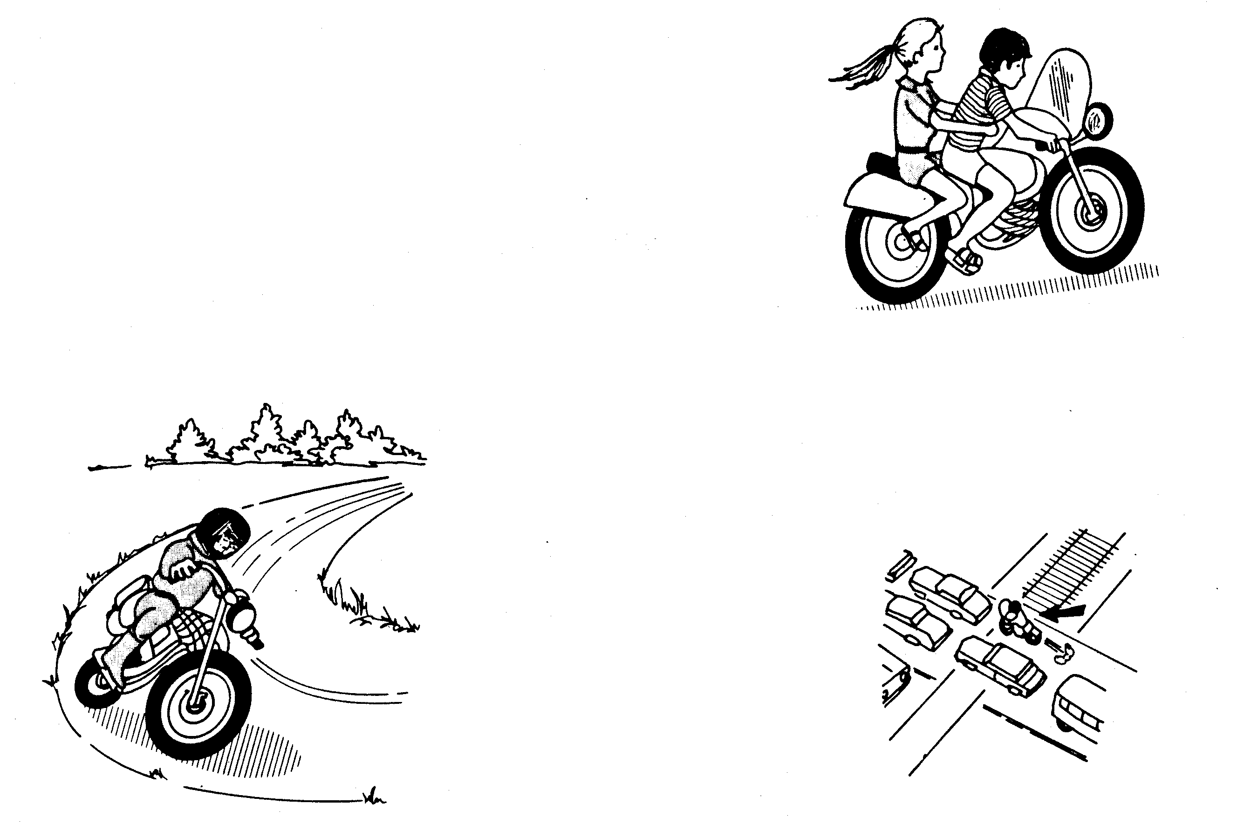
Clues to Motorcyclist Actions
Activity-Learning Location as Related to Condition of Pavement Ahead
Age and Way Dressed

Slide 7
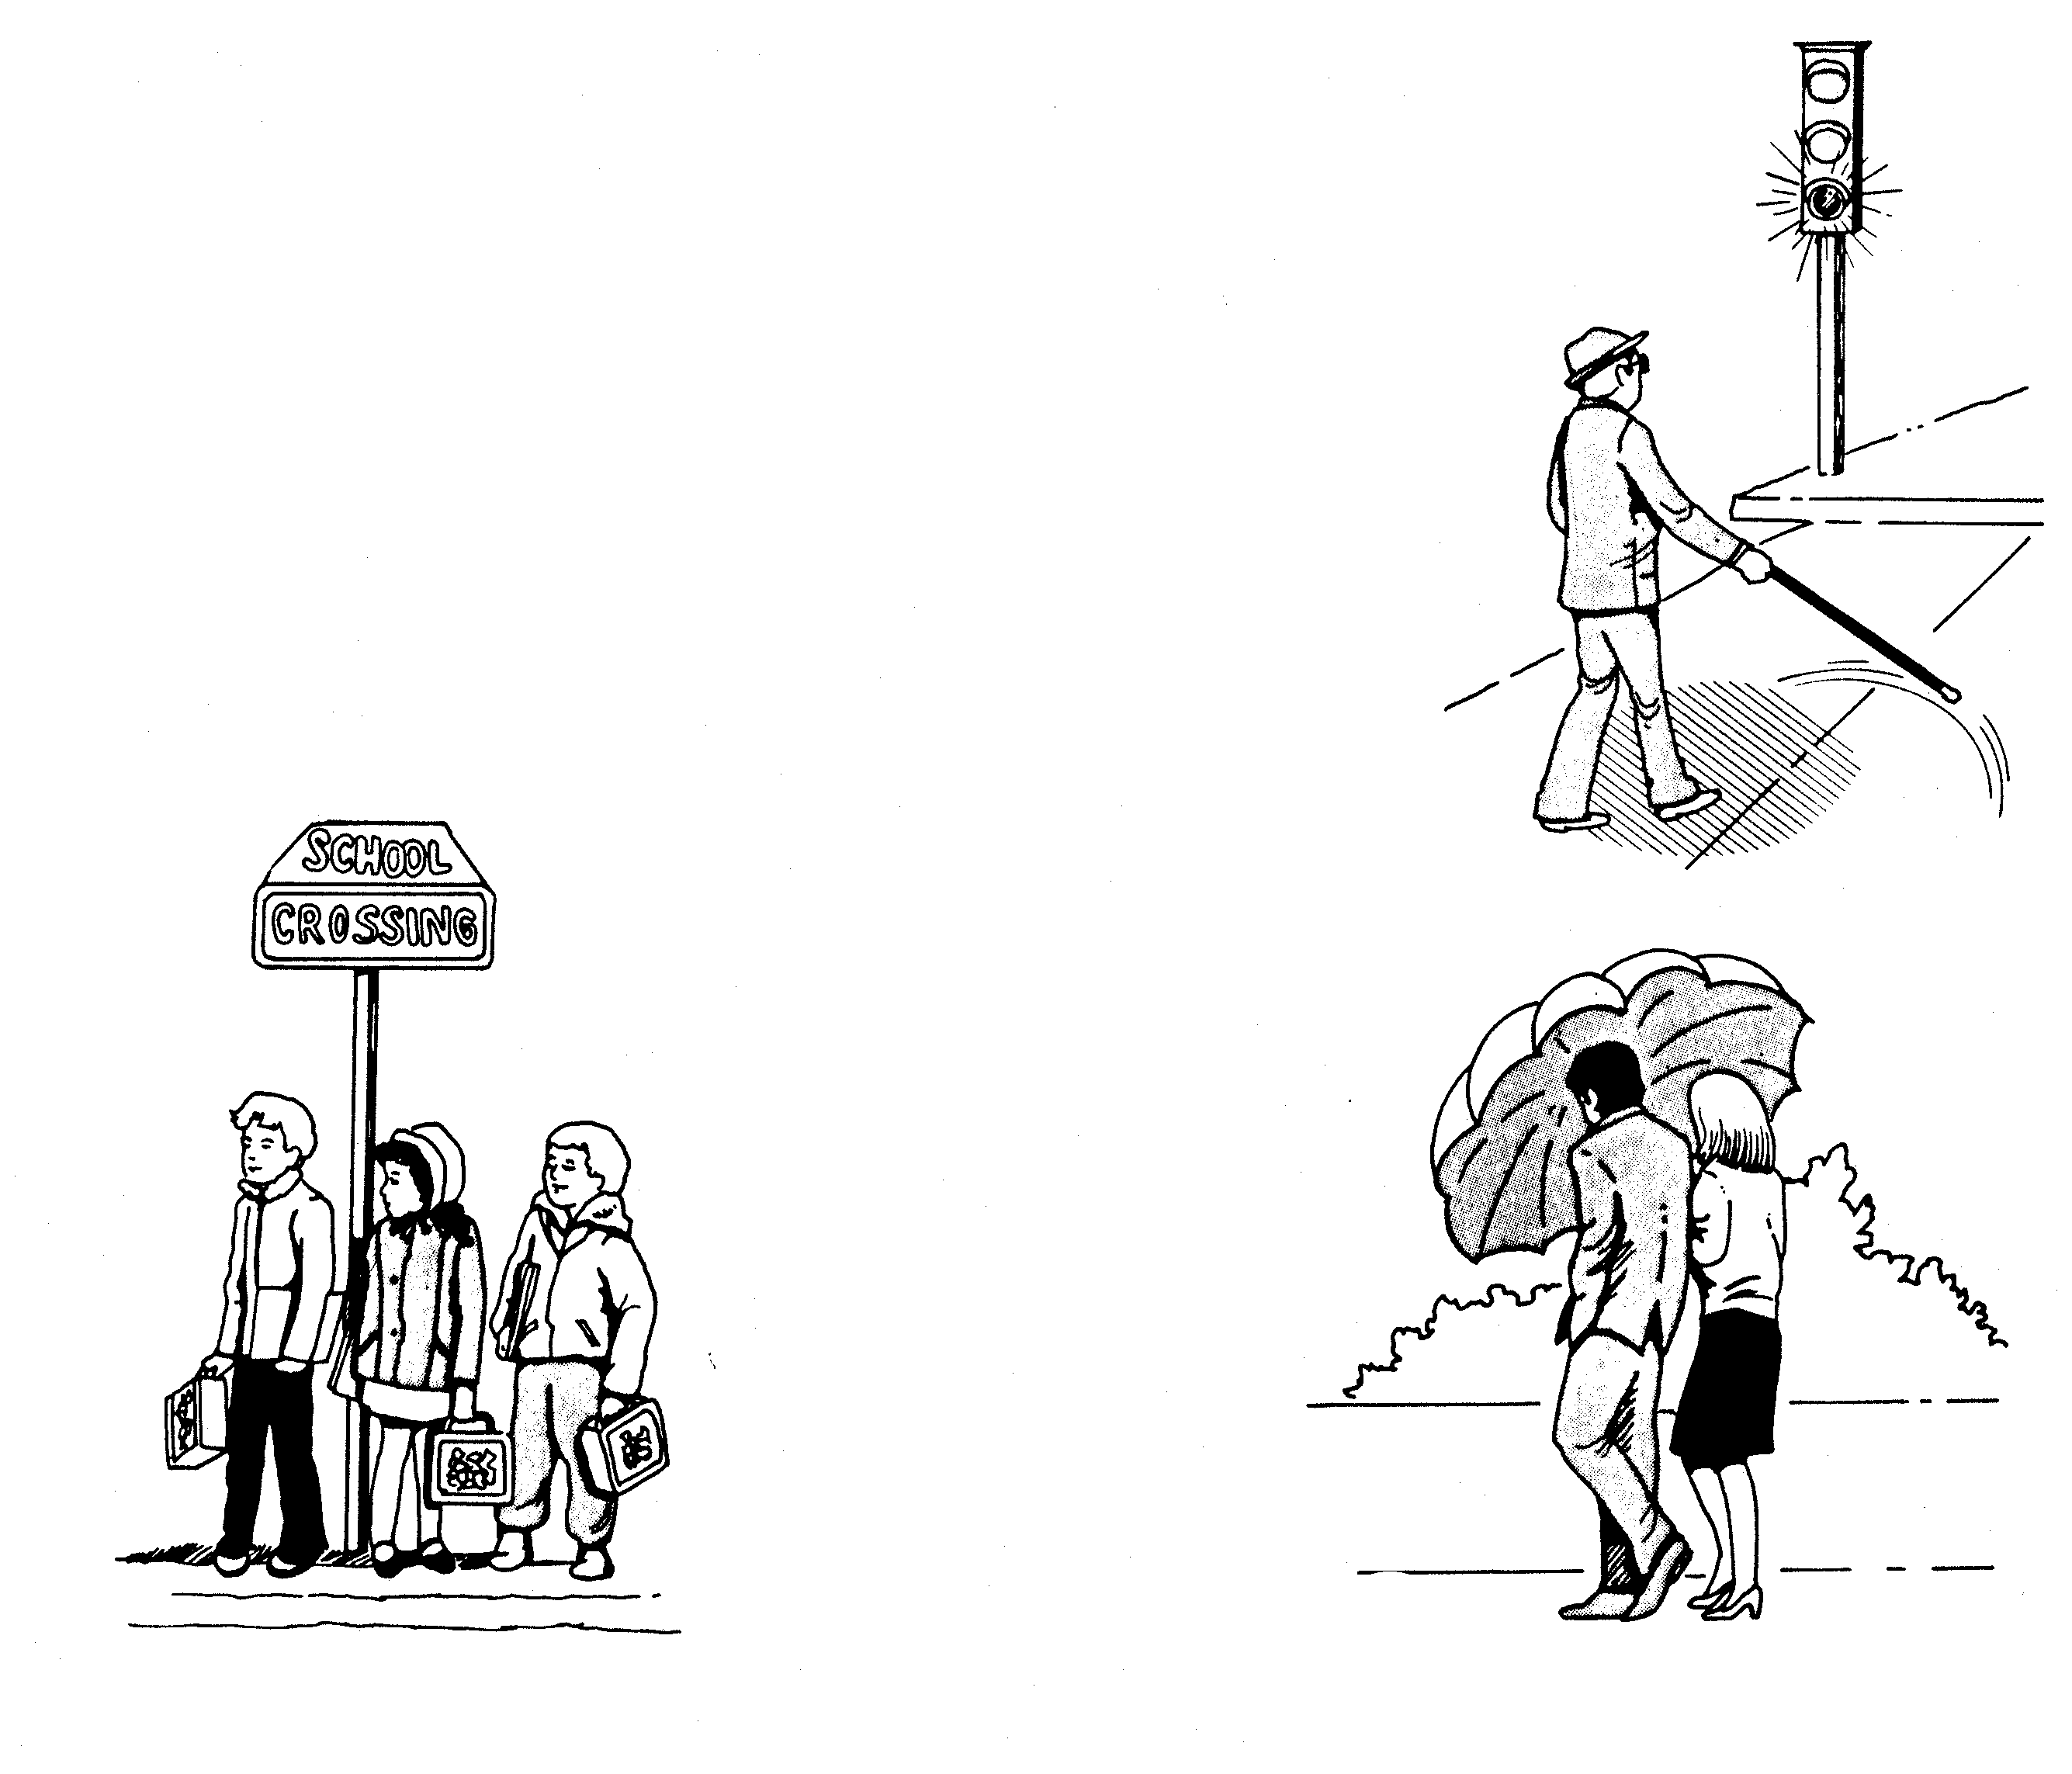
Clues to Pedestrian Actions
Age and Condition
Location
Activities

Slide 8
Contact/Mission
For more information on the (the topic of the presentation) please visit PDE’s website at www.education.pa.gov
The mission of the Department of Education is to ensure that every learner has access to a world-class education system that academically prepares children and adults to succeed as productive citizens. Further, the Department seeks to establish a culture that is committed to improving opportunities throughout the commonwealth by ensuring that technical support, resources, and optimal learning environments are available for all students, whether children or adults.

