Slide 1
Identifying Highway Conditions
Masters H-A through H-K

Slide 2
Session three Objectives
1. Define an area of less space
2. Identify static highway conditions that affect space
3. Identify dynamic traffic conditions that affect space
4. Define less sight distance and view to the sides
5. Identify static highway conditions that affect visibility
6. Identify dynamic traffic conditions that affect visibility
7. Identify clues to hidden side roads
8. Define an area of less traction
9. Identify roadway conditions that affect traction
10.Identify surface materials that affect traction

Slide 3
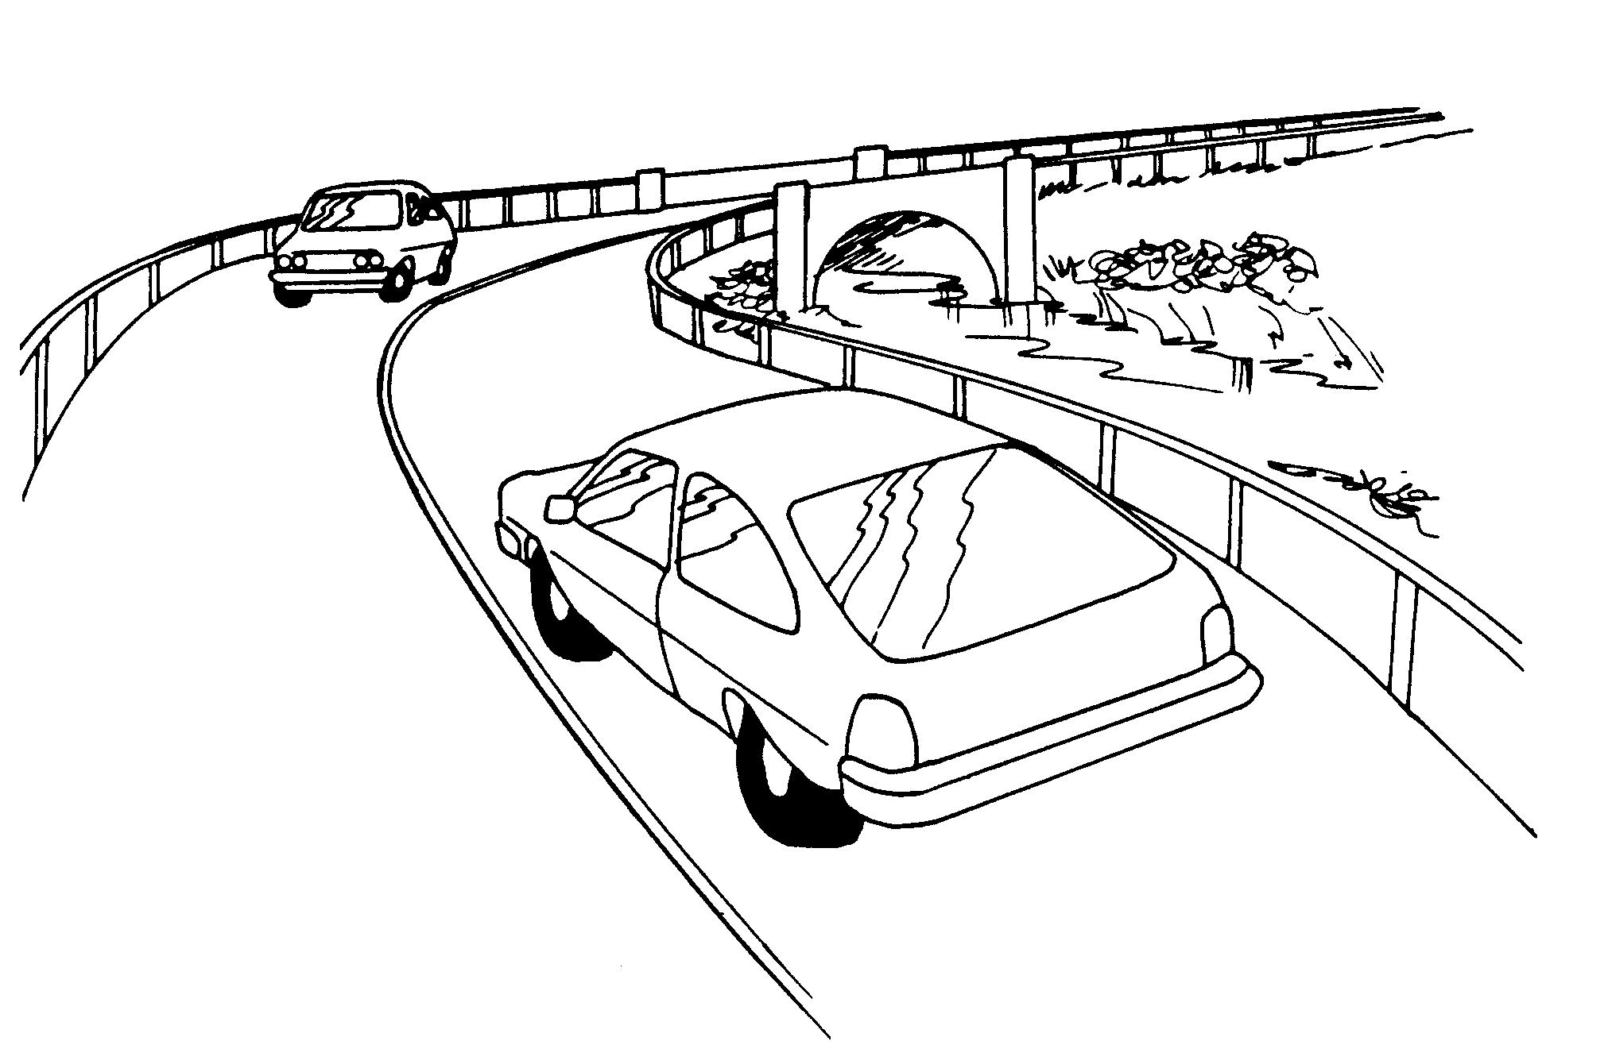
Less space to Sides
Less than one car width to one side
Roadway ahead gets narrower

Slide 4
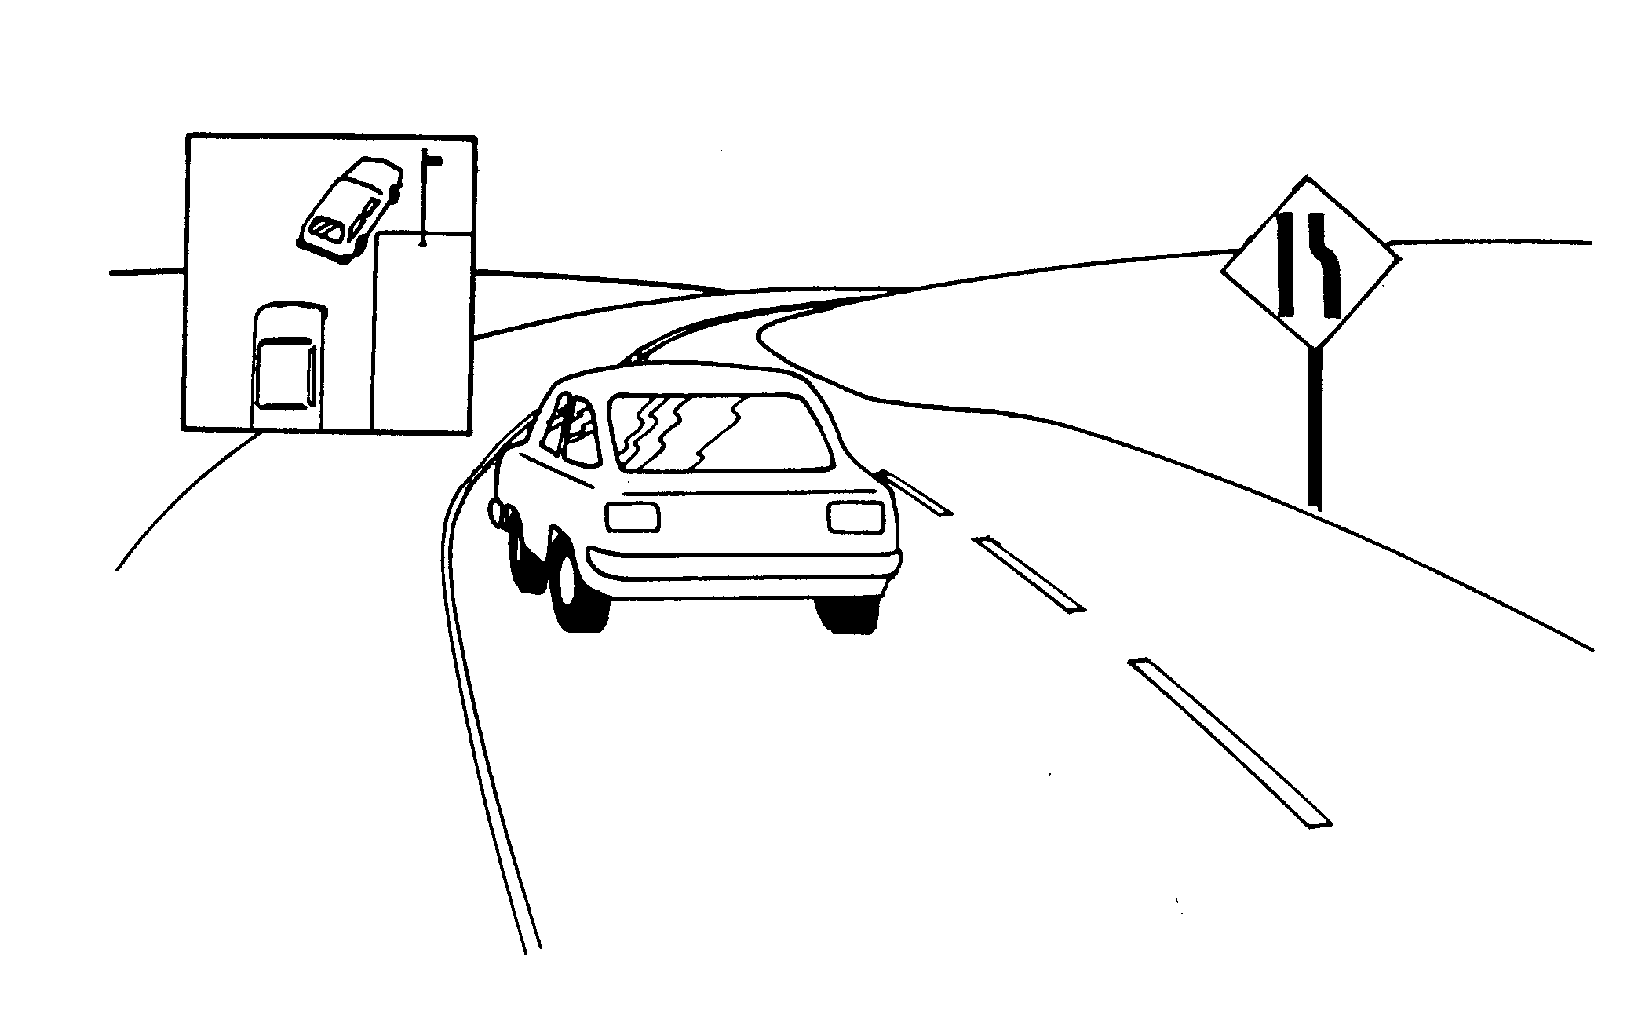
Changes in Space to Sides: Highway Conditions
Number of lanes, width of pavement, width of shoulder, guard rails
Embankments, fencing, posts, trees, snow bank, rock slide, barricades

Slide 5
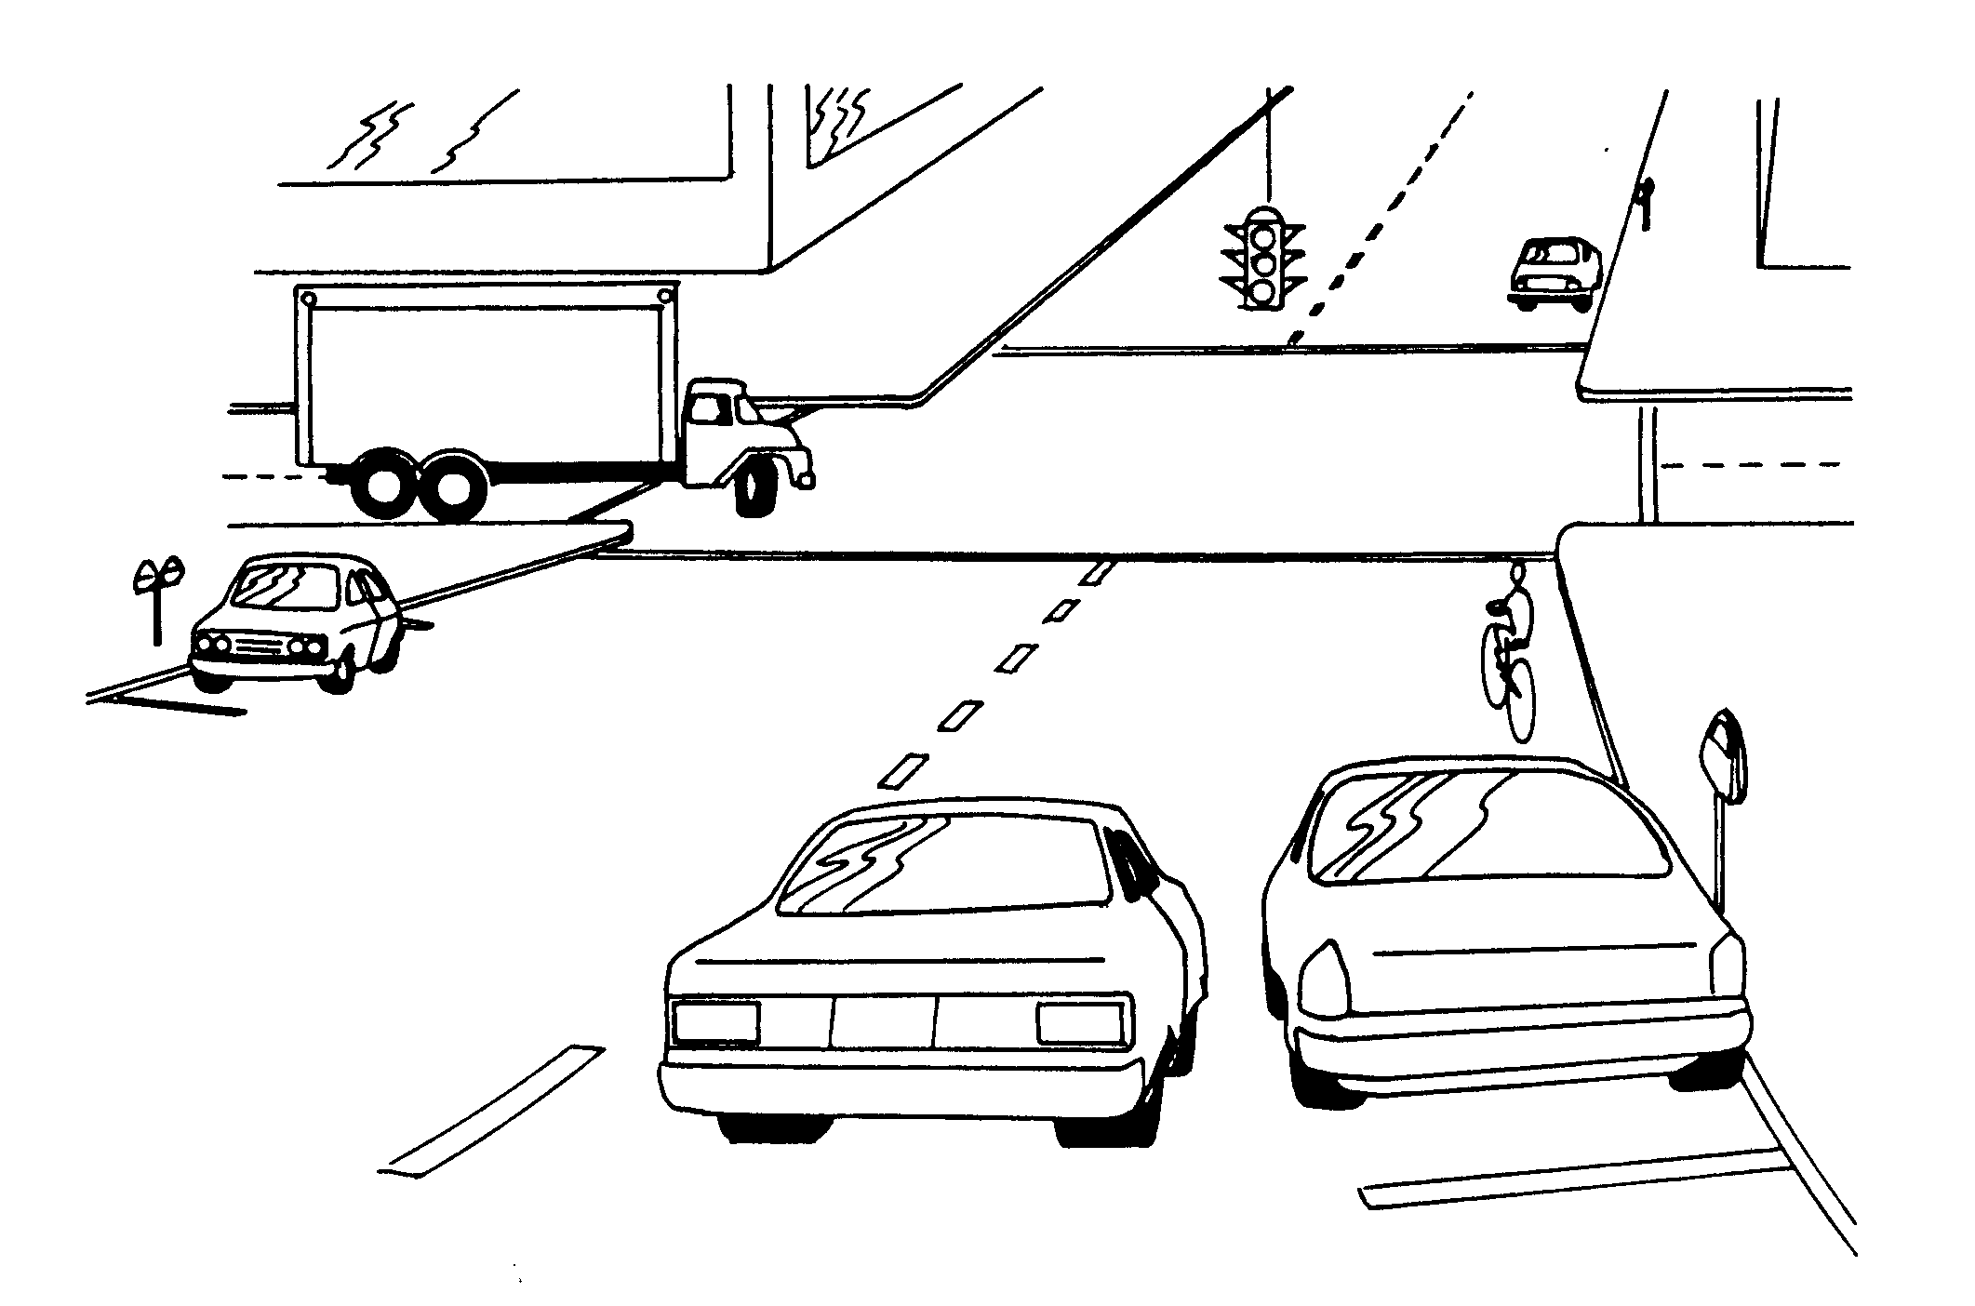
Changes to Space to Sides: Other Traffic
Oncoming line of cars, cars waiting to turn left
Parked delivery trucks, turning trucks, bikes, pedestrians, stalled cars

Slide 6
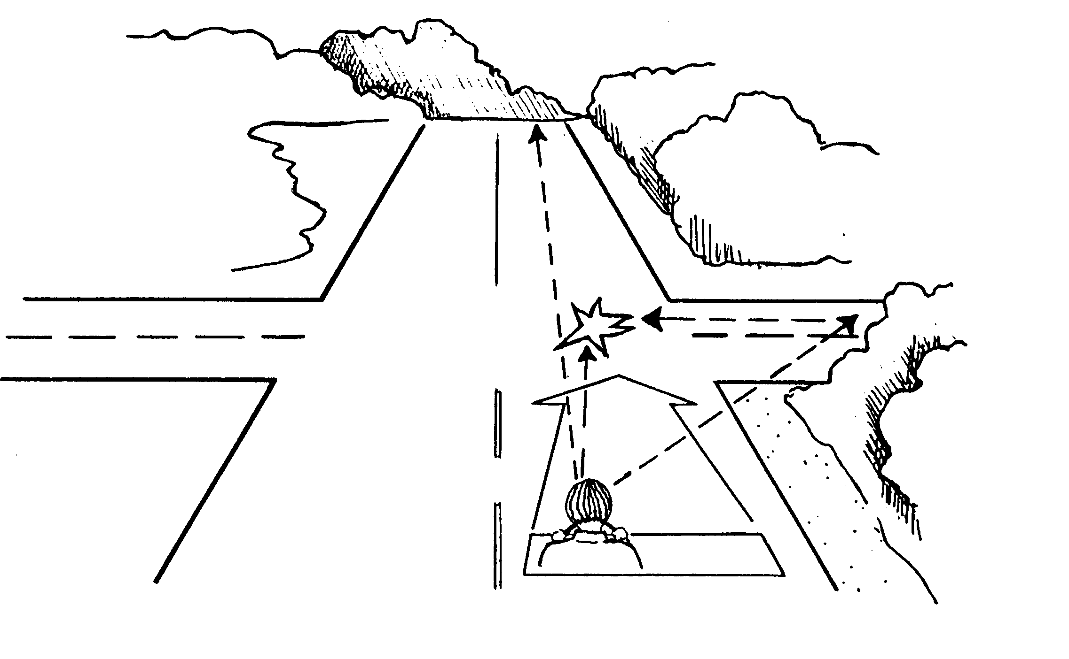
Less Sight Distance Ahead Less View to Sides
Present speed becomes unsafe for changes in sight distance or view to sides
Stopping distance becomes greater than seeing distance

Slide 7
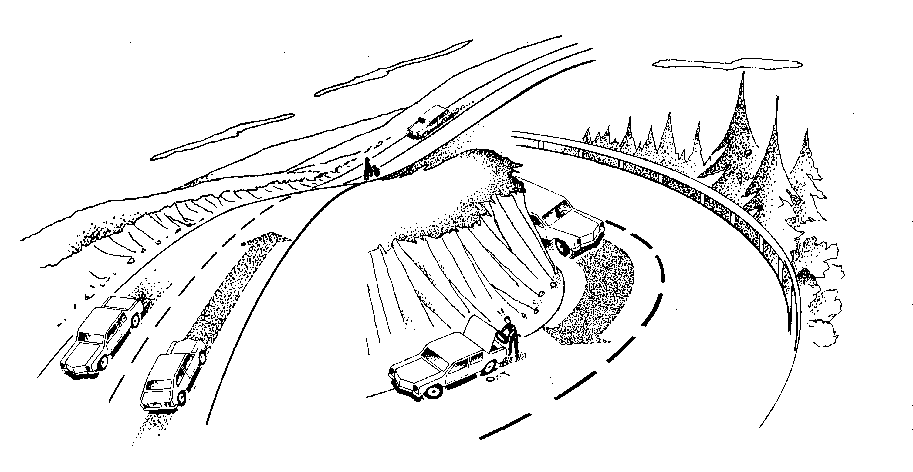
Changes in Sight Distance or View to Sides: Highway Conditions
Hills, curves, dips in road, embankments
Signs, shrubs, farm crops, buildings, snow banks

Slide 8
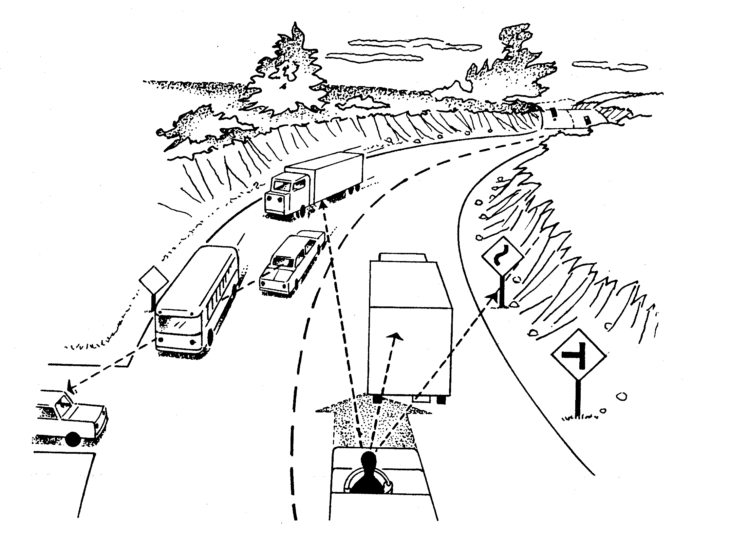
Changes in Sight Distance or View to Sides: Other Vehicles
Large trucks or buses ahead, cars or trucks standing, parking, turning or waiting to turn

Slide 9
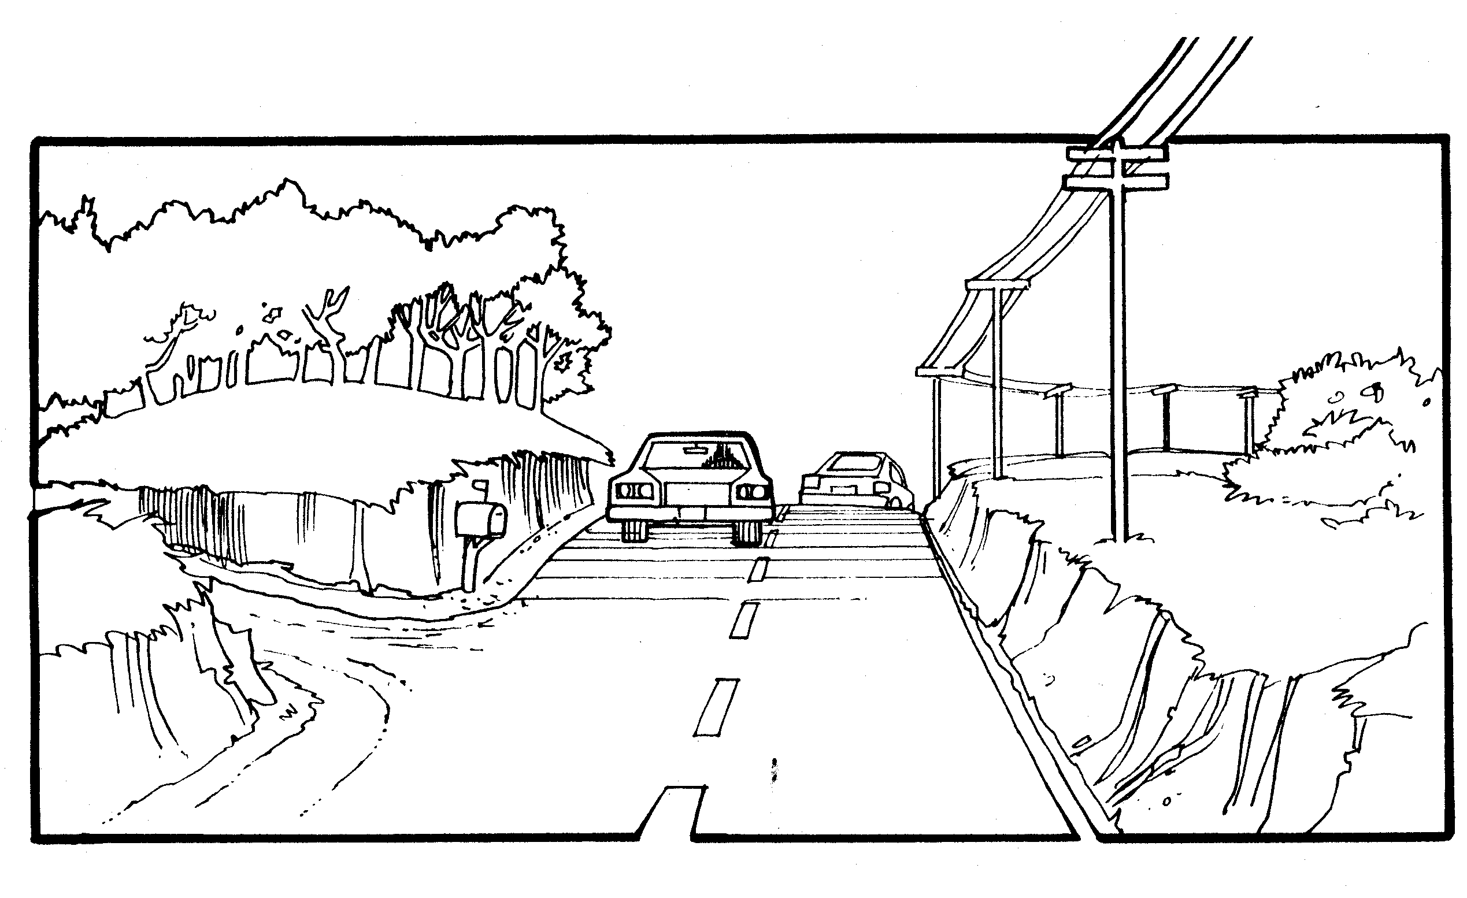
Clues to Hidden Side Roads
Mailboxes, telephone or electrical lines, farm house, cloud of dust

Slide 10
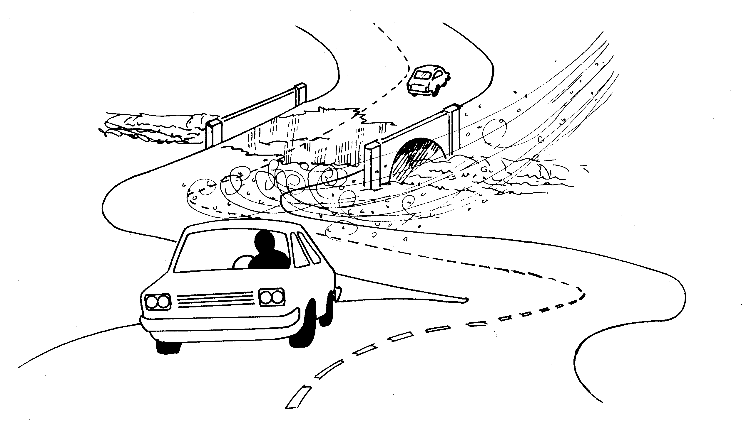
Areas of Less Traction
Less grip of tires on road surface, less ability to control car

Slide 11
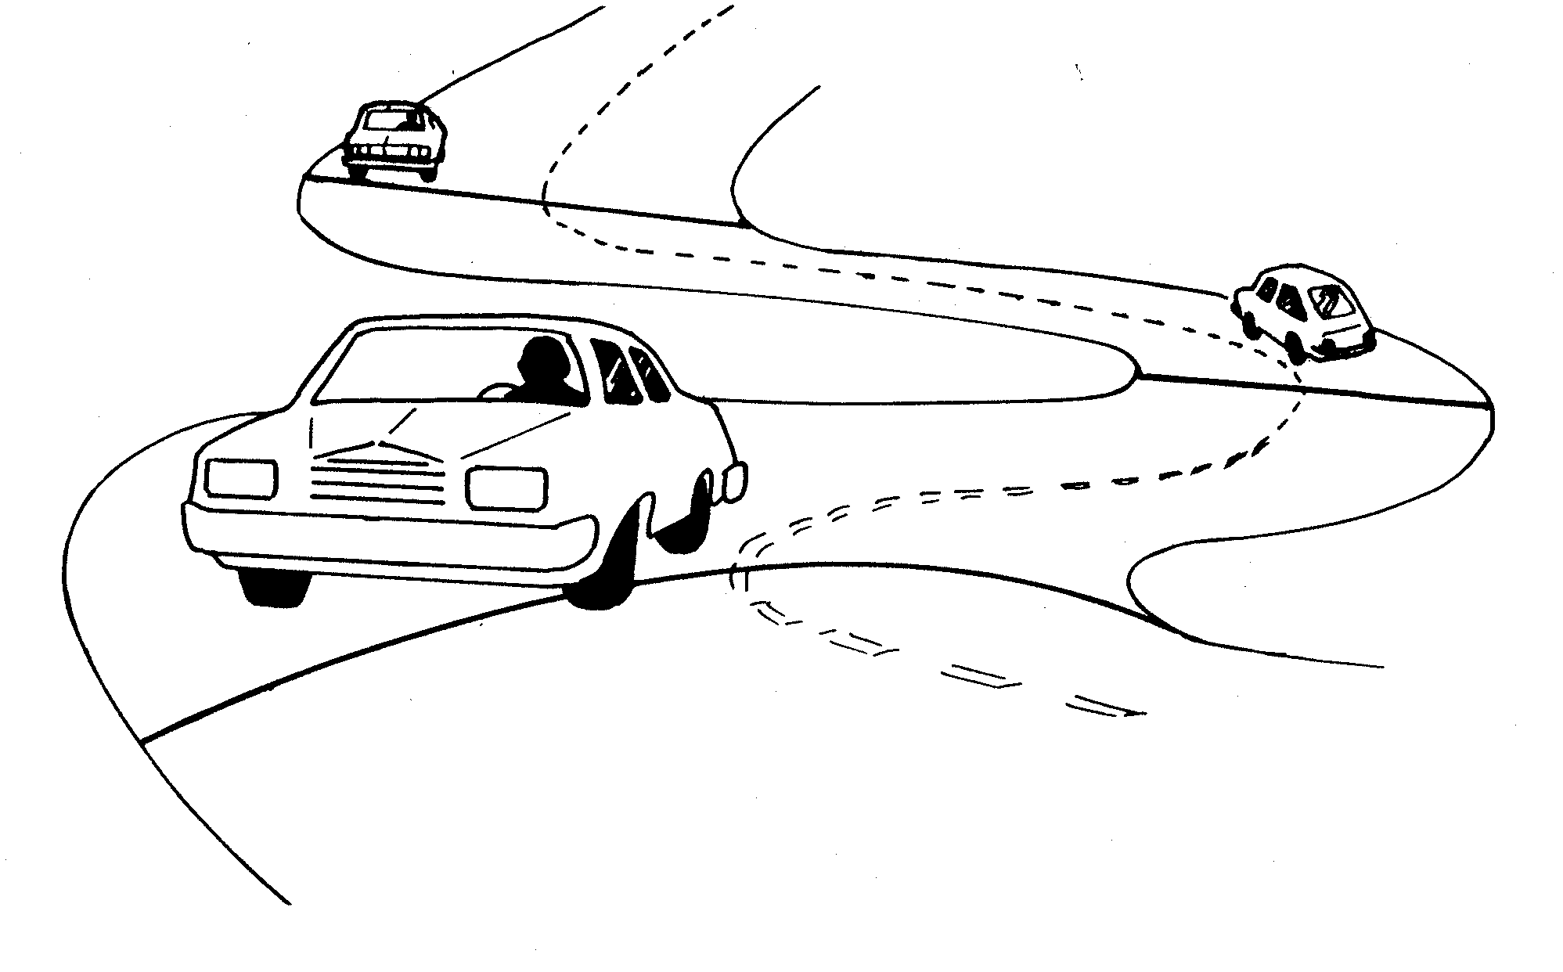
Changes in Traction: Roadway Conditions
Slope of Surface- flat, high in middle, low on one side
Shoulders- not level with pavement, soft, rough
Type of Surface – concrete, blacktop, brick, gravel
Surface Roughness – chuck holes, railroad tracks, sewer covers

Slide 12
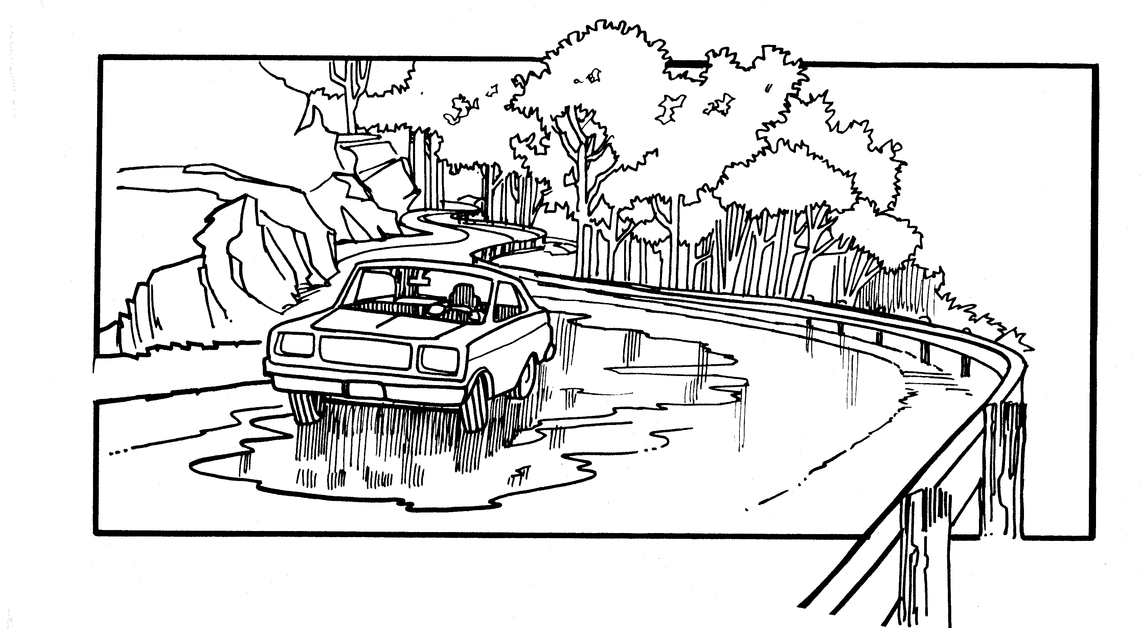
Changes in Traction: Surface Materials
Sand, mud, rock slides, oil, tar, water, ice, snow, frost

Slide 13
Contact/Mission
For more information on the (the topic of the presentation) please visit PDE’s website at www.education.pa.gov
The mission of the Department of Education is to ensure that every learner has access to a world-class education system that academically prepares children and adults to succeed as productive citizens. Further, the Department seeks to establish a culture that is committed to improving opportunities throughout the commonwealth by ensuring that technical support, resources, and optimal learning environments are available for all students, whether children or adults.

