Slide 1
Session Two Identifying Traffic Controls
Masters C-A through C-F

Slide 2
Session Two Objectives
Identify the regulatory signs and their respective meanings based on color, shape and symbol
Identify warning signs and their respective meanings based on color, shape and symbol
Identify guide signs and their respective meanings based on color, shape, symbol and numbering
Identify construction signs and their respective meanings based on color, shape and symbol
Identify the various traffic light signals and their respective meanings
Identify the various lane markings and their respective meanings

Slide 3
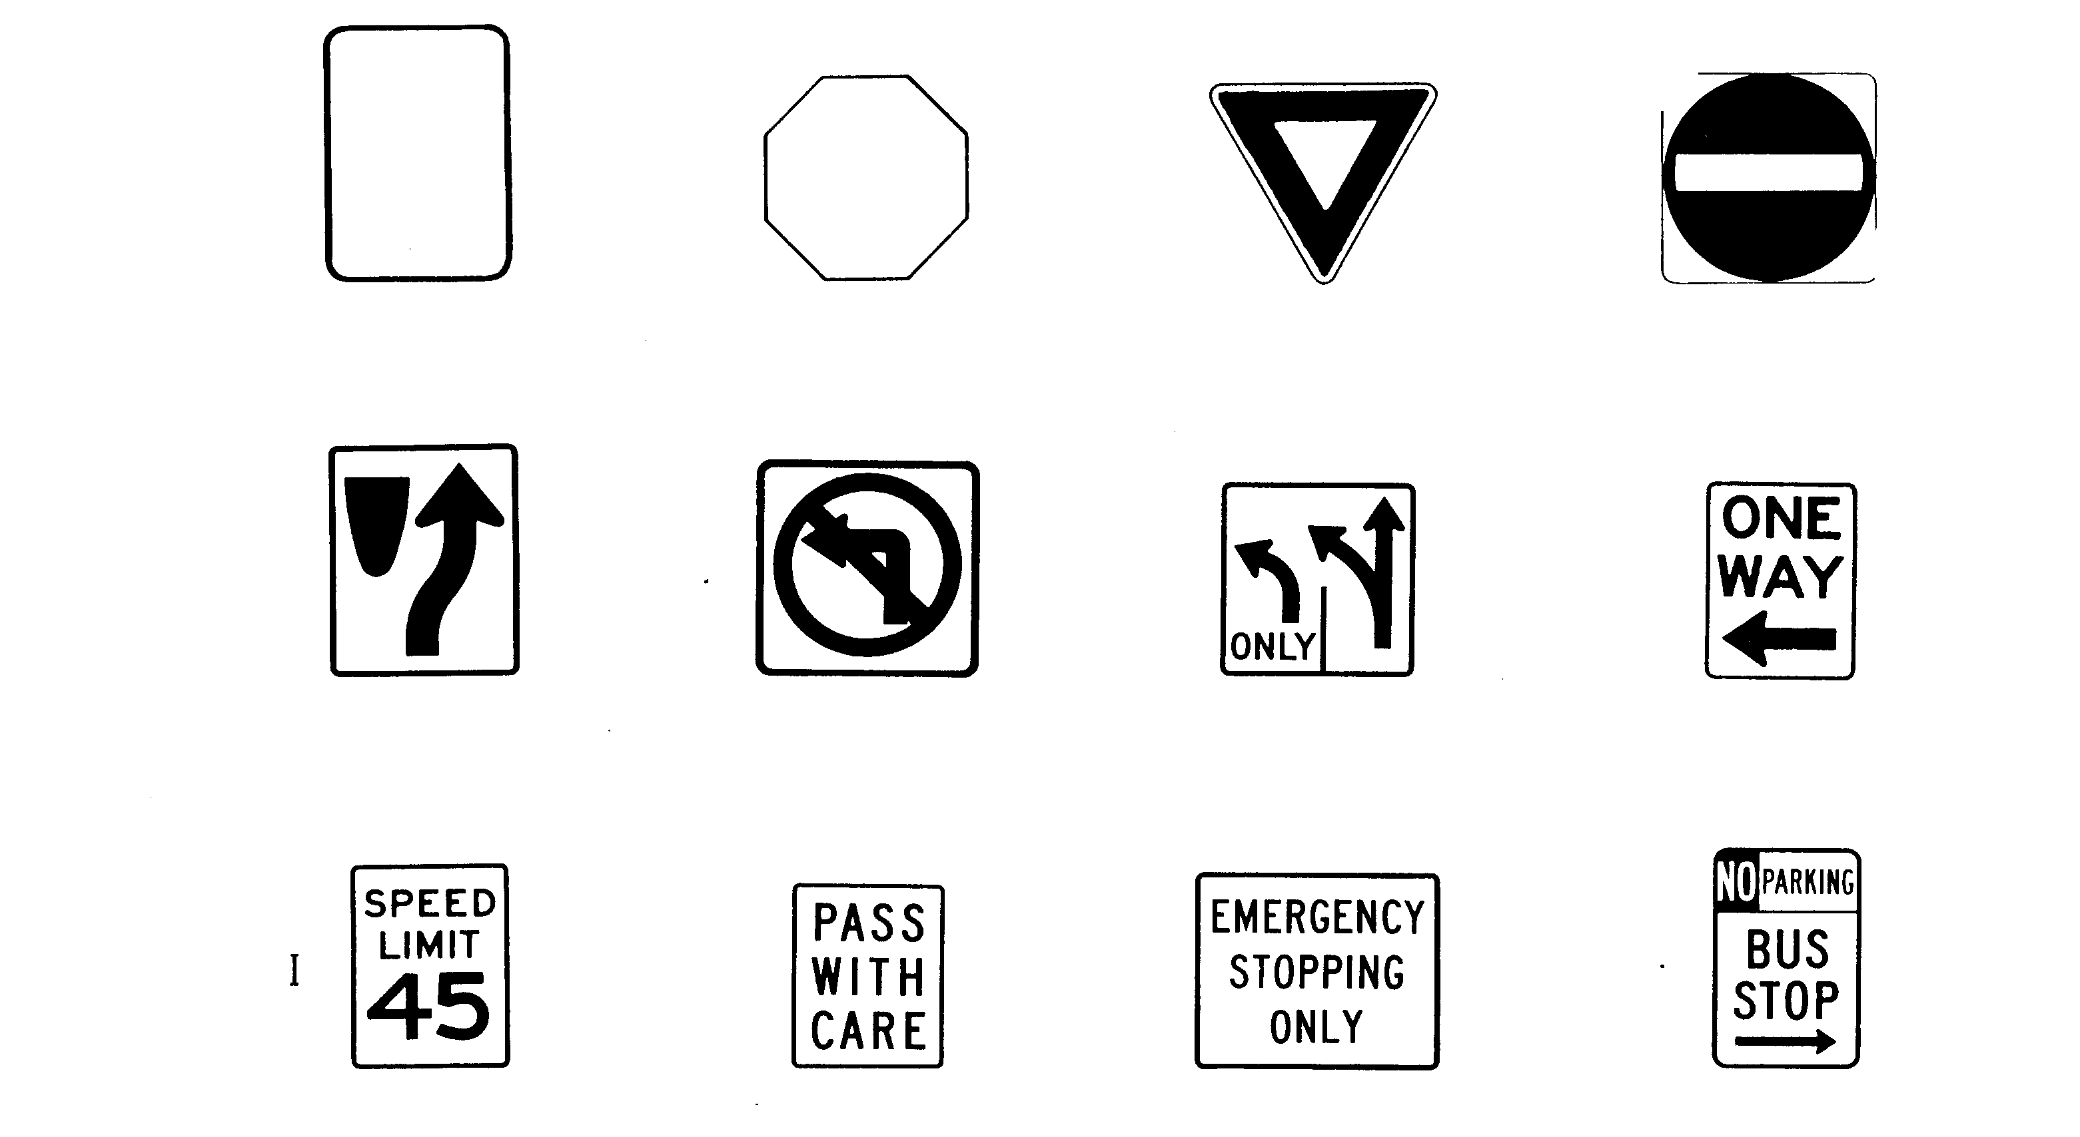
Regulatory Signs
Shapes - Colors – Symbols
Read from Bottom Up

Slide 4
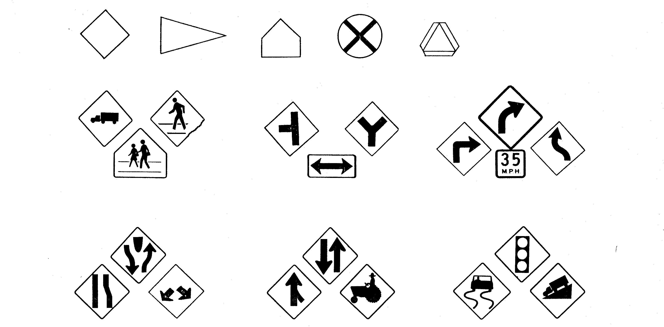
Warning Signs
Colors Shapes Symbols
Changes in Width Traffic Road Conditions
Read from Bottom Up
Crossings
Intersections
Curves

Slide 5
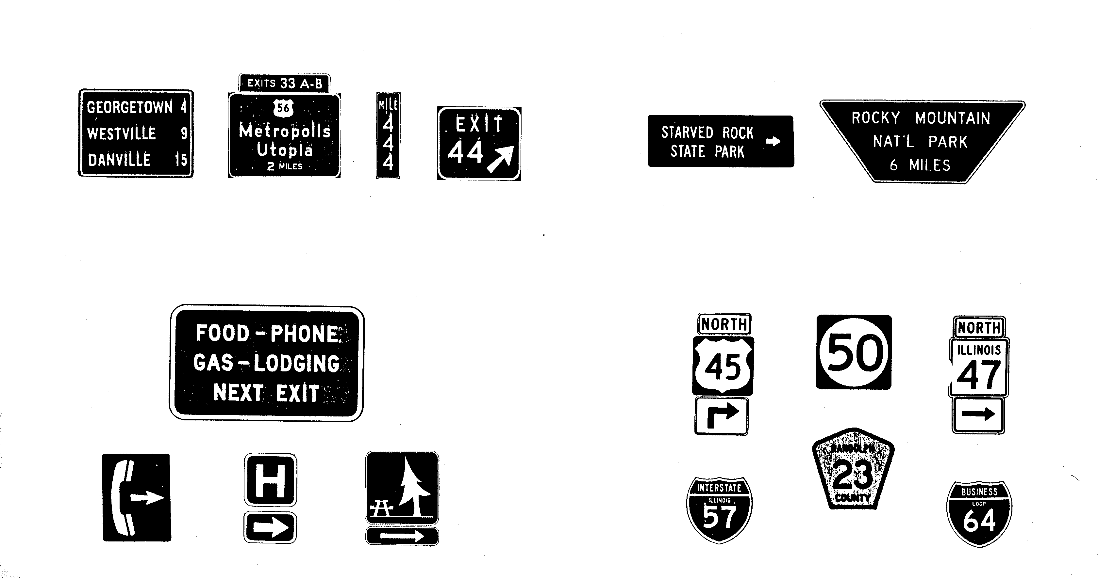
Guide Signs
Colors – Shapes – Symbols
Roadside Services Route Markers
Read from Bottom Up
Destination and Mileage
Recreation Areas

Slide 6
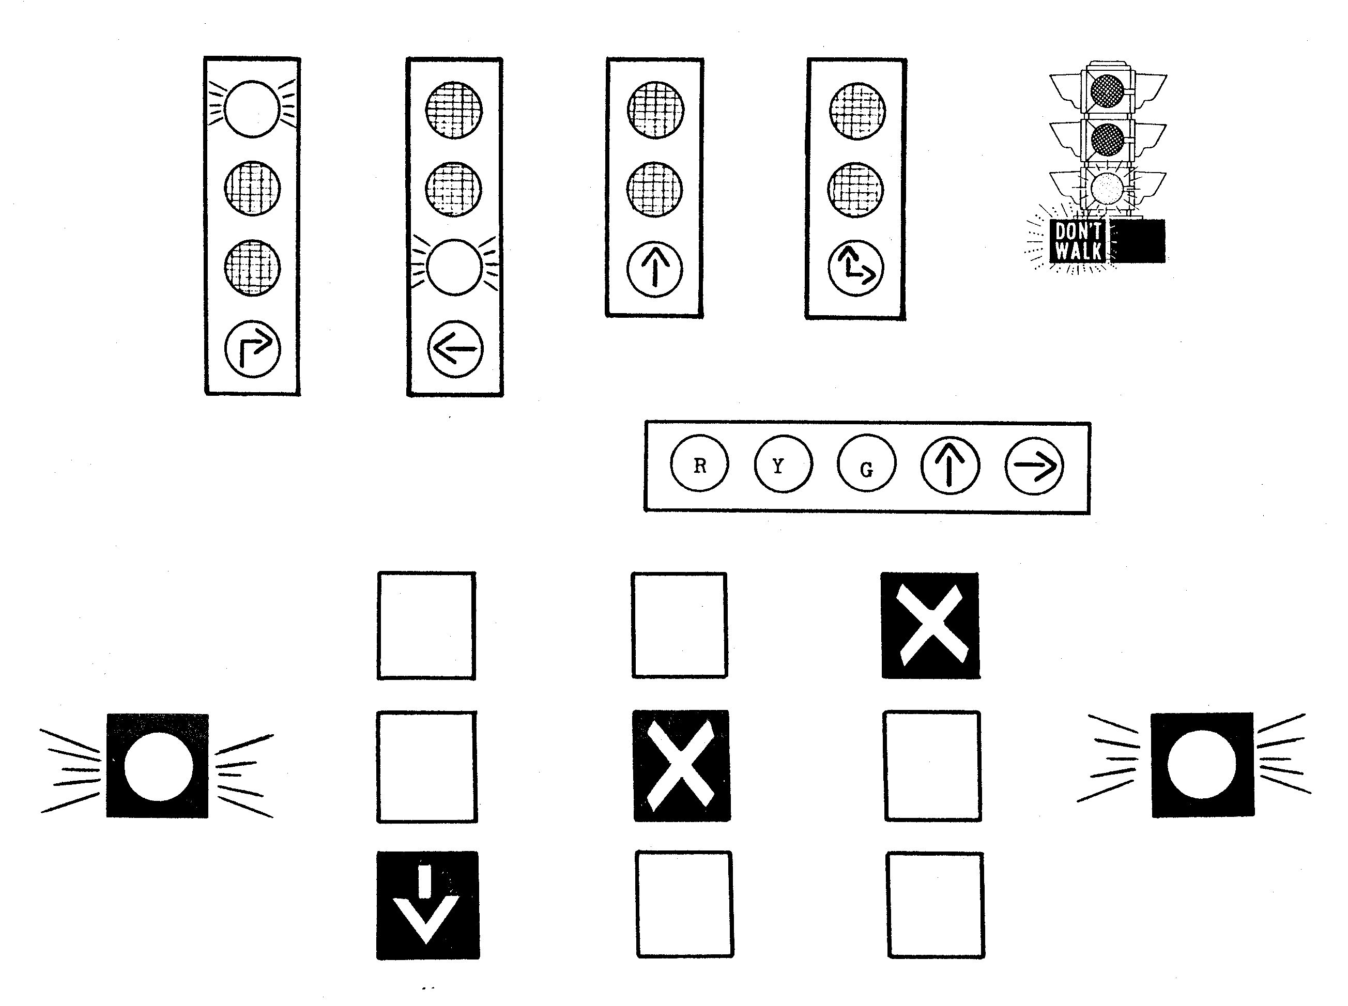
Traffic Control Signals

Slide 7
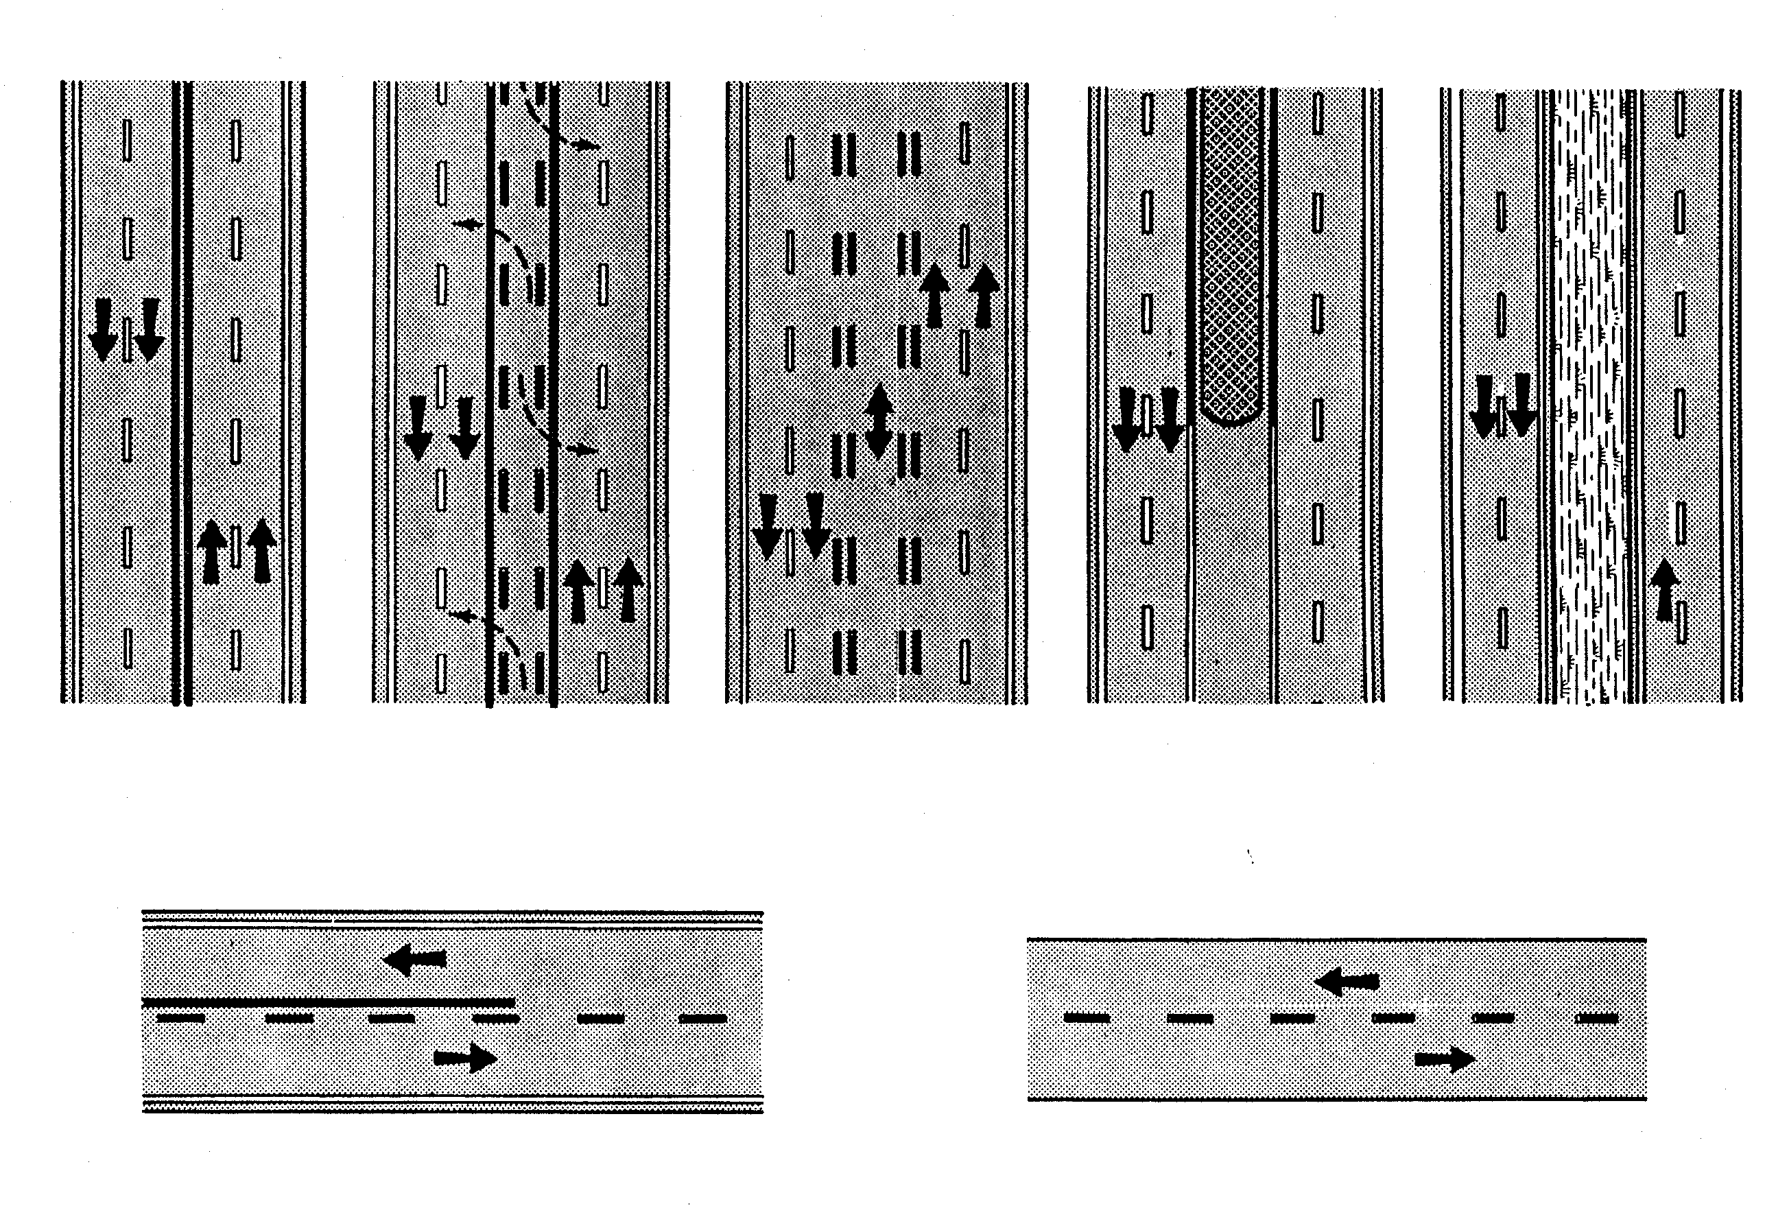
Pavement Markings

Slide 8
Contact/Mission
For more information on the (the topic of the presentation) please visit PDE’s website at www.education.pa.gov
The mission of the Department of Education is to ensure that every learner has access to a world-class education system that academically prepares children and adults to succeed as productive citizens. Further, the Department seeks to establish a culture that is committed to improving opportunities throughout the commonwealth by ensuring that technical support, resources, and optimal learning environments are available for all students, whether children or adults.

