Slide 1
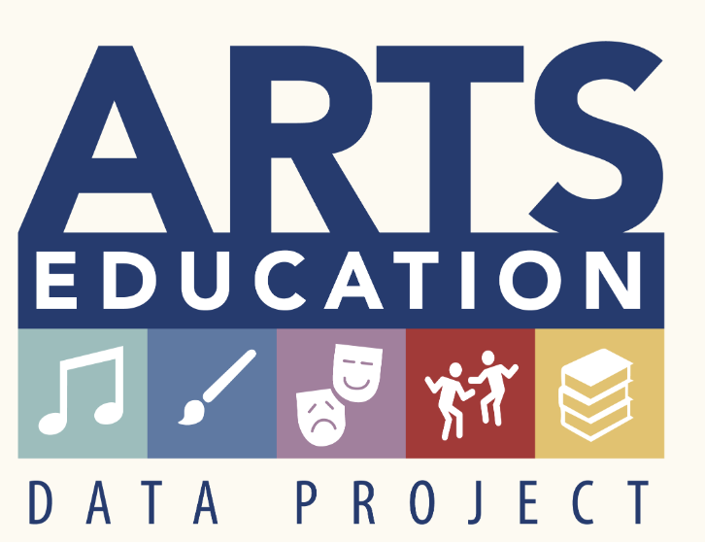
The Pennsylvania Dashboard for the…

Slide 2
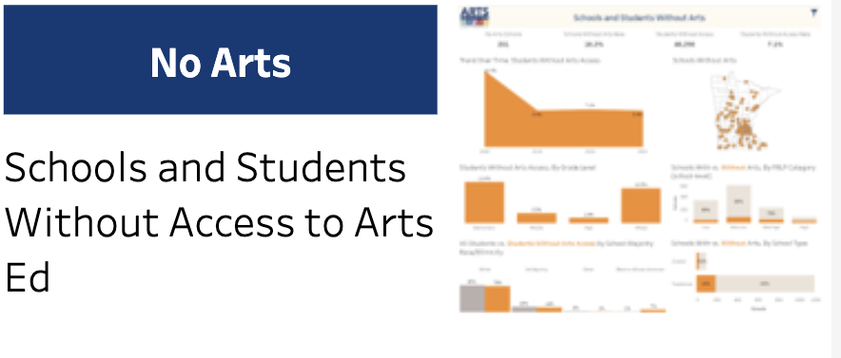
No Arts

Slide 3
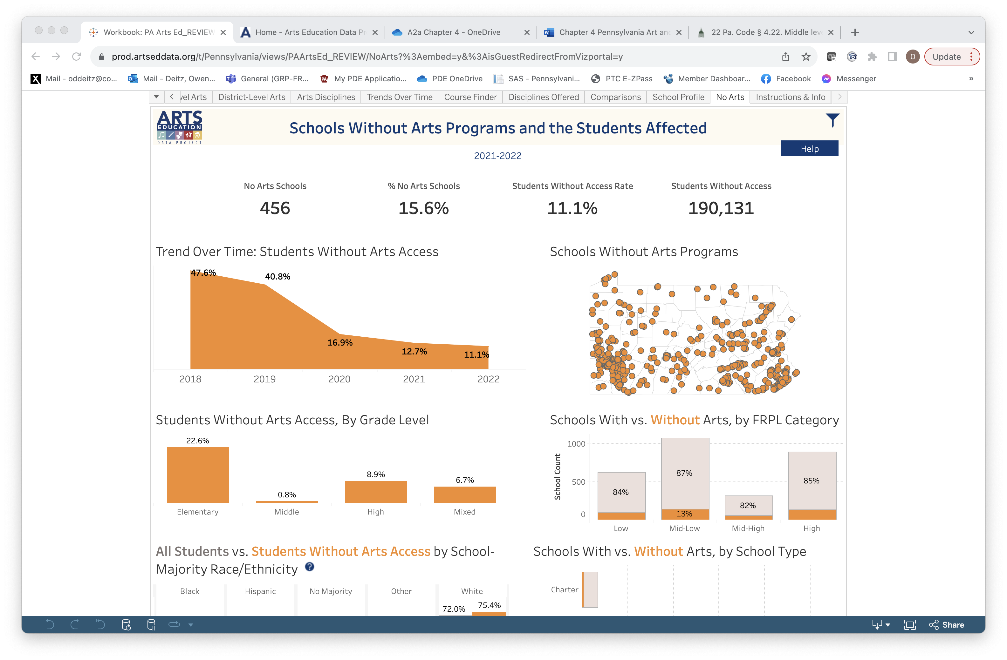
No Arts: Programs and Student Access
Information about schools without arts course and students without arts access is provided for 2021-2022 at the statewide level.

Slide 4
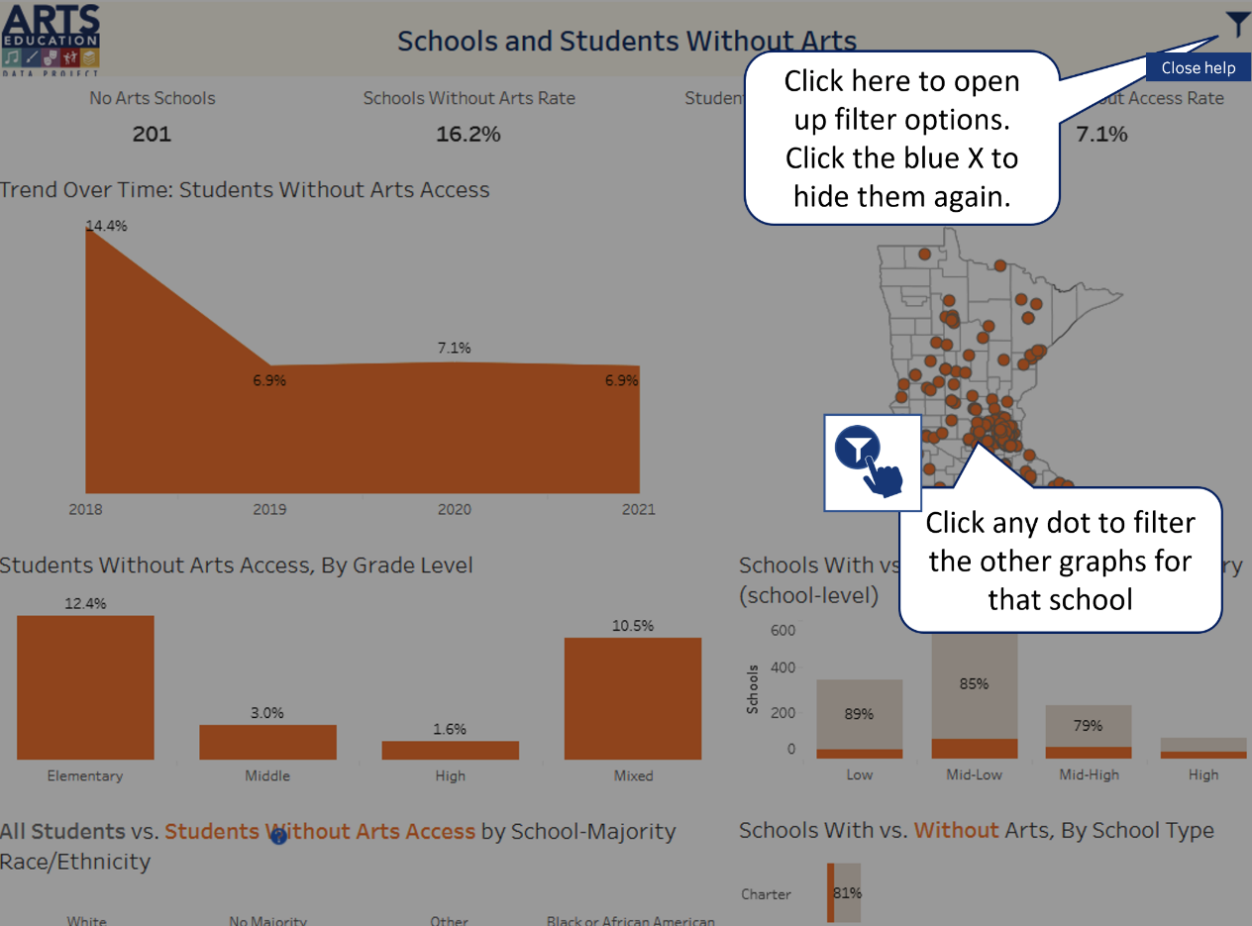
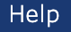
No Arts: Help
Select the Help button in the upper right-hand corner to better understand how this page presents data.

Slide 5
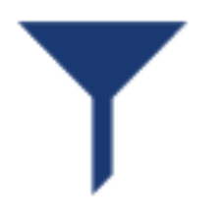
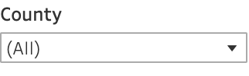
No Arts: Filter Icon
Use the filter icon and drop-down lists to filter by County.

Slide 6
No Arts: Programs and Student Access
Select points within this graph for specific information about students without access to arts programs statewide.

Slide 7
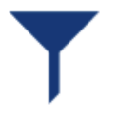
No Arts: Grade and School Level
Statewide data about students without access to arts is provided by grade level in this graphic.
Data for Grade Level and Schools Without Arts Programs can be more easily viewed by filtering at the county level.
Select a data dot to identify schools who report not having arts programs.

Slide 8
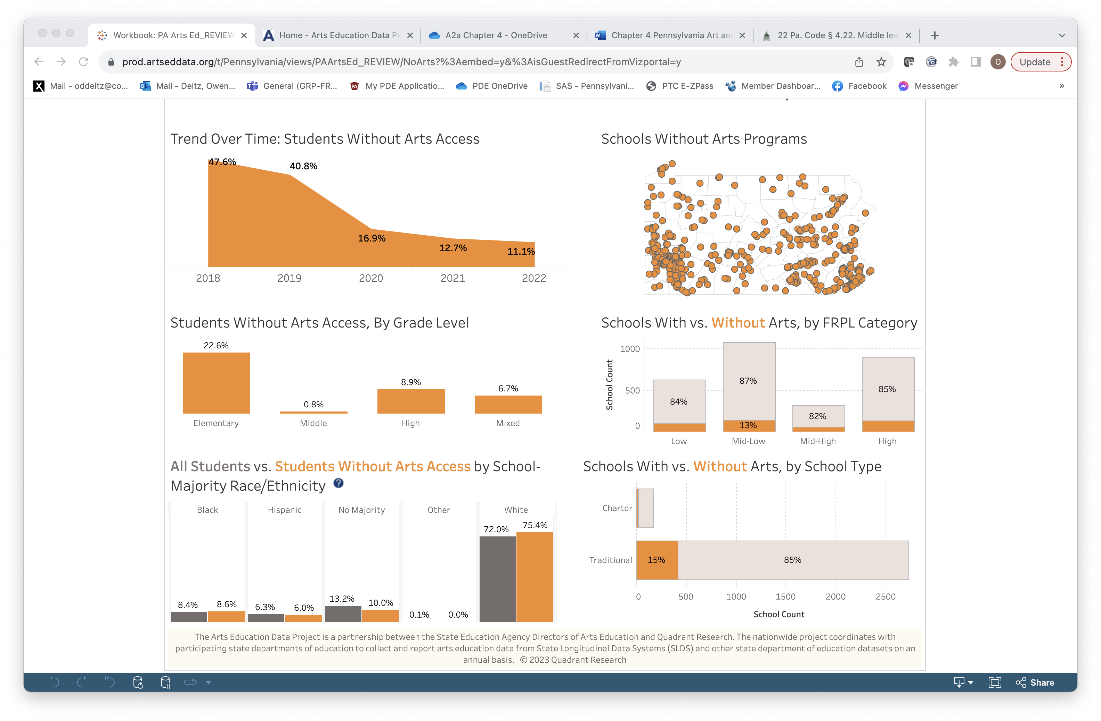
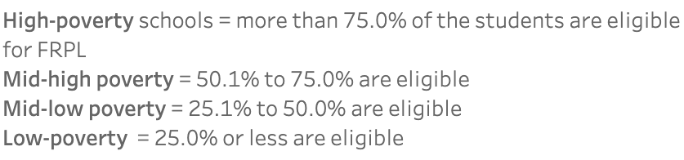
No Arts: Free/Reduced Lunch, School Type
Bar graphs are used to provide information about schools without arts by Free/Reduced Lunch Category.
Bar graphs are used to provide information about schools without arts by School Type (Charter/Traditional).

Slide 9
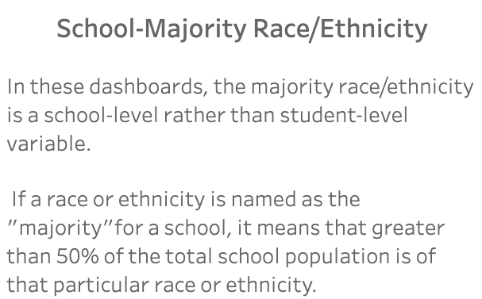
No Arts: Race/Ethnicity
Bar graphs are used to provide information about schools without arts by School-Majority Race/Ethnicity.
Refer to the definition of School-Majority Race/Ethnicity as found in the Information & Info Tab.

