Slide 1
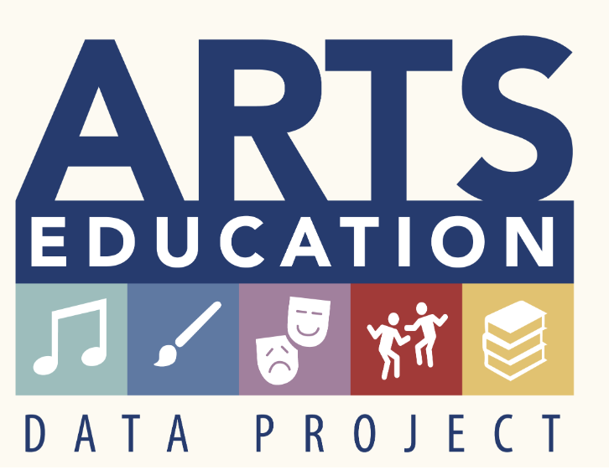
The Pennsylvania Dashboard for the…

Slide 2
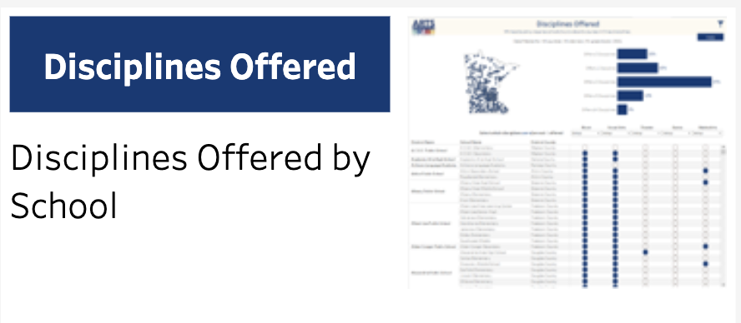
Disciplines Offered

Slide 3
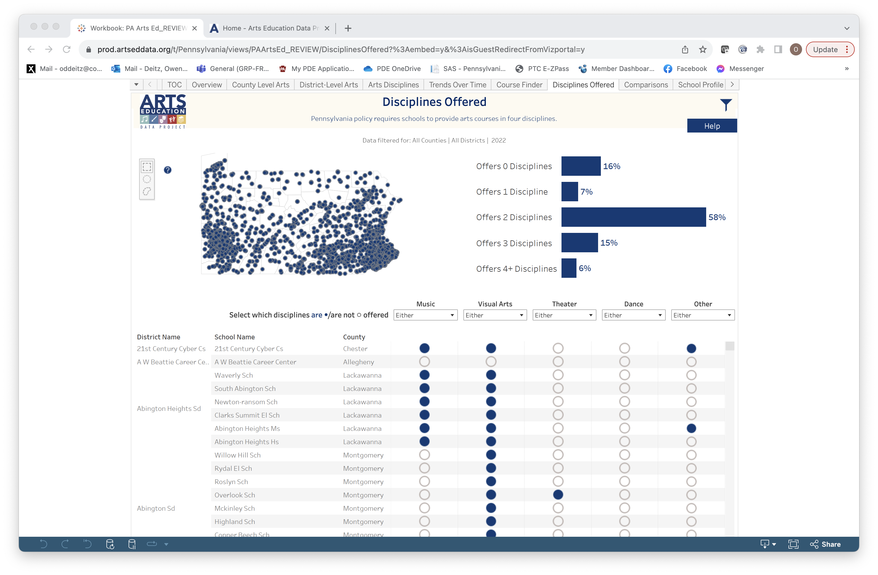
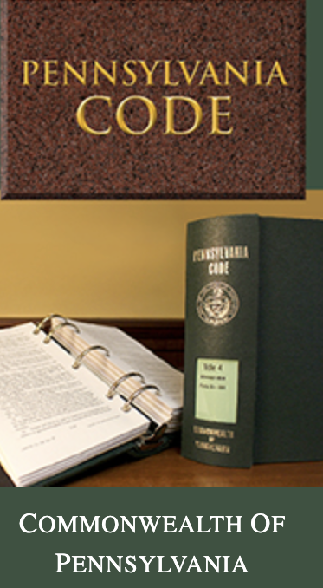
Disciplines Offered: PA Requirements
The Pennsylvania Code, Title 22, Chapter 4 regulations clarify that students in grades K-12 must be provided with instruction in all four arts disciplines.
Paragraphs 4.21, 4.22, and 4.23, state that “planned instruction aligned with academic standards in the following areas (dance, music, theatre and the visual arts) shall be provided to every student in the primary/middle level/high school program. Planned instruction may be provided as a separate course or as an instructional unit within a course or other interdisciplinary instructional activity.

Slide 4
Disciplines Offered: 0 to 4+
Statewide data appears on the homepage for this tab. Filter options will change the data appropriately. The sum of “%” may not equal 100% due to rounding.

Slide 5
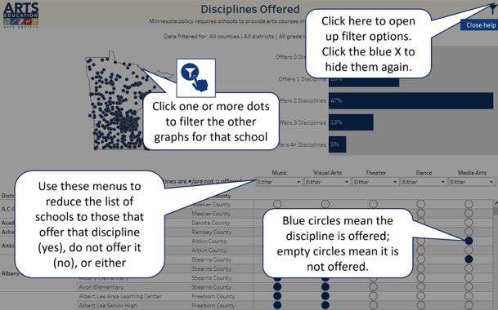


Disciplines Offered: Help

Slide 6
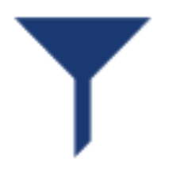
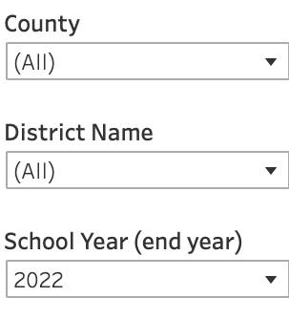
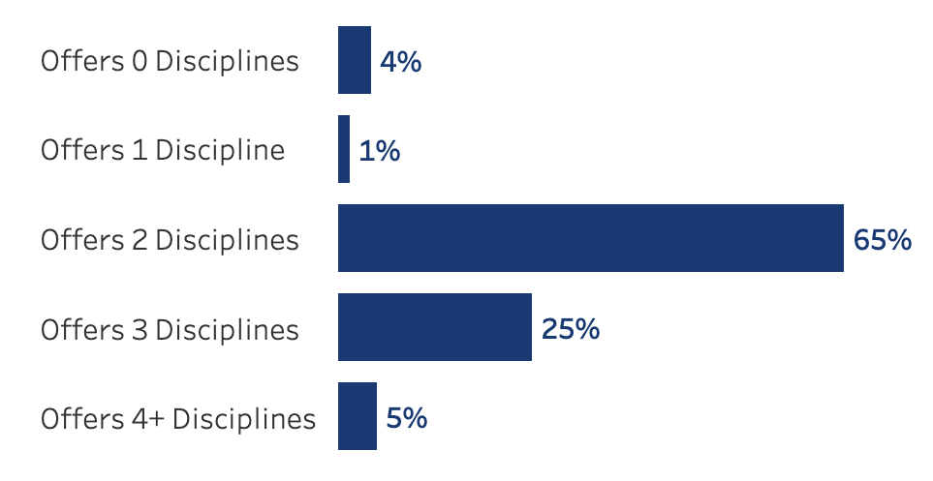
Disciplines Offered: Filter Icon
Select the filter icon and drop-down lists to filter by County, District, or School Year.
Charts and maps will change!

Slide 7
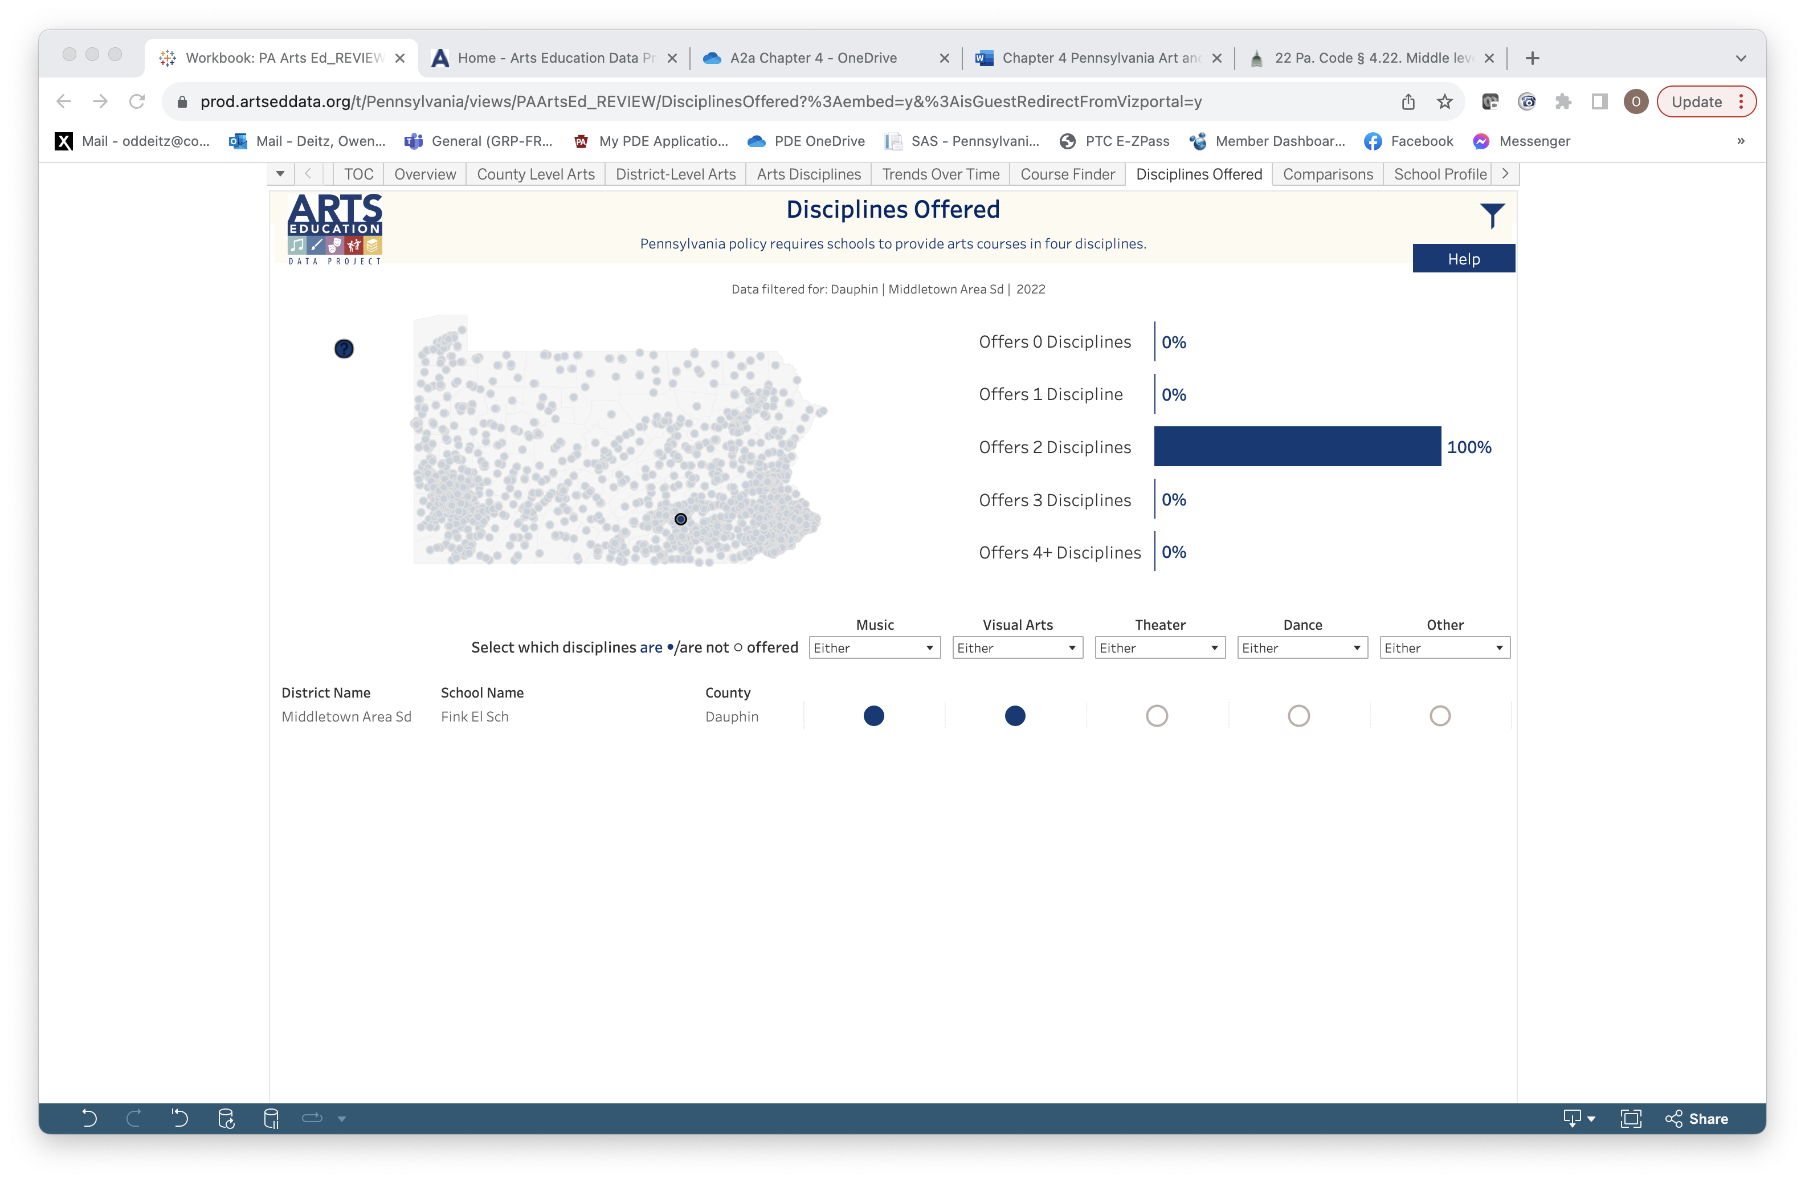
Disciplines Offered: School Level
Select the “lasso” tools to select multiple schools.
Select any school in the map to filter for that school.
Information about schools selected will appear below the map.

Slide 8
Disciplines Offered: Unique Combinations
To learn which schools do or do not offer a discipline, select "Yes/No." Use "Either" as a default if you are not searching for specific information about a particular discipline.
A list of schools that meet the selected criteria will appear on the left side of the page.

