Slide 1
The Pennsylvania Dashboard for the…

Slide 2
Course Finder

Slide 3
Course Finder
Course Finder explores a list of schools that offer courses based on your selection in the drop-down menu.
Once you select the courses, use the “Apply” button.

Slide 4
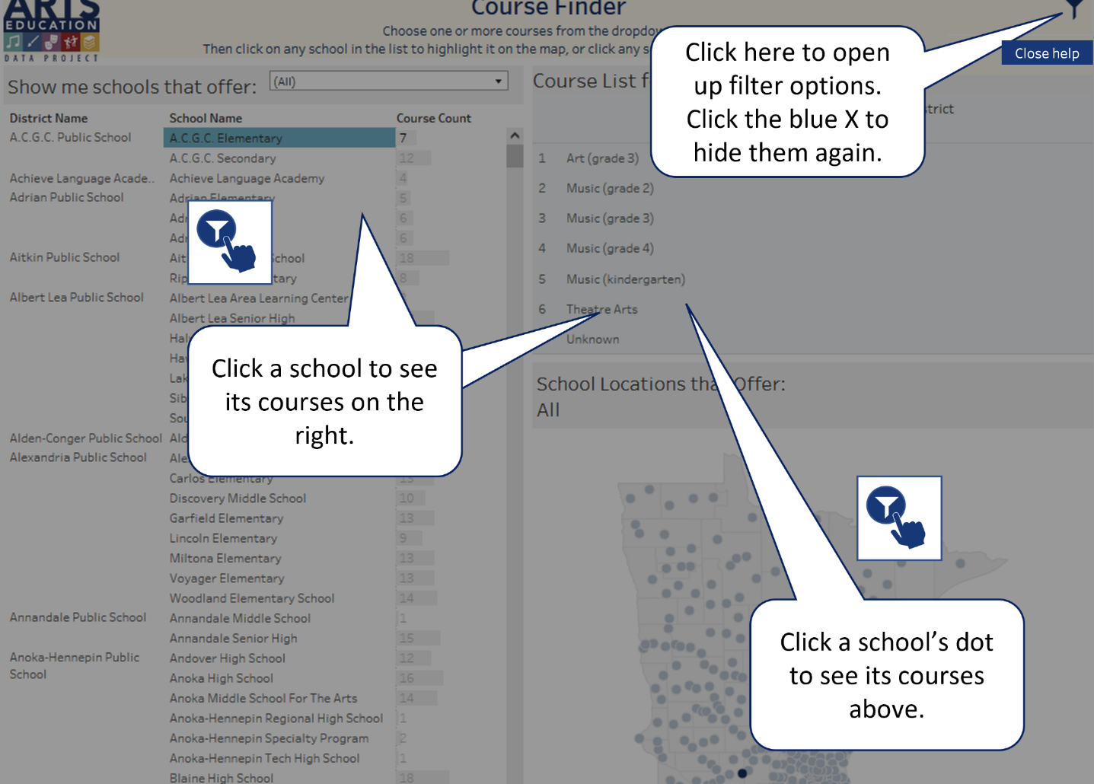
Course Finder
Select the Help button in the upper right-hand corner to better understand how this page presents data.

Slide 5
Course Finder: Filter Icon
Remember to select the filter icon to sort Course Finder by County, District, Discipline, and School Year (End Year). The data visualizations will change!

Slide 6
Course Finder: School Level Course Offerings
If an individual school is selected…
… courses offered in that school are populated.

Slide 7
Course Finder: State Map
This map has been filtered to identify all schools that offer courses in dance.
Selecting a data dot identifies a school that meets the filtering criteria. Additionally, a school list based on the filtering criteria will be provided on the left side of the page.
The state map initially shows all schools that offer arts courses. Selecting a data dot provides the name of the school.

