Slide 1
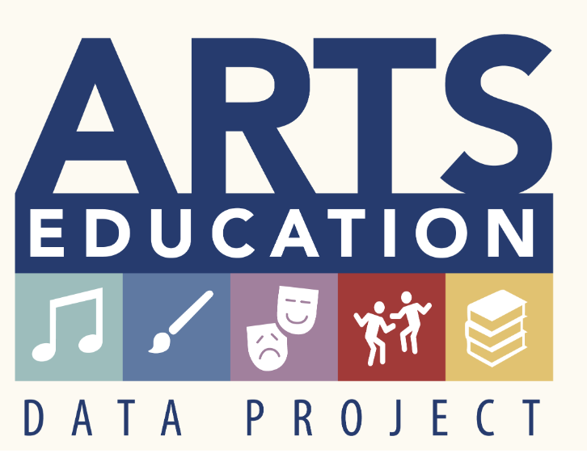
The Pennsylvania Dashboard for the…

Slide 2
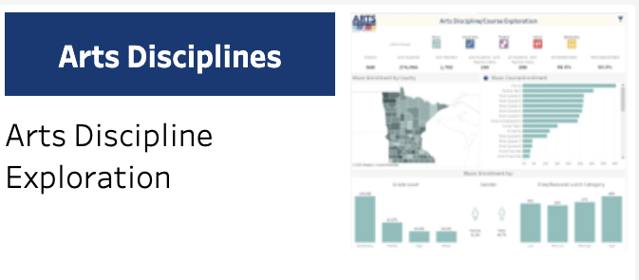
Arts Disciplines

Slide 3
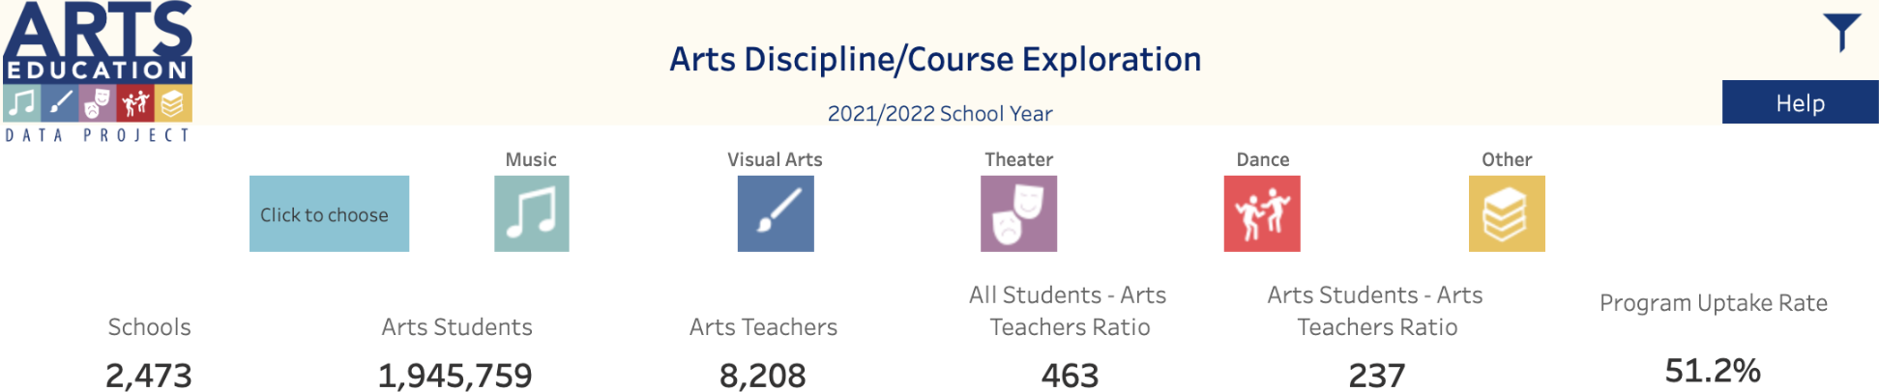
Arts Disciplines: Course Exploration
Select one of the arts disciplines icons (Music, Visual Art, Theater, Dance, Other) to view information for only that discipline.
The homepage for “Arts Discipline/Course Exploration” provides state level data regarding number of schools, arts students, arts teachers, and student-teacher ratios.

Slide 4
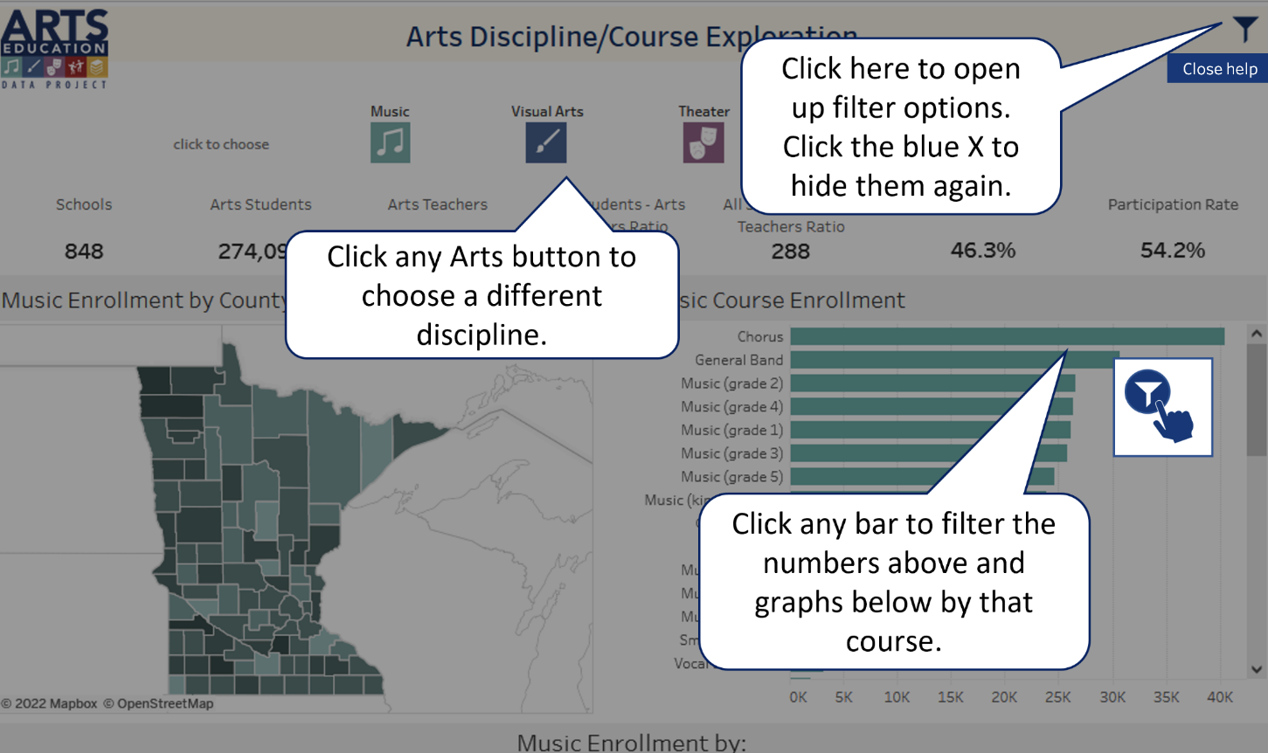
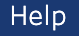
Arts Disciplines: Help
Select the Help button in the upper right-hand corner to better understand how this page presents data.

Slide 5
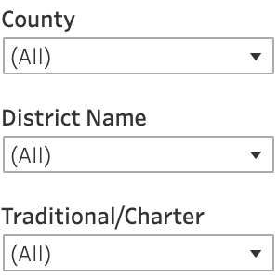
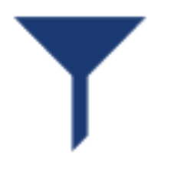
Arts Disciplines: Filter Icon
Select the filter icon to sort District Level Arts Data by County, District, or Traditional/Charter type.

Slide 6

Arts Disciplines: Enrollment
This chart shows statewide enrollment in select arts courses at the state level. Select the filter icon to see county, district, or traditional/charter views.
Select a county to explore that county’s overall arts enrollment.

Slide 7
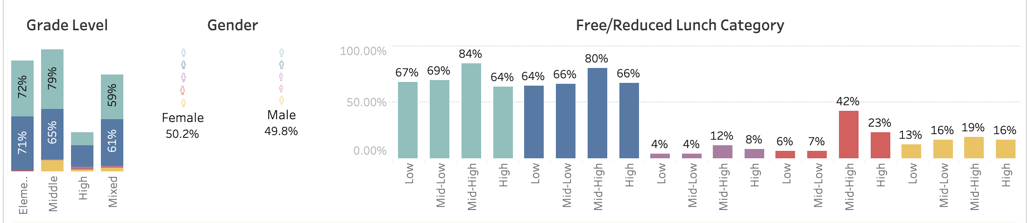
Arts Disciplines: Additional Data
Additional enrollment data by Grade Level, Gender, and Free/Reduced Lunch category is provided.

Slide 8

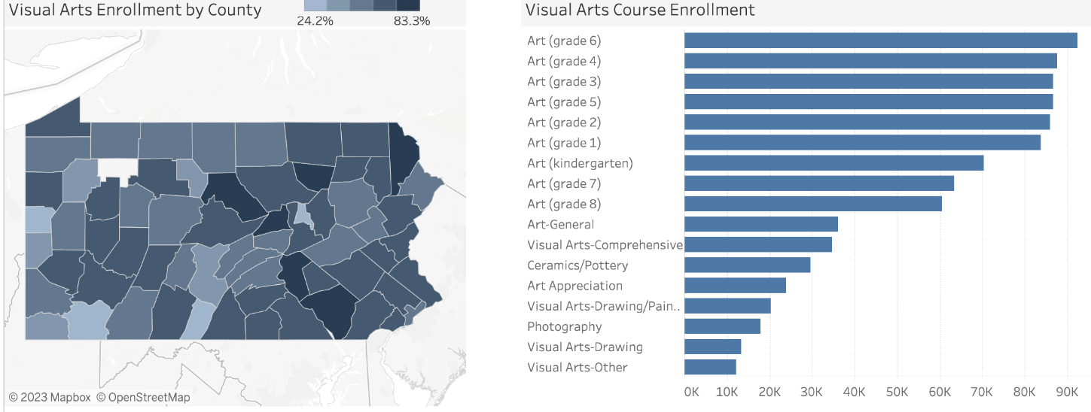
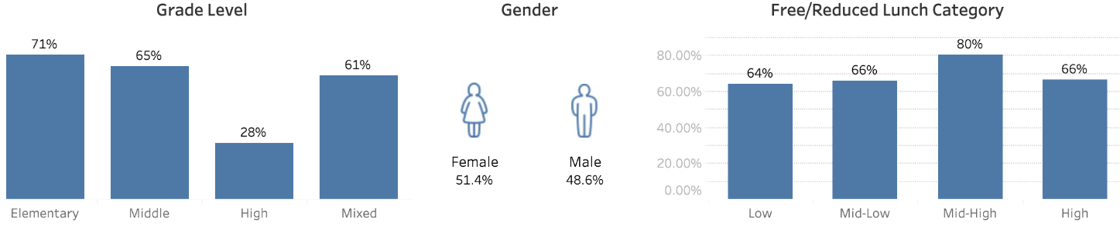
Arts Disciplines: Discipline Specific
Selecting an arts discipline changes the county map and the enrollment chart to display data for that discipline. These visualizations are displaying data for Visual Art.

Slide 9
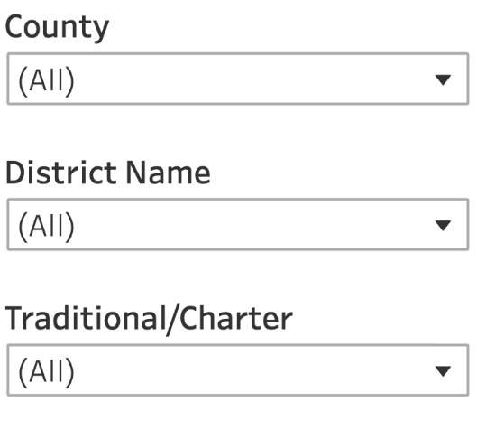
Arts Disciplines: Filter Options
Select the filter icon to sort Arts Discipline/Courses Offered by County, District, Traditional/Charter, or Locale Type.
Select an arts discipline icon to further refine your exploration.

