Slide 1
The Pennsylvania Dashboard for the…

Slide 2
District-Level Arts

Slide 3
District-Level Arts: Overall Enrollment
This data represents Public, Charter, and Career/Technical Education Centers.
Select the filter button to access the drop-down to change the year.

Slide 4
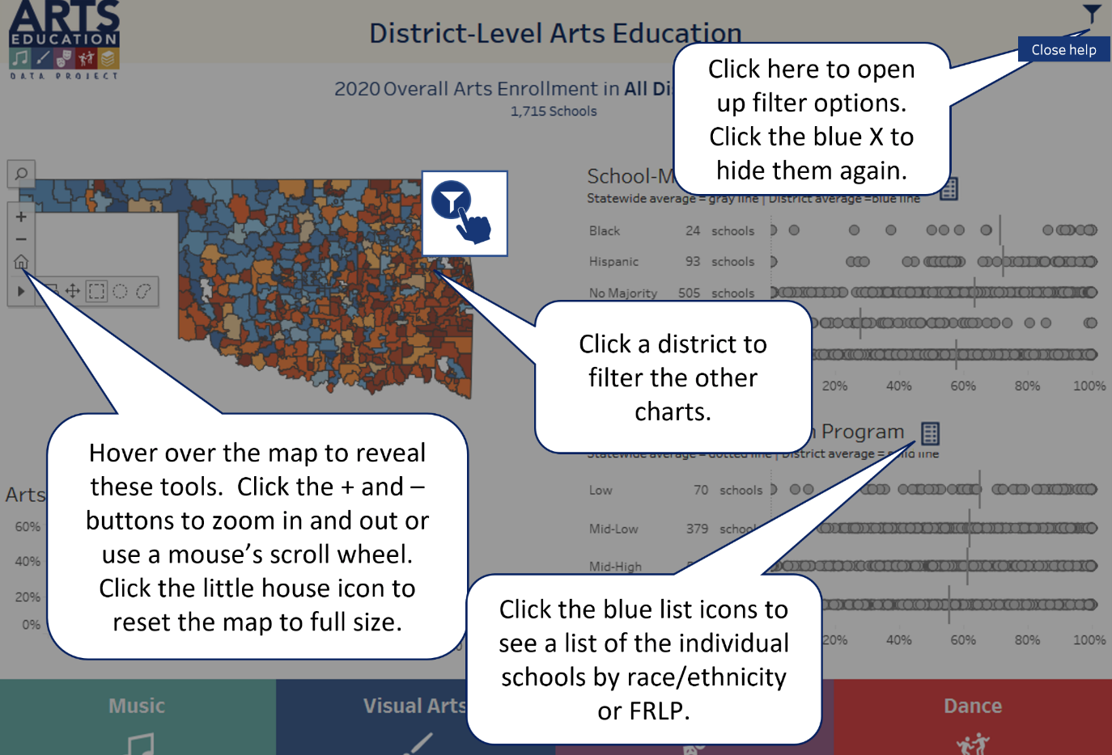
District-Level Arts: Help
Select the Help button in the upper right-hand corner to better understand how this page presents data.

Slide 5
District-Level Arts: Filter Icon
Use the filter icon to access the drop-down to change the year or district name.

Slide 6
District-Level Arts: Select a District
Select a district from this map to explore enrollment and access information, or…
…use the filter button to access the drop-down to select a district.

Slide 7
District-Level Arts: Enrollment Trend
School districts did not have to report elementary arts data prior to 2020, causing a noticeable increase between 2019 and 2020.
Select the filter button to access the drop-down to identify a district and explore that district’s arts enrollment trend.

Slide 8
District-Level Arts: Free & Reduced Lunch
Select this icon to view a full school list (see below).
Learn the definition for this section.
Select the data dots to find the % of students in the Free/
Reduced Lunch category enrolled in arts.
The full school list is organized based on the definition.

Slide 9
District-Level Arts: School-Majority Race/Ethnicity
Select this icon to see a full school list (see below).
Learn the definition for this section.
Select the data dots to find the % of students in the School-Majority Race/
Ethnicity categories enrolled in arts.
Select a district before viewing this list, it will be easier to read!

Slide 10
District-Level Arts: Disciplines
Data about schools who offer courses within each discipline is provided at the bottom of the page.

Slide 11
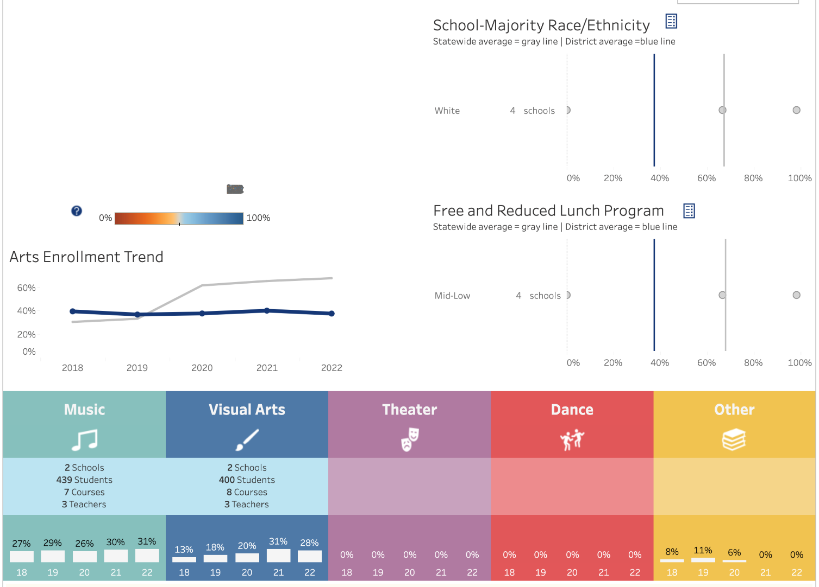
District-Level Arts: Filter Options
Remember to select the filter icon to sort District Level Arts Data by County, District, Traditional/Charter, or Locale Type. The data visualization will change!

