Slide 1
Programs of Study (POS) and Students Occupationally and Academically Ready (SOAR)
For Secondary Teachers and Postsecondary Institutions
February 5, 2026

Slide 2
Career and Technical Education
Goals as outlined in Perkins V State Plan
Increase academic achievement of students enrolled in CTE
Increase technical attainment of students enrolled in CTE
Increase business and industry engagement in CTE
Enrolled Career and Technical Education students have access to at least one high value industry recognized postsecondary credential

Slide 3
Program of Study (POS)
Incorporates elements of secondary and postsecondary education.
Content aligns with challenging academic standards and relevant career and technical coursework.
Progression of non-duplicative coursework includes the opportunity for secondary students to earn industry-recognized credentials.
They can also earn postsecondary credits through statewide articulation agreements with Perkins participating postsecondary institutions.

Slide 4
CTE Delivery Programs
Are programs without a SOAR agreement
Some (not all) have state developed Task Lists that are revised on a 3-year schedule
Can be found on the Teacher Resource Page

Slide 5
Programs of Study/SOAR
CIP
Title
POS Number
Task List
Academic Crosswalks
Secondary Partners
Framework | Department of Education | Commonwealth of Pennsylvania

Slide 6
Task List Revision
The task list revision committee is made up of secondary instructors, postsecondary instructors, and business and industry
6-8 secondary instructors
2-3 postsecondary instructors
3-4 business and industry partners (OAC members)
Participation is mandatory for all secondary and postsecondary instructors.
A task list is revised every 3 years

Slide 7
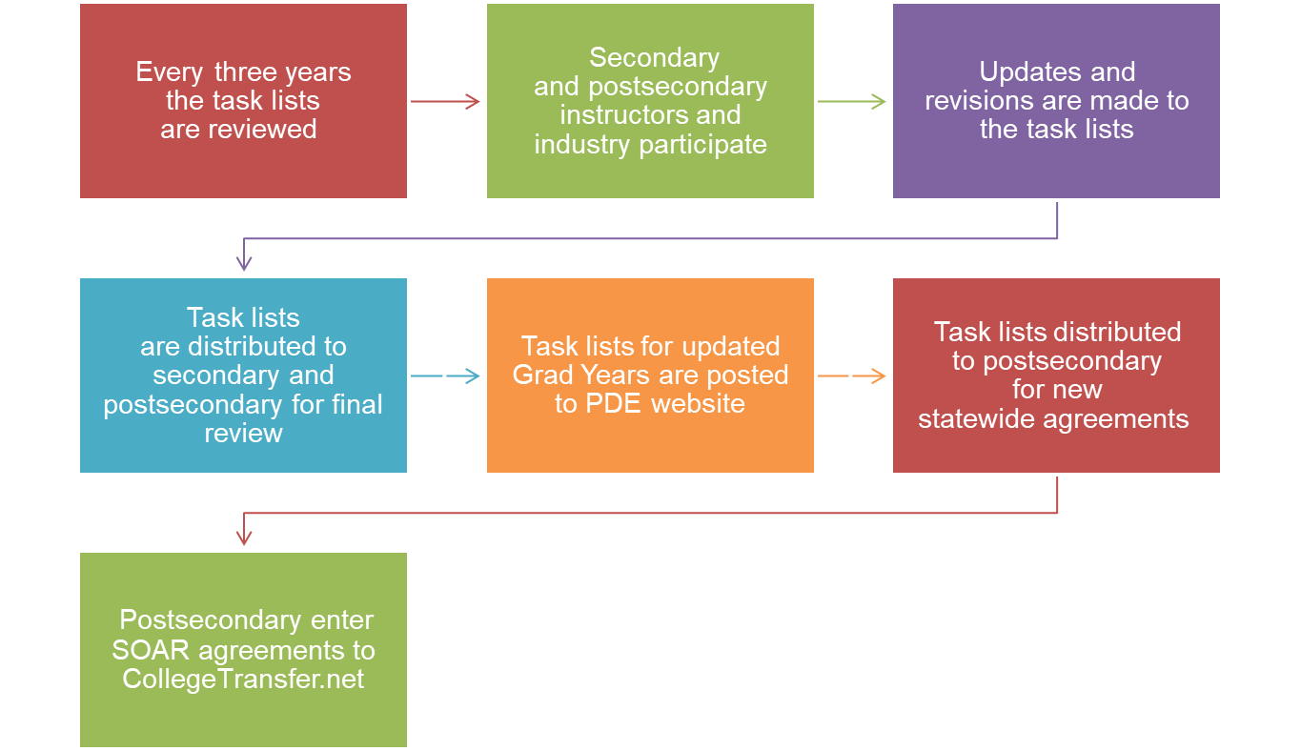
Programs of Study/SOAR Task Lists

Slide 8
Articulation Agreements
Local Agreement
Agreement between a local CTC or district with CTE programs and one Postsecondary Institution
Equal to or greater than 6 credits
Alignment Agreement
Agreement between a local CTC or district with CTE programs and one Postsecondary Institution
When both the statewide and local agreements are not possible due to restrictions set by third party accreditors or lack of a secondary program
3 technical, 3 general
POS must be an exact CIP to CIP match, or a CIP to CIP-related match
Fewer than 6 credits

Slide 9
SOAR
What does SOAR stand for?
  Students Occupationally and Academically Ready
What is the mission of SOAR?
  To prepare students for college and careers in a diverse, high performing workforce.

Slide 10
SOAR Statewide Articulation Agreements
Are for Perkins participating CTCs, districts with CTE programs, and Postsecondary Institutions.
One SOAR agreement could take the place of multiple local agreements and be used for the entire state of Pennsylvania.
Equal to or greater than 9 technical credits.

Slide 11
Benefits of Statewide Agreements
Provide a nonduplicative sequence of coursework leading to technical skill proficiency
Decrease the cost of a postsecondary credential
Enter workforce sooner
Prepare for in-demand occupations

Slide 12
Statewide Articulation for POS
Award nine or more technical credits in the aligned or related CIP
Articulated courses may not have conditions or prerequisites
For diploma, certificate or associate degree
Up to 16 months after high school graduation

Slide 13
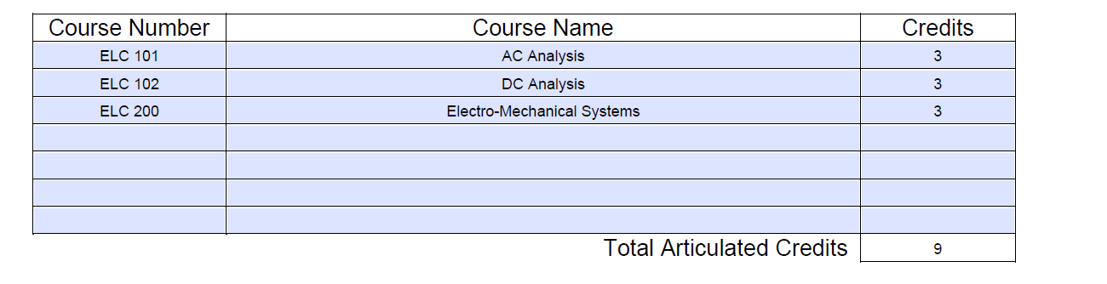
SOAR Signatory Addendum

Slide 14
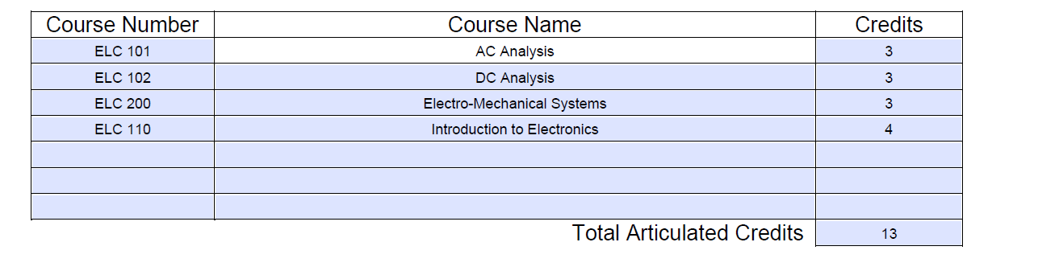
Prerequisites
Since ELC 110 is a prerequisite to ELC 200, then it must also be listed on the articulation agreement

Slide 15
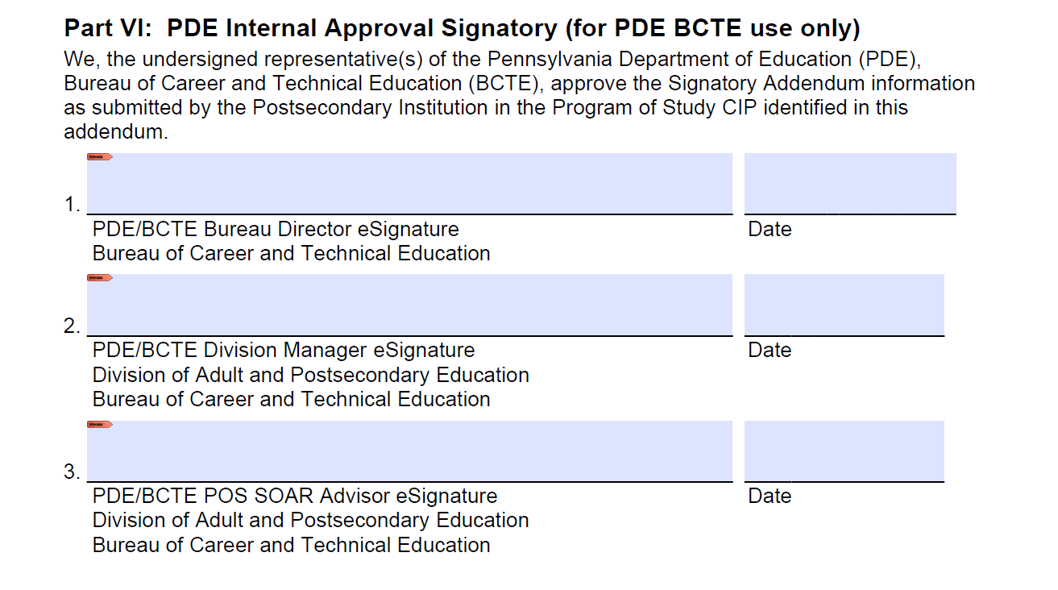
PDF Fillable Signatory Addendum
Must remain PDF fillable and use Adobe E-Signature

Slide 16
New Due Date
Previously, signatory addendums were due in the fall
Starting in 2026, signatory addendums from postsecondary institutions will be due March 1 through March 31
Graduating students will then be able to view SOAR agreements on www.collegetransfer.net over the summer months prior to committing to postsecondary education

Slide 17
Postsecondary Statewide Articulations
Posted on College Transfer
  Multiple audiences view equivalencies
    Secondary Guidance Personnel
    Secondary Teachers
    Students
    Parents
    Postsecondary Institutions
    PDE

Slide 18
POS Student Documentation
2.75 GPA Technical Coursework
Official School Transcript
Postsecondary Admissions, Bursar’s Office, and/or Registrar where student is applying
100% Completed & Signed Task List
Copy of High School Diploma
PA Certificate of Competency or PSC
Printout of Details page found on CollegeTransfer.net
Industry Credentials

Slide 19
Searching for Opportunities
www.CollegeTransfer.net hosts the SOAR agreements
  SELECT > Search
  SELCET > Search for Course Equivalencies
  SELECT > PA Bureau of Career and Technical Education
  SELECT > Postsecondary Institution
  SELECT > Search
To find SOAR agreements by Perkins postsecondary institution
To find SOAR agreements by CIP
  SELECT > Search
  SELECT > PA Bureau of CTE SOAR Programs
  Go to Search Criteria
  Go to Order By
  SELECT > CIP Code
  SELECT > A Program of Study
  SELECT > Your Graduation Year
  SELECT > Search
CONTINUE to check the site for new statewide agreements

Slide 20
SOAR Agreement Participation
215 Students Occupationally and Academically Ready (SOAR) Statewide Programs of Study (POS) agreements entered on www.collegetransfer.net.
37 Programs of Study with the addition of Construction Trades CIP 46.9999 as of January 2026
Nine of Twenty-one Perkins participating postsecondary institutions reported SOAR students that matriculated in the most recent academic year 2024-2025.
Based on reported data as submitted to PIMS for academic year 2024-2025, 82 students were awarded a total of 791 postsecondary credits.

Slide 21
SOAR Agreement Participation
Since the 2011 implementation, a total of 605 students earned a total of 5916 postsecondary credits through SOAR articulation.

Slide 22
Postsecondary Information
Databases must align
College Transfer
Typical errors found in databases
Secondary CIP
Postsecondary CIP
PIMS
CATS
Number of Matriculants

Slide 23
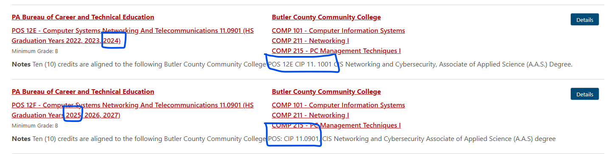
Postsecondary PIMS Data
Graduating High School students have 16 months to use SOAR credits
    Graduation year is relevant when reporting in PIMS
      CIP codes and credits could change

Slide 24
6 POS Removed Due to
No Articulation Agreements
CIP | PROGRAM TITLE
1.8301 | Veterinary/Animal Health Tech/Veterinary Assistant
26.1201 | Biotechnology
47.0699 | Vehicle Maintenance Technology
48.0703 | Cabinetmaking and Millwork
51.0601 | Dental Assisting/Assistant
52.0203 | Logistics, Materials & Supply Chain Management

Slide 25
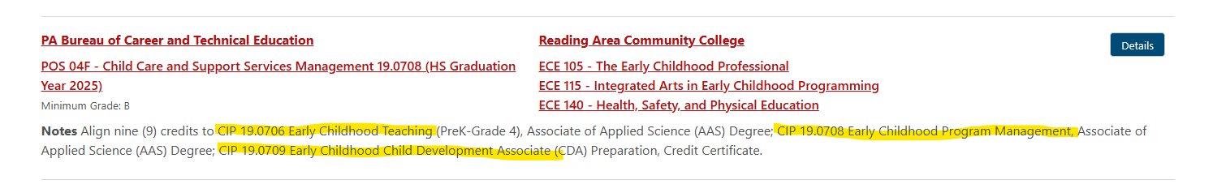
Various Postsecondary CIPs depending on path student takes

Slide 26
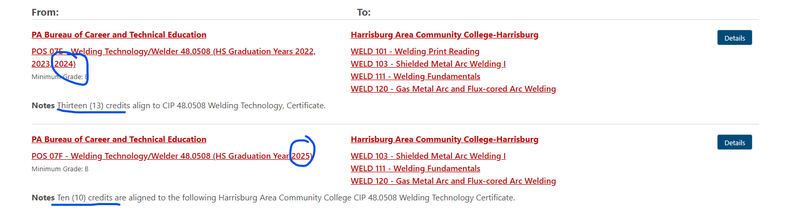
Credits change

Slide 27
Marketing SOAR to Prospective Students
From both secondary & postsecondary institutions
Relationship building between secondary and postsecondary Institutions
Career Fairs
Social Media
Packets
Discussed during counseling meetings at secondary level
Review of www.collegetransfer.net
Clarity on both secondary and postsecondary
Discussed during the admissions process at the postsecondary level

Slide 28
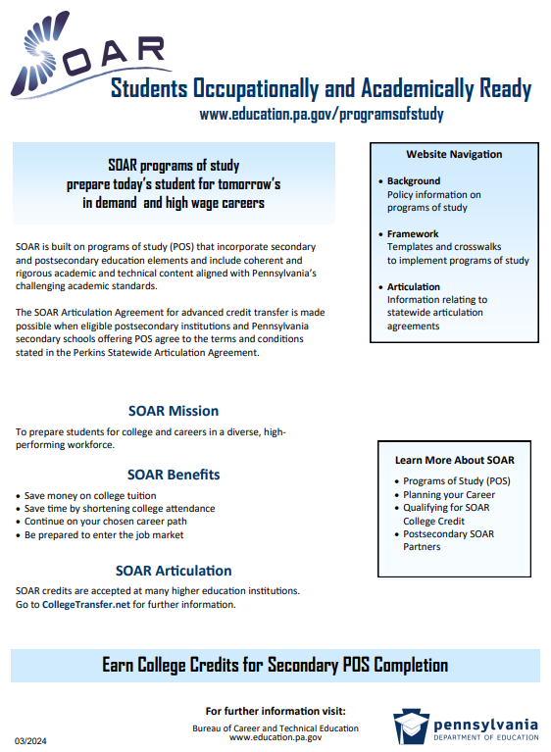
SOAR Flyer
Notes:
Posted on https://www.pa.gov/agencies/education/programs-and-services/instruction/career-and-technical-education/programs-of-study-soar
Under Resources at the bottom of the page
Direct link to flyer: https://www.pa.gov/content/dam/copapwp-pagov/en/education/documents/instruction/career-and-technical-education/programs-of-study/soar%20bulletin.pdf

Slide 29
CTE Program Of Study Search
Known as the PA College Transfer site
The link below is for users to see how PA Bureau of Career and Technical Education SOAR Programs of Study taken at the High School level may transfer into participating postsecondary institutions and technical centers.
https://collegetransfer.pa.gov/Search-Tools/Bureau-of-CTE-SOAR-Programs

Slide 30
POS and SOAR Contacts and Website
Bureau of Career and Technical Education
Ashley Hoke, Statewide POS Advisor
ashoke@pa.gov
Wendy Leiby, Statewide SOAR Advisor
wleiby@pa.gov
Tracey Readinger, Division Manager
trareading@pa.gov
Programs of Study SOAR | Department of Education | Commonwealth of Pennsylvania

Slide 31
Contact/Mission
For more information on POS and SOAR, please visit PDE’s website at www.education.pa.gov

