Slide 1
Programs of Study and SOAR for Secondary CTE Teachers and Postsecondary Institutions
3/25/2025

Slide 2
Career and Technical Education
Goals as outlined in Perkins V State Plan
Increase academic achievement of students enrolled in CTE
Increase technical attainment of students enrolled in CTE
Increase business and industry engagement in CTE
Enrolled Career and Technical Education students have access to at least one high value industry recognized postsecondary credential

Slide 3
Programs of Study/SOAR
  Components of the PDE POS web page
CIP
Title
POS Number
Task List
Academic Crosswalks
Secondary Partners
PDE Website

Slide 4
Task List Revision
A task list is revised every 3 years
The task list revision committee is made up of secondary instructors, postsecondary instructors, and business and industry
  6-8 secondary instructors
  2-3 postsecondary instructors
  3-4 business and industry partners (OAC members)
Participation is mandatory for all secondary and postsecondary instructors.

Slide 5
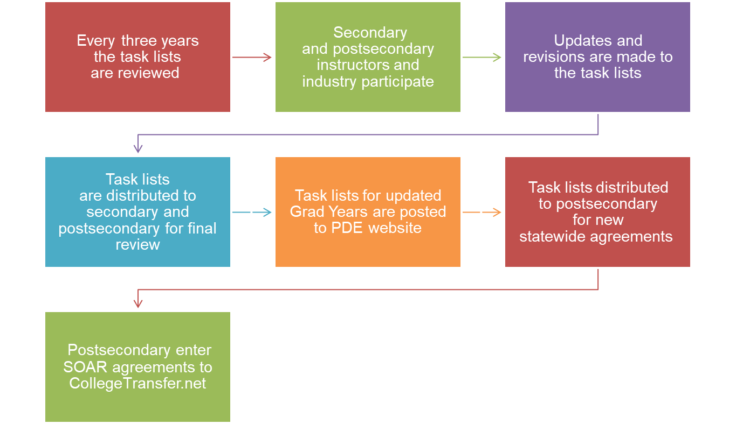
Programs of Study/SOAR Task Lists

Slide 6

SOAR
What does SOAR stand for?
  Students Occupationally and Academically Ready
What is the mission of SOAR?
  To prepare students for college and careers in a diverse, high performing workforce.

Slide 7
Benefits of SOAR and Statewide Agreements
Provide a nonduplicative sequence of coursework leading to technical skill proficiency
Decrease the cost of a postsecondary credential
Enter workforce sooner
Prepare for in-demand occupations

Slide 8
Articulation Agreements
Local Agreement
Alignment Agreement
Agreement between a local CTC or district with CTE programs and one Postsecondary Institution
Equal to or greater than 6 credits
  3 technical, 3 general
  POS must be an exact CIP to CIP match, or a CIP to CIP-related match
Agreement between a local CTC or district with CTE programs and one Postsecondary Institution
When both the statewide and local agreements are not possible due to restrictions set by third party accreditors or lack of a secondary program
Fewer than 6 credits

Slide 9
Dual Credit Agreements
​​​​​​Act 55 of 2022 requires each school district, career and technical center (CTC), and charter school to enter into an agreement with an institution of higher education to allow students to enroll in college coursework prior to high school graduation. Agreements must meet the requirements in the law. No later than July 31, 2023, and each year thereafter, schools must submit agreements and related data to PDE.​

Slide 10
CTE Delivery Programs
Are programs without a SOAR agreement
Some (not all) have state developed Task Lists that are also revised on the 3-year schedule
Can be found on the Teacher Resource Page
  Career and Technical Education Page
  A school MUST have an Alignment Agreement to use Perkins funds

Slide 11
Currently 36 Programs of Study
SOAR Statewide Agreements
For Perkins participating CTC, districts with CTE programs and Postsecondary Institutions
Equal to or greater than 9 technical credits

Slide 12
Statewide Articulation for POS
Award nine or more technical credits in the aligned or related CIP
Articulated courses may not have conditions or prerequisites
For diploma, certificate or associate degree
Up to 16 months after high school graduation beginning 2021

Slide 13

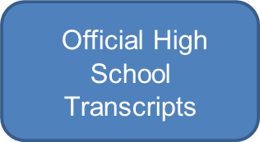
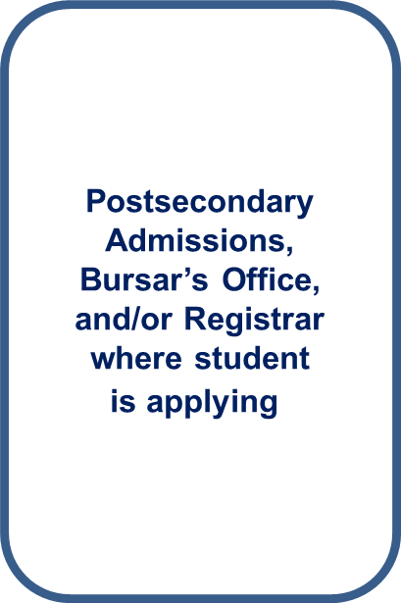



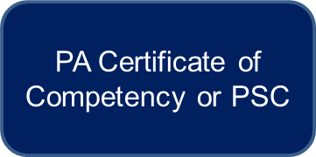


POS Student Documentation

Slide 14
Postsecondary Statewide Articulations
Posted on College Transfer
  Multiple audiences view equivalencies
    Secondary Guidance Personnel
    Secondary Teachers
    Students
    Parents
    Postsecondary Institutions
    PDE

Slide 15
Searching for Opportunities
www.CollegeTransfer.net hosts the SOAR agreements
To find SOAR agreements by Perkins postsecondary institution:
  SEARCH > PA Bureau of Career and Technical Education
  SELECT > Postsecondary Institution
To find SOAR agreements by CIP:
  SELECT > PA Bureau of Career and Technical Education
  SELECT > Show Advanced Search Options
  SELECT > Major or Program
CONTINUE to check the site for new statewide agreements

Slide 16
7 POS Removed Due to No Articulation Agreements
CIP | Program Title
01.8301 | Veterinary/Animal Health Tech/Veterinary Assistant
26.1201 | Biotechnology
46.9999 | Construction Trades
47.0699 | Vehicle Maintenance Technology
48.0703 | Cabinetmaking and Millwork
51.0601 | Dental Assisting/Assistant
52.0203 | Logistics, Materials & Supply Chain Management

Slide 17
SOAR Agreement Participation
Of the 23 postsecondary institutions that currently receive Perkins Funding from 2010 – 2024:
  13 institutions awarded 5125 credits
  10 institutions awarded zero SOAR credits
  524 students matriculated

Slide 18
Postsecondary Information
Databases must align:
  College Transfer
  CATS
  PIMS
Typical errors found in databases:
  Secondary CIP
  Postsecondary CIP
  Number of Matriculants

Slide 19
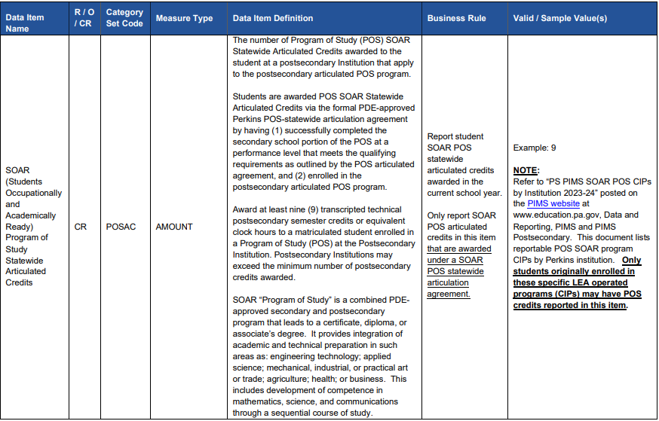
PIMS Reporting
Page 27 of the 2023-2024 PIMS Perkins Postsecondary Manual – Volume 1 list details on how to enter matriculants
Matriculants should be entered under POSAC
  No local or alignment agreement matriculants should be entered here

Slide 20
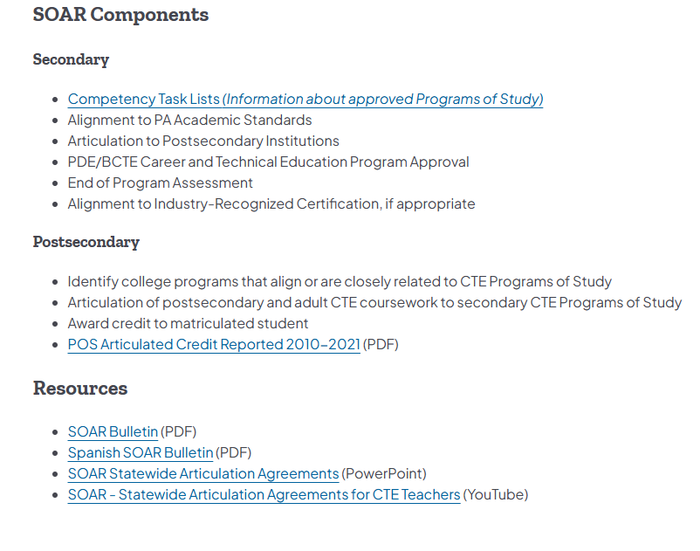
SOAR Flyer
Posted on Programs of Study SOAR | Department of Education | Commonwealth of Pennsylvania
Under Resources at the bottom of the page

Slide 21
POS and SOAR Contacts and Website
Bureau of Career and Technical Education
Ashley Hoke, Statewide POS Advisor
ashoke@pa.gov
Tracey Readinger, Statewide SOAR Advisor
trareading@pa.gov
Programs of Study SOAR | Department of Education | Commonwealth of Pennsylvania

Slide 22
Contact/Mission
For more information on the (the topic of the presentation) please visit PDE’s website at www.education.pa.gov

