Slide 1
Strategies: Educational Excellence for Health Care Providers and Educators
November 14, 2024

Slide 2
Bureau for Career and Technical Education
Division of Adult & Postsecondary CTE
Your NATCEP Advisors
  Rebecca Conway rebconway@pa.gov
  Tracey Readinger trareading@pa.gov
  Wendy Leiby wleiby@pa.gov
  Mark Price artprice@pa.gov
  To be hired Interested?
  To be hired Employment Open Jobs
ra-natcep@pa.gov

Slide 3
Overview of Updates
  Recent legislative activity in healthcare education
  Program approval trends
  Transition to a new online Integrated Monitoring System (IMS)
  Most common causes for findings of noncompliance
  FBI processing

Slide 4
New Legislation 2023-2024 Session
Senate Bill 668
  Highlights
    Allows use of Certified Medication Aides (CMA) in long term care facilities
    Certification program administered by DOH
    CMA to be designated on NA registry
  Signed into law
  Act No. 109 of 2024, Oct. 16, 2024
Senate Bill 1102
  Highlights
    Requires PDE develop a state standardized NA curriculum
    Deemed “approved” if no response from PDE in 45 days of application
    Allows graduate nurses and student nurses to test onto the NA registry
  Passed Senate 42-8
  Referred to the House on June 4, 2024

Slide 5
New Legislation 2023-2024 Session
Who’s Driving This?
  Pennsylvania Health Care Association (PHCA)
  Leading Age PA
Want to know more?

Slide 6
Program Approval Trends
Steady decline in number of approved programs over last 10+ years
273 programs end of 2012
167 programs end of 2023
Good news: September 2024 saw the first net gain in approved program since 2019. Surge in new program applications received by PDE indicates the trend could be reversing.

Slide 7
Integrated Management System (IMS)
What is it?
  Online system to track program reviews and approvals
  New program applications submitted online
  Self Study completed online; supporting documents uploaded
  Reports of Change submitted online
Why do we need it?
  Will consolidate seven databases PDE maintains into one integrated system
  Will streamline Self Study process for the programs; eliminates mailings
  Will eliminate many supporting documents currently required in Self Study

Slide 8
Can you identify the top five findings?
Act13/14 Abuse Quiz
Performance Checklist
Procedure Evaluations
CHRI/FBI Review
Attendance
Grades
Nurse Aide Training Report
Completion Certificate
Reimbursement Letters
Instructor not Licensed

Slide 9
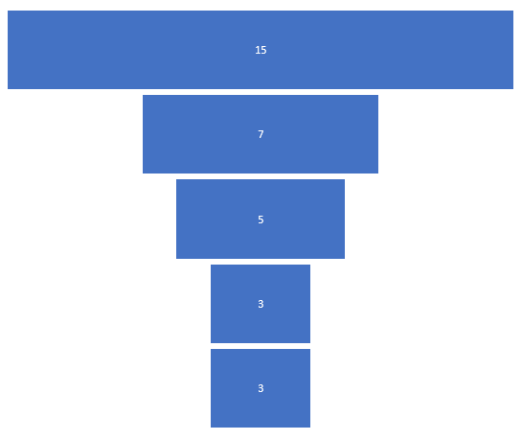
Top Five Findings of Noncompliance
CHRI/FBI Review
Nurse Aide Training Report
Performance Checklist
Procedure Evaluations
No Attendance

Slide 10
CHRI/FBI Review Errors
Not signed and dated by reviewer
Not available for PDE review
Obtained after start of class
Missing Rap Sheets
Unofficial copy of FBI
Not accompanied by letter of employment
  FBI reports from DOA can only be accepted with letter
  Prohibitive offenses on CHRI can only be accepted with letter

Slide 11
Nurse Aide Training Report Errors
Incorrect or Missing Dates:
  Completion Dates
  CHRI Review Dates
  FBI Review Dates
Missing CHRI Reviewer Signature

Slide 12
Performance Checklist Errors
Incorrect or Missing Dates:
  Missing Date Objective was Taught
  Missing Date Objective was Demonstrated
  Objectives Demonstrated on Date Student was Absent
Missing Grades on Page 12

Slide 13
FBI Procurement
PDE guidance to programs versus . . .
Program guidance to prospective students
30 days for processing plus USPS mailing
700 FBI reports processed each year
$9 for each mailing
7 pieces of information, no attachments, no photos
Just Seven Things
Name
Mailing address
Email
Phone
UEID # UZSV _ _ _ _ _ _
Program name
Program # 395 _ _ _ _
Notes:
NOTE:
Students should not be given a class start date until they have submitted all of their clearance information to the school/facility for review.

Slide 14

Contact/Mission
For more information on the Nurse Aide Training Programs, please visit the PDE website at www.education.pa.gov
The mission of the Department of Education is to ensure that every learner has access to a world-class education system that academically prepares children and adults to succeed as productive citizens. Further, the Department seeks to establish a culture that is committed to improving opportunities throughout the commonwealth by ensuring that technical support, resources, and optimal learning environments are available for all students, whether children or adults.

