Slide 1

The Nurse Aide Registry and the Competency Exam
July 27, 2026

Slide 2
Unit 7 – The Registry and Exam
Learning Objectives
  Identify the statutory requirements for the Nurse Aide Registry
  Describe the process for state competency testing of Nurse Aides

Slide 3
42 CFR 483.35 Nursing Services
  Nurse Aides have 4 months (120 days) from date of hire to pass the competency exam and be entered on the Nurse Aide Registry.
  eCFR :: 42 CFR 483.35 -- Nursing services.
  ‘Date of hire’ means the day the individual is placed on the facility payroll as a Nurse Aide.

Slide 4
Testing Guidelines
Must test within 2 years of completing a program
Must pass both written and skills portion of the exam
Individuals have 3 attempts to pass each portion
Nursing facilities are responsible to pay for all 3 attempts
All students should be given a copy of the PA Nurse Aide Candidate Handbook to help them prepare

Slide 5
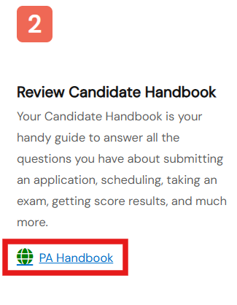
Nurse Aide Candidate Handbook
Comprehensive overview of the exam
Lists all testable skills a student may be asked to perform
Instructions for test registration
Pennsylvania Nurse Aide Testing: Online Exams | Credentia

Slide 6
Registration Process for Testing
Step 1
Candidate creates account on Credentia’s website and submits an application to test
Step 2
Program logs on and verifies candidate successfully completed training
Step 3
Candidate can now register for the written and skills exams

Slide 7
Program Best Practices
Ensure each student gets a copy of the Candidate Handbook
Conduct a ‘Mock’ written/skills exam to help students prepare
Instructors should review testing data quarterly
  Any problem content areas below 80%?
  If so, consider course revisions

Slide 8
Contact/Mission
For more information on NATCEP please visit PDE’s website at www.education.pa.gov
The mission of the Department of Education is to ensure that every learner has access to a world-class education system that academically prepares children and adults to succeed as productive citizens. Further, the Department seeks to establish a culture that is committed to improving opportunities throughout the commonwealth by ensuring that technical support, resources, and optimal learning environments are available for all students, whether children or adults.

