Slide 1

Criminal History Record Information (CHRI) & Federal Bureau of Investigation (FBI) Report Review for Nurse Aide Training Programs
August 17, 2026

Slide 2
Unit 5 – CHRI & FBI Review
Learning Objectives
  Identify the statutory requirements for CHRI review
  Describe the process for obtaining and reviewing a CHRI and, when applicable, FBI Report

Slide 3
PA Act 14 of 1997 (P.L. 169)
Requires review of CHRI reports for ALL nurse aide applicants obtained during the year prior to enrollment.
PA Residency
    Last two years – CHRI from State Police
    Less than two years – CHRI from State Police and FBI
Program must designate an individual to review reports
CHRI must be free of Prohibitive Offenses
Designee must sign and date CHRI report upon review
Program must notify the applicant in writing if admission is denied based on CHRI.

Slide 4
Prohibitive Offenses
Applicants to a nurse aide training program shall not be admitted if the criminal history record indicates a conviction of:
A felony Controlled Substance charge. (See 35 P.S. § 780-101).
An offense under Title 18 of the PA Crimes Code listed at PA Act 14 Prohibitive Offenses | Department of Education | Commonwealth of Pennsylvania
A federal or out-of-state offense similar in nature to those crimes listed above.

Slide 5
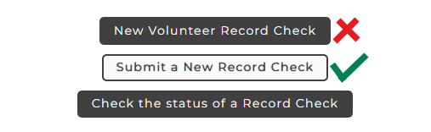
Obtaining a CHRI Report
Pennsylvania Access to Criminal History (PATCH) Pennsylvania Access To Criminal History - Home
Cost: Pa. State Police - $22.00
Note: Third party Vendor background checks - Unacceptable

Slide 6
Responses to CHRI Requests
Pending – system has not run the request
Under Review – system resolving identifiers
No Record
Record Exists – will be accompanied by RAP sheet that must be reviewed by the program
Note: The program cannot enroll an individual whose CHRI is still Pending or Under Review.

Slide 7
Steps to Review CHRI
Check for prohibitive offenses
Check the Grade of the offense
Check the Disposition

Slide 8

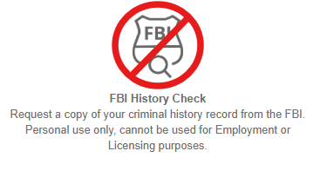
Obtaining FBI Reports
Applicant registers for fingerprinting at IdentoGO using service code 1KG6NX
Do not select FBI History Check at bottom of the page

Slide 9
Obtaining FBI Reports Continued
After the applicant has been fingerprinted, they must email ra-natcep@pa.gov to request the official copy of their FBI report. Unofficial copies cannot be accepted for enrollment.
PDE staff will process the request and send the official report to the applicant via certified mail.
Detailed Instructions can be found at Instructors Corner | Department of Education | Commonwealth of Pennsylvania

Slide 10
Review of FBI Reports
The FBI report must be reviewed by the program in the same manner as CHRI reports to determine enrollment eligibility.
Crime codes and names may vary from state to state. If the designated reviewer is uncertain a charge may be prohibitive, they are advised to consult with the school or facility’s solicitor to assist in making an enrollment decision.

Slide 11
Contact/Mission
For more information on NATCEP please visit PDE’s website at www.education.pa.gov
The mission of the Department of Education is to ensure that every learner has access to a world-class education system that academically prepares children and adults to succeed as productive citizens. Further, the Department seeks to establish a culture that is committed to improving opportunities throughout the commonwealth by ensuring that technical support, resources, and optimal learning environments are available for all students, whether children or adults.

