Slide 1
Nurse Aide Training and
Competency Evaluation Program
NATCEP
UNIT 4
Student & Administrative Policies

Slide 2
Student Nurse Aide Policies
Non-Discrimination Policy
Admission Policy
Advisement on MA Bulletin, 99-11-05
Physical Examination/Health Condition Policy
Attendance Policy
Level of Achievement Policy
Standard of Conduct Policy
Student Grievance Policy
Tuition Policy
Utilization of Student Policy
Receipt of Policies Document

Slide 3
Student Nurse Aide Policies 2
Non-Discrimination Policy
  In accordance with state and federal laws, participation in the Nurse Aide Training Program is governed and administered on individual achievement and mastery of program competencies. Participants will not be discriminated against on the basis of race, color, national origin, sex, age, or disability although some disabilities may preclude a person from being able to perform essential function of the job. Inquires should be directed to _______________ at street address, PA zip code or telephone number.

Slide 4
Student Nurse Aide Policies 3
Admission Policy
  Verification of Residency
    Applicants are required to demonstrate their residency in PA for the last two years prior to enrolling in a nurse aide training program. This PDE form is found at Instructors Corner | Department of Education | Commonwealth of Pennsylvania under the heading “Criminal History Record Information”.

Slide 5
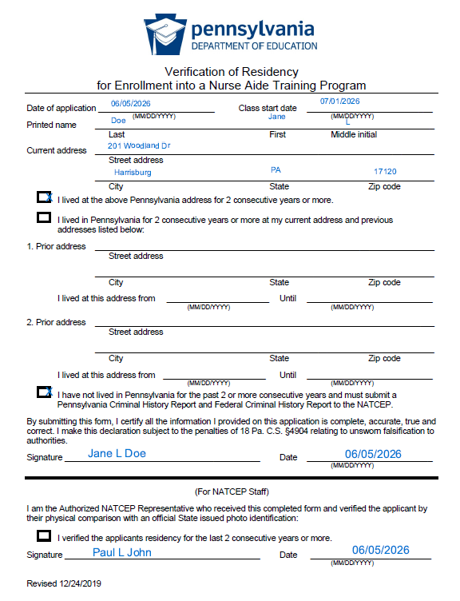
Student Nurse Aide Policies 4
Verification of Residency
Is this sample correctly filled out?

Slide 6
Student Nurse Aide Policies 5
Admission Policy
  PA Criminal History Record Information (CHRI) Report
  Applicants residing in the Commonwealth of PA for the last two years prior to their application will complete and submit a Pennsylvania State Police – Criminal History Record Information report, in compliance with Act 14, before the first day of class.
  An applicant who has not resided in the Commonwealth of PA for more than two full years, prior to the date of application, must complete and submit a PA CHRI and an FBI Report before the first day of class.

Slide 7
Student Nurse Aide Policies 6
Admission Policy
  The physical exam must document that the applicant is free of communicable disease in a communicable state.
  A completed, negative TB test obtained within the last year is required. A negative chest x-ray must be submitted if an applicant’s test results are positive. The chest x-ray may not be older than five years.

Slide 8
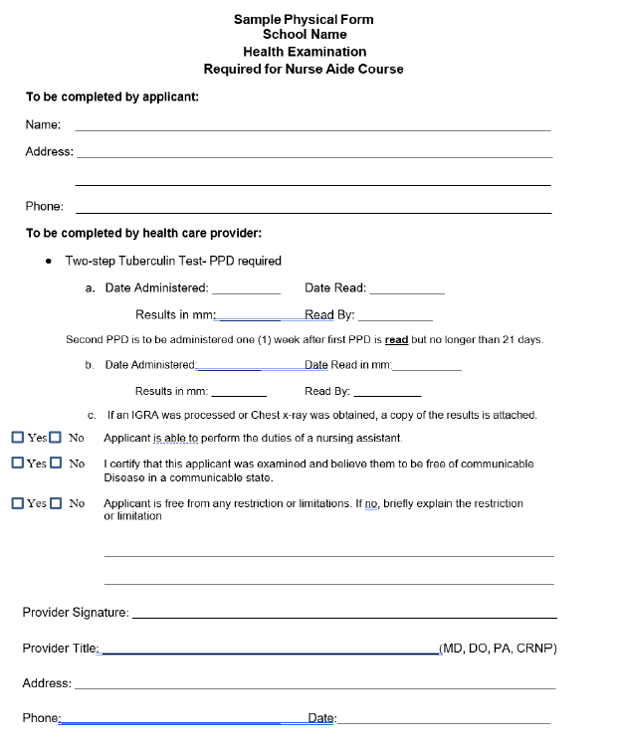
Student Nurse Aide Policies 7
Admission Policy
Sample Physical Form
  Does the physical form state free from communicable disease and have a place to record TB results?

Slide 9
Student Nurse Aide Policies 8
Admission Policy
  Advisement on MA Bulletin, 99-11-05
      Exclusion from Participation in Medicare, Medicaid or any other federal health care program is required. “While your CHRI may be acceptable for Nurse Aide training, you should be aware that Pennsylvania maintains a database by Department of Health and Human Services’ Office of Inspector General that identifies individuals or entities that have been excluded nationwide from participating in any federal health care program. Health care facilities are required to screen all potential employees to determine if they have been excluded from participation in federal health care programs. If you are on this exclusion list, it is possible that you will not be eligible for employment in a health care agency. To see if you are on the list, please go to the following website https://oig.hhs.gov/exclusions/”

Slide 10
Student Nurse Aide Policies 9
Physical Examination/Health Condition Policy
  The physical exam must include evidence that the applicant is free of communicable disease and in a communicable state and must have full use of hands, ability to stand for extensive periods, bend, pull, push and lift a minimum of 40 pounds without restrictions.
  The physical form must be signed by a physician, (MD or DO) or physician extender (CRNP or PA).
  A completed, negative TB test must be obtained within the last year is required. A negative chest x-ray must be submitted if a student’s test results are positive.

Slide 11
Student Nurse Aide Policies 10
Attendance Policy
  All students must complete the entire amount of approved program hours.
  A student must complete a minimum of 16 hours of instruction in the five content areas.
  Attendance will be documented on a daily basis.
  Any class or clinical time that is missed MUST be made up within a specified timeframe.
  Method for students to report absences
  Disciplinary procedure for tardiness or absence.

Slide 12
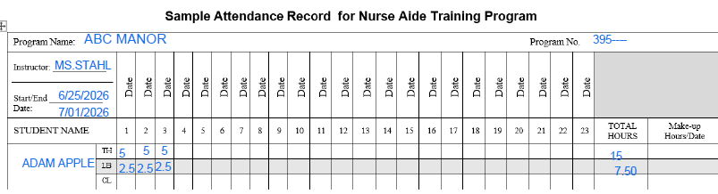
Student Nurse Aide Policies 11
Sample Attendance Record

Slide 13
Student Nurse Aide Policies 12
Level of Achievement Policy
  Theory: Maintain an 80% pass rate
  Skills Lab: Satisfactorily demonstrates all of the required skills
  Clinical: Satisfactorily demonstrates the performance objectives and professional conduct.
  A final clinical grade may be a S or U, P or F, or a numerical grade
    (scale of 0 to 10 used, a final average is required to pass the component.)

Slide 14
Student Nurse Aide Policies 13
Standard of Conduct Policy
  Program must have a policy that defines expected student behaviors in the program
  Academic honesty is expected of all Nurse Aide students. Dishonesty or cheating will not be tolerated.
  All students MUST always wear an identification tag. The tag will clearly identify them as a “Student” or “Trainee” until they satisfactorily complete the state competency examination.
  Professional and safe behavior is expected of all Nurse Aide students.
  It is imperative to demonstrate care that is legally sound and to be held to high, ethical standards to ensure abuse-free communication and care delivery.
  Violation of these standards of conduct will result in disciplinary action, which may include dismissal from the program.
  Dress code (describe the type of attire that may be worn, length of hair, fingernails, jewelry, etc.).

Slide 15
Student Nurse Aide Policies 14
Student Grievance Policy
  Must have at least 3 steps.
  The timeframe for a student grievance action must be within the length of the NATCEP.
  The grievance process should begin with the instructor and end with someone in administration.

Slide 16
Student Nurse Aide Policies 15
Tuition Policy
  Self-Sponsored – Students are responsible for tuition payments
  Facility Sponsored – Facility is responsible for the costs of training and testing which is approximately $ amount.
    Facilities are not obligated to pay the students a salary while they attend nurse aide training; however, providing a salary has been reported to boost recruitment and retention efforts.

Slide 17
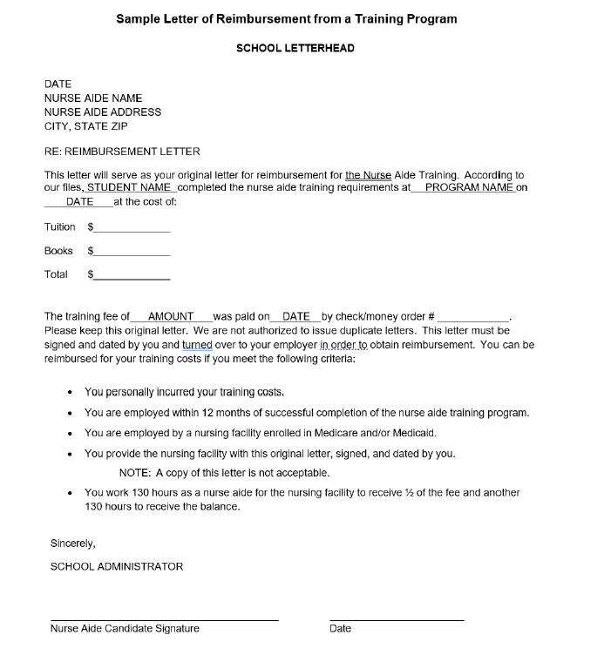
Student Nurse Aide Policies 16
Tuition Policy
  Sample Letter of Reimbursement
How many receipts can be issued to a student?

Slide 18
Student Nurse Aide Policies 17
Utilization of Student Policy
  Students may not replace staff or serve as staff members.
  Students will be supervised in the performance of resident care tasks for which the student has demonstrated competent performance.

Slide 19
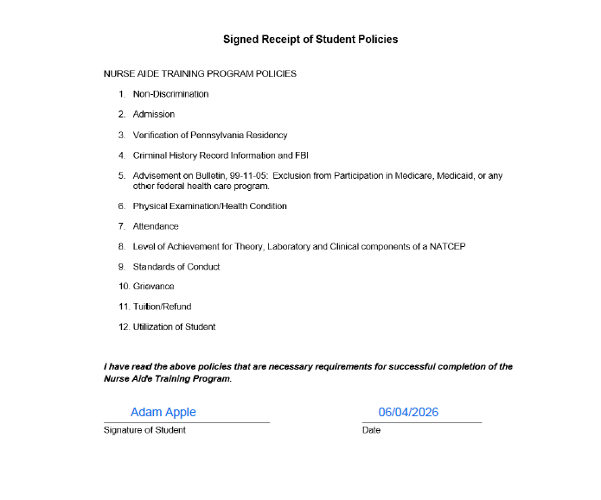
Student Nurse Aide Policies 18
Receipt of Policies Document

Slide 20
Administrative Policies
Documentation of Student Records
Ongoing Evaluation of the Program Policy
Policy Makers
Electronic Signatures
Record Keeping Policy
Student Training Agreement

Slide 21
Administrative Policies 1
Documentation of Student Records
  Written description of how grades, attendance, performance and anecdotal notes are to be documented by the instructor.
  Each class folder will contain program calendar, attendance sheets, copies of each student’s performance checklist, individual test scores and any anecdotal notes.
  All student records are considered confidential and will be maintained in a secure manner by the Program Coordinator.

Slide 22
Administrative Policies 2
Ongoing Evaluation of the Program Policy
  The Policy Makers will meet semi-annually.
  “Said party” or Program Coordinator will present the data.
  Frequency of the meetings is at the discretion of the NATCEP.
  Minutes must be maintained.

Slide 23
Administrative Policies 3
Policy Makers
  The following individuals will be responsible for revising and updating the NATCEP policies:
    Program Coordinator
    Instructor
    Director of Nursing
    Infection Control Nurse will review, and revise policies as needed
    Administrator will approve all policies before they are implemented

Slide 24
Administrative Policies 4
ELECTRONIC SIGNATURES
  If the program allows the execution of electronic signatures, a policy is required to provide rules that govern the use of electronic signatures.
  An electronic signature policy must include procedures that provide:
    a method for affixing an electronic signature
    when electronic signatures are permitted
    which documents upon which an electronic signature is permitted
    who is authorized to sign electronically (applicants, faculty and staff?)
  It is recommended that a solicitor or legal counsel review electronic signature policy prior to implementation.

Slide 25
Administrative Policies 5
Record Keeping Policy
  The following must be kept on file ad infinitum:
      PA Nurse Aide Training Report
      Certificate of Completion
      Copy of Performance Checklist for every student who begins the NATCEP (Including those students who withdraw or are dismissed during the program.)

Slide 26
Administrative Policies 6
Record Keeping Policy
  The following records shall be kept a minimum of three years:
    Attendance Records
    Grades (Quiz, Test, Lab, Clinical Evaluations)
    Program Calendar/Syllabus
    Procedure Evaluation Forms used to evaluate lab skills
    Program and Instructor Evaluations completed by students
    Anecdotal notes concerning Students or Course
    Physical Examination Documentation with TB test results
    Verification of Pennsylvania Residency
    CHRI Report and FBI Report (if applicable)
    Copy of Reimbursement Letter for self-pay students or Invoice for sponsored students

Slide 27
Administrative Policies 7
Student Training Agreement
  These agreements are used on an infrequent basis by facility-based programs. This is important to have especially if the facility does not choose to hire the candidates before the successful completion of the NATCEP.
    Student agrees to receive training free of charge.
    Student agrees to provide the facility with a completed physical and CHRI.
    Student understands that they are responsible for their own liability insurance.
    Student understands that employment as a nurse aide may or may not be available to them upon successful completion of the nurse aide training program.

Slide 28
Contact/Mission
For more information on the (the topic of the presentation) please visit PDE’s website at www.education.pa.gov
The mission of the Department of Education is to ensure that every learner has access to a world-class education system that academically prepares children and adults to succeed as productive citizens. Further, the Department seeks to establish a culture that is committed to improving opportunities throughout the commonwealth by ensuring that technical support, resources, and optimal learning environments are available for all students, whether children or adults.

