Slide 1

Teaching The Educator
Nurse Aide Training and
Competency Evaluation Program
(NATCEP)
Unit 2 – Curriculum Requirements

Slide 2
Unit 2 Objective
Our objective in this unit is identifying Federal Regulations known as OBRA and State Laws (Act 14) and how they stipulate what information needs to be presented during training.
These guidelines ensure that Nurse Aide students are trained properly and provide the highest level of care to residents of nursing homes in Pennsylvania.

Slide 3
OBRA
Omnibus Budget Reconciliation Act of 1987 (OBRA)
OBRA sets forth the following requirements:
      Qualifications for Nurse Aide Instructors
      Approval of NATCEPs
      Basic Curriculum Content
      A minimum number of program hours

Slide 4
PA - Act 14
State Law – Act 14 of 1997- Nurse Aide Resident Abuse Prevention Training Act
Additional Instructional Requirements
Identification, prevention and reporting of:
      Abuse
      Neglect
      Exploitation
Improper use of restraints
Responsiveness to abuse

Slide 5
Time Requirements
The federal and state requirements for approval of a NATCEP in the Commonwealth are as follows:
Federal regulations require a minimum 75 total hours of course instruction.
PA state minimums are 80 total hours of course instruction.
  There must be 37.5 hours of clinical instruction (5 hours of abuse training per Act 14).
  PA recommendation is 120 total hours of instruction with 55 hours of clinical instruction.

Slide 6
CRISP
Omnibus Budget Reconciliation Act of 1987 (OBRA)
Requires 16 hours of training in the following 5 areas, prior to direct contact with residents:
    Communication
    Resident’s Rights
    Infection Control
    Safety and Emergency
    Promoting Resident’s Independence
Notes:
OBRA 1987 requires 16 hours of training in the following 5 areas prior to resident contact.
Communication
Resident’s Rights
Infection Control
Safety and Emergency
Promoting Resident’s Independence.

Slide 7
More Mandatory Content…
Omnibus Budget Reconciliation Act of 1987
(OBRA)
    Nutrition
    Client’s Environment
    Identify and Report Body Systems and Diseases
    Personal Care Skills
    Caring for the Resident when Death is Imminent
    Basic Restorative Services
    Behavioral Health & Social Service Needs
    Care of Cognitively Impaired Client

Slide 8
Creating a Curriculum: Required Items
Textbook – relevant, current (generally < 5 years old)
Program Calendar
- orientation, lunch, and breaks
(not included in NATCEP hours)
Lesson Plans: OBRA says must address specific content
- one per day (includes clinical day lesson plans)
- instructional sequence
- resources to be used

Slide 9
Required Items Continued
The curriculum content must include all 23 objectives specific to Act 14
Quizzes, handouts, etc. – at the program’s discretion
  Must have written evidence of the students’ understanding
Laboratory Skill Checklists
Model curriculum available at: PA Nurse Aide Instructor Resources - Home

Slide 10
Act 14 Quiz – Example Question
According to Act 14, a mandated reporter is someone who is:
Legally required to report when abuse or neglect is observed or suspected
Legally required to submit a written report of the suspected
abuse to the Department of Health
c. Responsible for investigating abuse allegations
Responsible for determining the punishment for suspected
abusers

Slide 11
Procedure Evaluation Checklists
Comprehensive list of required procedures
Required for all procedures
List the steps for each procedure to be taught/demonstrated
Students should have a checklist to use when practicing
Inform students of the level of competency they must achieve to pass each procedure
  This should be outlined in the student policies

Slide 12
Federal and State Requirements
Classroom and Laboratory Environments
Lab Equipment - Good Working Order
Optimal Learning Environment
Complete Mock Unit (1 per 6 students)
Restrooms Within Reasonable Distance of Classroom

Slide 13
Federal and State Requirements - Clinical
Licensed as a LTC facility- without substandard issues
Direct supervision by an approved Instructor
Students many not perform a skill for which they have not been trained and deemed competent
Student may not replace regular staff
Student may not be assigned with nurse aide staff
10:1 student to instructor ratio
Objective driven experiences that progress from simple to complex
2-3 resident assignments per student and in close proximity

Slide 14
Clinical Experience Requirements (Cont.)
Clinical experience should include:
  Mechanical lift (if 18 or older)
  Shower and/or whirlpool
  Vital signs
Daily evaluation
Final evaluation grade
Generic Documentation Form
May not be in a locked unit or ventilator unit for entirety of clinical experience
Clinical affiliation agreement

Slide 15
Clinical Site Status
Substandard Quality of Care- any deficiency in:
  CFR-483.12 Freedom from Abuse, Neglect, Exploitation
  CFR-483.13 Resident Behavior and Facility Practices
  CFR-483.15 Quality of Life
  CFR-483.25 Quality of Care (S/S F,H,I,J,K,L)
Staffing waiver
Extended Survey
Civil money penalty of not less than $13,690.00 (adj. annually)
Termination of Medicare and/or Medicaid participation
Denial of payment for admission under Medicare/Medicaid
Operated under temporary management
Was closed or had its residents transferred pursuant to state action

Slide 16
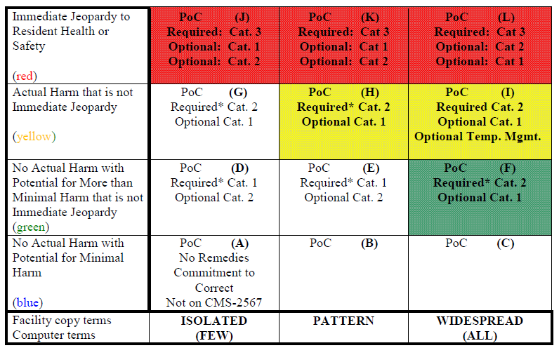
Interpreting Department of Health Surveys

Slide 17
Long Term Care in Pennsylvania
For information on locating a Nursing Care Facility in Pennsylvania
http://sais.health.pa.gov/commonpoc/nhLocatorie.asp
http://www.pabulletin.com/secure/data/vol45/45-42/1827.html

Slide 18
Performance Checklist
Master record of each Student’s level of competency that must be accurately and confidentially maintained when the objectives are taught and demonstrated
All spaces must be completed
Denote Lab (*) and Test Questions (+)
Provide final theory, lab and clinical grade
Signature of Instructor and Student
Original or copy to Completer (student)
Copy kept on file ad infinitum

Slide 19
Performance Checklist - Form
Skill List | Date Taught | Date Demonstrated | Satisfactory/ Unsatisfactory | Instructor’s Initials
COMMUNICATION SKILLS 1.2 Demonstrates appropriate and effective communication skills. | 6/8/22 | 6/24 | S | SW
1.2.1* Demonstrates effective, abuse-free verbal and non-verbal communication in keeping with the NA’s role with residents and their families. | 6/8/22 | 626 + | S | SW
1.2.2 Observes by using the senses of sight, hearing, touch and smell to report resident behavior to the licensed nurse. | 6/8/22 | 6/13 | S | SW
1.2.3 Documents observations using appropriate terms. | 6/8/22 | 6/25 | S | SW
1.2.4 Recognizes the importance of maintaining the resident’s record. | 6/8/22 | 6/25 | S | SW
1.2.5* Communicates in a respectful, adult manner, according to the resident’s stage of development and cultural background. | 6/8/22 | 6/26 | S | SW

Slide 20
Contact/Mission
For more information on NATCEP curriculum requirements please visit PDE’s website at www.education.pa.gov
The mission of the Department of Education is to ensure that every learner has access to a world-class education system that academically prepares children and adults to succeed as productive citizens. Further, the Department seeks to establish a culture that is committed to improving opportunities throughout the commonwealth by ensuring that technical support, resources, and optimal learning environments are available for all students, whether children or adults.

