Slide 1
TEMPLATE:
Presenting PVAAS to an Individual School Board
PowerPoint Template with Trainer Notes
Notes:
[SPEAKER’S NOTE: This template is for presenting PVAAS to an individual School Board. Therefore, it contains placeholder slides for scatterplot graphs, as well as a value-added summary, for your individual district/LEA audience.]

Slide 2
Pennsylvania
Value-Added Assessment System (PVAAS)
A Compass for Improvement
Presented at [District/LEA] School Board Meeting
Notes:
[SPEAKER’S NOTE: This is a cover slide for you to customize. Many of the slides in this template have trainer notes as well for you.]

Slide 3
A Traditional Data View of Achievement
Benchmark
Achievement
is based on
each student’s ending point.
EOY
EOY
EOY
EOY
Notes:
Let’s look at how we have traditionally viewed school achievement.
We give a summative assessment, usually at the end of the school year, and see whether or not students are measuring up to end of year expectations, without taking into account their starting point.
By looking at end of year performance, we can conclude that some students, schools or districts are “low,” “average,” or “high” in terms of student achievement.
However, this does not provide the entire picture as we are trying to make data-informed decisions in our schools and LEAs/ districts.
This does NOT tell us about student growth, or progress, that may have occurred during that school year – because we are not taking the starting point into consideration.

Slide 4
PVAAS Adds A New Dimension: Growth!
Growth
is based on
each student’s starting point!
Benchmark
Y1
Y2
Y3
Y4
Notes:
PVAAS growth DOES take into account the starting point.
PVAAS is a different way of looking at the data that adds the critical dimension of growth, or progress.
It is not another test but a comprehensive analysis of achievement trends and progress rates.
With PVAAS we are able to look at BOTH progress AND the level of achievement at a given point in time.
PVAAS is able to provide a measure that illustrates what effect “schooling” has had on students, regardless of variables such as ethnicity, socio-economic, EL and disability status.
PVAAS indicates the growth, or progress, these groups of students have made between state assessments (PSSA) on an annual basis.
PVAAS is the only PDE data tool that provides these measures of growth.

Slide 5
Achievement and Growth:
ACHIEVEMENT
Measures student performance at a single point in time
Typically related to socio-economic and demographic characteristics
Often measured by percent reaching proficiency
Might not focus on all students’ achievement
Educators cannot influence entering achievement
GROWTH
Compares students’ performance to their own prior performance, students are their own control
More closely related to teaching and schooling effectiveness
Focus placed on all students
Educators can influence the progress, or growth,
students make
TOGETHER:
A more complete picture of student learning
Notes:
As you review your PVAAS reporting, an important thing to remember is the difference between achievement and growth, and how they work together to provide a more complete picture of student learning. While both achievement and growth are important information to you, they provide you with different information.

Slide 6




PVAAS Reporting:
Both Reflective and Proactive
Last Year’s Students
This Year’s Students
Growth Reporting
Looking back, through the rearview mirror
Value-added (growth) measures compare the entering achievement of a group of students to their current achievement
Determine if the group of students has exceeded, met, or fallen short of the expected amount of growth
Projection Reporting
Looking ahead through the windshield
Projections that provide a student’s probability of successfully reaching various academic benchmarks
  On state assessments
  On college readiness exams (AP, PSAT, SAT and ACT)
  On ACCESS for ELLs
Notes:
PVAAS provides multiple types of reporting – the one most think of first is the value-added, or growth, reporting that helps educators determine if groups of students have met, exceeded, or fallen short of their expected amount of growth. This is the type of information that helps schools look back to last year’s students and assess if their programs and systems are meeting the needs of all students.
The other type of reporting – that is just as valuable– is student projection reporting, which provides educators with vital information on students about the path in which they are headed. It provides the student’s probability of successfully reaching various academic benchmarks on state assessments and college readiness exams. This is the type of information that helps schools look ahead – into the future – to say what path the student is currently on and is at risk.

Slide 7
Public Access to PVAAS Reports:
Value-Added, Growth of Student Groups, and/or Scatterplots for:
  LEA/District Level Reporting
  School Level Reporting
  Grade Level Reporting
  Student Group Reporting (ex. IEP, ED, EL)
For Subjects:
  English Language Arts (Grades 4-8, Keystone Literature)
  Math (Grades 4-8, Keystone Algebra I)
  Science (Grades 5, 8, Keystone Biology)
Not available to the public:
Teacher Level Reporting
Diagnostic Reporting
Student Level Reporting
  Projections to Future PSSA & Keystone exams
  Projections to AP, PSAT, SAT, ACT & ACCESS exams
Notes:
[SPEAKER’S NOTE: This is the complete list – point out that you are only going to discuss some of the reports. You might want to offer a longer session if members of the audience are interested.]

Slide 8
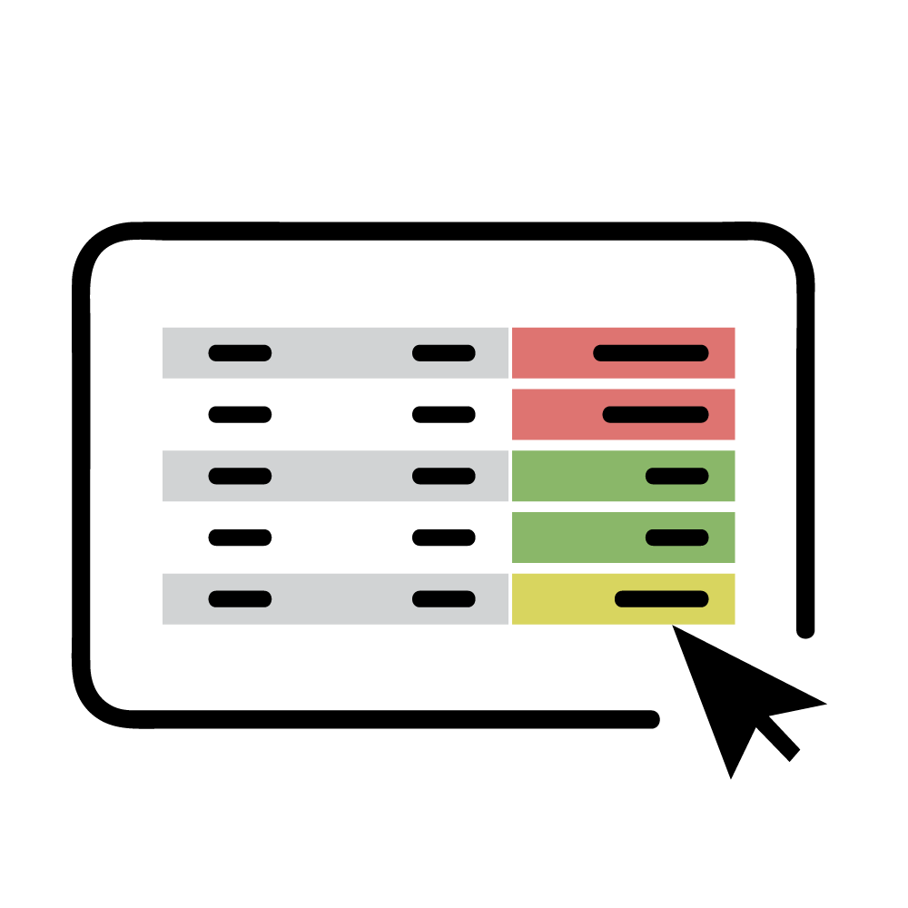
Measuring Academic Growth
Students don’t all start the year at the same place academically.
Growth Standard:
Regardless of their entering achievement, students should not lose ground academically.
Is it not a reasonable goal to
at least maintain the achievement of a group of students?
Notes:
If we are going to measure the academic growth that students make, it’s critical to recognize that students don’t all start the year or a course at the same place academically.
In Pennsylvania, growth is assessed against the standard for PA Academic Growth. It is based on the philosophy that regardless of the entering achievement level of a group of students, they should not lose ground academically.
So we ask, is it not a reasonable goal to maintain the achievement level of a group of students?
Is that not a reasonable expectation?
In other words, if students are fairly high achieving, is it not reasonable to expect that we, as educators, keep them fairly high achieving?
And if students are low achieving, is it not reasonable to expect that we would at least keep those students at that level of achievement (and not have them slip further behind)?
We would hope that everyone would agree that this is a reasonable expectation.

Slide 9
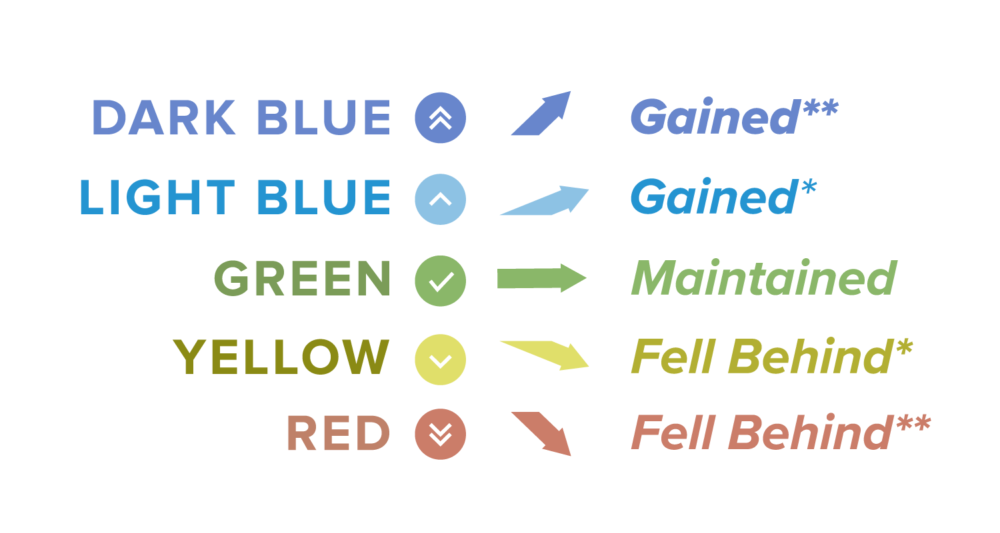
Understanding the Colors
Value-Added Measures are
color-coded!
“On average, did the students gain, maintain, or fall behind (in regard to their starting or entering achievement)?”
* Moderate Evidence
** Significant Evidence
Notes:
On PVAAS Value Added reports, you can potentially see all five colors. Let’s do a review of what these colors mean.

Slide 10
ALL Growth Colors Are Possible with ALL levels of achievement
A gaining, maintaining, falling behind color indicator is possible, regardless of beginning achievement level.
HIGH
ER
Gained**
Maintained
Fell Behind**
Gained**
Maintained
Fell Behind**
LOWER
Gained**
Maintained
Fell Behind**
Beginning
End
Beginning
End
Beginning
End
Notes:
What is also important to remember is that all groups of students – no matter who they are demographically, or in terms of achievement – can gain, maintain, or fall behind.

Slide 11
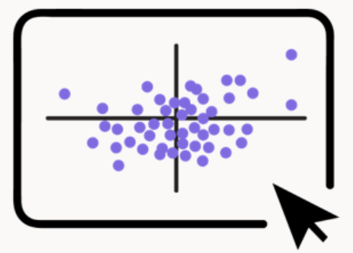
Scatterplots
Viewing Achievement and Progress Together
with PVAAS Web-based Scatterplots
Notes:
[SPEAKER’S NOTE: This slide introduces the scatter plot displays. Make sure that the audience understands the next slide as it is the key to understanding all of the following slides on scatter plots.]

Slide 12
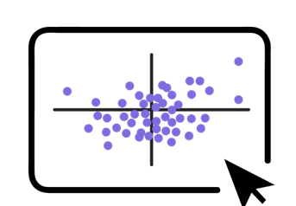
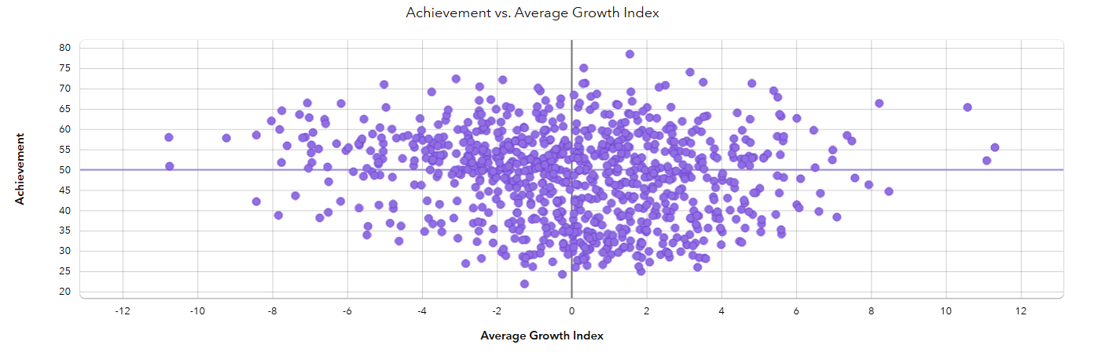
The Scatterplot Quadrants
A Visual and Global View of Achievement and Growth
Quad 2: Slipping
Higher Achievement
Lower Growth
Quad 1: Excelling
Higher Achievement
Higher Growth
ACHIEVEMENT
Quad 3: Underperforming
Lower Achievement
Lower Growth
Quad 4: Improving
Lower Achievement
Higher Growth
GROWTH
Notes:
Scatterplots illustrate the relationship between two variables, such as achievement and growth. Specifically, scatterplots enable you to visually examine the relationship between the variables. On the screen you see the relationship between growth (average growth index) and achievement.
Average Growth Index: The AGI indicates how strong the evidence is that the group of students in the LEA/district, school, or teacher's class exceeded, met, or did not meet the growth standard in the selected subject. The AGI is calculated by dividing the growth measure by its standard error. Because the AGI takes the standard error into account, it is a fair way to compare different members of the selected population.
If the AGI equal to or near 0, this shows progress similar to the growth standard.
If the AGI is Greater than 0, this shows more progress than the growth standard.
If the AGI is Less than 0, this shows less progress than the growth standard.
Achievement: This value represents the achievement of students in the LEA/district, school, or teacher's class in the currently selected year, subject, or Keystone content area. Higher achievement values indicate higher average achievement levels.
Schools or LEAs represented in Quadrant 1 can be thought of as “excelling.” These schools or LEAs have both higher achievement and higher growth. Schools in Quadrant 2 can be thought of as “slipping.” These have higher achievement but lower growth. Schools or LEAs in Quadrant 3 can be thought of as “underperforming.” These have both lower achievement and lower growth. Schools or LEAs in Quadrant 4 can be considered “improving.” These have lower achievement and higher growth.
Where is your LEA?

Slide 13
LEA/District Scatterplot:
Grade 4 Math and ELA

Slide 14
LEA/District Scatterplots:
Grade 5 Math and ELA

Slide 15
LEA/District Scatterplot:
Grade 6 Math and ELA

Slide 16
LEA/District Scatterplot:
Grade 7 Math and ELA

Slide 17
LEA/District Scatterplot:
Grade 8 Math and ELA

Slide 18
LEA/District Scatterplot:
Grades 5 and 8 Science

Slide 19
LEA/District Scatterplot:
Algebra I

Slide 20
LEA/District Scatterplot:
Literature

Slide 21
LEA/District Scatterplot:
Biology

Slide 22
Continuing the Conversation
What else does PVAAS have to offer?
Notes:
[SPEAKER’S NOTE: You may continue with some or all of the following slides if you wish to share additional information about what PVAAS data provides to your district. You may also choose to remove slides 23-34 and end with resources starting on slide 35.]

Slide 23
Visualize Data in Two Perspectives:
v
Looking Back
Looking Forward
Determining Effectiveness:
VALUE-ADDED GROWTH Data
Tracking
Student Progress:
TESTING History
Planning for Students’ Needs:
Student PROJECTIONS
to Achievement
Notes:
PVAAS has many different types of data and reporting available for educators each serving its own purpose. However, you can basically visualize PVAAS data in two larger ways– "looking back" and "looking forward.” Let’s start with the looking back side
The Value-added, or growth, information is what “looks back”
This information helps educators to evaluate the effectiveness of their schools and the influence they have on the academic growth of their students. How much growth did groups of students make in the past school year?
This data is available on several different types of reports in PVAAS.

Slide 24

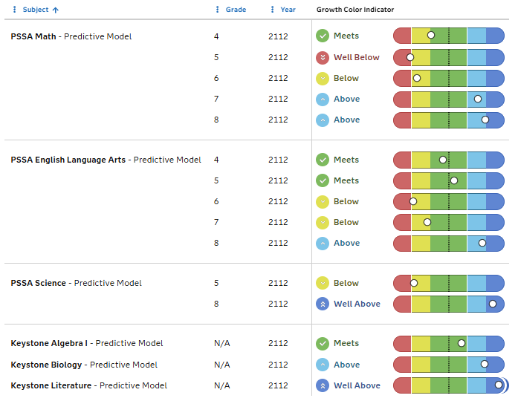

LEA/District/School Value-Added Report
Question for Educators:
Are all grade levels, content areas, and student groups meeting or exceeding the growth standard?
Notes:
This is an example of a Value-added Report that is available at both the district and school level. It is important to remember that this report is about the impact of the school or district’s academic programs on student growth!

Slide 25
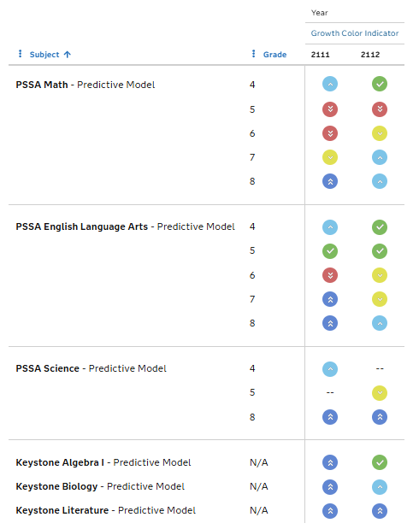
Value-Added Summary
Question for Educators:
Are all grade levels, content areas, and student groups meeting or exceeding the growth standard – over time?
Notes:
This is an example of a Value-added Report – using the new Summarize By feature - that is available at both the district and school level.
Here we can quickly see the growth color of each grade and subject over time, giving us more evidence about the strengths and areas of need of the system.

Slide 26
LEA/District Value-Added Summary:
Last Two Years

Slide 27
How Might Educators Use
PVAAS Growth Reports?
LEA/District Administrators use them to:
  Inform LEA/district continuous improvement efforts
  Plan for resource allocation and professional learning
School Administrators use them to:
  Enhance the professional growth of teachers
  Set goals, priorities and focus areas (schoolwide, grade and subject levels)
  Plan professional learning and student supports
Teachers use them to:
  Reflect on impact of instructional practices
  Assess student needs and pathways to proficiency
Notes:
LEA/District Administrators use them to:
Inform LEA/district continuous improvement efforts
Plan for resource allocation and professional learning
School Administrators use them to:
Enhance the professional growth of teachers
Set goals, priorities and focus areas (schoolwide, grade and subject levels)
Plan professional learning and student supports
Teachers use them to:
Reflect on impact of instructional practices
Assess student needs and levels of risk

Slide 28
Visualizing Data in Two Perspectives:
v
Looking Back
Looking Forward
Determining Effectiveness:
VALUE-ADDED GROWTH Data
Tracking
Student Progress:
TESTING History
Planning for Students’ Needs:
Student PROJECTIONS
to Achievement
Notes:
Let’s now look at the “looking forward” side of PVAAS
The student projection information is what “looks ahead”
This information helps educators to assess if students are on the path to proficiency or reaching an indicated benchmark on future state assessments or college/career readiness exams.
This data is available on several different types of reports in PVAAS.

Slide 29
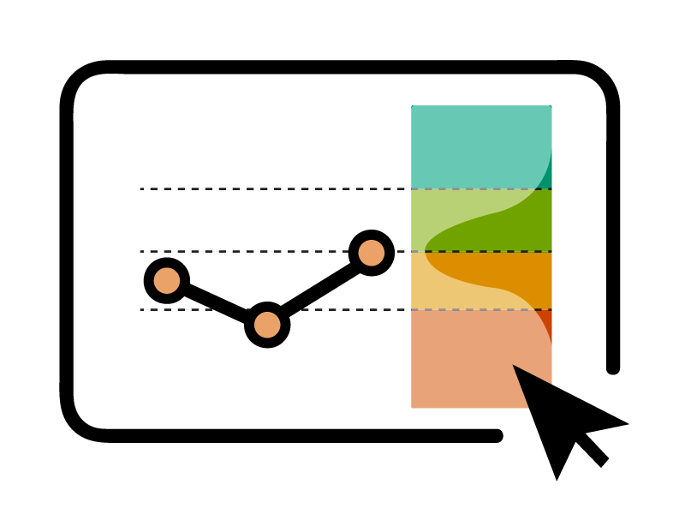
What are Projections?
Given a specific set of circumstances…
what is the most likely outcome?
Notes:
So what are projections? They are a way to express what is most likely to occur under a certain set of conditions. They inform us about what to expect in the future.

Slide 30



A Student’s Data Backpack
Looking
Forward
Data follows students across time: across years, schools, and LEAs/districts
Includes data from state-selected assessments such as PSSAs, Keystones and ACCESS for ELLs
Includes college readiness data, such as PSATs, SATs, ACTs and AP
Includes student’s projections for upcoming assessments, including PA Higher Ed benchmarks
Can include local data you select like benchmark or diagnostic assessments, such as the CDT
Looking
Back
Not on the public site
Notes:
One of the strengths of PVAAS as a statewide system is that it contains individual assessment data for students in Pennsylvania across years, no matter where the student was enrolled at the time of the assessment. This assessment history creates what we call the student’s ‘digital backpack’ that follows them through their academic career. At the individual student level, educators can view both the assessment history– or looking back– data for each student in addition to the student’s projections to future assessments– or looking forward– data as they make instructional decisions for students.
At the student level, [read slide].

Slide 31
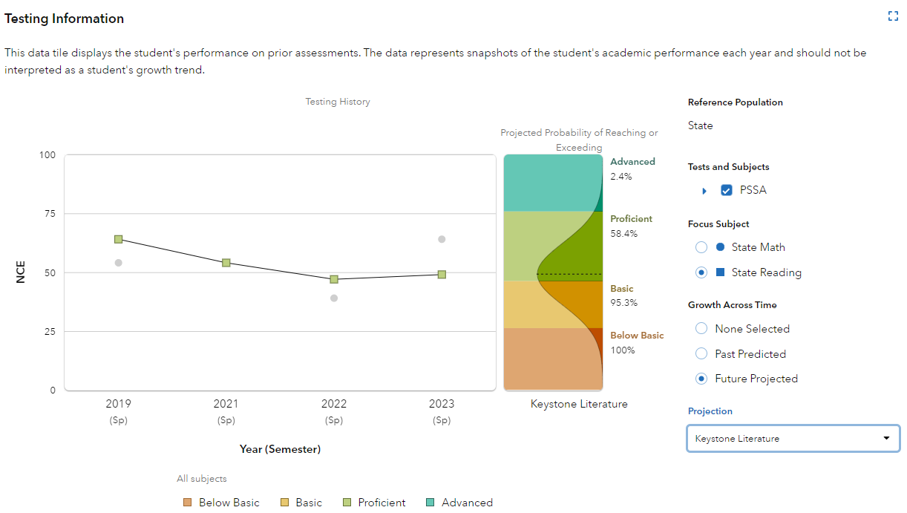
Projections Help
Educators and Students
Projections can help assess a student’s probability of reaching proficiency on a future PSSA or Keystone assessment.
Not on the public site
Notes:
For each individual student, an educator can see…
The student’s entire testing history on prior year’s state assessments – this includes all subjects and content areas
The student’s PVAAS projections to upcoming state assessments, and
The student’s projections to upcoming college readiness AP exams.
This data can help a school leader and team plan for a student’s course enrollment, enrichment, or intervention programming. Additionally, it can serve as a data point for teachers to conference with students and families as they work together to plan for a student’s goals and future educational path. This data is available for a school leader and any account holder with student access in PVAAS.

Slide 32
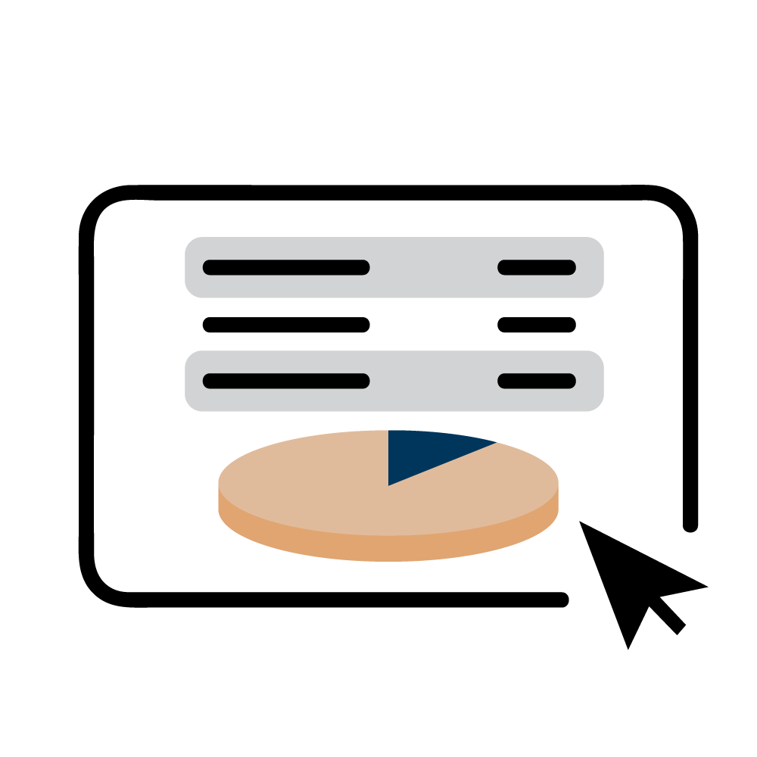
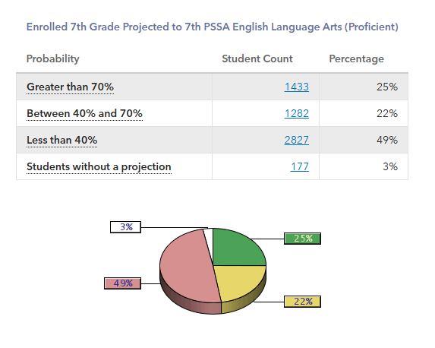
Projection Summary Report
Not on the public site
Notes:
The Projection Summary Report takes the individual students and summarizes the probabilities of all students at the selected grade level within the entire district for whom projections can be calculated based on all prior PSSA testing.
There are other Projection Summaries reports available from PVAAS, such as probabilities to Advanced. Participants are encouraged to explore these other Projection Summary Reports.

Slide 33
How Might Educators Use
Projection Reports?
Administrators can use for program planning:
  Intervention planning
  Resource allocation
  Course availability & placement decisions
  Grade-level and course-level planning
  School-level planning
  Comprehensive planning
Teachers can use to facilitate instructional planning:
  Proportion of students on a path to success (proficiency or higher)
  Proportion of students in need of additional support for reaching proficient or advanced levels of performance
  Plan for instructional strategies and practices based on students’ needs
Notes:
Projection reports can be used for planning purposes by both administrators and teachers, just at a slightly different level
Administrators can use these reports to facilitate program planning:
Intervention Planning
Resource Allocation
Course Availability & Placement Decisions
Grade-level and Course-level Planning
School-level Planning
Comprehensive Planning
Teachers can use these reports to facilitate instructional planning:
Proportion of students on a path to success (proficiency or higher)
Proportion of students in need of additional support for reaching proficient or advanced levels of performance
Plan for instructional strategies and classroom practices based on students’ needs

Slide 34

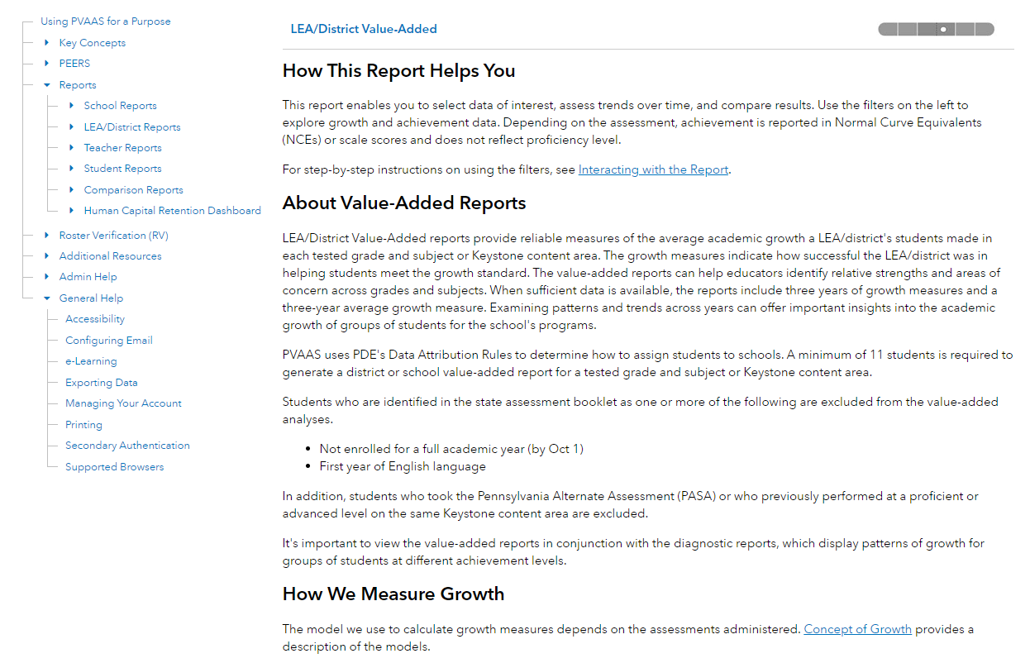
PVAAS
“Help”
Resources
Available on the public PVAAS website, pvaas.sas.com, under “Help”
Notes:
Please be aware that you can access PVAAS Help Menus if you need assistance with any report within the system.

Slide 35
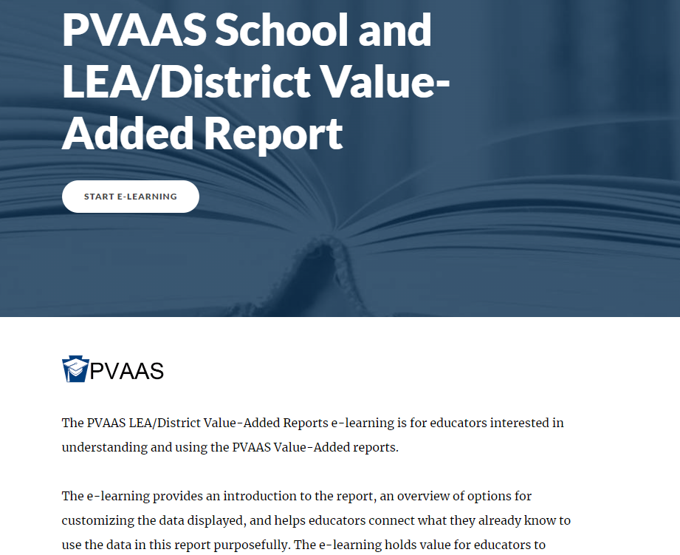
PVAAS e-Learning Modules
Available on the public PVAAS website, pvaas.sas.com, under “e-Learning”
Notes:
Please be aware that you can access PVAAS e-Learning Modules on various topics, as well.

Slide 36
PVAAS: Data for the Big Picture
Reports allow us to see high-level data trends:
Growth
Achievement
Over time (longitudinally)
All students
Highlights areas for further investigation!
Notes:
This slide helps frame how we can use PVAAS data at a high level to tell the story of what’s happening in our schools and where we may need to focus next. PVAAS doesn’t just give us isolated numbers—it helps us see trends that matter for planning, equity, and improvement.
Growth: One of the most powerful features of PVAAS is that it shows us student growth—not just where students are, but how far they’ve come. This is especially important when achievement alone doesn’t tell the whole story.
Achievement: We can also use the reports to look at how our students are performing against grade-level standards. When we pair this with growth data, we can identify where students are both excelling and where they need more targeted support.
Over time: PVAAS lets us look at patterns across years. Are we seeing consistent growth in a grade level or subject? Did a new initiative last year show an impact? This helps us reflect on what’s working and plan strategically over multiple years.
All students: We’re able to disaggregate the data by different groups—such as economically disadvantaged, English Learners, or students receiving special education services. This ensures we’re asking: Are all of our students growing? Are all of our students achieving? If not, we know where to look more closely.
This is one of the key takeaways: PVAAS helps us prioritize. Where we see concerning patterns—such as a cohort not meeting growth targets for multiple years—that’s a red flag for deeper analysis. It doesn’t give us all the answers, but it tells us where to look.

Slide 37
Turning Data Into Action
Identify areas of system strength and areas for improvement
Investigate growth and achievement reporting in PVAAS
Combine what we learn from PVAAS data sets with what we learn from local assessment data sets
Use the data to refine goal statements and action planning
Multiple data sets
make your analysis stronger!
Notes:
This slide is about moving from awareness to action. Once we have the big-picture trends from PVAAS, this is how we begin to use the data in practical ways—ways that inform our continuous improvement efforts, instructional priorities, and system-level decisions. Highlight future plans.

Slide 38
Thank you!
For more information, please contact:
[Add District PVAAS Point of Contact]
Notes:
[Customize with your district logo and contact information.]

