Slide 1
Getting Ready for the
Pennsylvania State Assessments
2023-2024

Slide 2
Agenda
  Contact Information
  Pennsylvania Alternate System of Assessment (PASA)
  Pennsylvania System of School Assessment (PSSA)
  Keystone Exams
  Accommodations
  English Learner Assessments

Slide 3
Contact Information
  Brian Truesdale, Chief, Division of Assessment and Accountability, btruesdale@pa.gov
  Dr. Megan Clementi, PSSA Mathematics, Keystone Algebra I, General Testing Questions, mclementi@pa.gov
  Dr. Beth Gannon, PSSA ELA, Keystone Literature, Accommodations, egannonrit@pa.gov
  Craig Weller, PSSA Science, Keystone Biology, crweller@pa.gov
  Lynda Lupp, Special Education Assessment Lead, llupp@pattan.net
  Lisa Hampe, Special Education Advisor, lihampe@pa.gov
  Drew Schuckman, NAEP, dschuckman@pa.gov
  Jay Gift, Testing Irregularities and General Testing Questions, rgift@pa.gov
  General PSSA and Keystone Exam Testing Questions, ra-ed-pssa-keystone@pa.gov
  Test Security/Irregularities, RA-edirregularities@pa.gov

Slide 4

PA Alternate System of Assessment
Dynamic Learning Maps
PASA DLM
Notes:
The PA Alternate System of Assessment (PASA) continues to use DLM (Dynamic Learning Maps) through the University of Kansas as the test and vendor. You will often hear the alternate test in PA referred to as the PASA DLM.

Slide 5

PASA DLM
Who Participates in the PASA DLM?
Only students with the most significant
cognitive disabilities who meet all six
of the state’s eligibility criteria.
Participation determination is made by the student’s IEP team.
ESSA regulations continue to stipulate no more than 1% of the total tested population should participate in the state alternate assessment.
PASA Eligibility Criteria
Notes:
Only students with the most significant cognitive disabilities who meet all six of the state’s eligibility criteria can participate in the PASA DLM. A link to the eligibility criteria is provided on this slide. The participation determination is made by the student’s IEP team. ESSA regulations continue to stipulate no more than 1% of an LEA’s total tested population should participate in the alternate assessment. Included here is a link to the six criteria that IEP Teams must adhere to when make assessment participation decisions.

Slide 6
PA 1% Compliance
PDE received a letter from USDE in October 2023 placing the state in ‘high risk’ status for continuing not to meet the 1% compliance federal regulation. A required improvement plan has been submitted.
PA has not been able to secure a state 1% waiver with USDE because the state also does not meet the federal requirement to assess at least 95% of all students and SWD.
LEAs who continue to exceed the 1% threshold can expect additional measures of oversight and monitoring by the BSE as required by the submitted improvement plan since PA is expected to not exceed 1% of students taking an alternate statewide assessment.
ESSA 1.0 Percent Threshold Justification Requirements (pa.gov)
Notes:
Pennsylvania has recently been placed on a ‘high risk’ status by the US Department of Education for failing to meet compliance with the regulation that stipulates no more than 1% of students can participate in an alternate state assessment. The state has not been able to gain a waiver for this requirement due to also not meeting the federal requirement to have at least 95% of students participate in statewide assessment overall. More information on 1% compliance can be accessed on the BSE web page provided on this slide.

Slide 7
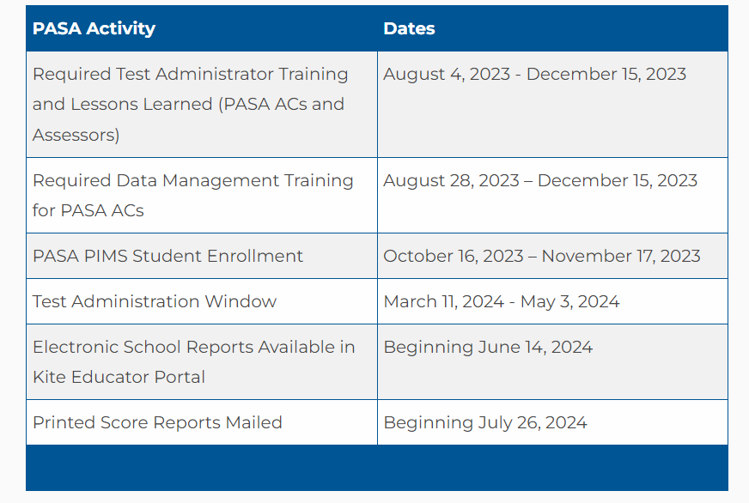
PASA DLM 2023-24 Important Dates
Parent Notification Letter for Year-End Model States (docx)
Parent Notification Letter (en Español) for Year-End Model States (docx)
2023-24 PASA DLM Instruction and Assessment Calendar (dynamiclearningmaps.org)
Notes:
Here is a snapshot of some important PASA DLM related dates. Refer to the full instruction and assessment calendar for full details. The link to the instruction and assessment calendar is provided on this slide. In addition, schools are encouraged to communicate with families about the PASA DLM testing window in a manner similar to what occurs for the PSSA and Keystone Exams. PASA DLM provides customizable, parent notification letters for school use.

Slide 8
PASA DLM Blueprints and Scoring
PASA DLM Blueprints
Blueprint for English Language Arts
Blueprint for Mathematics
Blueprint for Science
Score Report Information
  Sample score reports for ELA, Math, and Science
  Parent Interpretive Guide (English)
  Parent Interpretive Guide (en Espanol)
  Parent Cover Letter
          Talking with Parents About Score Reports
    Video About Score Reports
Notes:
This slide provides links to the PASA DLM blueprints for each tested subject. In addition, PASA DLM provides resources to support parents understanding of performance.

Slide 9
PASA DLM
Important Websites
PaTTAN PASA DLM Instruction and Assessment Resource Hub
  Provides all PA Alternate Assessment Team emails to PASA Assessment Coordinators, PA instruction and assessment calendar, and other resources
Pennsylvania DLM homepage
  Provides access to all PASA DLM specific information including link to manuals, calendar, score reports, instructional resources, and annual Required Test Administrator Training
BSE Assessment
  Provides PASA information including 1% threshold requirement information
Notes:
This slide provides important websites that house PASA related information.
The first is a PaTTAN hosted website. While it contains varied resources, Assessment Coordinators can find all AC communications housed here.
The next website is Pennsylvania’s DLM homepage that provides all assessment related information along with valuable instructional resources and professional development opportunities. It is also where ACs and test administrators login to complete assessment related tasks.
Finally, the BSE assessment webpage contains information alternate assessment dates and other information such as 1% participation requirements including threshold information.

Slide 10
PASA DLM-Assessment Coordinator (AC)
PASA Getting Ready is a required training for the Special Education Administrator serving as the PASA AC
2023-24 PASA Getting Ready: What Special Education Administrators Need to Know About PASA DLM Participation and 1% Compliance Requirements WebinarOpens In A New Window (YouTube)​
2023-24 PASA Getting Ready: What Special Education Administrators Need to Know About P​ASA DLM Participation and 1% Compliance Requirements​ (PDF)
Notes:
If you are viewing today’s training and you are also an assessment coordinator for the PASA, please see the links to the annual PASA Getting Ready webinar and PowerPoint presentation. This training is required for the special education administrator who serves as the PASA AC. The first link provides the presentation recording, and the second link provides the PowerPoint slide deck.

Slide 11
PASA DLM – Assessment Coordinator – Con’t
PASA DLM Contacts
TOPIC | NAME | EMAIL ADDRESS
PASA DLM General Questions and Accountability | Lisa Hampe Lisa Hauswirth Lynda Lupp | lihampe@pa.gov lhauswirth@pa.gov llupp@pattankop.net
PASA Enrollment and Data Management | PA Help Desk | alternateassessment@pattankop.net
ESSA: 1% Threshold Justification | Lisa Hampe Lisa Hauswirth | lihampe@pa.gov lhauswirth@pa.gov
PASA Eligibility, Test Irregularities, Test Security Violations | Lisa Hampe Lisa Hauswirth Lynda Lupp | lihampe@pa.gov lhauswirth@pa.gov llupp@pattankop.net
DLM Trainings, Resources, General PASA DLM Questions | Meredith Penner (East) Kim Jenkins (East) Tara Russo (Central) Kelley DesLauriers (West) | mpenner@pattankop.net kjenkins@pattankop.net trusso@pattan.net kdelauriers@pattanpgh.net alternateassessment@pattankop.net
Notes:
This slide provides contact information for the PA PASA team.

Slide 12
Pennsylvania System of School Assessment
PSSA

Slide 13
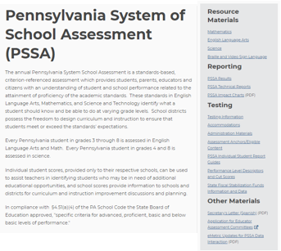
Pennsylvania System of School Assessment
Pennsylvania System of School Assessment (PSSA)

Slide 14
PSSA Resources and Tools
PSSA Testing Window
DRC eDIRECT
Assessment Anchors and Glossaries
Item and Scoring Samplers (Click subject under Resource Materials)
Performance Level Descriptors and Cut Scores
Technical Reports
Pennsylvania Standards Aligned System (SAS)
Classroom Diagnostic Tools (CDT)

Slide 15
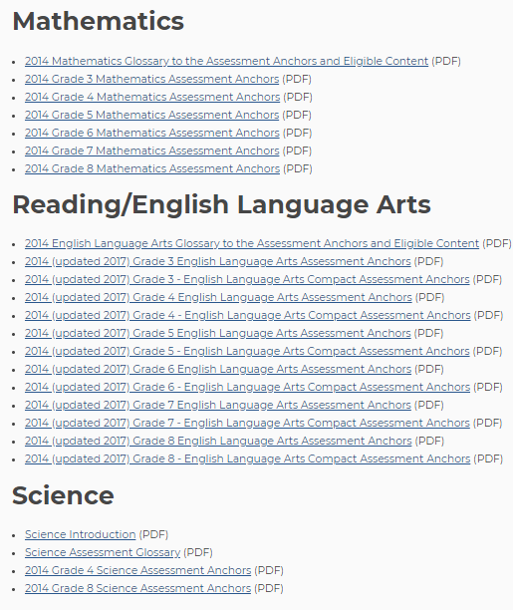
PSSA Assessment Anchors and Glossary
Assessment Anchors and Glossary

Slide 16
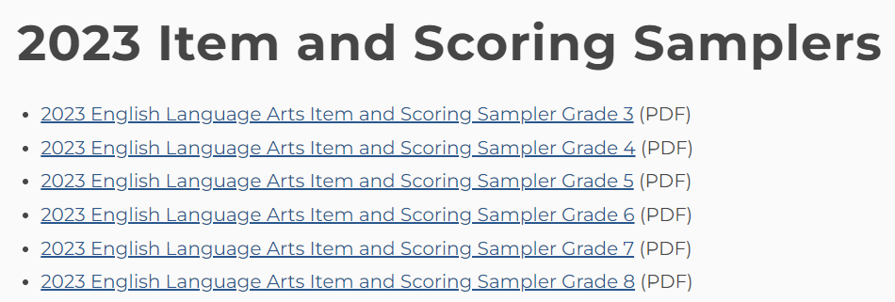
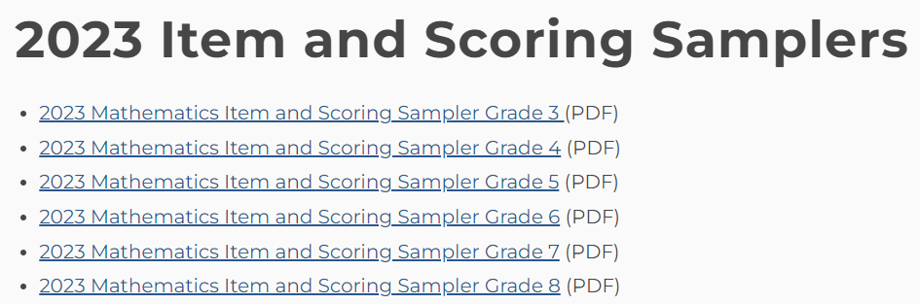
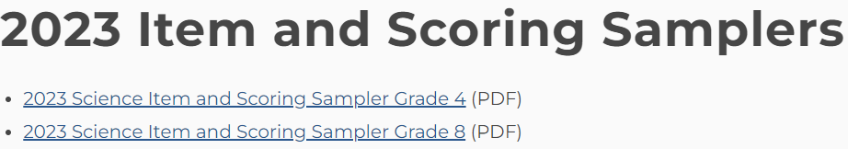
PSSA Item and Scoring Samplers
  English Language Arts
  Mathematics
  Science

Slide 17
PSSA ELA Resources and Tools
English Language Arts (ELA) Test Design
Scoring Guidelines
ELA Curriculum, Assessment, & Instruction (CAI) Community (SAS)
English Language Arts Resources
Pennsylvania State Literacy Plan (PaSLP) Toolkit
Text Dependent Analysis (TDA) Toolkit

Slide 18
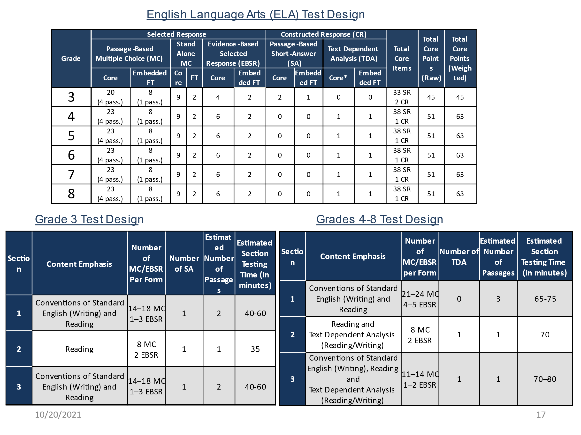
PSSA ELA Test Design
English Language Arts (ELA) Test Design

Slide 19
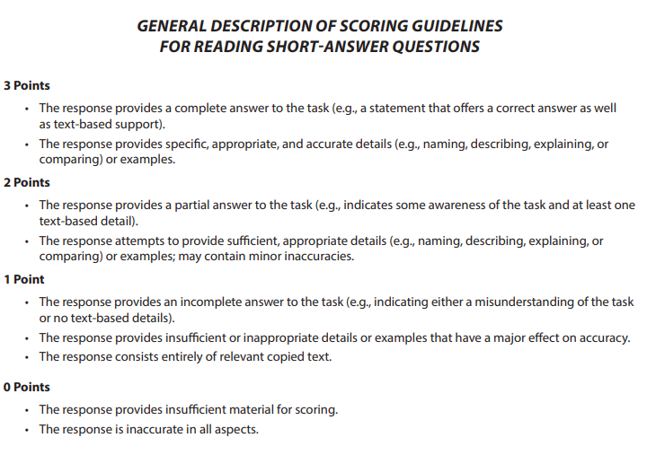
PSSA ELA Grade 3 Scoring Guidelines

Slide 20
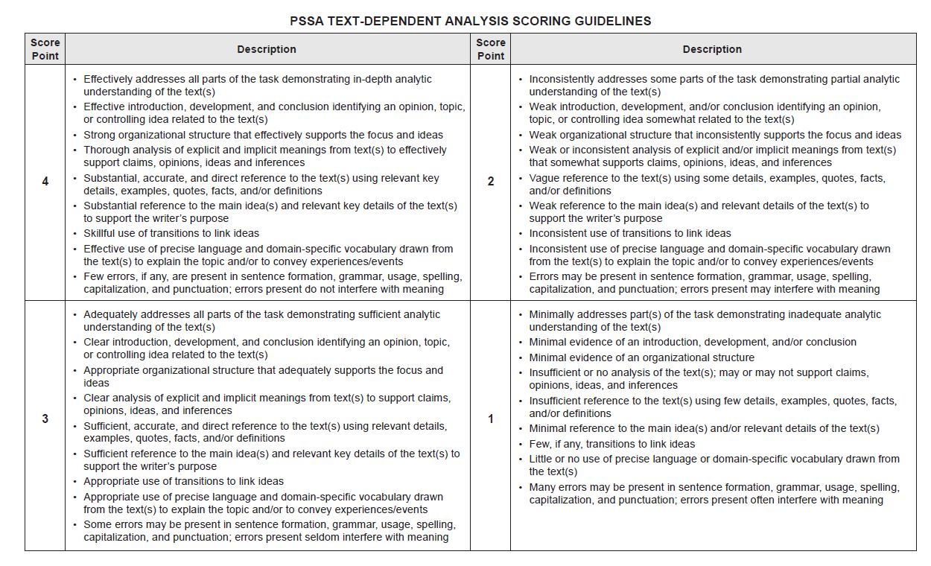
PSSA ELA TDA Scoring Guidelines

Slide 21
PSSA Mathematics Resources and Tools
Mathematics Test Design
Scoring Guidelines
Calculator Policy
Mathematics Resources
Mathematics Learning Community (SAS)

Slide 22
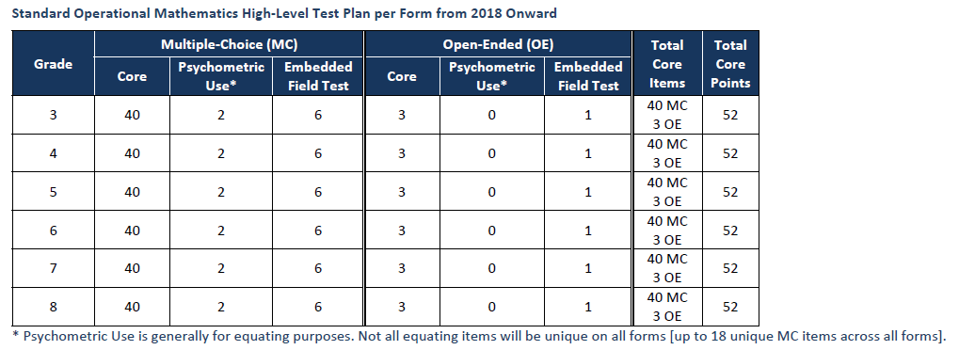
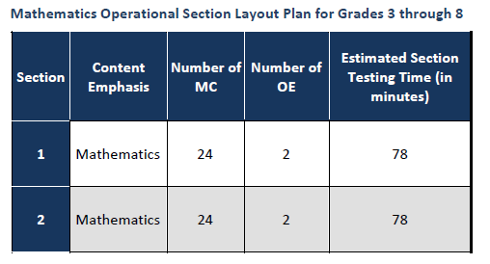
PSSA Mathematics Test Design
Mathematics Test Design

Slide 23
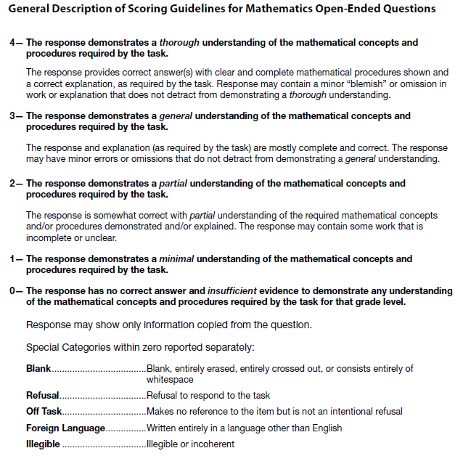
PSSA Mathematics Scoring Guidelines

Slide 24
PSSA Mathematics Tools
Rulers and Protractors
  Rulers are provided for grade 3 students. Rulers are scaled to the ⅛ inch and millimeter. Students will measure to the ¼ inch and centimeter.
  Protractors are provided for grade 4 students.
Calculators
  See attached Pennsylvania Calculator Policy
  Grade 3
    may not use calculators for any part of the test
  Grades 4 - 8
    may not use calculators during the non-calculator portion of the assessment

Slide 25
PSSA Science Resources and Tools
Science Test Design
Scoring Guidelines
Science Resources
Science Learning Community

Slide 26
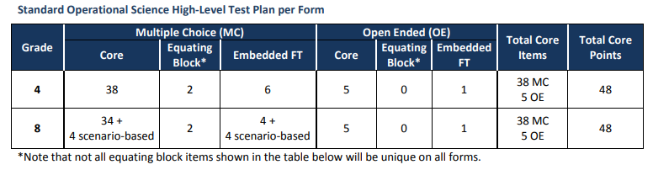
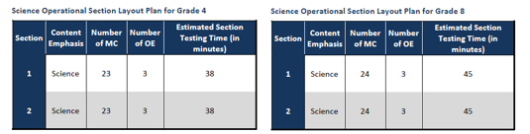
PSSA Science Test Design
Science Test Design

Slide 27
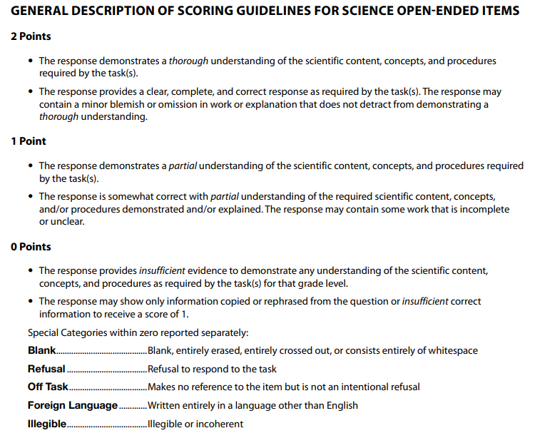
PSSA Science Scoring Guidelines

Slide 28
PSSA Science Tools and Scenarios
Calculators (Pennsylvania Calculator Policy)
Calculators are permitted though not required
Memory of the calculators must be cleared prior to assessment and after the assessment by TAs
Students may not share calculators during the assessment
Science Scenarios
Contains text, graphics, charts, and/or tables
Describes the results of a project, an experiment, or similar research to answer MC questions

Slide 29
Keystone Exams

Slide 30
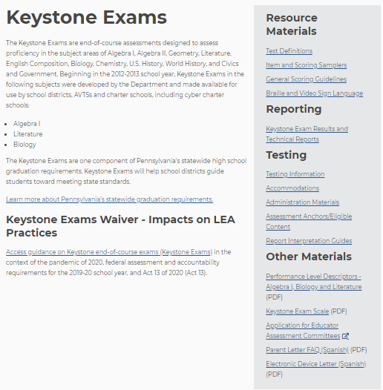
Keystone Exams 2
Keystone Exams

Slide 31
Keystone Exams Resources and Tools
Keystone Exams
Keystone Testing Window
Assessment Anchors/Eligible Content
Item and Scoring Samplers
Pennsylvania Standards Aligned System (SAS)

Slide 32
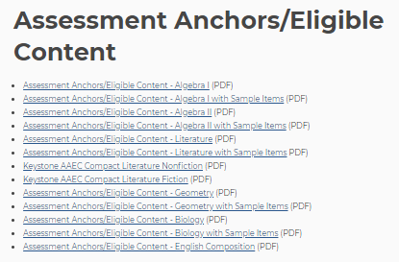
Keystone Exams Assessment Anchors and Glossary
Assessment Anchors and Glossary

Slide 33
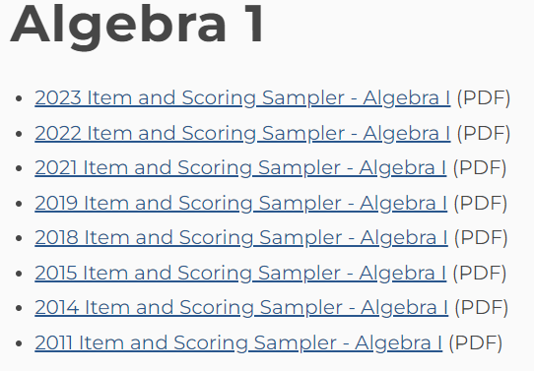
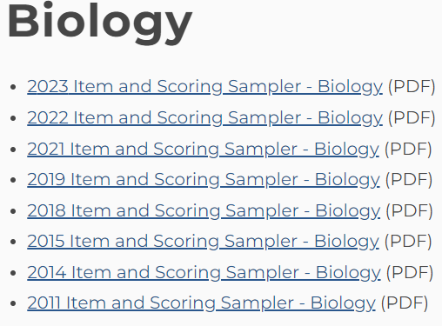
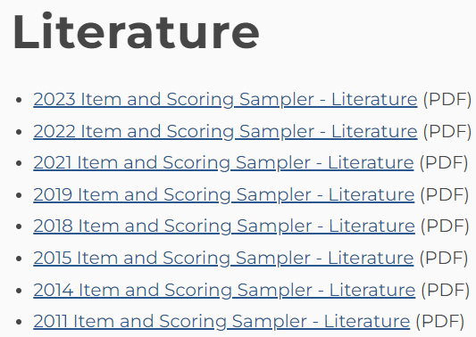
Keystone Exams Item and Scoring Samplers
Item and Scoring Samplers

Slide 34
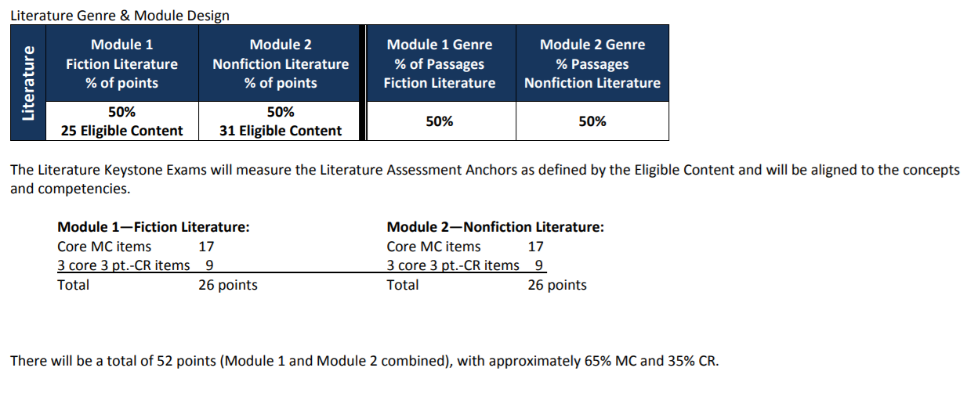
Keystone Literature Test Definition
Keystone Literature Test Definition

Slide 35
Keystone Literature Resources and Tools
Keystone Literature Test Definition
Literature Constructed-Response Scoring Guidelines
ELA Curriculum, Assessment, & Instruction (CAI) Community
English Language Arts Resources
Pennsylvania State Literacy Plan (PaSLP) Toolkit
Text Dependent Analysis (TDA) Toolkit

Slide 36
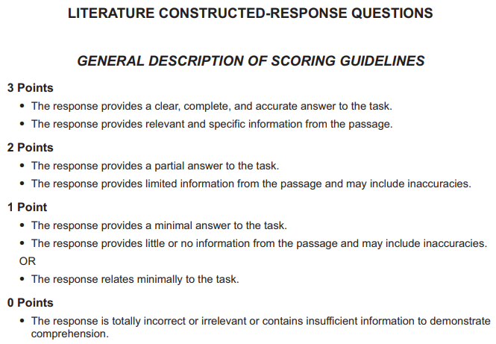
Keystone Literature Scoring Guidelines

Slide 37
Keystone Algebra I Resources and Tools
Keystone Algebra I Test Definition
Algebra I Constructed-Response Scoring Guidelines
Calculator Policy
Mathematics Resources
Mathematics Learning Community

Slide 38
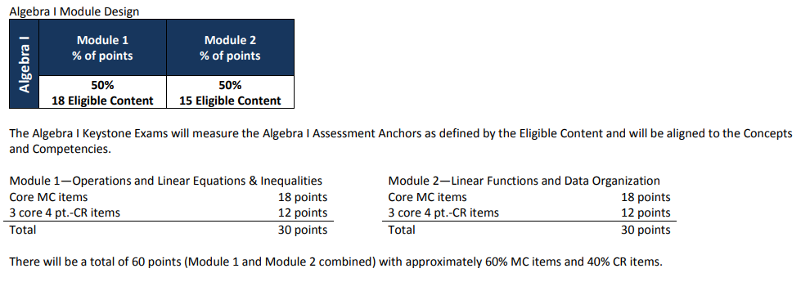
Keystone Algebra I Test Definition
Keystone Algebra I Test Definition

Slide 39
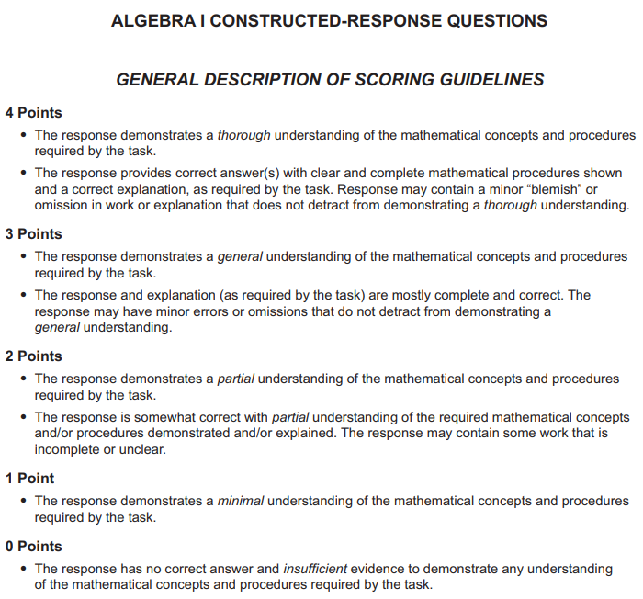
Keystone Algebra I Scoring Guidelines

Slide 40
Keystone Biology Resources and Tools
Keystone Biology Test Definition
Biology Constructed-Response Scoring Guidelines
Science Resources
Science Learning Community

Slide 41
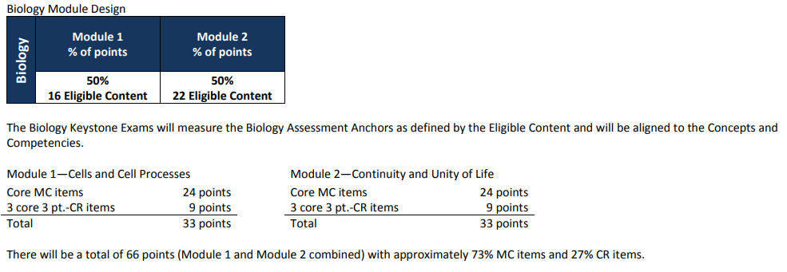
Keystone Biology Test Definition
Keystone Biology Test Definition

Slide 42
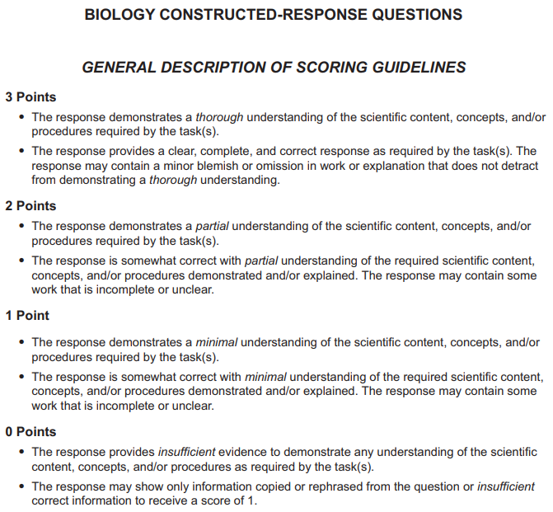
Keystone Biology Scoring Guidelines

Slide 43
Accommodations
  Accommodations Webpage
Accommodations PowerPoint
Webinar Link
Accommodations Guidelines
Accommodations Guidelines for ELs
Read Aloud and Scribing Guidelines
Supplemental Guidelines for ASL in VSL
Unique Accommodations Assurance Form
Confidentiality Form

Slide 44
English Learner Assessments
Academic Assessments
  ELs in their first total 12 months of enrollment in U.S. schools are not required to take the ELA PSSA or Literature Keystone Exam
  ELs who meet the eligibility criteria to take the PASA follow the same requirements for Mathematics, Algebra I, Science, and Biology.
  For more information on EL participation in state assessments, please see the current Accommodations Guidelines for ELs
English Language Proficiency Assessment
  All ELs, K-12, are required to take the ACCESS for ELLs® English Language Proficiency Test
  ELs who meet the eligibility criteria to take the PASA participate in the Alternate ACCESS for ELLs®

Slide 45
English Learner Accommodations
    Word-to-word translation dictionaries, without definitions and without pictures may be used for PSSA Mathematics, Keystone Algebra I, PSSA Science, and Keystone Biology; not for any part of the PSSA ELA or Keystone Literature
    Qualified interpreters/sight translators for PSSA Mathematics, Keystone Algebra I, PSSA Science, and Keystone Biology; not for any part of the PSSA ELA test (except for the TDA prompts) or Keystone Literature
    Spanish versions PSSA Mathematics, Keystone Algebra I, PSSA Science, and Keystone Biology

Slide 46
Getting Ready: 2023-2024
For more information on Getting Ready for the 2023-24
State Assessments please visit
PDE’s Assessment and Accountability webpages.
The mission of the department is to academically prepare children and adults to succeed as productive citizens. The department seeks to ensure that the technical support, resources and opportunities are in place for all students, whether children or adults, to receive a high-quality education.

