Slide 1
What IEP Teams Must Consider When Determining Alternate State Assessment Participation
Using the PASA Eligibility Criteria: Decision Making Companion Tool
Notes:
Participation in state assessments is a Federal requirement for all students and no more than 1% of students with disabilities can participate in an alternate assessment known in Pennsylvania as the PASA DLM. IEP Teams must understand Pennsylvania’s 6 PASA Eligibility Criteria and what data, documentation and considerations should be reviewed.

Slide 2
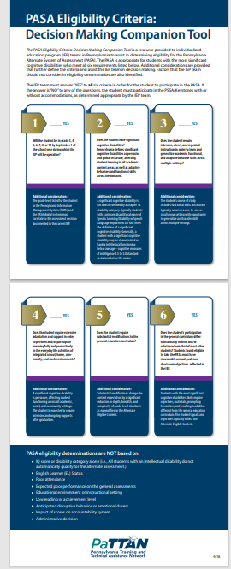
Who is Eligible for the PASA DLM (Pennsylvania Alternate System of Assessment Dynamic Learning Maps)?
PASA Eligibility Criteria: Decision Making Companion Tool is the resource IEP teams are required to use when determining eligibility for participation in the PASA.
Notes:
Pennsylvania’s 6 criteria and decision-making tool are not new in PA.
IEP teams should download the PASA Eligibility Criteria: Decision Making Companion Tool.
For a student to be found as having the most significant cognitive disability and eligible for the alternate assessment in PA, each of the six (6) PASA Eligibility Criteria must be true as determined by the student’s IEP team using data and documentation. In other words, there need to be 6 – YES responses to all 6 criteria.
Let’s review each criteria…

Slide 3
Criteria #1
Will the student be in grade 3, 4, 5, 6, 7, 8, or 11 by September 1 of the school year during which the IEP will be operative?
ELA Grades 3-8 and 11
Math Grades 3-8 and 11
Science Grades 5 (*new 2025), 8, 11
Notes:
Criteria 1 asks the IEP team if the student will be in a tested grade level within the duration of this IEP?
ELA and Math are tested in grades 3-8 and 11
Science is tested in 5, 8, 11 (New for 2025: Science is tested in grade 5 instead of grade 4)
Check the accuracy of the reported grade level in all student information systems including PIMS and demographic data listed on the IEP.
Prior PASA eligibility is not part of the eligibility consideration since each of the 6 eligibility criteria must be reviewed annually by the IEP team.

Slide 4
Criteria #2
Does the student have significant cognitive disabilities? Pennsylvania defines significant cognitive disabilities as pervasive and global in nature, affecting student learning in all academic content areas, as well as adaptive behaviors and functional skills across life domains.
Most significant cognitive disability
IQ is typically 2.5 or more standard deviations below the mean (i.e., 63 or lower)
Chapter 14 primary disability of SLD, ED, SI likely do not meet the definition
OHI should be reviewed with caution
Notes:
Criteria #2 asks if the student has ‘Significant Cognitive Disabilities’ or we often say the most significant cognitive disability. Pennsylvania defines significant cognitive disabilities as pervasive and global in nature, affecting student learning in all academic content areas, as well as adaptive behaviors and functional skills across life domains. The term most significant cognitive disability does not directly correlate with a disability category. Rather, it’s a term associated with alternate assessment participation.
Evidence you may expect to see in a student with the most significant cognitive disability eligible for the PASA would include an IQ score of 2.5 or more standard deviations below the mean, which is an IQ of 63 or lower.
Students with a chapter 14 primary disability of Specific Learning Disability, Emotional Disturbance or Speech only do not by definition have a significant cognitive disability.
Students with a primary disability of Other Health Impairment or OHI should be reviewed with caution since this disability encompasses such a wide range of functioning.

Slide 5
Criteria #3
Does the student require intensive, direct, and repeated instruction in order to learn and generalize academic, functional, and adaptive behavior skills across multiple settings?
Adaptive Behavior Deficits
Scores in lowest reported range in multiple or all measured areas
IEP goals devoted to adaptive behavior
Independent living goal if transition age
Notes:
Criteria 3 asks IEP Teams if the student requires intensive, direct, and repeated instruction to learn and generalize academic, functional, and adaptative behavior skills across multiple settings.
Adaptive behavior is the collection of conceptual, social, and practical skills that all people learn in order to function in their daily lives. The student’s evaluation report should include scores in the lowest reporting range in multiple areas of adaptative behavior scales or measures.
The IEP team should discuss if the student has IEP goals devoted to adaptive behavior skills such as feeding, toileting, self-help, etc.
Also, if the student is of transition age, review if the transition plan in the IEP includes an independent living goal as part of the determination for criteria 3.

Slide 6
Criteria #4
Does the student require extensive adaptation and support in order to perform and/or participate meaningfully and productively in the everyday life activities of integrated school, home, community, and work environments?
Extensive Support
Related services (OT, PT, Speech, Augmentative Communication)
Stay in school through age 21
Graduate based upon IEP goals
Intensive agency support after graduation
Notes:
Criteria 4 asks IEP teams if the student requires extensive adaptation and support to perform and or participate meaningfully and productively in the everyday life activities of integrated school, home, community and work environments.
An IEP team can look for evidence in the IEP including, but not limited to:
Related services in school (OT, PT, Speech)
Specially designed instruction outlining access for the student to participate meaningfully and productively in everyday life activities
Use of assistive technology such as Augmentative Communication
Whether the student is expected to stay in a school aged program through age 21 and graduate based upon IEP goals and objectives
AND Intensive agency support is in place beyond school aged eligibility in the form of supports coordination for example.

Slide 7
Criteria #5
Does the student require substantial modifications to the general education curriculum?
Substantial Modifications
Instruction aligned to DLM Essential Elements
May require tactile materials, objects, assistive technology
Alternate local assessment
Notes:
Criteria 5 asks IEP teams if the student requires substantial modifications to the general education curriculum. Substantial modifications change the content expectation by a significant reduction in depth, breadth, and complexity of grade-level standards
IEP teams may locate documentation to respond to criteria 5 in the student’s IEP Section VI Specially Designed Instruction and Section VII Educational Placement Questions for the IEP Team
Consider whether the student has instruction aligned to the Dynamic Learning Maps Essential Elements
Students eligible for the PASA DLM may require tactile materials, assistive technology, or objects to learn and/or respond to instructional tasks
Consider whether the student takes an alternate local assessment
A student may be educated in a regular education classroom, however, the student eligible for the PASA DLM would be instructed using substantial adaptations or modifications to the general education curriculum. Educational environment is not the sole determination of PASA eligibility.

Slide 8
Criteria #6
Does the student’s participation in the general curriculum differ substantially in form and/or substance from that of most other students? Students found eligible to take the PASA must have measurable annual goals and short-term objectives reflected in the IEP.
#6
Curriculum substantially differs
Short-term objectives for every IEP goal
ULS (Unique Learning Systems) or other modified/alternate curricular materials are used
Does not equate to participation in the general education classroom
Notes:
Criteria 6 asks if the student’s participation in the general curriculum differs substantially in form and/or substance from that of most other students.
These students have short-term objectives for every goal in the IEP.
Modified or alternate materials are used to teach the student, such as unique learning systems.
Remember, participation in the general education curriculum does not equate to participation in the general education classroom.

Slide 9
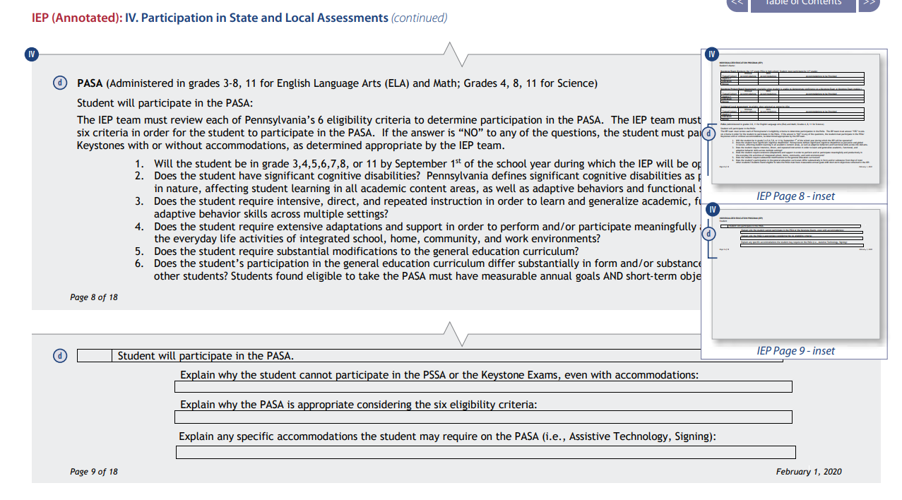
Annotated IEP
Individualized Education Program (IEP) (Annotated) (pattan.net)
Notes:
The annotated IEP linked here lists the 6 eligibility criteria for PASA participation. You would expect to see the analysis of the data discussed by the IEP team for each of the 6 criteria in the “Explain why the PASA is appropriate considering the six eligibility criteria” field when the IEP team answers YES to each criteria.

Slide 10
Bureau of Special Education
Assessments (pa.gov)
Notes:
For more information on the PASA and related resources, visit the link provided on this slide.

