Slide 1
EMERGENCY PERMITS
Division of Certification Services
Bureau of School Leadership
& Teacher Quality
Notes:
Revised 2017-06

Slide 2
UPDATED RESOURCES
Website changes and updates
User Guides for Applicant and LEA
Recorded Webinar

Slide 3
EMERGENCY PERMITS
CSPG 13: Emergency Permits NEW! 2/18
CSPG 14: Act 97 Waiver of Certification
CSPG 25: Vocational Emergency Permit NEW! 4/18

Slide 4
Emergency Permits are issued to the requesting school entity – not the candidate. Permits are not transferrable between school entities.

Slide 5
Three-Step Application
1. The applicant submits a permit request via the Teacher Information Management System (TIMS) at the request of an employing school entity.
2. The school entity selects the type of permit and subject area(s). The entity selects the date, method of payment, and submits the application.
3. The applicant or the school submits the required documents along with the TIMS cover sheet.

Slide 6
Documentation Submitted to PDE
Professional license copy:
School nurse
Dental hygienist
Vocational subject areas designated in CSPG 25
Official Transcripts to ra-TeacherCert@pa.gov
All initial permits except school nurse, dental hygienist, and PA certified educators
Certain Vocational subject areas per CSPG 25
Every long-term substitute with educational obligation (type 01) reissuances

Slide 7
Non-US Citizen/Foreign Educated
Permanent Resident Visa – green card (photocopy of front and back)
Signed Declaration of Intent
Foreign bachelor’s equivalency submitted on foreign evaluation report (original or notarized photocopy)
* See CSPG 5 for details

Slide 8
Emergency Permits in TIMS
Teacher Information Management System

Slide 9
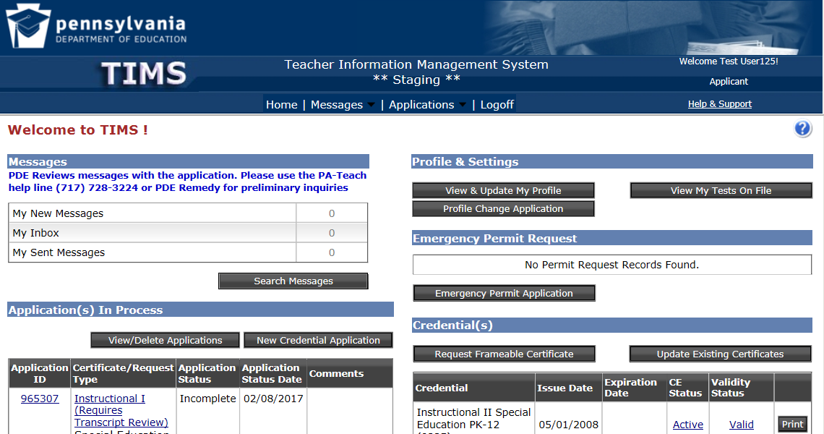
Educator’s View in TIMS
“Emergency Permit Application”

Slide 10
Educator’s Application Steps
Demographic Details
Certification Details (In- and Out-of-State)
Affiliation Details: Must “Add New Affiliations” if your LEA is not listed
LEA Selection
Background Questions
GMC
Code of Conduct
Affidavit

Slide 11
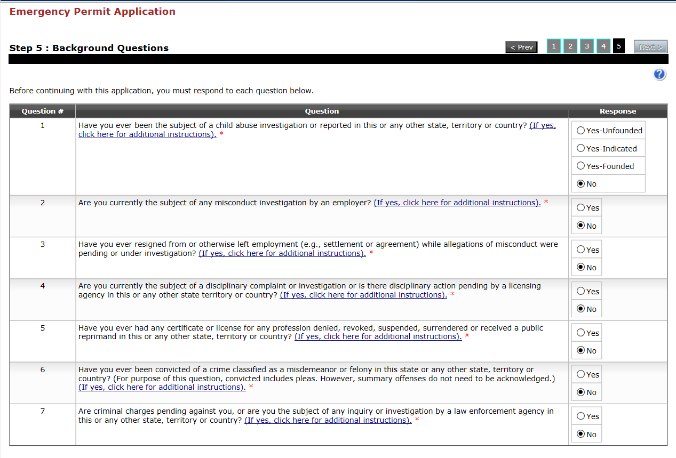
Background Questions
Each question includes a link with detailed information regarding submission requirements if the answer is other than “No.”

Slide 12
Affidavit

Slide 13
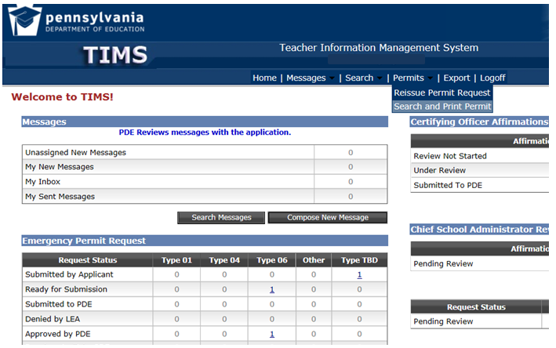
LEA Permits Options
Permits Menu Options:
Reissue Permits from a prior year
Search and Print Permits
Automatic Reissues require 338G form for background questions

Slide 14
LEA View in TIMS
The Certifying Officer and Chief School Administrator share the same dashboard.
Sections are visible, but inactive, until you log in under the desired role.

Slide 15
Search Permit Request in TIMS

Slide 16
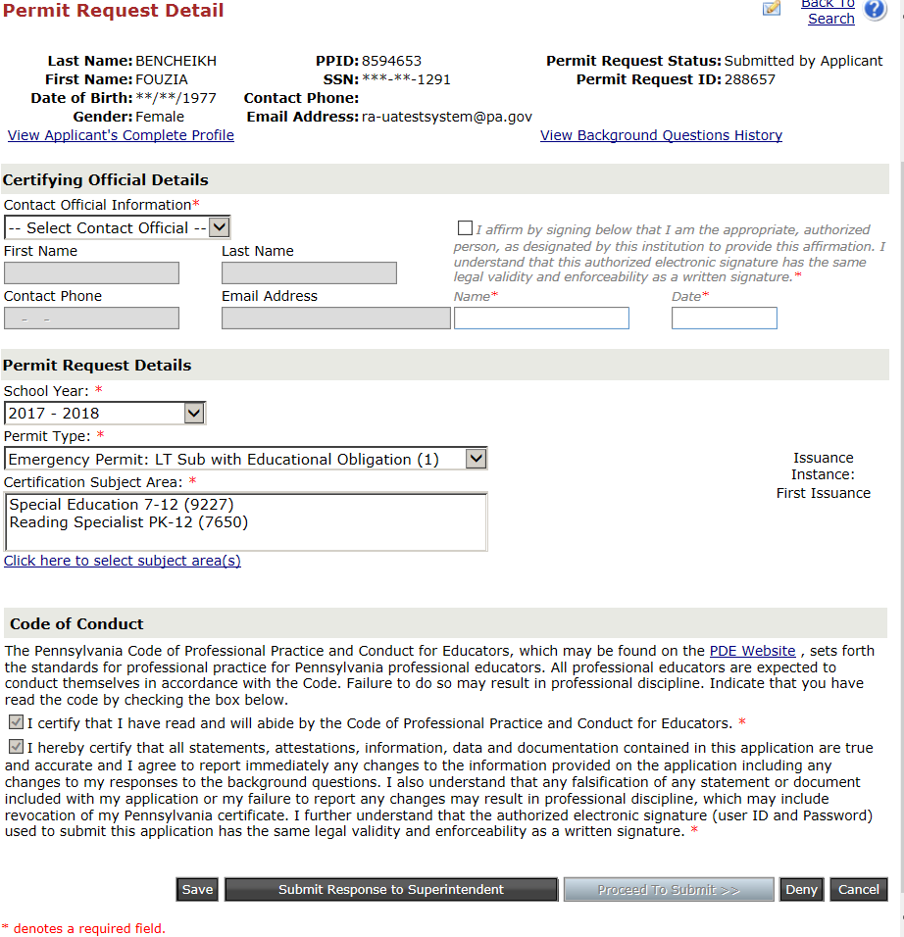
Permit Request Details

Slide 17
Type 04 Requests
Requested for position when LEA is not anticipating future employment for the position. Examples:
Temporary coverage (sabbatical, medical)
Coverage while recruiting
Coverage for position that will be eliminated
Can be issued twice for the same subject area.

Slide 18
Type 01 Requests
Requested for position when LEA anticipates future employment for the position. Examples:
New Position
Resignation
Termination
Retirement
Death

Slide 19
First Type 01 Re-issuance
New education tier:
August 1-November 30 = 6 program credits
December 1-March 31 = 3 program credits
April 1-July 31 = proof of program enrollment

Slide 20
Second Type 01 Re-issuance
Second and all subsequent reissuances require:
9 program credits
A permit may be reissued one time after the program is completed for testing purposes IF the tests have been attempted in the previous year. The LEA must alert PDE that the permit is being requested based on testing.

Slide 21
Education Obligation
It is the school district’s responsibility to discuss education obligation with the position candidate.
Refer position candidate to CSPG 13 for complete information.

Slide 22
Type 06 Substitute Audit
Audit requires an official transcript verifying the Bachelor’s degree if the substitute does not hold a PA certificate.
* Remember, a transcript is not on file for those holding 06 permits unless they were audited in the past.

Slide 23
Guest Teacher Permits
Day-to-day substitute permits may be requested by the LEA responsible for the guest teacher program.
* This does NOT apply to long term substitutes.

Slide 24
Private Provider Reminders
Each LEA is responsible for the substitutes working with its students
Only LEAs may request emergency permits.
Please check to make sure your private provider substitutes:
Have active and valid certificates or you have requested an emergency permit; and
Provide original transcripts for your personnel folders.

Slide 25
Locally Issued Day-to-Day Substitute
Issued by Chief School Administrator
Active PA Certificate or comparable out of state certificate
Teacher Preparation Program Completers
Prospective Teacher Substitutes

Slide 26
EXPEDITES
PDE asks that the schools do not exercise their privilege to expedite for emergency permit applications. Emergency permit applications are already given priority over every other application type. All schools’ permit requests are based on an emergency situation and should be taken by date received in order to be fair to all.

Slide 27
Correcting Educator Mistakes
DENY applications when the:
Educator applies multiple times
Educator is not needed
There is no penalty for the educator when you deny an application. Your denial is a deletion that PDE never sees.

Slide 28
Emergency Permit Tips
You may request emergency permits for the current school year at any time.
You must carefully check each application and select the desired school year on the Permit Request Details screen when the displayed year is incorrect.
Permit applications for the next school year can be submitted beginning July 1.
After the year is advanced you may select the previous school year on the Search Permit Request screen if you need to request permits for summer school.
You may enter multiple subjects* on a long-term permit
*The content subject must be included on special education type 01 permits if the educator does not hold the pre-requisite certificate.

Slide 29
Questions?
For more information on Certification please visit PDE’s website at www.education.pa.gov
The mission of the department is to academically prepare children and adults to succeed as productive citizens. The department seeks to ensure that the technical support, resources and opportunities are in place for all students, whether children or adults, to receive a high quality education.

