Slide 1
Assessment Test Session Fields
Changes to the creation of test sessions for PSSA and Keystone Assessments
Notes:
Welcome to today’s webinar! We will be discussing the changes in the test sessions for PSSA and Keystone assessments.

Slide 2
Test Session Information
Goals for today:
  Review the new Test Session Name fields on the Student template.
  Go over the changes related to the fields.
  Discuss when test sessions will be created.
  Look at the reports affected.

Slide 3
Test Session Webinar
Changes for 2026-27 School Year:
  The Homeroom field (field 13) will not be used for Test Session creation.
  Three new fields have been created specifically for naming the assessment test sessions.
  Winter Keystone Assessment will be online.
Notes:
The new fields are on the Student Template

Slide 4
What Is Not Changing
Test session files will still be sent to the testing vendor for PSSA and Keystones.
Separate Student files will also still be sent.
PIMS test session names can be updated.
Still have the option to not have test session created for Keystone assessments.
Test sessions can still be changed, deleted, edited, created within the testing vendor’s system.

Slide 5
New Test Session Fields
Three new fields were added to the Student Template:
Field 228 – ELA Assessment Test Session Name
Field 229 – Math Assessment Test Session Name
Field 230 – Science Assessment Test Session Name
(Page 181, 182 in PIMS Manual Vol. 1)

Slide 6
Test Session Specifics
Each field is a 20-character alpha numeric field.
Special characters allowed: / ( ) . - _
Spaces are allowed between words
They are updateable
They will be used for both PSSA and Keystone assessments
The fields are Conditionally Required

Slide 7
Connect to Test Session Fields
The Test Session fields are used in conjunction with:
Field 212 – PSSA/PASA Assessment
Field 214 – Keystone Winter Assessment
Field 215 – Keystone Spring Assessment
Field 216 – Keystone Summer Assessment

Slide 8
Conditionally Required
If field 212 – PSSA/PASA Assessment = “B”, then the Assessment Test Session Name field will be required.
If field 214-216 – Keystone Assessment = “1-7”, then the Assessment Test Session Name field will be required.

Slide 9
PSSA Test Session
  When field 212 = “B”, then the student’s grade is checked.
  For students in grades 3, 4, 6, 7 then the following are required:
      Field 228 – ELA Assessment Test Session Name field
      Field 229 – Math Assessment Test Session Name field
  For students in grades 5, 8 then the following are required:
      Field 228 – ELA Assessment Test Session Name field
      Field 229 – Math Assessment Test Session Name field
      Field 230 – Science Assessment Test Session Name field

Slide 10
PSSA Example
Student in the 4th grade, with a “B” in field 212.
Then the following fields are required:
  Field 228: ELA Assessment Test Session Name
  Field 229: Math Assessment Test Session Name
  * Different information can be in each test session field.

Slide 11
PSSA Coding
Coding students in Field 212 with “I” – not participating:
  Students grades 3-8 with an “I” in field 212 will still be sent to the testing vendor.
  The Test Session Name fields would not be required.
  The PSSA Assessment Subgroup ACS – Precodes will count both students coded with “B” and “I” in field 212.
Notes:
Students with a “I” will still be sent to testing vendor.
Go over the possibility of PSSA with an “I”, not creating test sessions, but will still send information.

Slide 12
PSSA Coding 2
Coding students in Field 212 with “A” – PASA.
  Students grades 3-8 with an “A” in field 212 will not be sent to the testing vendor.
  Will not require test session names.

Slide 13
PSSA Test Session File
Test Session Files - PSSA
  PSSA Test Sessions – All Students in grades 3-8
  Sent after an internal snapshot:
    PSSA Test Sessions on March 17, 2027.

Slide 14
Keystone Test Session
If fields 214-216 are populated with (1-7):
Values:
1 – KALG - Math Assessment Test Session Name
2 – KBIO – Science Assessment Test Session Name
3 – KALG & KBIO – Math AND Science Assessment Test Session Name
4 – KLIT – ELA Assessment Test Session Name
5 – KALG & KLIT – Math AND ELA Assessment Test Session Name
6 – KBIO & KLIT – Science AND ELA Assessment Test Session Name
7 – KALG, KBIO, KLIT – Math, Science AND ELA Assessment Test Session Name

Slide 15
Keystone Field Information
If fields 214-216 are populated with “0”:
No test sessions will be required or sent
Test sessions will need to be created in the testing vendor’s site.

Slide 16
Keystone Example
Student is in 10th grade with a “3” in field 215 (Spring Keystones)
Then the following will be required:
  Field 229: Math Assessment Test Session Name
  Field 230: Science Assessment Test Session Name
  * Different information can be in each test session field.

Slide 17
Keystone Test Session File
Students grades 3-12 with (1-7) in fields 214-216
Test Session Snapshot Dates:
  Winter: October 27, 2026
  Spring: April 7, 2027
  Summer: May 27, 2027

Slide 18
Test Session Administrations
Please work with your Assessment Coordinator.
  Either in PIMS or at the testing vendor, sessions need to be created.
Consider after each assessment, the test session may be updated.
  Example: Student taking Winter and Spring Keystone.
  Example: Student taking PSSA and Keystone.

Slide 19
Does Not Affect
The use or nonuse of test sessions does not affect:
  Participation counts
  Accountability
  Reporting
  Most ACS’s
    Difference between PSSA and Keystone Test Session (precode) ACS

Slide 20
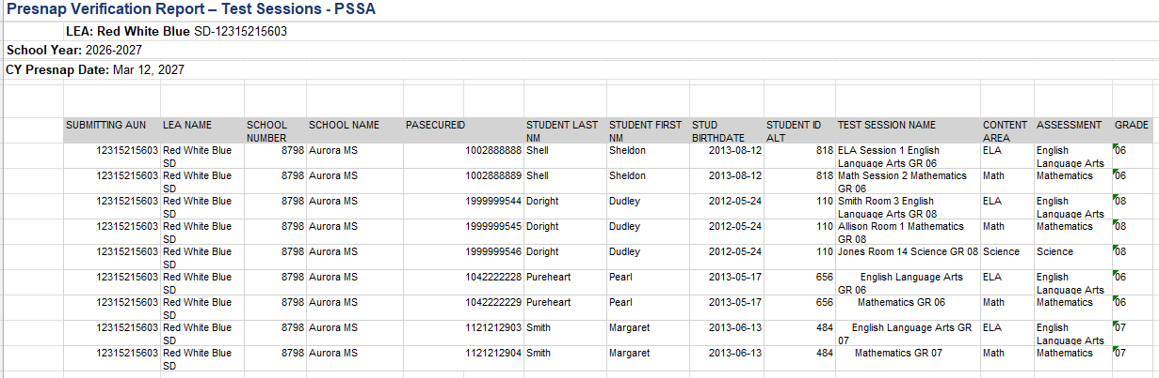
Report Information (Presnap)
V2 Report - Student > Internal Snapshots > Presnap > Keystone/PSSA - Presnap Verification Report – Test Session PSSA
Notes:
Report parameters
Valid school enrollment on the selected date
Grad Status not S or J – from Appendix AL – S – Grads between dates of July 1 and Sept 30, J – Incorrectly reported, but cannot be deleted
Grades 3 – 8
Special Education field is NOT Y
PSSA/PASA Assessment field is not A
Highlighted portion in red is the Test Session Name
The circled yellow is the name of the test session from what was in Student template field 13 – homeroom field.
The test sessions can be edited, changed, overwritten within DRC’s eDirect system.

Slide 21
Report Breakout 1
  This student in sixth grade is coded in field 212 with “B”.
  Test Session Names: ELA Session 1, Math Session 2
  Test Session Name field includes Test Session Name, Assessment, grade
Notes:
Report parameters
Valid school enrollment on the selected date
Grad Status not S or J – from Appendix AL – S – Grads between dates of July 1 and Sept 30, J – Incorrectly reported, but cannot be deleted
Grades 3 – 8
Special Education field is NOT Y
PSSA/PASA Assessment field is not A
Highlighted portion in red is the Test Session Name
The circled yellow is the name of the test session from what was in Student template field 13 – homeroom field.
The test sessions can be edited, changed, overwritten within DRC’s eDirect system.

Slide 22
Report Breakout 2
  This student in eighth grade is coded in field 212 with “B”.
  Test Session Names: Smith Room 3, Allison Room 1, Jones Room 14
  Test Session Name field includes Test Session Name, Assessment, grade
Notes:
Report parameters
Valid school enrollment on the selected date
Grad Status not S or J – from Appendix AL – S – Grads between dates of July 1 and Sept 30, J – Incorrectly reported, but cannot be deleted
Grades 3 – 8
Special Education field is NOT Y
PSSA/PASA Assessment field is not A
Highlighted portion in red is the Test Session Name
The circled yellow is the name of the test session from what was in Student template field 13 – homeroom field.
The test sessions can be edited, changed, overwritten within DRC’s eDirect system.

Slide 23
Report Breakout 3
  This student in seventh grade is coded in field 212 with “I”.
  Test Session Names are not required and space for the Test Session Name is blank
  Test Session Name field includes Test Session Name (blank), Assessment, grade
Notes:
Report parameters
Valid school enrollment on the selected date
Grad Status not S or J – from Appendix AL – S – Grads between dates of July 1 and Sept 30, J – Incorrectly reported, but cannot be deleted
Grades 3 – 8
Special Education field is NOT Y
PSSA/PASA Assessment field is not A
Highlighted portion in red is the Test Session Name
The circled yellow is the name of the test session from what was in Student template field 13 – homeroom field.
The test sessions can be edited, changed, overwritten within DRC’s eDirect system.

Slide 24
Post Snapshot Report
V2 Report - Student > Internal Snapshots > Snapshot > Keystone > PSSA – PSSA Test Session Verification

Slide 25
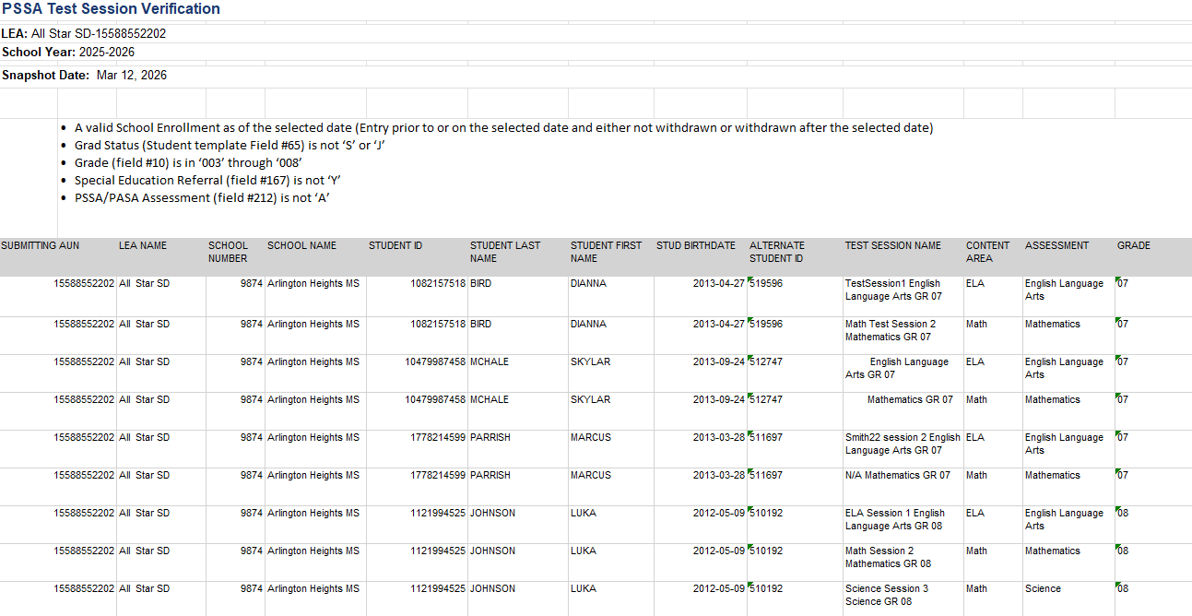
Report Example
Notes:
Check on how report will display – if it will be complete with PSSA B and I from 212

Slide 26
Keystone Test Session Files
Test Session Files - Keystones
  Depends on value in the Keystone Assessment fields (214, 215, 216) on the Student template.
  Sent after an internal snapshot
  Purpose: Give the option to have test sessions created in PIMS for test takers.
Notes:
The value in fields 214-216 – depending on the assessment will determine if a test session or how many test sessions are created.
A value of 0 does not create any test sessions
The test session name is based on what is in field 13 – homeroom field
The homeroom field is an updateable field, meaning it can be changed before and after snapshots if you want to name a specific test session and then return the field to the home room number/name
As with PSSA, the test sessions can be updated, edited, deleted, overwritten in eDirect.

Slide 27
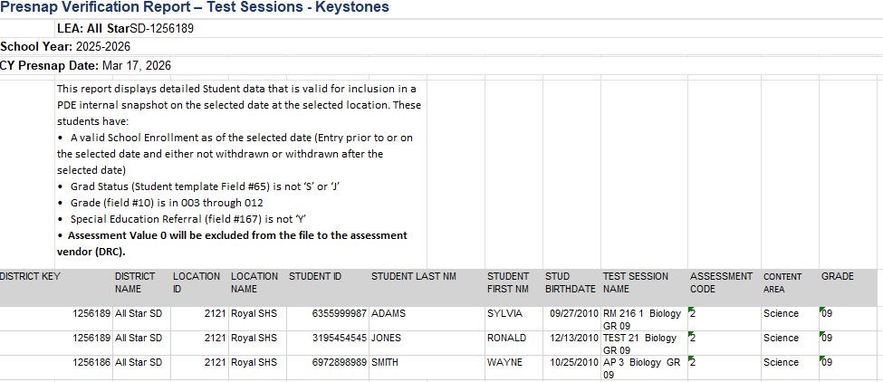
Keystone Presnap Test Session
V2 Report – Student > Internal Snapshots > Presnap > Keystone/PSSA - Presnap Verification Report Test Sessions Keystones
Notes:
Report Parameters:
Valid school enrollment
Grad Status not S or J
Grade 3-12
Special Education field is NOT Y
Assessment Value ‘0’ excluded
Same information as in the PSSA test session report

Slide 28
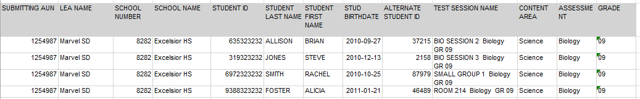
Keystone Test Session Post Snapshot
V2 Report – Student > Internal Snapshot > Snapshot > Keystone/PSSA - Test Sessions Keystones
Notes:
Report Parameters:
Valid school enrollment
Grad Status not S or J
Grade 3-12
Special Education field is NOT Y
Assessment Value ‘0’ excluded
Same information as in the PSSA test session report

Slide 29
PSSA Test Session ACS
PSSA Assessment Subgroup ACS – Precodes
  Due after the PSSA Test Session snapshot.
  ACS measures:
    Number of students in grades 3-8
    With “B” or “I” in field 212

Slide 30
Keystone Test Session ACS
Keystone Assessment Subgroup ACS – Precodes
  Does not measure students who are or are not taking the Keystone Assessment.
  Measures the number of Test Sessions created.
  A “0” in fields 214-216 are filtered out of the report.

Slide 31
Testing Vendor Information
Files sent to the testing vendor:
  Shipment Files
  Student Files
  Test Session Files

Slide 32
Resources
Assessment Data Set:
  PDE Website > Programs and Services > Instruction > Elementary and Secondary Education > Assessments > Pennsylvania Accountability Sytem (PAS)
  Scroll down to Trainings – Assessment and Accountability Trainings

Slide 33
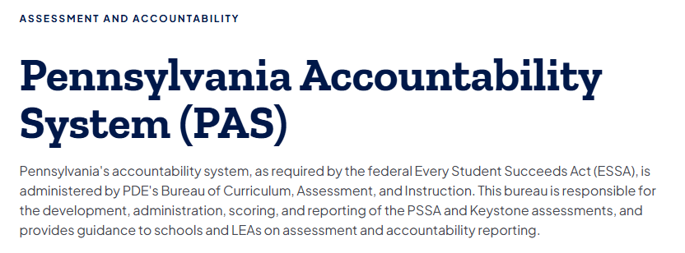
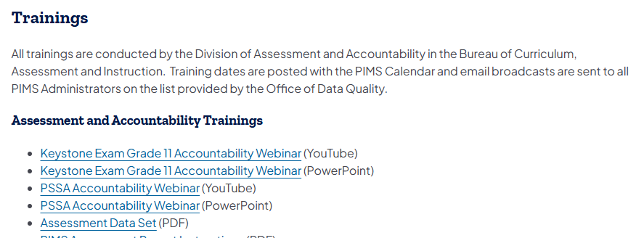
PAS

Slide 34
PIMS Resources
PIMS Resources:
  PDE Website > Data and Reporting > Pennsylvania Information Management System (PIMS) > Manuals and Calendar
  Volume 1 & 2 of the PIMS Manual
  Data Reporting Calendar

Slide 35
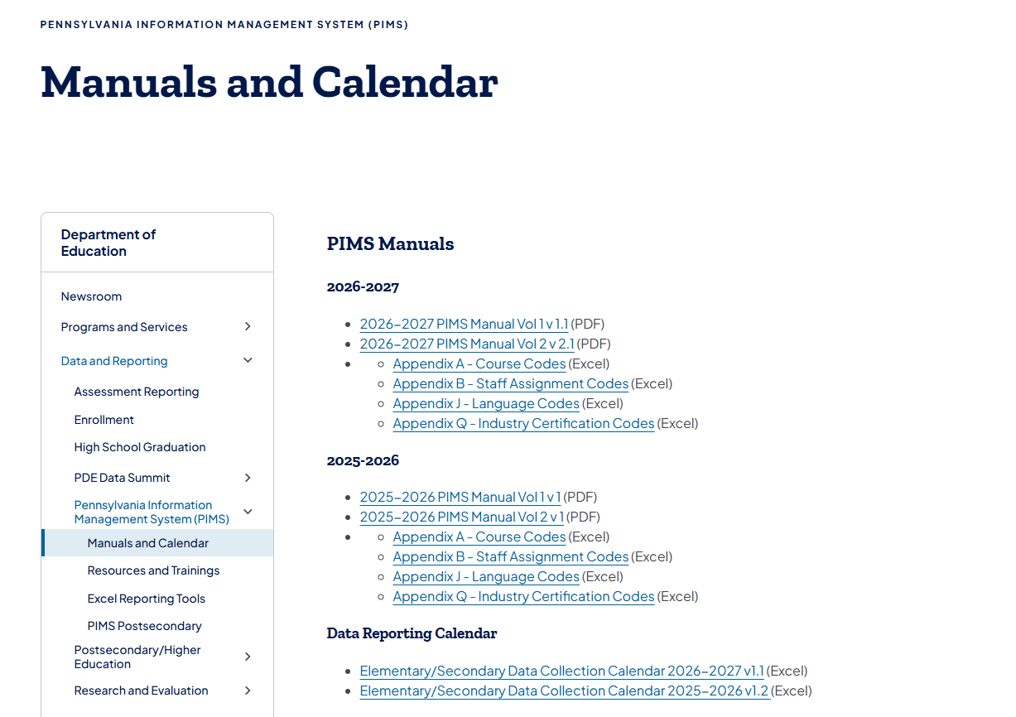
Manual and Calendar

Slide 36
Contacts
For the PIMS Application Support Desk:
1-800-661-2423
For the Data Quality Office:
RA-DDQDataCollection@pa.gov

Slide 37
Assessment Test Session Name Fields
For more information on the (the topic of the presentation) please visit PDE’s website at www.education.pa.gov
The mission of the Department of Education is to ensure that every learner has access to a world-class education system that academically prepares children and adults to succeed as productive citizens. Further, the Department seeks to establish a culture that is committed to improving opportunities throughout the commonwealth by ensuring that technical support, resources, and optimal learning environments are available for all students, whether children or adults.

