Slide 1
The Follow-Up Survey: Purpose, Process, and Proven Strategies
03/18/2026
Notes:
Hello and welcome to The Follow-Up Survey: Purpose, Process and Proven Strategies.

Slide 2
Overview
• Audience Takeaways
○ The benefits of effectively conducting follow- up surveys.
○ Proven methods for increasing survey response rates.
○ Insight into how to use survey data for improvement efforts.
Notes:
Welcome everyone, and thank you for being here today.
Before we dive in, let me give you a quick roadmap of what we're going to cover, and more importantly, what you're going to walk away with.
First, we're going to talk about the benefits of conducting follow-up surveys effectively. Not just why they matter in theory, but how they actually help you gather meaningful feedback, track outcomes, and drive real, continuous improvement in your programs and services.
Second, we'll walk through some proven methods for increasing your survey response rates. Because let's be honest, even the best survey is only as good as the data it collects. We'll give you practical strategies you can put to use right away.
And third, we'll look at how to actually use that data once you have it. Collecting feedback is step one — turning it into action is where the real impact happens. We'll show you how to translate survey results into meaningful improvements for both your students and your programs.
So with that, let's get started.

Slide 3
Purpose – Why?
Why is the follow-up survey needed?
  Meet Perkins V federal accountability requirements
  Evaluate program performance
  Enhance available data for schools and PDE
Notes:
So now that we know what we're covering today, let's talk about the why, why does this follow-up survey exist in the first place?
There are three core reasons.
The first is federal accountability. Under Perkins V, career and technical education programs are required to be evaluated on a regular basis. This survey is how we demonstrate that we're meeting those federal requirements, it's not optional, it's a mandate, and conducting it well matters.
The second reason is program performance. The survey gives us a direct line of sight into how our programs are actually doing. Are we hitting our goals? Where are students succeeding, and where are there gaps? Most importantly, it lets us track how students are doing after they leave our programs, which is one of the truest measures of whether what we're doing is working.
And the third reason is data enhancement, for both local schools and the Pennsylvania Department of Education. The information we collect doesn't just sit in a report somewhere. It feeds into decisions that shape educational outcomes across the entire state.
Alright, let's keep moving.

Slide 4
Purpose – What?
What is the follow-up survey?
  CTE Students who have graduated are sent security code to complete survey to see what they are doing post-CTE
  Created to meet Perkins V Federal Accountability
  2026 Survey is of graduated students from the 2024-25 School Year (SY)
Notes:
Now that we've covered the why, let's talk about the what, what exactly is the follow-up survey?
At its core, the follow-up survey is a tool we use to reach out to CTE graduates after they've completed their programs. Each graduate is sent a unique security code that allows them to access and complete the survey. It's designed to be straightforward and accessible, we want to make it as easy as possible for them to participate.
So what are we actually asking them? The survey focuses on what graduates are doing with their lives after CTE. Are they employed? Are they continuing their education? Are they in some form of additional training? These answers paint a picture of where our students end up, and that picture tells us a great deal about how effective our programs really are.
And as we mentioned on the last slide, this survey was built specifically to satisfy the Perkins V federal accountability requirements. It's the mechanism we use to demonstrate that our CTE programs are delivering results.
Now, one important detail, the survey runs on a bit of a lag by design. The 2026 survey is actually going out to students who graduated during the 2024-25 school year. That gives graduates time to settle into their post-CTE lives before we check in, so the data we collect is more meaningful and reflective of real outcomes.
Alright, let's move on to the next slide.

Slide 5
Survey Questions
1. According to records from <<School name>>, you were enrolled in the program <<Program name>>. Is this correct? If no, please explain.
  Yes
  No
2a. As of October, November and/or December 2025, what was your education status?
  Enrolled in Additional Schooling
  Not enrolled in additional schooling
Notes:
These two survey questions are provided by PDE and are included in every follow-up survey. They help us verify important information and gather key data on participants' current educational status. In total, there are 8 questions in the follow-up survey.
The first question asks, 'According to records from [School Name], you were enrolled in the program [Program Name]. Is this correct?' This is a simple way to confirm that our records are accurate. If the participant answers 'No,' they can provide an explanation. PDE will review this answer to determine if it's accurate, and if it isn't, the answer will be changed to 'Yes.’
The second question looks at the participant’s education status for a specific period—October, November, and December of 2024. It asks, 'As of October, November, and/or December 2024, what was your education status?' The two response options are 'Enrolled in Additional Schooling' or 'Not enrolled in additional schooling.

Slide 6
Survey Questions Continued
2b. What type of schools were you enrolled during October, November and/or December 2025?
  4-year or higher postsecondary institution
  2-year postsecondary institution
  Less than 2-year technical or trade school
  Other
2c. Is this program related to the program in question 1?
  Yes
  No
Notes:
Let’s continue with some more survey questions. These next two questions only appear if the participant answered 'Enrolled in Additional Schooling' to question 2a. This ensures that the survey stays relevant to the individual’s specific situation.
The first of these is question 2b, which asks, 'What type of schools were you enrolled in during October, November, and/or December 2024?' This question helps us gather more detailed information about the type of schooling the participant is pursuing.
The response options are:
4-year or higher postsecondary institution
2-year postsecondary institution
Less than 2-year technical or trade school
Other
By asking this, we can better understand the educational paths that participants are taking after the program.
Next, we have question 2c, which asks, 'Is this program related to the program in question 1?' The two options here are 'Yes' or 'No.' This helps us assess whether the additional schooling the participant is pursuing is connected to the original program they were enrolled in. These two questions give us deeper insight into the participant’s educational journey and help ensure that we’re capturing the right information.

Slide 7
Survey Questions Continued
3. What best describes your employment status in October, November, and/or December 2025?
  Employed – part-time or full-time, does not include military service
  Full-time military service – doesn’t include reserves or national guard
  National Community Service or Peace Corps
  Unemployed, seeking work
  Unemployed, not seeking work because of choice, illness, full-time student status, retirement, pregnancy, or other reason
4. Describe briefly your job title in October, November, and/or December 2025.
  Enter description: (student enters text here)
Notes:
Let’s move on to the next set of survey questions. These questions focus on the participant’s employment status, and question 4 will only appear if the participant answers 'Employed' to question 3.
First, question 3 asks, 'What best describes your employment status in October, November, and/or December 202?' This is designed to gather information about the participant's work situation at that time. The response options are:
Employed – part-time or full-time, excluding military service
Full-time military service – doesn’t include reserves or National Guard
National Community Service or Peace Corps
Unemployed, seeking work
Unemployed, not seeking work due to choice, illness, full-time student status, retirement, pregnancy, or another reason
This helps us understand the participant’s employment status in a detailed way.
If the participant answers 'Employed' to this question, they will then be prompted with question 4, which asks them to 'Describe briefly your job title in October, November, and/or December 2024.' This is an open-ended question, allowing them to enter their job title or a brief description of their role.
These questions are designed to give us a clearer picture of both the employment and educational status of the participants, as well as how they may have transitioned post-program.

Slide 8
Survey Questions Continued
5. How is your job related to the program in question 1?
  Directly or closely related
  Remotely or not related
6. How many hours per week do you work in your primary job? (do not include overtime)
  In hours per week: (student enters hours here in numbers)
Notes:
Let’s look at the last two questions in the survey. These questions will only appear if the participant answered 'Employed' to question 3, and they help us better understand how the job is connected to the program and the participant’s work hours.
Question 5 asks, 'How is your job related to the program in question 1?' The two response options are:
Directly or closely related
Remotely or not related
This helps us assess the relevance of the participant's current employment to the program they completed, giving us insights into how well the program has prepared them for their career.
The final question, question 6, asks, 'How many hours per week do you work in your primary job? (Do not include overtime.)' The participant will simply enter the number of hours they work each week in their primary job. This gives us a sense of their work commitment and can be useful for understanding how employment fits into their overall post-program activities.
And with that, we've covered all 8 survey questions. These questions are designed to gather a comprehensive understanding of the participant's educational and employment status after completing the program.

Slide 9
How does it affect me (LEAs)?
Directly tied to CAR Report and meaningful progress
  Secondary: 3S1 Post Program Placement
  Adult: 1P1 Postsecondary Retention and Placement
  Better response rates = more accurate data for LEAs
Notes:
Now let's get into what this means specifically for you as LEAs, because this survey data doesn't just live in a federal report somewhere. It directly affects your CAR Report and your ability to demonstrate meaningful progress.
Let me break down exactly where this data shows up.
For secondary programs, the follow-up survey feeds into 3S1 - Post-Program Placement. This metric tracks whether your graduates are going on to gainful placement after completing their CTE program, whether that's a job, continued education, or additional training. The follow-up survey is how you capture that information. Strong response rates mean you can report that outcome with confidence.
For adult programs, the equivalent metric is 1P1 - Postsecondary Retention and Placement. Same concept, different population. It tracks whether adult learners are continuing their education or entering the workforce after completing your program. Again, the data that feeds this metric comes directly from the follow-up survey.
Both of these are reported in your CAR, and both are used to evaluate whether your programs are meeting their performance targets under Perkins V.
And this brings me to a point I really want you to take away from this section, better response rates equal more accurate data. It's that simple. The more graduates who complete the survey, the more complete your picture is. And a more complete picture means better metrics, more accurate reporting, and a stronger case for the work your programs are doing.
So your response rates aren't just a number, they're a direct reflection of your program's story.

Slide 10
How are Students Contacted?
LEAs are responsible for contacting students
  Ways to contact
    Phone
    Email
    Social Media
    Snail Mail
  Use one or more ways – the more the merrier
Notes:
So we've established why the survey matters and how it affects your reportingnow let's talk about the practical side of things. How do you actually get students to complete it?
The first thing to know is that LEAs are responsible for reaching out to their own students. This isn't something that happens automatically. It takes a proactive effort on your part, and that effort is what makes the difference between a strong response rate and a weak one. The more diligently you reach out, the more accurate and complete your data will be.
Now, when it comes to how you contact students, you have several options at your disposal.
Phone calls are one of the most personal and effective methods. A direct call shows students that someone is genuinely following up, it's harder to ignore than a message sitting in an inbox.
Email is quick, easy, and low-cost. It works especially well for graduates who are actively checking their messages and are comfortable with digital communication.
Social media has become one of the most powerful tools for reaching younger graduates. If your students are on Instagram, Facebook, or other platforms, meeting them where they already are can make a big difference.
And don't count out snail mail. For some students, a physical piece of mail actually stands out more than anything digital, especially if it comes from a familiar school or program.
The bottom line here is this, don't limit yourself to just one method. The more ways you reach out, the better your chances of making contact. Mix and match, follow up more than once, and remember, the more the merrier when it comes to getting those responses back.

Slide 11
Who is surveyed?
Adult Affidavit Students
  For the 2026 Survey: Perkins V accountability definitions require PDE to survey adult CTE students who completed (CTE status type code of 41) their CTE program during the 2024-25 reporting year.
  Student will not be surveyed if incorrectly reported in C4 CTE Collection
Notes:
Now let's talk about who is actually being surveyed on the adult side.
For the 2026 Survey, Perkins V accountability requirements direct PDE to survey adult CTE students who completed their CTE program during the 2024-25 reporting year. In your data, these are students with a CTE status type code of 41, that completion code is what flags a student as eligible for the survey.
Making sure those students are accurately identified and reported is critical. If they're in your records correctly, they'll be included. If they're not — they won't be.
And that brings me to a really important point. If a student is incorrectly reported in the C4 CTE Collection, they will not be surveyed. It's that straightforward. Errors in reporting mean those students get left out entirely, which affects your response pool, your data, and ultimately your performance metrics.
So my strong encouragement to everyone watching is this, after you submit your data, check your QC reports. Make it a habit. That's your opportunity to catch any errors before they become a problem. Accurate data in means accurate survey results out.
We want every eligible student to have the chance to be counted, and that starts with clean, correct reporting on your end.

Slide 12
Who is surveyed?
Secondary Students
  Perkins V accountability definitions require PDE to survey CTE concentrators who exited a secondary CTE program during the 2024-25 reporting year.
    Secondary 12th graders who are
      (1) Perkins Concentrator; AND
      (2) Have a CTE Status type code of 40, 60 or 71
  Student will not get surveyed if incorrectly reported in C4 CTE Collection
Notes:
Now let's shift over to the secondary side and talk about which students fall into this category.
Under Perkins V accountability definitions, PDE is required to survey CTE concentrators who exited a secondary CTE program during the 2024-25 reporting year. These are the students we are focused on for this survey cycle.
To be included, a student needs to meet two criteria. First, they must be a Perkins Concentrator, meaning they completed a significant portion of their CTE program. Second, they need to have one of three specific CTE Status Type Codes in PIMS. Those codes are 40, which indicates the student graduated; 60, which indicates the student dropped out; or 71, which indicates the student exited without a diploma.
Both of those criteria need to be present. Concentrator status plus one of those three codes is what makes a student eligible for the survey.
And just like on the adult side, this same rule applies here: if a student is incorrectly reported in the C4 CTE Collection, they will not be surveyed. Wrong data means missed students, and missed students means gaps in your reporting.
After you submit, please take the time to review your QC reports and verify that your secondary students are reported accurately. It is a simple step that makes a significant difference.

Slide 13
Survey Process
Starts with good LEA reporting in previous year
  Students must meet all criteria on previous slides
PDE creates list of students to survey
  Based on what LEAs report in C4 CTE Collection
List is found in PIMSReports_V2
Notes:
Now let's walk through how the survey process actually works from start to finish.
It all begins with accurate LEA reporting from the previous year. The data you submit is the foundation that the entire survey process is built on. Students must meet all of the criteria we covered on the previous slides, whether that is Perkins Concentrator status, the correct exit codes, or completion status on the adult side. If that data is solid going in, everything that follows runs smoothly.
Once LEAs report their data through the C4 CTE Collection, PDE takes that information and builds the list of students who will be surveyed. There is no separate nomination process or manual list. The survey list comes directly from what you report. That connection is important to understand because it means the quality of your reporting has a direct impact on who gets surveyed and how useful that data ends up being for your CAR report and performance metrics.
So where do you actually find this list? Once PDE generates it, you can access it in PIMSReports_V2. That is your go-to resource for confirming which students from your LEA are included in the survey pool. We encourage you to check it, review it, and make sure the students who should be on that list are actually there.
The whole process starts and ends with accurate data. Get that right, and everything else falls into place.

Slide 14
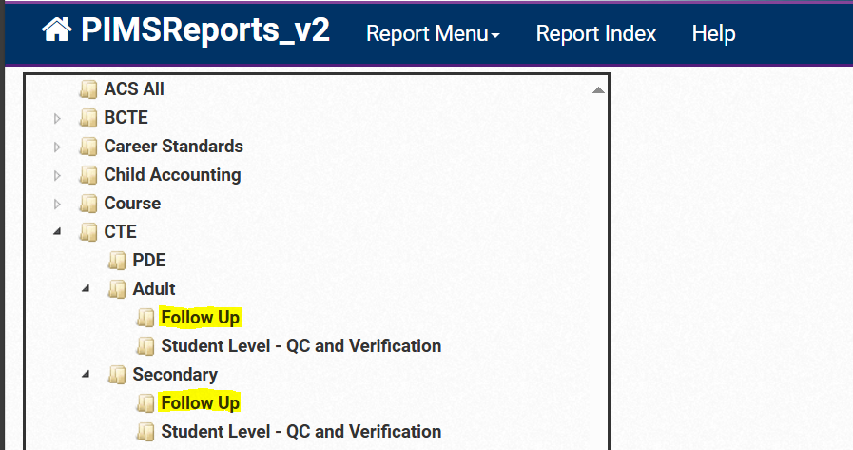
Survey Process
Notes:
Let's take a look at exactly where you can find your student survey lists inside PIMSReports_V2.
For secondary students, you will follow this path: PIMSReports_V2, then CTE, then Secondary, then Follow-Up, and you will find the List of Secondary CTE Students to Survey right there.
For adult students, the path is almost identical: PIMSReports_V2, then CTE, then Adult, then Follow-Up, and there you will find the List of Adult CTE Students to Survey.
You can see both of those locations highlighted in the screenshot on this slide. When you are in PIMSReports_V2, you are looking for that Follow-Up folder within whichever category applies to you, whether that is Secondary or Adult.

Slide 15
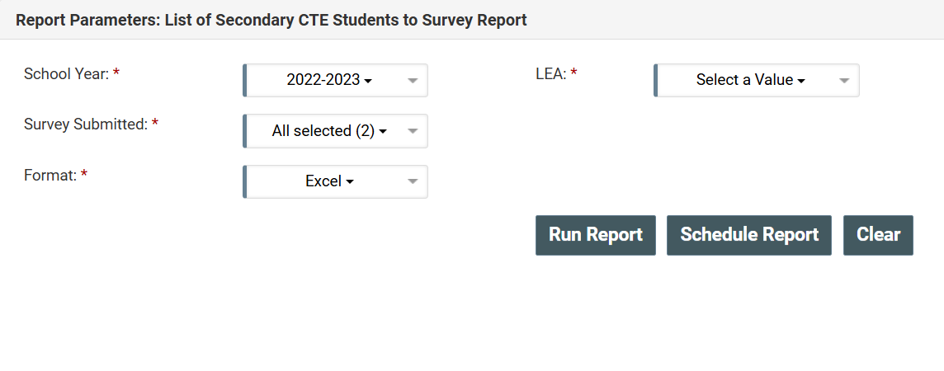
Survey Process
Notes:
Now let's walk through how to actually download the list. The screenshot here shows the secondary version of this page, but the steps are exactly the same for adult education, so everything I am about to cover applies to both.
When you land on this page, you will see a few fields to fill in before downloading.
The first is Select Year. Choose the reporting year that aligns with the survey you are working on. Make sure that year matches the survey cycle you are conducting outreach for.
Next, Select Your LEA. Choose your district or institution from the dropdown. This filters the list down to only your students, so what you download is specific to you.
There is also a Survey Submitted field with a yes or no option. This is a helpful one. If a student already completed the survey, it will show as yes, and you can take them off your outreach list. No need to follow up with students who have already responded.
Finally, for format, we strongly recommend selecting Excel. It gives you the flexibility to sort, filter, and track your outreach efforts in a way that a PDF or other format simply does not allow.
Now, a couple of important things to keep in mind about this list. It is updated every Tuesday, so you will want to check back weekly as your outreach is underway. And unlike some other PIMS data, this list does not refresh automatically with each PIMS update. PDE has to manually apply changes, so that Tuesday cadence is something to build into your routine.
Check it weekly, keep your outreach list current, and you will be in good shape.

Slide 16
Students to Survey Report
Security Code
  Follow-up survey specific code – NOT THEIR PASECUREID
Survey Submitted
  Did they submit survey – Yes/No
Student demographic data
  Name, PASecureID, CIP Code, Address, etc.
Notes:
Let's take a quick look at what is actually included in the report once you download it.
The first column you will want to pay attention to is the Security Code. This is a follow-up survey specific code that is unique to this process. It is important to note that this is not the student's PASecureID. This is the code students will use to access and complete the survey, so it is a critical piece of information when you are reaching out to them.
Next is the Survey Submitted column. This is a simple yes or no field, but it is incredibly useful for managing your outreach. Anyone marked yes has already completed the survey and does not need to be contacted. Anyone marked no is still on your list. As you work through your outreach efforts, this column is what tells you where to focus your energy.
And then you have the student demographic data. The report includes each student's name, PASecureID, CIP code, address, and other relevant details. This is the information you will use to actually locate and contact your students through whichever outreach methods work best for your LEA.
Together, these three pieces give you everything you need to manage your follow-up outreach in an organized and efficient way. Download it, sort it, and get to work.

Slide 17
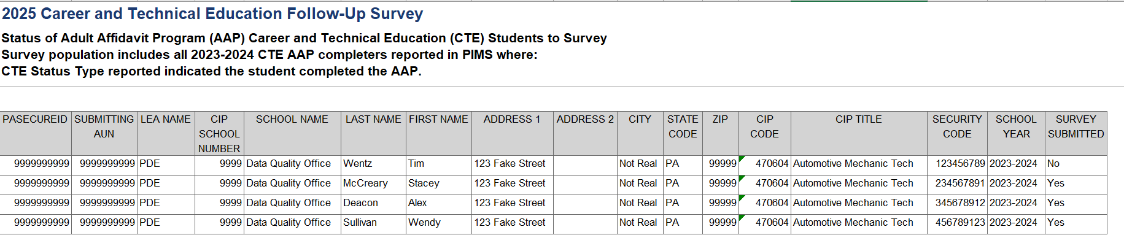
Report Example
Notes:
Here is a look at what the actual report looks like when you pull it from PIMSReports_V2.
As you can see, it is laid out in a clean, straightforward format. All of the data points we just covered are right there in front of you, student names, addresses, CIP codes, security codes, and the survey submitted status.
This is your working document throughout the survey window. Use it to organize your outreach, track who has responded, and identify who still needs to be contacted. Whether you are reaching out by phone, email, mail, or social media, everything you need to make that contact is in this report.
Get familiar with it, and you will find the outreach process is much easier to manage than it might seem at first.

Slide 18
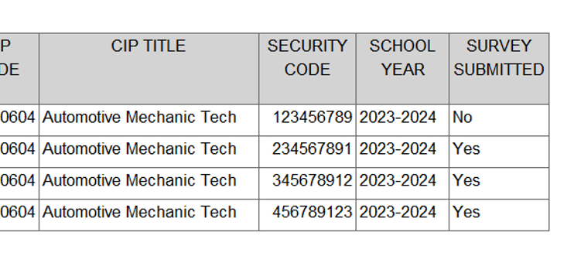
Report Example
Notes:
Let's take a closer look at the report and break down what each column actually means.
Starting with the Security Code. As we mentioned before, this is a survey-specific code assigned to each individual student. It is not their PASecureID. This code is what the student uses to access the survey, so when you are reaching out to them, this is the code you will be passing along. Keep it handy.
Moving to the Survey Submitted column. A quick yes or no tells you exactly where each student stands. Anyone showing yes is done and off your list. Anyone showing no still needs to hear from you. This column is what lets you work efficiently and make sure your outreach is targeted toward the students who actually still need to respond.
And then the demographic data rounding out the report. You have the student's name for personalized outreach, their PASecureID for identification and verification, the CIP code which tells you which program they completed, and their address for anyone using direct mail as part of their contact strategy.
Everything in this report has a purpose. The security code gets students into the survey, the submitted status tells you who to focus on, and the demographic data gives you the tools to actually reach them. Use all of it together and you will have a well-organized, efficient outreach process that makes sure no student falls through the cracks.

Slide 19
Survey Process Continued
Once a student has their personalized security code…
  They go to survey site to submit their survey
  Make sure to include website link in your communications!
    https://www.flp.pa.gov/
Notes:
So once a student has their personalized security code, the next step is simple. They visit the survey site, enter their code, and complete the survey.
The website is flp.pa.gov, and this is something you will want to include in every single communication you send out. Whether you are reaching out by email, phone, social media, or mail, make sure that link is front and center. The easier you make it for students to find the survey, the more likely they are to complete it.
Think of your outreach as a package deal. The security code gets them in, and the website link tells them where to go. Both pieces need to be in every message.
Write it down, save it, and start including it in your templates now: flp.pa.gov.

Slide 20
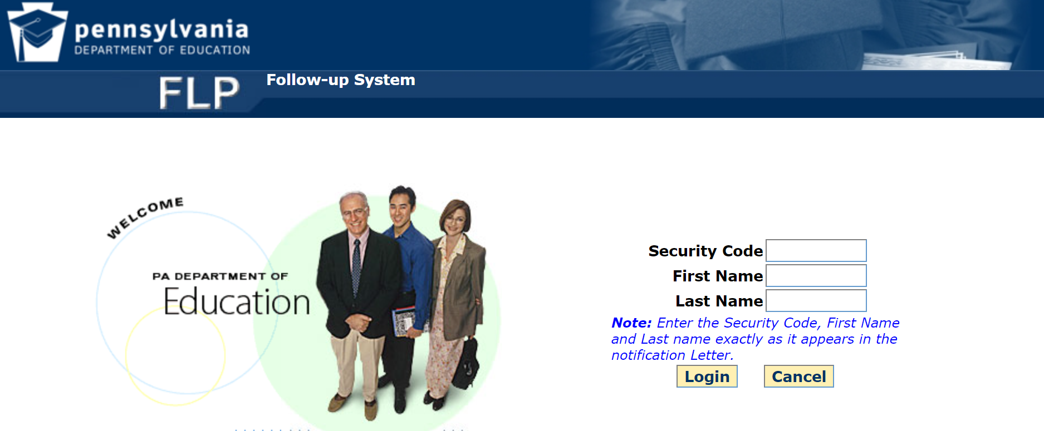
Survey Site
Notes:
Here is a look at the actual survey site that students will land on when they visit flp.pa.gov.
As you can see, logging in is straightforward. Students need to enter two things: their personalized security code and their name.
Now, the name entry is where we see a lot of hiccups, so please pay close attention to this when you are doing your outreach. Students must enter their name exactly as it appears in the Notification Letter.
The second thing to emphasize is the security code. Students must use the survey-specific security code, not their PASecureID.
A little extra clarity in your outreach goes a long way here.

Slide 21
Outreach Strategies
Use more than one contact method
  Not every student uses…
    Social Media
    Email
    Or answers Phone Calls
  The wider the net, the more fish you’ll catch!
Notes:
Let's talk strategy. When it comes to getting students to complete the survey, one of the most important things you can do is use more than one contact method.
Here is the reality. Not every student is on social media. Not every student checks their email regularly. And plenty of people simply do not answer phone calls from numbers they do not recognize. If you are relying on just one method to reach your graduates, you are guaranteed to miss a portion of them.
Think about the students you are trying to reach. They have moved on from your program. Some have jobs, some are in college, some have moved to new addresses. Life has gotten busy for them, and your survey is not at the top of their priority list. That is not a criticism, it is just reality. So the more ways you reach out, the better your chances of actually making contact.
The old saying fits perfectly here. The wider the net, the more fish you will catch. Combine phone calls, emails, social media messages, and direct mail. Follow up more than once. Try different channels at different times. Some students will respond to the first email. Others might need a phone call a week later before they take action.
A little extra effort in your outreach strategy can make a significant difference in your response rates, and remember, those response rates feed directly back into your CAR report and your program metrics.
Cast a wide net and stay persistent.

Slide 22
Outreach Strategies Continued
Ways to contact
  Email
  Social Media
  Phone
  Combination of above
    More avenues = better chances of getting response
If a student does not have internet access, LEAs may enter the student’s survey response data with the student’s written or verbal permission
Notes:
We just covered why using multiple contact methods matters, so now let's talk about putting that into practice.
Your main options are email, social media, phone, or some combination of all three. And as we have said, a combination is almost always going to be your best approach. Different students respond to different things, and hitting multiple channels gives you the best shot at making contact. There is no single magic method that works for everyone, so do not treat any one channel as your only option.
The more avenues you use, the better your chances of getting a response. It really is that simple.
Now, here is something important that does not come up often but is worth knowing. If a student does not have internet access and cannot complete the survey online, that does not mean they have to be left out. LEAs have the ability to enter a student's survey response data on their behalf, as long as they have the student's written or verbal permission to do so. This is a great option to keep in mind, especially for adult learners who may not have reliable internet access at home.
No student should be excluded from the survey just because of a technology barrier. If you can get them on the phone or meet with them in person, you can still capture their response and make sure they are counted.

Slide 23

Outreach – Email
Email – Streamlining with Mail Merge
  What is Mail Merge?
  Cost and considerations
  How it works
  Can be used for bulk emails, letters, labels and envelopes
Notes:
Let's talk about one of the most efficient tools you can use for your email outreach, and that is Mail Merge.
If you are not already familiar with it, Mail Merge allows you to send personalized messages to a large group of people all at once. Instead of manually typing out each student's name and security code into individual emails, you connect an email template to a data source like an Excel spreadsheet, and the tool automatically fills in the personalized details for each recipient. Every student gets a message that feels like it was written just for them, and you did not have to copy and paste hundreds of times to make that happen.
Before you dive in, it is worth checking with your LEA to see if you already have a license for a Mail Merge tool. Many organizations already have access through Microsoft and may not even realize it. If you do not have a license, it is worth looking into, because the time it saves is significant.
To put it in perspective, if you are reaching out to a handful of students, doing it manually is manageable. But if you are working through a list of hundreds of graduates, manually entering each student's email address and security code one by one adds up fast. Mail Merge takes that burden off your plate entirely.
And it is not just for email. You can use Mail Merge to generate letters, labels, and envelopes as well. So if you are incorporating direct mail into your outreach strategy, the same process applies. One template, one data source, and you are done.
It is a simple tool that can make a big difference in how efficiently you manage your outreach.

Slide 24
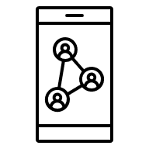
Outreach – Social Media
Social Media
  Everyone uses it!
  Create Facebook and Twitter posts to reach out to Alumni
  Make it stand out
    Use students who are in graphic design or media classes to help
    Work smarter – not harder
  Stress importance of the survey
Notes:
Now let's talk about social media as part of your outreach strategy, because this one is too valuable to overlook.
The reality is that social media is where people are spending their time. Your alumni are on it, your former students are on it, and reaching them there is often far more effective than waiting for them to check an email or return a phone call. Platforms like Facebook are especially useful for connecting with graduates who may have moved on but are still reachable through their networks.
Creating posts that point alumni toward the survey is a great way to cast that wider net we talked about earlier. Include the website link, remind them what the security code is for, and make it easy for them to take action right from the post.
Now here is a tip that I really love for this one. If your school has graphic design or media students, put them to work. Let them design your social media graphics. They get a real-world project for their portfolio, and you get professional-looking content that actually stands out in a crowded feed. That is working smarter, not harder.
A post that looks polished and intentional is going to get far more engagement than a plain text update. The more your post stands out, the more likely people are to stop scrolling, read it, and actually click the link.
And whatever you post, make sure you are communicating why the survey matters. People are much more likely to take five minutes out of their day if they understand the impact their response has. Tell them their feedback shapes the programs that students are going through right now. Make it personal and make it meaningful.
Social media is free, it is far-reaching, and your students can help you do it well. Take advantage of it.

Slide 25

Outreach – Phone
Phone call
  Call them directly
    More personal
  Get verbal permission to enter data for them
Notes:
Now, let’s dive into using Phone Calls as part of your outreach strategy.
Call Them Directly:
Sometimes, a phone call can make all the difference! It's more personal than an email or text, and students are more likely to respond when they hear a friendly voice. Picking up the phone and calling students directly to remind them about the survey not only adds a personal touch, but it also gives you the opportunity to answer any questions they might have right on the spot. It’s a great way to build rapport, especially if the student hasn’t responded to other forms of outreach. Plus, it shows that you care enough to follow up and make sure they have the chance to be heard.
Get Verbal Permission to Enter Data:
What if a student is struggling with the survey or doesn’t have easy access to it? That’s where phone calls come in handy too! If they’re unable to fill out the survey themselves, you can offer to enter their data for them—with their verbal permission, of course. It’s important to note that, for this to be valid, you’ll need to make sure that the student agrees for you to input their information. This way, even if a student doesn’t have internet access or is facing other barriers, they won’t be left out of the survey process.
Getting verbal permission and filling in the data on their behalf can be a big help to both the student and the survey process. It also makes sure that their voice is still counted, even if they’re not able to complete it on their own. Plus, when you document that permission, you’ve got everything covered for compliance.
This method can really help boost your survey response rates, and it makes the process feel more accessible for those who might be having difficulty completing the survey themselves. It’s all about meeting the students where they are and making sure they have every opportunity to provide feedback.

Slide 26
Outreach – Student Contacts
Update student contact info
  As they graduate
  Through social media or alumni groups
  Why it’s important
Notes:
This next point is one that is easy to overlook but makes a huge difference when survey time comes around, and that is keeping your student contact information up to date.
The best time to capture accurate contact details is right as students are graduating. Before they walk out the door for the last time, make sure you have a current phone number, email address, and mailing address on file. Once they leave, tracking them down becomes significantly harder. Building that contact update into your graduation process means you are starting your outreach from a much stronger position.
Social media and alumni groups are also worth mentioning here. Encouraging students to follow your program's social media accounts or join an alumni group before they graduate gives you a built-in way to stay connected. Even if their phone number or email changes, a social media connection can remain intact for years.
That kind of ongoing connection is valuable well beyond just the survey.
And here is the why behind all of this. Outdated contact information is one of the biggest reasons students do not get surveyed. It is not always that they are unwilling to respond, it is that the message never reached them in the first place. Keeping your records current removes that barrier entirely.
Accurate contact information leads to better outreach, better outreach leads to higher response rates, and higher response rates lead to better data for your programs. It is a chain reaction that starts with something as simple as updating a phone number at graduation.
Make it a habit, and it will pay off every single survey cycle.

Slide 27
Outreach – Multiple Methods
Use more than one contact method
  Not every student uses…
    Social Media
    Email
    Or answers Phone Calls
  The wider the net, the more fish you’ll catch!
Notes:
We have covered each contact method individually, so now let's bring it all together.
The core message here is simple. Do not rely on just one method. Not every student is active on social media. Not every student checks their email. And plenty of people do not pick up phone calls from numbers they do not recognize. If you are only reaching out one way, you are leaving responses on the table.
Think of it like fishing. The more lines you have in the water, the better your chances of catching something. Some students will respond to an email right away. Others will see your Facebook post and click the link. Some will need a phone call before they take action. And for a few, a piece of physical mail arriving at their door will be what finally gets their attention.
You do not know in advance which method will work for which student. So use them all. Send the email, make the call, post on social media, and drop a letter in the mail for good measure. Follow up more than once through more than one channel.
The extra effort is worth it. Every additional response you collect is another data point that strengthens your reporting and more accurately reflects what your programs are actually achieving.
Cast a wide net and stay consistent.

Slide 28
Planned Timeline (Subject to Change)
April 1st - Follow-up survey opens
April 20th - LEAs complete first wave of communication
June 1st - LEAs complete second wave of communication
July 13th - LEAs complete third wave of communication
August 31st - Follow-up survey closes
Notes:
Let's take a look at the planned timeline for this year's follow-up survey. Before I walk through the dates, I want to note that this timeline is subject to change, so keep an eye out for any updates.
Here is how it is laid out. The survey officially opens on April 1st. From there, the expectation is that LEAs will complete their first wave of communication by April 20th, so you will want to have your outreach materials ready to go right when the survey opens.
The second wave of communication should be completed by June 1st, and the third wave by July 13th. These checkpoints are designed to help you stay consistent with your follow-up rather than scrambling at the end.
The survey then closes on August 31st, giving you a full four months to collect responses.
We recognize that this period overlaps with other collections and responsibilities on your plate. The good news is that the outreach strategies we have been covering today, your email templates, your social media posts, your phone outreach processes, can all be adapted and reused for other data collection efforts you have going on at the same time. Build them once and put them to work in multiple places.
Our strong recommendation is to build yourself a checklist around these milestones. Mark the dates, assign responsibilities if you have a team, and treat each wave of communication as its own deadline. Staying organized from the start is what keeps this from feeling overwhelming at the end.
Four months is a solid window. Use all of it.

Slide 29
Actionable Takeaways
Implement Multi-Channel Outreach
Utilize Automation
Track Survey Progress
Notes:
As we wrap up, let's bring it all back to three things you can put into action right away.
First, implement multi-channel outreach. Use email, phone, social media, and mail together. Do not rely on just one method, and do not be afraid to follow up more than once.
Second, utilize automation. Tools like Mail Merge exist to save you time. Set up your templates now so that when the survey opens on April 1st, you are ready to go from day one.
And third, track your progress. Check your reports regularly, note who has submitted and who has not, and use that information to guide each wave of communication. The list in PIMSReports_V2 updates every Tuesday, so make it part of your weekly routine.
Do those three things consistently throughout the survey window and you will be in great shape.

Slide 30
Contact/Mission
Perkins Accountability System Administration Questions:
Brenda Gomez-Perez, Bureau of Career and Technical Education, brgomezper@pa.gov
Perkins Planning Process Questions:
Monique Burton, Bureau of Career and Technical Education, moburton@pa.gov
CTE Follow-Up Survey, Non-Technical Questions: Office of Data Quality, ra-catsdata@pa.gov
PIMS Reports (PIMSReportsV2) Access and Technical Questions:
PIMS Support Services: 1-800-661-2423
Notes:
Here are your contacts for different aspects of the follow-up survey. Please reach out to us, we are here to help! Thank you for watching!

