Slide 1

The Follow-Up Survey: Purpose, Process, and Proven Strategies
04/04/2025
Notes:
Hello and welcome to the CTE Data Team’s presentation on The Follow-Up Survey: Purpose, Process and Proven Strategies.

Slide 2
Purpose – Why?
Why is the follow-up survey needed?
  Meet Perkins V federal accountability requirements
  Evaluate program performance
  Enhance available data for schools and PDE
Notes:
First, I’d like to talk about why the follow-up survey is needed. What it its importance? There are a few key reasons why it’s crucial:
Meeting Perkins V Federal Accountability Requirements
First and foremost, the follow-up survey helps us meet the Perkins V requirements. Perkins mandates that career and technical education programs be evaluated regularly to ensure we’re meeting federal guidelines.
Evaluating Program Performance
The survey plays a key role in assessing how well our programs are performing. It allows us to see if we’re hitting goals and objectives, and most importantly, it helps us identify areas where improvements can be made. It gives us the ability to track how students are doing post-education, which is a critical piece in evaluating the success of CTE programs.
Enhancing Available Data for Schools and PDE
Finally, the survey helps collect valuable data that can be used to make more informed decisions. This data supports both local schools and PDE, enhancing educational outcomes across the state.

Slide 3
Purpose – What?
What is the follow-up survey?
  CTE Students who have graduated are sent security code to complete survey to see what they are doing post-CTE
  2025 Survey is of graduated students from the 2023-24 School Year (SY)
Notes:
It is a Survey Sent to CTE Students Who Have Graduated
The follow-up survey is designed to gather insights directly from CTE graduates about their post-graduation experiences.
It asks what the students' current activities are, like whether they’re employed, continuing their education, or pursuing other forms of training. This helps us understand the outcomes of CTE programs and how well they’re preparing students for their next steps.
Created to Meet Perkins V Federal Accountability
As I mentioned, this survey is essential for meeting the federal requirements under Perkins V, which mandates that we collect data to evaluate the success of career and technical education programs. It helps us stay in compliance with those requirements, and accountable.
2025 Survey is for Graduates from the 2023-24 School Year
The 2025 survey, which refers to the survey that we will collect during 2025, will be sent to students who graduated during the 2023-24 school year. The data we collect will give us important insights into what these graduates are doing after completing their CTE programs.

Slide 4
Survey Questions
1. According to records from <<School name>>, you were enrolled in the program <<Program name>>. Is this correct? If no, please explain.
  Yes
  No
2a. As of October, November and/or December 2024, what was your education status?
  Enrolled in Additional Schooling
  Not enrolled in additional schooling
Notes:
Okay, let’s take a close look at all survey questions and possible questions – there is variation depending on graduates’ responses. In total, they will have as many as 8 questions, or as few as three.
Here are the first two questions, which are included in every follow-up survey. They help us verify important information about the program of study, and gather key data on participants' current educational status.
The first question asks, 'According to records from [Your School Name], you were enrolled in the program [Your Program Name]. Is this correct?' This is a simple way to confirm that our records are accurate regarding their program of study. If the participant answers 'No,' they are given an open-ended field to provide an explanation. PDE will review this answer to determine if it's accurate, and if it isn't, the answer will be changed to 'Yes.’
As an example, if a student answered that “No” they didn’t participate in Program 120401 for Cosmotology and offered the explanation that they “were in a barber program.” Since barbering is cosmetology, we would change their answer back to “Yes.”
The second question – 2A – looks at the participant’s education status for a specific period—October, November, and December of 2024. It asks, 'As of October, November, and/or December 2024, what was your education status?' The two response options are 'Enrolled in Additional Schooling' or 'Not enrolled in additional schooling.

Slide 5
Survey Questions Continued
2b. What type of school were you enrolled during October, November and/or December 2024?
  4-year or higher postsecondary institution
  2-year postsecondary institution
  Less than 2-year technical or trade school
  Other
2c. Is this program related to the program in question 1?
  Yes
  No
Notes:
Based on their answers to question 2A about education from the last slide, participants may get these next two questions. They will only appear if the participant answered 'Enrolled in Additional Schooling' to question 2A. This ensures that the survey stays relevant to the individual’s specific situation.
The first of these is question 2b, which asks, 'What type of school were you enrolled in during October, November, and/or December 2024?' This question helps us gather more detailed information about the type of schooling the participant is pursuing.
The response options are:
4-year or higher postsecondary institution
2-year postsecondary institution
Less than 2-year technical or trade school
Other
By asking this, we can better understand the educational paths that participants are taking after the program.
Next, we have question 2c, which asks, 'Is this program related to the program in question 1?' The two options here are 'Yes' or 'No.' This helps us assess whether the additional schooling the participant is pursuing is connected to the original program they were enrolled in. These two questions give us deeper insight into the participant’s educational journey.

Slide 6
Survey Questions Continued
3. What best describes your employment status in October, November, and/or December 2024?
  Employed – part-time or full-time, does not include military service
  Full-time military service – doesn’t include reserves or national guard
  National Community Service or Peace Corps
  Unemployed, seeking work
  Unemployed, not seeking work because of choice, illness, full-time student status, retirement, pregnancy, or other reason
4. Describe briefly your job title in October, November, and/or December 2024.
  Enter description: (student enters text here)
Notes:
Here are the next set of survey questions. These questions focus on the participant’s employment status, and question 3 is given to everyone. Then question 4 will only appear if the participant answers 'Employed' to question 3.
First, question 3 asks, 'What best describes your employment status in October, November, and/or December 2024?' This is designed to gather information about the participant's work situation at that time. The response options are:
Employed – part-time or full-time, excluding military service
Full-time military service – doesn’t include reserves or National Guard
National Community Service or Peace Corps
Unemployed, seeking work
Unemployed, not seeking work due to choice, illness, full-time student status, retirement, pregnancy, or another reason
This helps us understand the participant’s employment status in a more detailed way.
If the participant answers 'Employed' to this question, they will then be prompted with question 4, which asks them to 'Describe briefly your job title in October, November, and/or December 2024.' This is an open-ended question, allowing them to enter their job title or a brief description of their role.
These questions – 2A, B and C, 3 and 4 – are designed to give us a clearer picture of both the employment and educational status of the participants, as well as how they may have transitioned post-program.

Slide 7
Survey Questions Continued
5. How is your job related to the program in question 1?
  Directly or closely related
  Remotely or not related
6. How many hours per week do you work in your primary job? (do not include overtime)
  In hours per week: (student enters hours here in numbers)
Notes:
Let’s look at the last two questions in the survey. These questions will only appear if the participant answered 'Employed' to question 3, and they help us better understand how the job is connected to the program as well as the participant’s work hours.
Question 5 asks, 'How is your job related to the program in question 1?' The two response options are:
Directly or closely related
Remotely or not related
This helps us assess the relevance of the participant's current employment to the program they completed, giving us insights into how well the program has prepared them for their career.
The final question, question 6, asks, 'How many hours per week do you work in your primary job? (Not including overtime.)' The participant will simply enter the number of hours they work each week in their primary job. This gives us a sense of their work commitment and can be useful for understanding how employment fits into their overall post-program activities.
So now we've covered all 8 survey questions, which are designed to gather a comprehensive understanding of the participant's educational and employment status after completing the program.

Slide 8
How does it affect me (LEAs)?
Directly tied to CAR Report and meaningful progress
  Secondary: 3S1 Post Program Placement
  Adult: 1P1 Postsecondary Retention and Placement
  Better response rates = more accurate data for LEAs
Notes:
So, let’s talk about how this data affects you as LEAs, and why it’s so important for your reports.
First of all, the data from these follow-up surveys is directly tied to your CAR Report and showing meaningful progress. This is crucial because the follow-up data feeds into the CAR, helping you demonstrate how well your programs are performing. The more accurate and thorough the responses are, the better you can show progress—whether that’s about student success or how effective your programs are.
For Secondary, we have 3S1 Post-Program Placement, which tracks whether students have achieved gainful placement after completing the program. Collecting solid follow-up data here lets you clearly show how well your program prepares students for the next step in their careers or further education. It’s all about demonstrating that your program is getting students into productive, gainful placements.
For Adult learners, we have 1P1 Postsecondary Retention and Placement, which is basically the adult version of 3S1. It tracks how many adult learners are either continuing their education or getting jobs after finishing your program. It’s the same concept as 3S1—solid follow-up data lets you report these outcomes accurately.
Lastly, better response rates = more accurate data. The more responses you get, the more complete and reliable your data becomes. For LEAs, that means better metrics, which ultimately lead to better decision-making and more accurate reporting. This is how you show progress and prove the real impact of your programs in your annual reports.

Slide 9
How are Students Contacted?
LEAs are responsible for contacting students
  Ways to contact
    Phone
    Email
    Social Media
    Snail Mail
  Use one or more ways – the more the merrier
Notes:
Alright, let’s talk about how students are contacted for the follow-up surveys.
LEAs are Responsible for Contacting Students:
This step of reaching out to students is crucial because it helps ensure that you’re gathering accurate data which reflects real post-program outcomes. Without reaching out to students, you cannot get the full picture of how well your programs are doing.
There are several ways to contact students:
Using more than one method can really help boost your response rates. Here are the most common ways to get in touch:
First is Phone: A personal call can really go a long way. It’s a great way to make a direct connection.
Email: This is quick and easy—especially if students are responsive to digital communication.
Social Media: A really effective option, especially if you’re trying to reach younger or more tech-savvy students who may check social media more frequently.
Snail Mail: Traditional mail does still have its place. For students who don’t check digital forms of communication regularly, postal mail can be a helpful tool.
Use One or More Ways – The More, The Merrier:
Using multiple methods of contact whenever possible is key. The more ways you reach out to students, the better your chances of getting a response. Phone calls, emails, social media messages, and even good old-fashioned mail—mixing it up can really help boost your follow-up survey response rates.

Slide 10
Who is surveyed?
Adult Affidavit Students
  For the 2025 Survey: Perkins V accountability definitions require PDE to survey adult CTE students who completed (CTE status type code of 41) their CTE program during the 2023-24 reporting year.
  Student will not be surveyed if incorrectly reported in C4 CTE Collection
Notes:
So which students are you going to survey?
First, let’s talk about Adult Affidavit Students
For the 2025 Survey:
As part of Perkins V accountability, PDE must gather this information on adult CTE students who completed their programs during the 2023-24 reporting year. These students need to be accurately identified and reported for the survey to ensure we’re meeting federal guidelines. It’s really important to make sure these students are correctly represented in your records.
Student Will Not Be Surveyed if Incorrectly Reported in C4 CTE Collection:
This is a key point to remember. Accuracy in the C4 CTE reporting is essential to make sure we reach the right students during the follow-up survey, and gather reliable data. If there’s an error in the C4 CTE reporting process, those students will be left out of the survey, and we want to avoid that. Please check your QC reports after submitting data to make sure your data is accurate.

Slide 11
Who is surveyed?
Secondary Students
  Perkins V accountability definitions require PDE to survey CTE concentrators who exited a secondary CTE program during the 2023-24 reporting year.
    Secondary 12th graders who are
      (1) Perkins Concentrator; AND
      (2) Have a CTE Status type code of 40, 60 or 71
  Student will not get surveyed if incorrectly reported in C4 CTE Collection
Notes:
Now, let’s talk about who is surveyed in the Secondary category.
Here the survey targets CTE concentrators who exited a secondary CTE program during the 2023-24 reporting year, again based on the Perkins V accountability requirements.
The Perkins Secondary Follow-Up Indicator (survey marker) applies to 12th-grade CTE students who were reported in PIMS as:
Perkins Concentrators (so they’ve completed a significant portion of their CTE program), and
Have one of a few different CTE Status Type Codes—these codes indicate whether the student graduated, dropped out, or exited the program without a diploma. The codes we’re looking for are:
CTE Status Type Code 40 (Graduated),
60 (Dropped out), or
71 (Exited with no diploma).
As with the adult students, it’s important to remember that if a secondary student is incorrectly reported in the C4 CTE Collection, they won’t be surveyed. Accurate reporting is key here—if the student’s data isn’t reported correctly, they won’t be included in the follow-up survey. So, double-checking that information is critical to ensure we’re surveying the right students.

Slide 12
Survey Process
PDE creates list of students to survey
  Based on what LEAs report in C4 CTE Collection
List is found in PIMSReports_V2
Notes:
Next I’m going to dive into the survey process itself.
Once the LEAs report their data through the C4 CTE Collection, PDE takes that information and creates a list of students to survey. This list is directly based on the data that LEAs have provided in the C4 CTE Collection. The more accurate your reporting is, the more accurate the survey data will be, which is essential for your CAR report and accountability measures.
So where can you find your list of students to survey? PDE creates the survey list, and it is available as a report in PIMSReports_V2. Next I’m going to show you how to find, download and use this report.

Slide 13
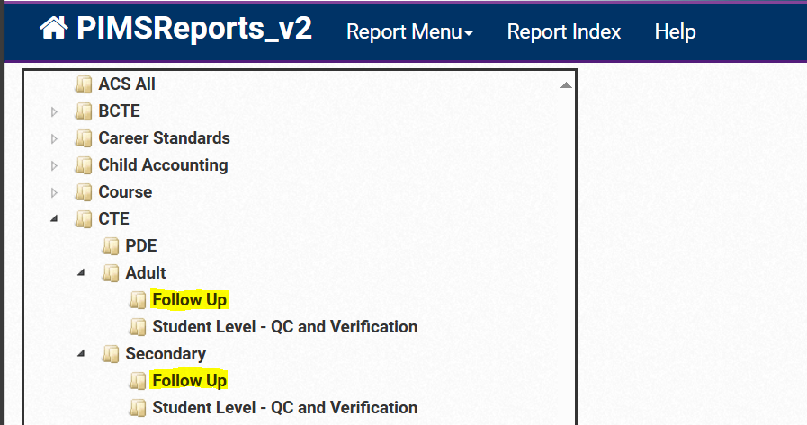
Survey Process
Notes:
Here is how to access your list of students to survey. First, log into PIMSReport_v2.
For Secondary Education: To find the list of secondary CTE students to survey, you’ll want to navigate through PIMSReports_V2 with the following path:
CTE folder> then Secondary folder> then Follow-Up folder. The report title is List of Secondary CTE Students to Survey, and it will include all of your secondary students who are eligible to be surveyed.
For Adult Education: The list of adult students is also found in PIMSReports_v2, with a slightly different path. You’ll want to access these folders:
CTE > Adult > Follow-Up > Report name: List of Adult CTE Students to Survey.
In this screenshot, you can see exactly where to navigate in PIMSReports_V2 to find the secondary and adult education lists. For both, you will follow the same first steps of logging into PIMSReports_v2 and opening the CTE folder. Then choose either the Adult or Secondary folder, and then Follow-Up, and then the report named List of <Blank> CTE Students to Survey – either Adult or Secondary.

Slide 14
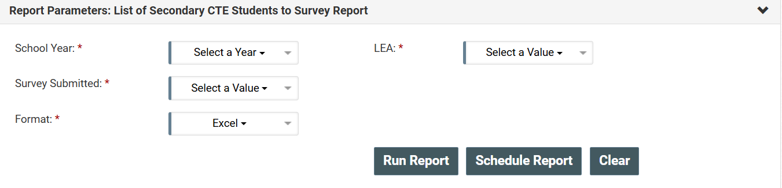
Survey Process
Notes:
Next let’s look at the process of downloading the list of students to survey.
This screenshot shows the download page for secondary education students, but the steps are exactly the same for adult education students, so this applies to both groups.
Here’s what you’ll need to do:
Select School Year: Start by choosing the relevant year for the survey data. Make sure you select the school year that aligns with the survey you’re conducting – for example, the upcoming survey being administered this year (2025) pulls from the 2023-24 reporting year student data.
Select Your LEA: Next, choose your Local Education Agency (LEA) from the drop-down list. This will ensure that the data you download corresponds specifically to your district or institution.
Survey Submitted (Yes/No/All Students): This field will tell you whether or not a student has already responded to the survey. If it says "Yes," that means the student has already completed the survey, so you can skip them in any subsequent follow-up efforts.
Format Selection: We highly recommend selecting Excel as the format for downloading the list. Excel is easy to work with, and you can sort, filter, and manipulate the data as needed, making it much easier to manage and track responses.
A few important things to note
This list is updated every Tuesday, so you can expect a refresh of surveys submitted by your students each week.
However, unlike some other PIMS data, this list doesn't automatically update with each PIMS refresh. PDE must manually apply any changes to the report, so make sure to check for updates each week to ensure you have the most current information.
By following these steps, you'll be able to download an up-to-date list of students to survey, which will be critical in managing your follow-up efforts

Slide 15
Students to Survey Report
Security Code
  Follow-up survey specific code – NOT THEIR PASECUREID
Survey Submitted
  Did they submit survey – Yes/No
Student demographic data
  Name, PASecureID, CIP Code, Address, etc.
Notes:
Let's take a look at what's included in the report that you’re going to download for your list of students to survey. Each student has a record with these fields:
Security Code:
This is a follow-up survey specific code, not the student's PASecureID. It’s used for identification purposes in relation to the survey only.
Survey Submitted:
This column shows whether the student has submitted the survey or not. It will be marked as Yes or No, so you know who still needs to be contacted.
Student Demographic Data:
The report also includes demographic information for each student, such as:
Name
PASecureID
CIP Code (Program Code)
Address
And other relevant details to help you identify and contact the students.
This report gives you the necessary information to manage the follow-up survey process efficiently.

Slide 16
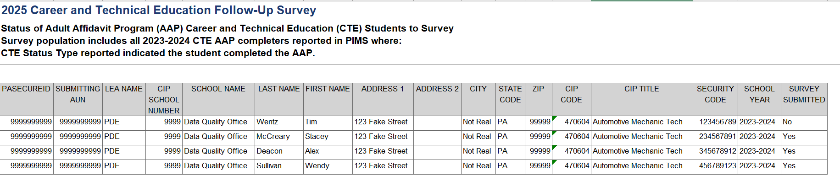
Report Example
Notes:
Here is an example of the report you’ll be working with.
This screenshot shows you what the report will look like when you pull it from PIMSReports_V2. As you can see, it provides a comprehensive view of the data you’ll be using for the follow-up survey process.
Some of the more important columns:
First column is PASecureIDs
Right in the middle are Last and First Name of Student
And the 4 parts of the student mailing address
Over on the right side are CIP Code and Title
Security code, which is the unique survey-specific code that the student will need to log in
And then the last column is Survey Submitted, Yes/No

Slide 17
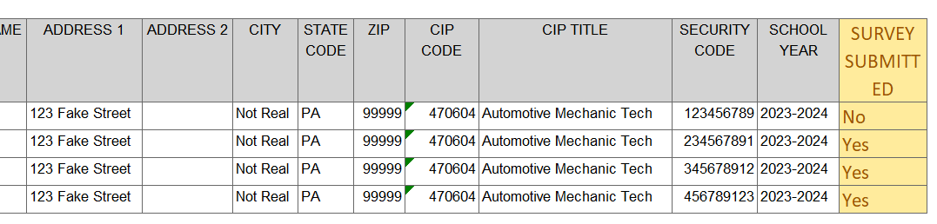
Report Example
Notes:
Now let’s take a closer look at those items:
Security Code:
This is a survey-specific code that’s assigned to each student. It’s really important to note that this is not the student’s PASecureID. This unique code is just for the follow-up survey process and helps us identify the student in relation to the survey itself. It’s an essential part of keeping track of who has been surveyed and who still needs to be contacted.
Survey Submitted:
In this column, you’ll see whether the student has already submitted their survey. It will show either a Yes or No, so you can filter on either complete or incomplete surveys. This helps you to prioritize your outreach efforts and focus only on students who have yet to respond.
Student Demographic Data:
Along with the survey-specific details, this report also includes important demographic information to help you contact and verify the students for follow-up.
Name: So you can properly address the student and ensure personal outreach.
PASecureID: This is included for identification purposes, helping ensure that you’re contacting the right person.
CIP Code: Tells you which program the student completed, giving context to their experience.
Address: If you’re using direct mail as one of your contact methods, this field will provide the student’s address.
This report helps you to effectively manage the follow-up survey process and make sure you’re reaching out to the correct students. With this detailed information, you can make sure no one falls through the cracks.

Slide 18
Survey Process Continued
Once a student has their personalized security code…
  They go to survey site to submit their survey
  Make sure to include website link in your communications!
    https://www.flp.pa.gov/
Notes:
Now that we’ve covered the information you’ll find in the report, let’s move on to the next step in the survey process.
Once a student has their personalized security code, they can head over to the survey site to submit their responses.
Make sure to include the website link in your communications! It’s important that students have easy access to the survey, and providing the link will help them get there quickly. The website to use is listed here. It is:
https://www.flp.pa.gov/
This link takes them directly to the page where they can enter their security code and complete the survey. Sharing this link clearly in all of your outreach, whether it’s through email, phone calls, mail or social media messages, will make the process as seamless as possible for the students.

Slide 19
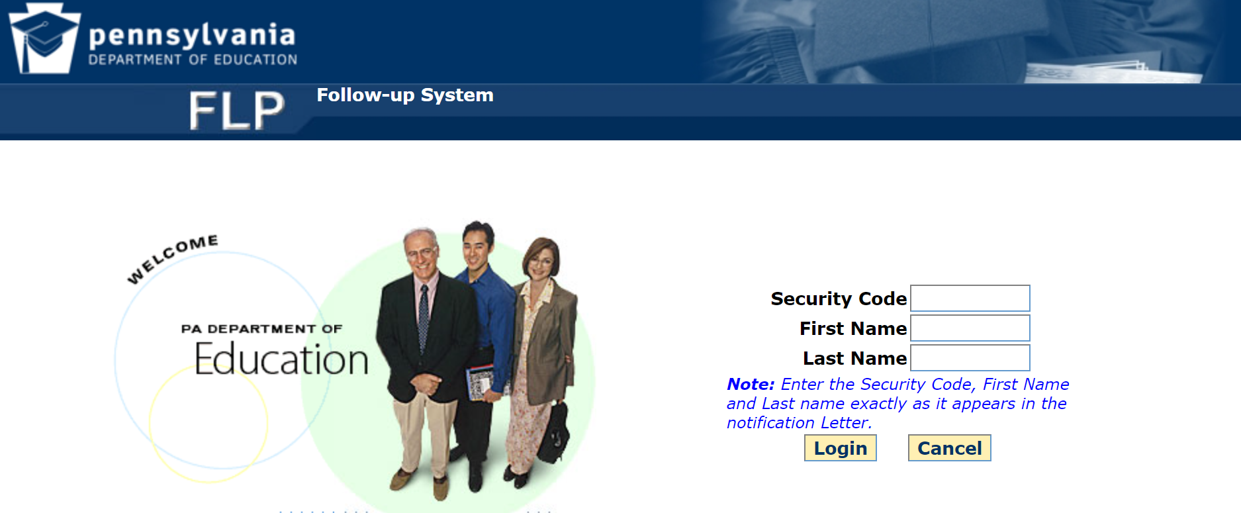
Survey Site
Notes:
This is a screenshot of FLP survey site where students will be submitting their responses.
How do they Log In: To log into the survey, students will need to enter a few key pieces of information:
Personalized Security Code: This is the survey-specific code we discussed earlier. It's essential for identifying the student and linking them to their survey.
First Name and Last Name: They must enter their name exactly as it appears in the Students To Survey report downloaded from PIMS, that I talked about earlier. This includes paying attention to capitalization! For example, if their name is listed in all capital letters in this report, they need to type it in all caps on the survey site as well.
Important Reminder for Outreach: As you reach out to students, be sure to emphasize these points:
Exact Name Entry: Remind students that they must enter their name exactly as it appears in PIMS, including the capitalization. If their name is in all caps in PIMS, they should enter it in all caps on the survey site.
Security Code: It's also very important to stress that students need to use the security code provided to them and not their PASecureID. The security code is specific to the survey, and the PASecureID will not work for logging in.

Slide 20
Outreach Strategies
Use more than one contact method
  Not every student uses…
    Social Media
    Email
    Or answers Phone Calls
  The wider the net, the more fish you’ll catch!
Notes:
Now, let’s dive into some outreach strategies to help maximize your survey response rates.
Use More Than One Contact Method: It’s very important to not rely on just one contact method. We know that students engage with different types of communication in different ways. Some students might prefer social media, while others may check their email more regularly or even answer the phone.
Not Every Student Uses…: Some students might not use social media at all, and some may not respond to emails or phone calls. If you're only using one contact method, you’re missing out on reaching certain students who might not engage with that channel.
The Wider the Net, the More Fish You’ll Catch: By using multiple methods to reach out, you’re casting a wider net. The more options you provide for students to respond to the survey, the more likely you’ll catch their attention and get a response. Whether it's a call, email, social media message, or even traditional mail, the more contact methods you use, the better your chances of success in gathering valuable data!
So, remember: a little extra effort in diversifying your communication strategy can go a long way in getting your survey responses.

Slide 21
Outreach Strategies Continued
Update student contact info
  As they graduate
  Why it’s important
Notes:
Let’s talk about updating student contact information as part of your outreach strategy. When and how can you do this?
As They Graduate:
One of the key times to update contact information is as students graduate. When students complete the program, it’s a perfect opportunity to make sure their details—such as phone number, email address, and home address—are up to date. Having accurate information will make it much easier for you to reach out to them after graduation for follow-up surveys or other communications.
Through Social Media or Alumni Groups:
After graduation, it can be challenging to stay in touch with former students, but social media and alumni groups are great tools to help bridge that gap. These platforms allow you to easily keep track of former students, even after they’ve moved on from the program. You can connect with them via Facebook, LinkedIn, or other platforms where alumni might be active. By encouraging students to join alumni groups or follow your program’s social media accounts before they graduate, you’ll have a built-in way to reach them after they leave.
Why is it Important:
Keeping student contact information current is essential to facilitate reaching out for follow-up surveys or other important communications. Having up-to-date contact info leads to more accurate survey responses and, in turn, more reliable data for your reports. Second, it helps you maintain engagement with your alumni, which is valuable for your program’s long-term success.
Ultimately, staying on top of updating student contact info makes the entire follow-up process smoother and more efficient, while also giving you a chance to keep students involved with your program even after they’ve graduated.

Slide 22
Planned Timeline (Subject to Change)
April 7th - Follow-up survey opens
April 21st - LEAs complete first wave of communication
June 2nd - LEAs complete second wave of communication
July 14th - LEAs complete third wave of communication
August 31st - Follow-up survey closes
Notes:
Now, let’s take a look at the Planned Timeline for the follow-up survey. Please keep in mind that this timeline is subject to change, but it gives us a good sense of what to expect moving forward.
April 1st – The follow-up survey officially opens.
By April 21st – LEAs will complete the first wave of communication with students.
By June 2nd – LEAs will complete the second wave of communication.
NLT July 14th – LEAs will complete the third wave of communication.
August 31st – The follow-up survey closes.
We know you’ve got a lot going on with other collections, but by giving four months to collect responses, we hope this timeline allows enough breathing room for everyone to stay on track without feeling overwhelmed. Plus, the outreach methods you use for this survey can be helpful for other data collection projects you might be working on at the same time.
With so many important dates ahead, it can be easy to lose track of things. To stay organized, we recommend creating a checklist. This way, you can stay on top of each milestone and ensure that you’re ready to go when it’s time to reach out to your students.

Slide 23
Contact/Mission
Perkins Accountability System Administration Questions:
Brenda Gomez-Perez, Bureau of Career and Technical Education, brgomezper@pa.gov
Perkins Planning Process Questions:
Monique Burton, Bureau of Career and Technical Education, moburton@pa.gov
CTE Follow-Up Survey, Non-Technical Questions: Office of Data Quality, ra-catsdata@pa.gov
PIMS Reports (PIMSReportsV2) Access and Technical Questions:
PIMS Support Services: 1-800-661-2423
Notes:
Here are your contacts for different aspects of the follow-up survey. Please reach out to us, we are here to help! Thanks everyone for attending!

