Slide 1
PIMS Perkins Postsecondary
Student Data Collection
Perkins End Of Year Collection
2025-26
Notes:
Hello, my name is Wendy Sullivan, and I am with the Pennsylvania Department of Education’s Data Quality Office; and I’d like to welcome you to this webinar dedicated to the 2025-26 student data submission for Perkins End of Year Collection.
Joining me today is the rest of the CTE Data Team…
Tim Wentz our CTE Supervisor, Alex Deacon and Stacey McCreary.
Also, with us today from the Bureau of CTE is Brenda Gomez Perez, Beth Marshall, Tracy Readinger, Wendy Leiby and say whomever else joined from BCTE.

Slide 2
Resources for the Webinar
PIMS Perkins Postsecondary Student Data Set How-To-Guide and the PowerPoint presentation for this webinar, as well as the other reference documents, are posted on the PDE website.
Link to the PDE PS PIMS Website
Notes:
To get started, let me give you the locations you’ll need to access all of the handouts we’ll be going over during this webinar. All the resources for the PIMS Perkins Postsecondary 2025-26 student data submission for Perkins End of Year are posted on the PIMS Postsecondary website.
To assist you with this submission, our team compiled 6 handouts for you.
PIMS Perkins Postsecondary How to Guide with a Submission Checklist
PS PIMS SOAR POS CIPs by Institution
PIMS Perkins Postsecondary User Manual – Volume 1
PIMS Perkins Postsecondary User Manual – Volume 2 – Word and Excel Versions
PIMS Perkins Postsecondary Data Collection Calendar
PIMS Postsecondary Perkins EOY Collection Webinar/PowerPoint

Slide 3
Agenda
Overview of CTE in PA
Overview of PIMS End of Year (EOY) Perkins Collection
EOY Perkins Collection Timeline
PS PIMS Data Quality Rules
Data Exception Request
Data Deletion Request
Notes:
Let’s review today’s agenda:
Overview of CTE in PA
Overview of PIMS End of Year (EOY) Perkins Collection
EOY Perkins Collection Timeline
PS PIMS Data Quality Rules
Data Exception Request
Data Deletion Request

Slide 4
What is Career & Technical Education?
Through a combination of academic classes and hands-on learning experiences, students enrolled in CTE programs gain academic, employability, technical, and real-world skills - and graduate high school prepared for college, a career, and their community
  Experienced Industry professionals teach students in learning spaces using state-of-the-art equipment
  Programs integrate with academics in a rigorous and relevant curriculum
Notes:
What is Career and Technical Education?
Through a combination of academic classes and hands-on learning experiences, students enrolled in CTE programs gain academic, employability, technical, and real-world skills - and graduate high school prepared for college, a career, and their community
Experienced Industry professionals teach students in learning spaces using state-of-the-art equipment
Programs integrate with academics in a rigorous and relevant curriculum

Slide 5
CTE Dollars and Schools Statistics
$128,485,000 million in state CTE Funding for 2025-26 School Year
  About $10.5 million more than the 2024-25 School Year
$45,395,790 million in federal Perkins Funding for the 2025-26 School Year
  $31,777,053 million for Secondary
  $13,618,737 million for Adult/Postsecondary
Secondary – 236 -152 School Districts/Charter Schools and 84 CTCs
Adult – 58 CTCs
Postsecondary – 19 Institutions of Higher Learning
Notes:
Here are some basic CTE Dollars and Schools Statistics.
$128,485,000 million in state CTE Funding for 2025-26 School Year
About $10.5 million more than the 2024-25 School Year
$45,395,790 million in federal Perkins Funding for the 2025-26 School Year
$31,777,053 million for Secondary
$13,618,737 million for Adult/Postsecondary
For 24-25 School Year
Secondary – 236 -152 School Districts/Charter Schools and 84 CTCs
Adult – 58 CTCs
Postsecondary – 20 Institutions of Higher Learning
Building Count for Secondary and Adult is based on Unique School Number. Building Count for Postsecondary is based on Unique Institution.

Slide 6
CTE Enrollment Statistics
76,300 Secondary Students
10,524 Adult/AAP/Adult Affidavit Students
60,434 Postsecondary Students
147,258 Total CTE Students
Notes:
CTE Enrollment Statistics for the 24-25 School Year.
76,300 Secondary Students
10,524 Adult/AAP/Adult Affidavit Students
60,434 Postsecondary Students
147,258 Total CTE Students

Slide 7
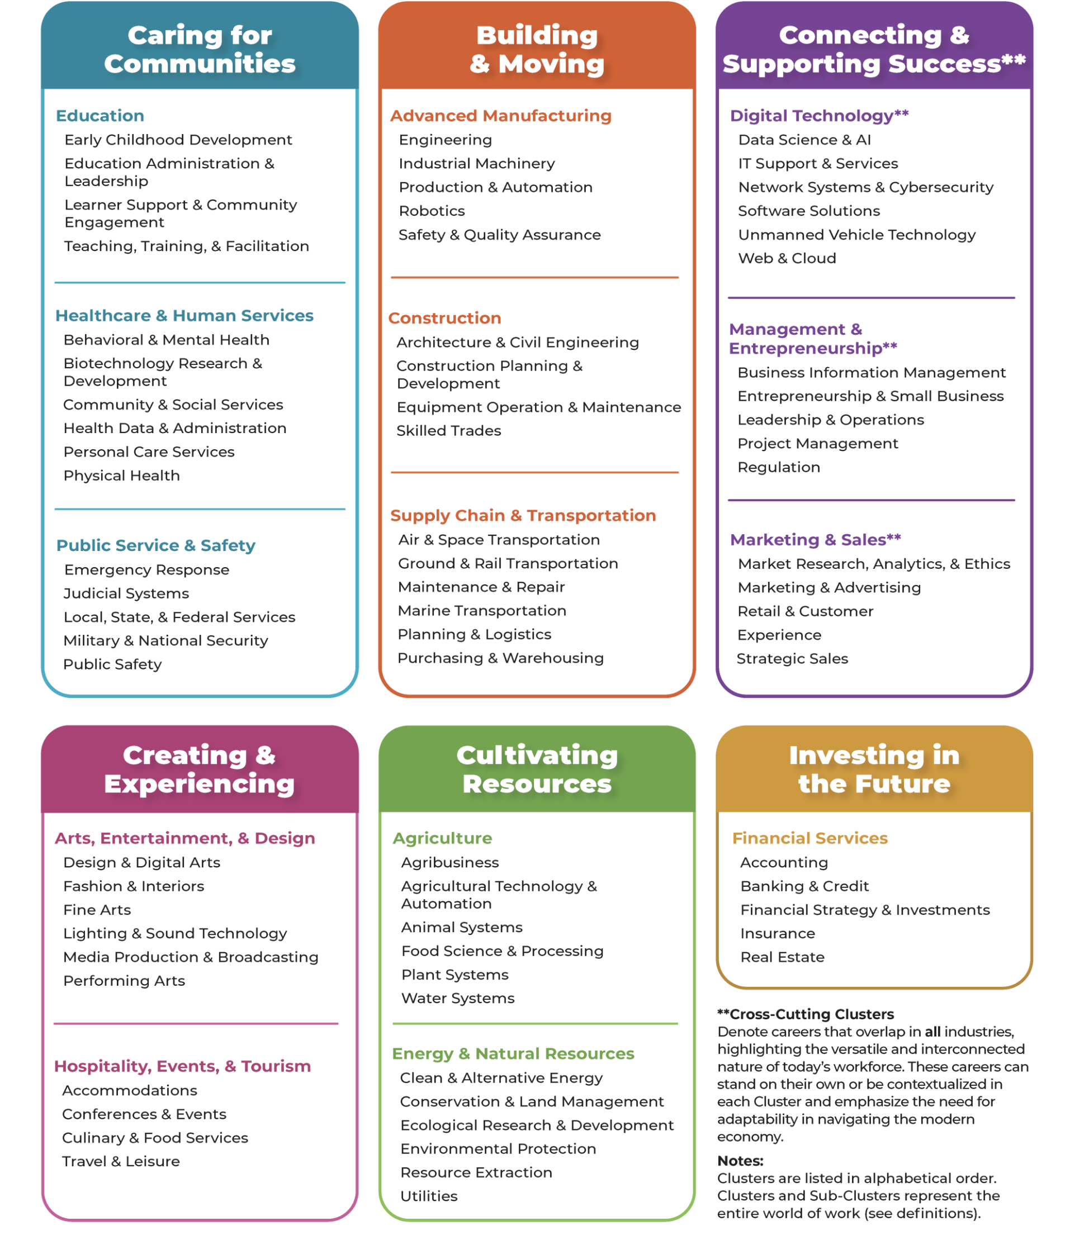
New Career Clusters
Education
Healthcare & Human Services
Public Service and Safety
Advance Manufacturing
Construction
Supply Chain & Transportation
Digital Technology
Management & Entrepreneurship
Marketing & Sales
Arts, Entertainment, & Design
Hospitality, Events, & Tourism
Agriculture
Energy & Natural Resources
Financial Services
https://careertech.org/career-clusters/
Notes:
Recently, new career clusters were introduced by Advance CTE and accepted by the US Department of Education. They are listed on this slide. We will be publishing a CIP specific list with Career Clusters in the near future. The new career clusters include Education,
Healthcare & Human Services,
Public Service and Safety,
Advance Manufacturing,
Construction,
Supply Chain & Transportation,
Digital Technology,
Management & Entrepreneurship,
Marketing & Sales,
Arts, Entertainment, & Design,
Hospitality, Events, & Tourism,
Agriculture,
Energy & Natural Resources, and
Financial Services
More information about the Career Clusters can be found at https://careertech.org/career-clusters/

Slide 8
Classification of
Instructional Programs (CIPs)
Each Institution determines which CIPs they want to offer annually
  Based on the Local Industry Needs
  Based on PA Industry Needs
  Based on High Priority Occupation (Federal)
87 CIPs at the Secondary Level
  Delivery Method 70 – Secondary Program of Study
  Delivery Method 75 – Secondary Career and Technical
145 CIPs at the Adult Level
  Delivery Method 80 – Adult Program
442 CIPs at the Postsecondary Level
Notes:
Each Institution determines which CIPs they want to offer annually
Based on the Local Industry Needs
Based on PA Industry Needs
Based on High Priority Occupation (Federal)
87 CIPs at the Secondary Level
Delivery Method 70 – Secondary Program of Study
Delivery Method 75 – Secondary Career and Technical
145 CIPs at the Adult Level
Delivery Method 80 – Adult Program
442 CIPs at the Postsecondary Level

Slide 9
How Can I Establish a New CIP?
Institutions just need to ask!
Form - Application to Establish or Renew a Classification of Instructional Program (CIP) Code for Perkins Postsecondary Institutions.
Forms are due by January 31. Late or incomplete submissions will not be considered.
Email to: Beth Marshall @ betmarshal@pa.gov
Each request must be on a separate form.
If you have questions regarding the form, contact Beth Marshall at betmarshal@pa.gov or phone 717-783-6860
Notes:
Institutions just need to ask!
Form - Application to Establish or Renew a Classification of Instructional Program (CIP) Code for Perkins Postsecondary Institutions.
Forms are due by January 31. Late or incomplete submissions will not be considered.
Email to: Beth Marshall @ betmarshal@pa.gov
Each request must be on a separate form.
If you have questions regarding the form, contact Beth Marshall at betmarshal@pa.gov or phone 717-783-6860

Slide 10
Perkins EOY Collection
Notes:
Now, let’s take a closer look at the Perkins EOY Collection.

Slide 11
Why is PIMS Perkins Postsecondary Data Collected?
To meet state and federal reporting requirements
Which PIMS Templates must be uploaded to accommodate Perkins EOY reporting?
      PS Student Institution Template
      Campus Student Program Fact Template
Notes:
Why is PIMS Perkins Postsecondary Data Collected?
Primarily to meet the Perkins V federal legislation reporting and accountability requirements at the secondary, adult and postsecondary levels. There are also certain state reporting requirements as well connected to the career and technical education programs. Today we will be addressing postsecondary requirements.
There are 2 templates for the PIMS Perkins Postsecondary CTE collection that must be uploaded.
PS Student Institution Template – This template contains basic demographic information regarding an institution’s students.
Campus Student Program Fact Template – This template collects various “data items” such as the Perkins Industry Credential Earned Indicator and the Pell Grant Indicator.

Slide 12
Perkins EOY
Data Collection Timeline
Collection Window | Correction Window | Accuracy Certification Statement (ACS)
July 31st – August 31st | September 1 – 15 | September 15, 2026
Notes:
The submission window for the PIMS Perkins Postsecondary 2024-25 student data submission for Perkins End of Year Collection is from July 31 to August 31. We need to stress to all of you that we are going to have to ensure that all PIMS Perkins Postsecondary related data is submitted and loaded to the PIMS data warehouse within that window. LEAs will be strictly held to that submission window from August 1 to August 31st and then in turn need to make full use (as appropriate) of the correction window from September 1 to September 15 to finalize all PIMS Perkins Postsecondary data. During the correction window LEAs should (if they did not already) generate and review PIMS Perkins Postsecondary Student Data Quality Control Reports listed in the PIMS Perkins Postsecondary CTE Student Data Set How to guide.
Please submit your signed ACS by September 15th.
Remember – PDE personnel cannot begin processing the Consolidated Annual Report (CAR) until all signed and initialed ACSs have been received by PDE.

Slide 13
Which PIMS Perkins Postsecondary students need to be reported?
All students enrolled in a Perkins Postsecondary program at any time during the July 1 – June 30 academic year.
NOTE: Students that are enrolled in a postsecondary program but did NOT graduate high school cannot be reported.
Notes:
Institutions should report all students enrolled in a Perkins postsecondary program at any time during the July 1 – June 30 academic year.
NOTE: Students that are enrolled in a postsecondary program but did not graduate high school cannot be reported.

Slide 14
What defines a Perkins
Postsecondary Program?
Must be in compliance with PA statutes, regulations, and policies
Shall be a career and technical education program
Shall be a credit-based program identified with an accepted Classification of Instructional Program (CIP) code
Shall have a statement of objectives printed in the institution’s catalog
Shall have an occupational objective
Notes:
To be defined as a Perkins postsecondary program the program must meet the following criteria:
Each program must be in compliance with Pennsylvania statutes, regulations, and policies.
Each program shall be a career and technical education program, offering a sequence of courses that provides individuals with rigorous academic content and relevant technical knowledge and skills needed to prepare for further education and careers in current or emerging professions, which may include high-skill, high-wage, or in-demand industry sectors or occupations, as required by Perkins V.
Each program shall be a credit-based program and shall be identified with an accepted Classification of Instructional Program (CIP) code.
Each program shall have a statement of objectives that will be printed in the institution’s catalog. The statement must indicate clearly that the program is designed for job placement incorporating employment-related job skills and knowledge. The catalog must indicate that the program is primarily occupational.
Each program shall have an occupational objective that is consistent with gainful employment opportunities (as opposed to volunteer) available at the local, regional, or state level.

Slide 15
What defines a Perkins
Postsecondary Program (continued)?
Shall involve a planned coherent sequence of courses
50% of course work (minimum of 15 credit hours) directly related to job skill development and knowledge
Shall be designed to be completed in two calendar years (24 months) or less when pursued full-time
Must offer formal recognition for completion that is less than a baccalaureate degree
Must be under the direct control of the institution
Notes:
To be defined as a Perkins postsecondary program the program must meet the following criteria continued
Each program shall involve a planned coherent sequence of courses, and also shall have at least 50 percent of the course work (minimum of 15 credit hours) devoted to the development of directly related job skills and knowledge including, but not necessarily limited to: training labs, work experience, on-the-job cooperative experience, and clinical work.
Each program shall be designed in such a way that all postsecondary-level requirements, including requirements for admission to the program or for courses within the program, can be completed in two calendar years (24 months) or less when pursued by a full-time student.
Each program must offer formal recognition for completion. Acknowledgment may be an associate degree, diploma, certificate, or other recognition, including registered apprenticeship, which is less than a baccalaureate degree.
Each program must be under the direct control of the institution regarding curriculum, faculty, admissions, work experience, on-the-job cooperative experience, and clinical work.

Slide 16
Perkins EOY Templates
Notes:
Now, let’s take a closer look at the Perkins EOY Templates, the template rules and their data fields.

Slide 17
Template Rules
Templates have dependencies
Upload PS Student Institution Template AND Campus Student Program Fact Template
File Naming Convention
  InstitutionID_TargetTable_YYYYMMDDHHMM.xxx
      CSV or TXT
      AUN#_PS_STUDENT_INSTITUTION_202608010800.csv
      AUN#_CAMPUS_STUDENT_PGM_FACT_202608010800.csv
Notes:
Some template rules to keep in mind.
Templates have dependencies. Meaning the PS Student Institution Template must be uploaded prior to uploading the Campus Student Program Fact Template or the templates must be uploaded together.
File Naming Convention. There is a specific file naming convention in order to upload templates in PS PIMS.
The files must be comma delimited or csv or tab delimited or txt
The naming convention includes the AUN of the Insitution_TargetTableName_4 digit year, 2 digit month, 2 digit day, 2 digit hour, and 2 digit minutes.
All fields may not contain data but all fields within the template MUST BE accounted for in order to transmit data.

Slide 18
Template Rules (continued)
PS Student Institution Template
    One record per student / institution / academic year
Campus Student Program Fact Template
    One record per student / institution / campus / academic year / category set code / measure
Notes:
Additional Template Rules
Fields in the template are marked R for required, O for optional , and CR for conditionally required. Conditionally required means based on a previous field entry, you will need to enter data in this field as well.
For the PS Student Institution Template – there should be one record per student/per institution/per academic year.
For the Campus Student Program Fact Template – One record per student per institution per campus per academic year per category set code per measure. This template will have multiple records per student. We will look at this more closely is a short while.

Slide 19
Key Fields and Template Field Types
Key Fields
  Unique Key Field for the Template
  Field cannot be updated with a new upload; Must delete the record
Template Field Types
  R = Required
  O = Optional
  CR = Conditionally Required
Notes:
Key Fields and Template Field Types
Key Fields – these template fields are key to the data table. These fields cannot be updated with a new upload. The record must be deleted and then a new record uploaded.
Fields in the template are marked R for required, O for optional , and CR for conditionally required. Conditionally required means based on a previous field entry, you will need to enter data in this field as well.

Slide 20
PS Student Institution Template
Institution ID (#1) Key Field – the 9-digit administrative unit number (AUN) of the LEA
PASecureID (#2) Key Field – the 10-digit PASecureID
Collection Term (#3) - EOY
Collection Type (#4) - PERKINS
Academic Year (#5) - 2026
Name & Address (#7, 8, 9, 41, 42, 43, 44, 45, 46, and 47)
Birth Date (#10)
PS Local Student ID (#12)
Notes:
Let’s take a closer look at the PS Student Institution Template. Remember this template has one record per student. The demographics you report on this template are used for the Consolidated Annual Report (CAR) Performance Indicators.
Field #1 – Institution ID. This is your 9 digit AUN Number
Field #2 – PASecureID. This is the 10 digit student number created in PASecureID application.
Field #3 – Collection Term. This should be populated with EOY.
Field #4 – Collection Type. This should be populated with PERKINS.
Field #5 – Academic Year. This should be populated with 2026.
Fields #7-9, 41 to 47 – Student’s Name and address. This is the student’s legal full last, first and middle name. This is the student’s legal address with no punctuation. Do not use commas, periods, or number signs.
Field #10 – Birth Date. This is the student’s date of birth. Please use the format 4 digit year dash 2 digit month dash two digit day.
Field #12 – PS Local Student ID. This is the student number for the student in your local system.

Slide 21
Gender and Race/Ethnicity
Gender Code (#16) – M = Male or F = Female
Race/Ethnicity Code (#17)
  1 – American Indian/ Alaskan Native
  3 – Black or African American, non-Hispanic
  4 – Hispanic of any race
  5 – White, non-Hispanic
  6 - Two or more races
  8 – Race and ethnicity unknown (Last resort option)
  9 – Asian
  10 – Native Hawaiian or other Pacific Islander
Notes:
Field #16 – Gender Code. This field identifies the student’s gender. M for Male or F for Female.
Field #17 – Race Code. This field identifies the student’s race. There are eight options.
1 = American Indian/Alaskan Native
3 = Black or African American, Non- Hispanic
4 = Hispanic of any race
5 = White, Non-Hispanic
6 = Two or More races
8 = Race and Ethnicity unknown. This option should only be used if you cannot get this information from the student.
9 = Asian
10 = Native Hawaiian or other Pacific Islander

Slide 22
Hispanic Indicator
Hispanic Indicator (#22)
  YES
  NO
  UNK
Nonresident Alien Indicator (#24)
  This field is not collected.
  Valid Value = UNK
Notes:
Field #22 – Hispanic Indicator – This indicates if the student is Hispanic. The options are YES, NO, or UNK for Unknown. Please note – If you indicated Yes for Hispanic Indicator, PDE is expecting their Race/Ethnicity to be #4 Hispanic of any race.
Field #24 – Nonresident Alien Indicator. This field is not collected. Please enter UNK for this data field.

Slide 23
Special Populations
Please code each field below with YES OR NO
Disability Indicator (#25)
  Section 504 students should be coded as YES
Military Family (#29)
Student is a Single Parent (#30)
Migrant Student (#33)
EL Status (#34)
Notes:
The next fields we will look at are the special population indication fields. All fields should be coded with YES or NO. If you need more detailed information about the field, please refer to the 2025-26 PIMS Perkins Postsecondary User Manual – Volume 1. All of these fields are required. Please make every effort to gather this information. This fields are used on the Consolidated Annual Reports (CAR) for federal reporting.
Field #25 – Disability Indicator. This field indicates whether the student qualifies as an individual with any disability (as defined in section 3 of the Americans with Disabilities Act of 1990 (ADA)). Students with a Section 504 plan should be coded as YES.
Field #29 – Military Family. This field indicates whether the student’s parent/guardian is an active duty member of a branch of the United States Armed Forces (Army, Navy, Air Force, Marine Corp, and Coast Guard) including full-time National Guard.
Field #30 – Student is a Single Parent. This field indicates whether a student is a single parent. A single parent is any individual who is unmarried or legally separated from a spouse and who has a minor child or children for which the parent has either custody or joint custody, or is pregnant.
Field #33 – Migrant Student. This field indicates whether the student is a migrant worker or whose parent or spouse is a migrant worker.
Field #34 – EL Status. This field indicates whether student is an English Learner (EL) as of the reporting period. This includes any individual who:
Has limited ability in speaking, reading, writing, or understanding the English language
Whose native language is a language other than English, or
Lives in a family or community environment in which a language other than English is the dominant language.

Slide 24
Special Populations (continued)
Please code each field below with YES OR NO
EL Status (#34)
Out of Workforce Individual (#35)
Economic Disadvantaged Status (#36)
Homeless Student (#56)
Foster Student (#74)
Notes:
Special Populations continued
Field #34 – EL Status. This field indicates whether student is an English Learner (EL) as of the reporting period. This includes any individual who:
Has limited ability in speaking, reading, writing, or understanding the English language
Whose native language is a language other than English, or
Lives in a family or community environment in which a language other than English is the dominant language.
Field #35 – Out of Workforce Individual. This field indicates whether a student is an out of workforce individual.
Field #36 – Economic Disadvantage Status. This field indicates whether a student is considered economically disadvantaged.
Field #56 – Homeless Student. This field identifies if the student meets Section 725 of the McKinney-Vento Act, as amended by the ESSA.
Field #74 – Foster Student. This field identifies a student who is in or has aged out of the foster care system.

Slide 25
Campus Student Program Fact
Institution ID (#1) – The 9-digit AUN
Campus ID (#2)
  Main Campus = 9999
  Branch Campus = 4-digit PDE defined code
PASecureID (#3) – Enter 10-digit PASecureID
Program Code (#4) – 6-digit CIP Code
Collection Term (#5) – EOY
Collection Type (#6) – PERKINS
Notes:
Let’s take a closer look at the Campus Student Program Fact Template. Remember this template has multiple records per student – a minimum of 5 are needed per student. Additional records maybe needed depending on the student’s situation.
Field #1 – Institution ID. This is your 9 digit AUN Number
Field #2 – Campus ID. This identifies the campus. Main Campus = 9999. Branch Campus = 4 digit PDE Defined Code for the Campus found in EdNA.
Field #3 – PASecureID. This is the 10 digit student number created in PASecureID application.
Field #4 – Program Code. This is the 6 digit Classification of Instructional Programs (CIP) code of the student's primary Perkins program.
Field #5 – Collection Term. This should be populated with EOY.
Field #6 – Collection Type. This should be populated with PERKINS.

Slide 26
Campus Student Program Fact (continued)
Academic Year (#7) – 2026
Category Set Code (#8)
5 Required Category Set Codes
8 Conditionally Required Category Set Codes
  4 of the 8 are Mutually Exclusive
Measure Type (#9) – Three Types
  PARTICIPATION (YES)
  AMOUNT (Number)
  INDICATOR (YES/NO)
Notes:
Field #7 – Academic year. This should be populated with 2026.
Field #8 – Category Set Code - There are 8 Category Set Codes. There are five required and eight conditionally required data items. Note, however, that four of the conditionally required data items are mutually exclusive.
Field #9 – Measure Type. There are three measure types that get reported on the Campus Student Program Fact template. Each measure type relates back to the Category Set Code (Field #8)
PARTICIPATION - YES
AMOUNT - NUMBER
INDICATOR – YES or NO

Slide 27
Campus Student Program Fact (continued)
Student Program Fact Amount (#10) –
  Used with the AMOUNT Measure Type
  Enter an Amount - 16.25
Student Program Category Set Indicator (#11) –
  Used with the PARTICIPATION and INDICATOR Measure Type
    YES or NO
Notes:
Field #10 – Student Program Fact Amount
If your measure type is AMOUNT, then you would enter the number in this column. For this example we used the amount 16.25
Field #11 – Student Program Category Set Indicator.
If your measure Type is PARTICIPATION or INDICATOR, then you would enter YES or NO in this column.

Slide 28
Campus Student Program Fact (continued)
Start Date (#12) –
  Used with Perkins Participation (PPI) Category Set Code
  Date the student started in the primary Perkins program (CIP)
End Date (#13) –
  Used with Perkins Participation (PPI) Category Set Code
  Date the student completed or dropped out of the primary Perkins program (CIP)
Notes:
Field #12 – State Date.
This field is part of the Participation (PPI) Category Set Code
Date the student started in the primary Perkins program (CIP) in this column.
Field #13 – End Date.
Used with Perkins Participation (PPI) Category Set Code
Date the student completed or dropped out of the primary Perkins program (CIP) in this column if this applies to the student.

Slide 29
Category Set Code (#8) - Required
    PPI – Perkins Participation Indicator
    PICEI – Perkins Industry Credential Earned Indicator
    COCC – Cumulative Occupational Credits Completed
    CACC – Cumulative Academic Credits Completed
    PGI – Pell Grant Indicator
Notes:
Let’s look at the Required Category Set Codes.
PPI – Perkins Participation Indicator. Report a constant value of “YES” since all students submitted in this collection will be Perkins students. Note that the Program Start Date must be submitted with this data item. Program End Date must be submitted only if relevant.
PICEI - Perkins Industry Credential Earned Indicator. A YES/NO indicator that specifies if the Perkins student earned an industry credential during the reporting year as a result of the primary Perkins program CIP reported for the student.
COCC - Cumulative Occupational Credits Completed. An AMOUNT indicator that indicates the number of cumulative occupational credits that are successfully earned (passed) by the student as part of the student’s reported primary Perkins postsecondary program (CIP). An occupational course is one whose only content is specific to an occupation as identified by the CIP and the industry.
CACC - Cumulative Academic Credits Completed. An AMOUNT indicator that indicates the number of cumulative academic credits successfully earned (passed) by the student as part of the student’s reported primary Perkins program (CIP). An academic course is one that focuses on academic subject matter such as mathematics, language arts, or a science content that is not occupationally specific but applied to the occupation.
PGI - Pell Grant Indicator. A YES/NO indicator that specifies whether the student received a federal Pell need-based grant during the academic year.

Slide 30
Category Set Code (#8) - Required
INSTITUTION ID | CAMPUS ID | PASECUREID | PROGRAM CODE | COLLECTION TERM | COLLECTION TYPE | ACADEMIC YEAR | CATEGORY SET CODE | MEASURE TYPE | CAMPUS STUDENT PGM CATEGORY SET AMOUNT | CAMPUS STUDENT PGM CATEGORY SET INDICATOR | CAMPUS STUDENT PGM CATEGORY SET START DATE | CAMPUS STUDENT PGM CATEGORY SET END DATE
123456789 | 9999 | 1234567890 | 10.0202 | EOY | PERKINS | 2026 | PPI | PARTICIPATION |  | Yes | 2023-08-28
123456789 | 9999 | 1234567890 | 10.0202 | EOY | PERKINS | 2026 | PICEI | INDICATOR |  | No
123456789 | 9999 | 1234567890 | 10.0202 | EOY | PERKINS | 2026 | COCC | AMOUNT | 0.00
123456789 | 9999 | 1234567890 | 10.0202 | EOY | PERKINS | 2026 | CACC | AMOUNT | 24.00
123456789 | 9999 | 1234567890 | 10.0202 | EOY | PERKINS | 2026 | PGI | INDICATOR |  | No
Every student should have these Category Set Codes!
PPI, PICEI, COCC, CACC, and PGI
Notes:
Now that we understand the fields in the Campus Student Program Fact Template, let’s look at an example.
For the Required Category Set Codes – Remember each student in the PS Institution Student Template must have these 5 rows.
As you can see in the picture, Category Set Code PPI has a measure type of PARTICIPATION. Therefore, column 11 has a YES. Since Start Date and End Date are associated with PPI, the student has a start date. An end date has not been entered for the student since the student did not drop out or graduate.
Category Set Code, PICEI, has a measure type of INDICATOR. Therefore, column 11 has a YES.
Category Set Code, COCC, has a measure type of AMOUNT. Therefore, column 10 has an amount.
Category Set Code, CACC, has a measure type of AMOUNT. Therefore, column 10 has an amount.
Category Set Code, PGI, has a measure type of INDICATOR. Therefore, column 11 has a YES.

Slide 31
Category Set Code (#8) –
Conditionally Required
POSAC – SOAR (Students Occupationally and Academically Ready) Program of Study Statewide Articulated Credits
LAC – Local Articulated Credits
DACB – Degree Awarded Code – Baccalaureate
COA – Certificate of Apprenticeship
Notes:
Let’s review the Conditionally Required Category Set Codes. The codes are required if the student meets the category set code.
POSAC - SOAR (Students Occupationally and Academically Ready) Program of Study Statewide Articulated Credits.
LAC - Local Articulated Credits. We will discuss these more on the next slide.
DACB - Degree Awarded Code – Baccalaureate. A YES-only indicator that specifies if the student received a baccalaureate degree in the reporting year.
COA - Certificate of Apprenticeship. Report “YES” if student received a Certificate of Completion of an Apprenticeship in the reporting year. The apprenticeship program must comply with Pennsylvania Department of Labor and Industry Apprenticeship Training Office standards through a written agreement with a registered apprenticeship sponsor.

Slide 32
Difference between POSAC and LAC
POSAC – SOAR (Students Occupationally and Academically Ready) Program of Study Statewide Articulated Credits
  PA Bureau of CTE SOAR Programs Link
  Requirements must be met for these credits are awarded
  Must be 9 credits for more
  Report using the Postsecondary CIP, NOT the Secondary CIP
  SOAR credits can only be use for Certificate, Diploma, Associate Degree, and Technical Associate Degree
LAC – Local Articulated Credits
  Between your Institution and the LEA
Notes:
Let’s review the Conditionally Required Category Set Codes. The codes are required if the student meets the category set code.
POSAC - SOAR (Students Occupationally and Academically Ready) Program of Study Statewide Articulated Credits. The number of Program of Study (POS) SOAR Statewide Articulated Credits awarded to the student at a postsecondary Institution that apply to the postsecondary articulated POS program. Must be 9 credits or more. Remember SOAR credits are based on the Student’s Graduation Year from High School. Students have 16 months to use their credits. Remember to report SOAR Credits using the Postsecondary CIP and NOT the Secondary CIP. Please note that SOAR credits are only applicable to Certificate, Diploma, and Associate Degree.
Students are awarded POS SOAR Statewide Articulated Credits via the formal PDE-approved Perkins POS-statewide articulation agreement by having (1) successfully completed the secondary school portion of the POS at a performance level that meets the qualifying requirements as outlined by the POS articulated agreement, and (2) enrolled in the postsecondary articulated POS program. This is for statewide articulated POS. Refer to “PS PIMS SOAR POS CIPs by Institution 2025-26” posted on the PIMS website at www.education.pa.gov, Data and Reporting, PIMS and PIMS Postsecondary.
LAC - Local Articulated Credits. The number of Local Articulated Credits awarded to the student at a postsecondary Institution that apply to the postsecondary articulated program through the CATS Postsecondary Articulation approvals. These include Local and Alignment articulation types.

Slide 33
Category Set Code (#8) –
Conditionally Required
INSTITUTION ID | CAMPUS ID | PASECUREID | PROGRAM CODE | COLLECTION TERM | COLLECTION TYPE | ACADEMIC YEAR | CATEGORY SET CODE | MEASURE TYPE | CAMPUS STUDENT PGM CATEGORY SET AMOUNT | CAMPUS STUDENT PGM CATEGORY SET INDICATOR | CAMPUS STUDENT PGM CATEGORY SET START DATE | CAMPUS STUDENT PGM CATEGORY SET END DATE
123456789 | 9999 | 1234567890 | 10.0202 | EOY | PERKINS | 2026 | POSAC | AMOUNT | 10.00
123456789 | 9999 | 1234567890 | 10.0202 | EOY | PERKINS | 2026 | LAC | AMOUNT | 6.00
123456789 | 9999 | 1234567890 | 10.0202 | EOY | PERKINS | 2026 | DACB | INDICATOR |  | Yes
123456789 | 9999 | 1234567890 | 10.0202 | EOY | PERKINS | 2026 | COA | INDICATOR |  | Yes
Only report these Category Set Codes if the student
meets the category definition!
POSAC, LAC, DACB, and/or COA
Notes:
Now that we understand the fields in the Campus Student Program Fact Template, let’s look at an example.
For the Conditionally Required Category Set Codes – Remember each student in the PS Institution Student Template may or may not have these 4 rows. You would report these category set codes only if the student meets the category definition.
Category Set Code, POSAC, has a measure type of AMOUNT. Therefore, column 10 has an amount.
Category Set Code, LAC, has a measure type of AMOUNT. Therefore, column 10 has an amount.
Category Set Code, DACB, has a measure type of INDICATOR. Therefore, column 11 has a YES.
Category Set Code, COA, has a measure type of INDICATOR. Therefore, column 11 has a YES.

Slide 34
Category Set Code (#8) –
Conditionally Required, Mutually Exclusive
    DACC – Degree Awarded Code – Certificate
    DACD – Degree Awarded Code – Diploma
    DACA – Degree Awarded Code – Associate
    DACTA – Degree Awarded Code – Terminal Associate
    If you report one of these codes, you must report an end date!
Notes:
On this slide, we’ll review the Conditionally Required, Mutually Exclusive Category Set Code. For these codes, you will only report 1 out of the 4 if the student meets the Category Set Code.
DACC - Degree Awarded Code – Certificate. A YES-only indicator that specifies if the student completed the program and was awarded a certificate solely related to the student’s Primary Perkins CIP.
DACD - Degree Awarded Code – Diploma. A YES-only indicator that specifies if the student completed the program and was awarded a diploma solely related to the student’s Primary Perkins CIP.
DACA - Degree Awarded Code – Associate. A YES-only indicator that specifies if the student completed the program and was awarded an associate’s degree solely related to the student’s Primary Perkins CIP.
DACTA - Degree Awarded Code – Terminal Associate. A YES-only indicator that specifies if the student completed the program and was awarded a terminal associate’s degree solely related to the student’s Primary Perkins CIP.

Slide 35
Category Set Code (#8) –
Conditionally Required, Mutually Exclusive
INSTITUTION ID | CAMPUS ID | PASECUREID | PROGRAM CODE | COLLECTION TERM | COLLECTION TYPE | ACADEMIC YEAR | CATEGORY SET CODE | MEASURE TYPE | CAMPUS STUDENT PGM CATEGORY SET AMOUNT | CAMPUS STUDENT PGM CATEGORY SET INDICATOR | CAMPUS STUDENT PGM CATEGORY SET START DATE | CAMPUS STUDENT PGM CATEGORY SET END DATE
123456789 | 9999 | 1234567890 | 10.0202 | EOY | PERKINS | 2026 | DACC | INDICATOR |  | YES
123456789 | 9999 | 1234567890 | 10.0202 | EOY | PERKINS | 2026 | DACD | INDICATOR
123456789 | 9999 | 1234567890 | 10.0202 | EOY | PERKINS | 2026 | DACA | INDICATOR
123456789 | 9999 | 1234567890 | 10.0202 | EOY | PERKINS | 2026 | DACTA | INDICATOR
Only report one of the four options if the student meets the category definition! DACC, DACD, DACA or DACTA
Don’t forget the End Date on the PPI Category Set Code if the student is marked YES for one of the four options!
Notes:
For the Conditionally Required Category Set Codes – Remember each student in the PS Institution Student Template may or may not have one of these 4 rows. You would only report only 1 out of the 4 rows and you would report the one of the category set codes if the student meets the category definition.
Category Set Code, DACC, has a measure type of INDICATOR.
Category Set Code, DACD, has a measure type of INDICATOR.
Category Set Code, DACA, has a measure type of INDICATOR.
Category Set Code, DACTA, has a measure type of INDICATOR.
You would only put YES in Column 11 for the INDICATOR that the student met. For example, if the student received a Diploma, you put YES in Column 11 and report only that row.

Slide 36
Uploading to PS PIMS
Notes:
Now, we will look at Uploading to PS PIMS

Slide 37
PS PIMS Access
Pennsylvania Keystone Login Portal Link
  Setup Account
MyPDESuite Login Link
  PS PIMS
    DIST Access
  PIMSReportsV2
    Institution All
Notes:
In order to upload to PS PIMS, you must first have a Keystone Login. Included on this slide is the link to create a Keystone Login.
Then you will be able to log into MyPDESuite.
Make sure you have access to PS PIMS with DIST access and PIMSReportsV2 with Institution All access.
Work with your Local Security Admin to get access to these applications.

Slide 38
Submitting files to PS PIMS
For files to be successfully submitted to the Pennsylvania Information Management System (PIMS) warehouse, the files must be uploaded through all the stages of production in the PS PIMS application.
Templates are Uploaded into PS PIMS
  Select the Correct Collection
  Indicate if the file has a header
File Manager checks files for proper format and individual records for Errors
  Files are then Added to a Batch
Batch Manager reviews the files in the Batch and the PIMS Warehouse for errors via two types of validations:
  Data Quality Engine (DQE)
  Extract, Transform, and Load (ETL) Errors
Notes:
For files to be successfully submitted to the Pennsylvania Information Management System (PIMS) warehouse, the files must be uploaded through all the stages of production in the PS PIMS application.
Templates are Uploaded into PS PIMS
Select the Correct Collection
Indicate if the file has a header
File Manager checks files for proper format and individual records for Errors
Files are then Added to a Batch
Batch Manager reviews the files in the Batch and the PIMS Warehouse for errors via two types of validations:
Data Quality Engine (DQE)
Extract, Transform, and Load (ETL) Errors

Slide 39
Data Quality Engine –
File Manager
Valid Values in the PS PIMS Manual
  Gender = F or M
  Race/Ethnicity = 1-10
POSAC Credit count must be 9 or greater
Degree Awarded Code must have an End Date
Start Date must be before 7/1/2026
End Date must be between 7/1/2025 and 6/30/2026
Notes:
New for this year are Data Quality Engine Rules for File Manager and Batch Manager.
We’ll look at the File Manager Rules first.
In File Manager, all fields will be checked for Valid Values. Valid Values can be found in the Postsecondary Perkins User Manual.
A few examples would be for Gender, valid values are F or M. For Race/Ethnicity, valid values are 1 through 10.
Additional file manager rules are
POSAC Credit count must be 9 or greater
Degree Awarded Code must have an End Date in the PPI row.
Start Date must be before 7/1/2026
End Date must be between 7/1/2025 and 6/30/2026

Slide 40
Data Quality Engine –
Batch Manager
Cross check Economic Disadvantaged Status and Pell Grant Indicator
CIP Match on Campus Student Program Fact Template
Percent Change in Number of Completers
Percent Change in Number of Pell Grant Students
Notes:
Now we will look at the Batch Manager Rules.
We will be cross checking Economic Disadvantage Status and Pell Grant Indicator.
We will be making sure that the CIP Match for each student on the Campus Student Program Fact Template.
These errors must be fixed.
There will also be two warning rules.
The first will look at the Number of Completers from the previous year to the data you are uploading now. If the change is greater than 15%, you will get this warning error.
The second will look at the Number of Pell Grant Students from the previous year to the data you are uploading now. If the change is greater than 10%, you will get this warning error.
If your Institution receives these errors, please check your data to make sure you aren’t missing any students before requesting a data exception. We will cover that topic next.

Slide 41
Requesting Data Exceptions
Notes:
Requesting Data Exceptions is an easy process. Let’s look at what’s involved.

Slide 42
What is a Data Exception?
Allows you to bypass the Batch Manager rule(s)
  For example – 17% change in Completers from the previous reporting year
Draws attention to possible data error or missing data prior to data pushing into the warehouse
Data must be error-free
Must provide detailed reason for the request
Notes:
What is a Data Exception?
Allows you to bypass the Batch Manager rule(s)
For example – 12% change in Completers from the previous reporting year
Draws attention to possible data error or missing data prior to data pushing into the warehouse
Data must be error-free
Must provide detailed reason for the request

Slide 43
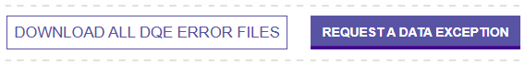
Requesting A Data Exception
From the Batch Manager, open the Batch.
At the bottom of the Data Quality Engine Results, click on Request A Data Exception.
This will open a new page.
Scroll to the bottom.
Notes:
To request a Data Exception, go to Batch Manager.
From the Batch Manager, open the Batch.
At the bottom of the Data Quality Engine Results, click on Request A Data Exception.
This will open a new page.
Scroll to the bottom.

Slide 44
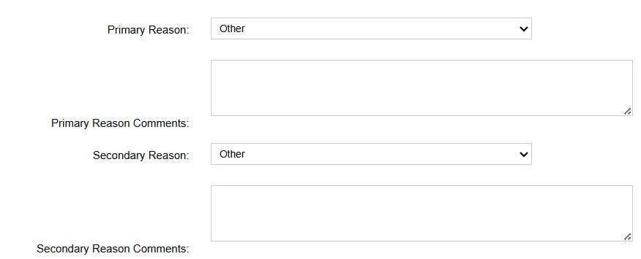
Requesting A Data Exception
(continued)
For Primary and Secondary Reason, select Other.
Enter text to address each warning.
Enter text here
If needed, enter additional text here
Notes:
You must enter a Primary Reason. For the Primary Reason drop down, please select Other.
Enter information explaining why the data is accurate.
If you need to provide more information, use the Secondary Reason, select Other.
Continue to explain why the data is accurate.

Slide 45

Requesting A Data Exception
(continued)
Select Submit Data Exception Request.
Please give 24 business hours for us to review the data exception.
Notes:
Select Submit Data Exception Request.
Please give 24 business hours for us to review the data exception.

Slide 46
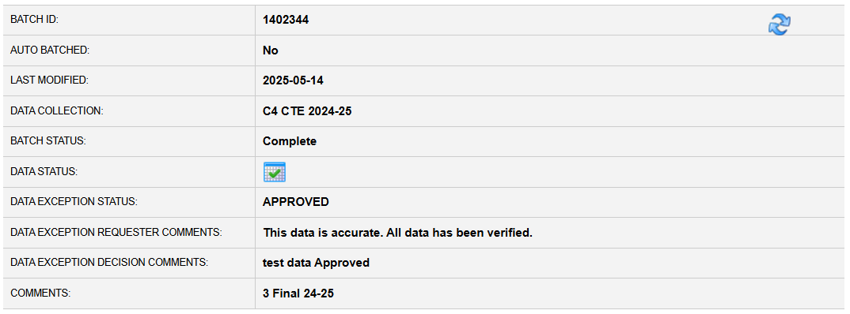
Bad Data Exception
Denied please provide more information on data verification.
Notes:
This is an example of a bad data exception request.
Saying This data is accurate. All data has been verified. Is not a valid reason to request a data exception.
We need to know why the data is accurate.

Slide 47
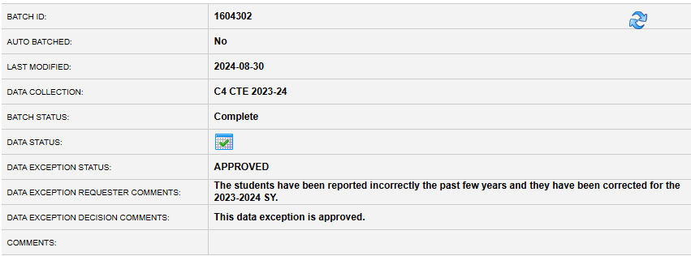
Good Data Exception 1
24-25 Perkins EOY
We have more completers this year to due additional program offerings.
Notes:
Here is an example of a good data exception.
We have more completers this year to due additional program offerings.

Slide 48
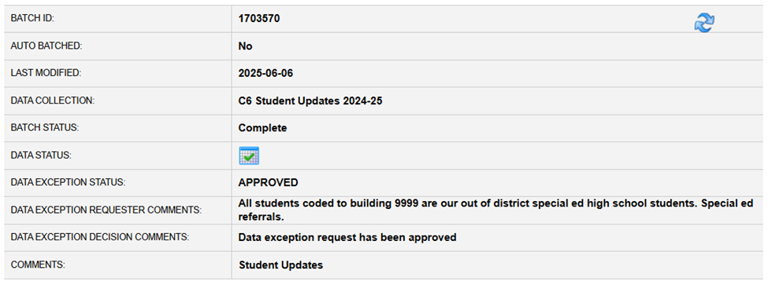
Good Data Exception 2
24-25 Perkins EOY
Pell Grant participation is low due to uploading data by CIP versus all data at once.
Notes:
Here is an example of a good data exception.
Pell Grant participation is low due uploading data by CIP versus all data at once.

Slide 49
PIMSReports V2
Notes:
Now that your data has been accepted into PIMS, we’ll review PIMS ReportsV2 and the reports you can use to verify your data.

Slide 50
Postsecondary Folder
Details Reports
MOE Folder
Perkins Folder
  Follow Up
  Student Level QC & Verification
Notes:
In PIMSReports V2, you are looking for the Postsecondary Folder.
In the main folder are several details reports. These reports will show you what data made it into the PIMS Warehouse.
There is an MOE Folder that covers the MOE collection.
Our presentation focuses on the Perkins Folder. Within the Perkins Folder are two additional folders – Follow Up and Student Level QC & Verification.
The next few slides will look at reports in the Student Level QC & Verification Folder.

Slide 51
Data Coordinator Role
Higher Education data coordinators must:
Review PIMS Perkins Postsecondary data quality control reports to identify errors
Work with Data Owners to make corrections, when needed
  Upload Corrected Data
Deliver PIMS Perkins Postsecondary Accuracy Certification Statement (ACS) to the chief school administrator for approval and signature
Make sure the final, signed ACS is submitted to PDE via e-mail by September 15, 2026
Notes:
PIMS Perkins Postsecondary Data Coordinator Role
Higher Education data coordinators must review PIMS Perkins Postsecondary data quality reports to identify and correct errors.
Work with Data Owners to make corrections when needed and upload corrected data.
After verifying all data is correct, generate and verify the PIMS Perkins Postsecondary Accuracy Certification Statement (ACS).
Please have your Chief School Administrator sign the ACS and send via email to the RA account listed on the ACS. The signed ACS form and its associated summary statistics must be submitted to PDE by September 15, 2026. PDE cannot begin processing Perkins indicators until all ACSs have been received. ACS statements are subject to state and federal audits.

Slide 52
QC Report 01 and 02
QC Rpt01 - PS Student Institution IDs Not in Campus Student Program Fact
  Report used to inform LEA when students within LEA PS Student Institution data were not found within LEA Campus Student Program Fact
  To be counted within your final Perkins CTE Student Data Submission, you must correct students on this report.
QC Rpt02 - Students Reported in More Than One Program Code for a Campus
  Report used to inform LEAs of any CTE students within Campus Student Program Fact submission that were reported multiple Program Codes (CIP Codes)
  Students can only be reported in one Program. You must correct students on this report.
Notes:
Let’s review the Data QC Reports. Please run each of these reports and review the information to ensure accurate and quality data. Remember this data is used for CAR Reports, Allocating Funds, and other Federal and State reporting.
QC Rpt01 - PS Student Institution IDs Not in Campus Student Program Fact
Report used to inform LEA when students within LEA PS Student Institution data were not found within LEA Campus Student Program Fact
To be counted within your final Perkins CTE Student Data Submission, you must correct students on this report.
QC Rpt02 - Students Reported in More Than One Program Code for a Campus
Report used to inform LEAs of any CTE students within Campus Student Program Fact submission that were reported multiple Program Codes (CIP Codes)
Students can only be reported in one Program. You must correct students on this report.

Slide 53
QC Report 03 and 03A
QC Rpt03 - List of Statistically Countable Perkins CTE Students by Campus and Program
  Report lists students considered to be statistically countable as a Perkins CTE enrollees by school and program.
  Review this list to determine if PIMS student records need to be added, deleted, or modified.
QC Rpt03A - Perkins CTE Enrollments by Campus and Program
  Report lists students considered to be statistically countable as a Perkins CTE enrollees by campus and program.
  Review this list to determine if PIMS student records need to be added, deleted, or modified.
Notes:
QC Rpt03 - List of Statistically Countable Perkins CTE Students by Campus and Program
Report lists students considered to be statistically countable as a Perkins CTE enrollees by school and program.
Review this list to determine if PIMS student records need to be added, deleted, or modified.
QC Rpt03A - Perkins CTE Enrollments by Campus and Program
Report lists students considered to be statistically countable as a Perkins CTE enrollees by campus and program.
Review this list to determine if PIMS student records need to be added, deleted, or modified.

Slide 54
QC Report 03B and 03C
QC Rpt03B - Verify List of CTE Students with Program of Study Articulated Credits
  Report lists students considered to be statistically countable as a CTE program enrollees reported as having Program of Study SOAR Articulated Credits.
  Review this list to determine if PIMS student records need to be added, deleted, or modified.
QC Rpt03C – Verify List of CTE Students with Local Articulated Credits
  Report lists students considered to be statistically countable as a CTE program enrollees reported as having Local Articulated Credits (LAC)
  Review this list to determine if PIMS student records need to be added, deleted, or modified.
Notes:
QC Rpt03B - Verify List of CTE Students with Program of Study Articulated Credits
Report lists students considered to be statistically countable as a CTE program enrollees reported as having Program of Study SOAR Articulated Credits.
Review this list to determine if PIMS student records need to be added, deleted, or modified.
QC Rpt03C – Verify List of CTE Students with Local Articulated Credits
Report lists students considered to be statistically countable as a CTE program enrollees reported as having Local Articulated Credits (LAC)
Review this list to determine if PIMS student records need to be added, deleted, or modified.

Slide 55
QC Report 04 and 05
QC Rpt04 - Errors for Invalid Data Element Relationships for Perkins CTE Students
  Report used to inform LEAs of Perkins students with invalid relationships between specified student data elements. Review the following students listed on each tab.
  Make corrections to either the PS Student Institution or the Campus Student Program Fact data to resolve errors.
QC Rpt05 - Warnings for Questionable Data Element Relationships for Perkins CTE Students
  Report used to inform LEAs of Perkins CTE students reported have questionable relationships between specified student data elements. Review the following students listed on each tab.
  Make corrections to either the PS Student Institution or the Campus Student Program Fact data.
Notes:
QC Rpt04 - Errors for Invalid Data Element Relationships for Perkins CTE Students
Report used to inform LEAs of Perkins students with invalid relationships between specified student data elements. Review the following students listed on each tab.
Make corrections to either the PS Student Institution or the Campus Student Program Fact data to resolve errors.
QC Rpt05 - Warnings for Questionable Data Element Relationships for Perkins CTE Students
Report used to inform LEAs of Perkins CTE students reported have questionable relationships between specified student data elements. Review the following students listed on each tab.
Make corrections to either the PS Student Institution or the Campus Student Program Fact data

Slide 56
Accuracy Certification Statement
My LEA data is accurate. Now what?
Postsecondary > Perkins > Student Level – QC and Verification
  Accuracy Certification Statement (ACS)
    Postsecondary Perkins CTE Enrollment ACS Report
    Verify the Data in the ACS!
Notes:
After you verify your data is correct by running all the reports mentioned on the previous slides, you are now ready to run the Postsecondary Perkins CTE Enrollment ACS Report
This is the document that needs to be signed by your Institution's Admin and email the RA-ACS account.
Please review this document carefully. This is your last chance to identify errors.

Slide 57
ACS Page 2 Bad Data???
Reporting ZERO for
  Special Populations
  Males or Females
  Race/Ethnicity
SPECIAL POPULATION | TOTAL | FEMALE | MALE
Disability Indicator | 6 | 2 | 4
Economically Disadvantaged | 335 | 250 | 85
EL Status | 24 | 16 | 8
Nontraditional Enrollees | 246 | 124 | 122
Military Family | 0 | 0 | 0
Student is a Single Parent | 0 | 0 | 0
Migrant Student | 0 | 0 | 0
Out of Workforce Individual | 0 | 0 | 0
Homeless Student | 0 | 0 | 0
Foster Student | 0 | 0 | 0
RACE / ETHNICITY | TOTAL | FEMALE | MALE
American Indian/Alaskan Native | 0 | 0 | 0
Asian | 35 | 35 | 0
Black or African American | 65 | 42 | 23
Hispanic of any race | 94 | 55 | 39
Native Hawaiian or other Pacific Islander | 1 | 0 | 1
Race and ethnicity unknown | 193 | 130 | 63
Two or more races | 12 | 0 | 12
White | 593 | 374 | 219
Notes:
ACS Page 2 Bad Data???
On page 2 of the ACS, Special Populations will only have data for the special populations your institution reported. I’ve added all the Special Populations options for the purpose of our presentation. If you are missing Special Populations, please verify the data is accurate. We recognize getting some of this information can be hard. Work together with other departments and your professors to gather this data.
Under Race and Ethnicity, look for zeros and verify the data is correct. The same as special populations, race/ethnicity will only have data on the ones your institution reported.

Slide 58
ACS Page 3 Bad Data???
Reporting ZERO for
  Pell Grant Recipient
  Completer
PROGRAM CODE | CIP NAME | TOTAL | MALE | FEMALE | ACHIEVED CONCENTRATOR STATUS | ACHIEVED PARTICIPANT STATUS | DID NOT ACHIEVE PARTICIPANT STATUS | PELL GRANT RECIPIENT | COMPLETER
11.0103 | Information Technology | 18 | 12 | 6 | 10 | 11 | 7 | 0 | 0
Notes:
ACS Page 3 Bad Data???
Since we aren’t in your schools, we don’t know if the data is correct or in error. Only you and your data team know your students.
Reporting ZERO for Pell Grant Recipients or Completers
On page 3 of the ACS at the far right columns, highlighted in yellow. If these are ZEROs, please verify it your data.

Slide 59
Submitting My ACS
Postsecondary > Perkins > Student Level – QC and Verification
  Accuracy Certification Statement (ACS)
    Postsecondary Perkins CTE Enrollment ACS Report
    Emailed to the RA-EDACSSubmission@pa.gov
    FOLLOW THE DIRECTIONS on the ACS!!
      Name the file correctly
      Include ALL pages - All pages must have the same date
      Use the correct subject line
    If you upload additional data or delete data after sending in the ACS, you MUST send in a new ACS!
Notes:
Don’t forget to submit your ACS!
The Postsecondary Perkins ACS can be found in PIMSReports V2 by clicking on Postsecondary > Perkins > Student Level – QC and Verification
Accuracy Certification Statement
Postsecondary Perkins CTE Enrollment ACS Report
Review Your ACS for accuracy!
Emailed to the RA-EDACSSubmission@pa.gov
FOLLOW THE DIRECTIONS on the ACS!!
Name the file correctly
Include ALL pages - All pages must have the same date
Use the correct Subject Line
If you upload additional data or delete data after sending in the ACS, you MUST send in a new ACS!

Slide 60
Data Deletion Request
Notes:
Next, we will review requesting a data deletion.

Slide 61
Requesting a Data Deletion
Some fields are updateable, some are not
Data in Key Fields needs to be deleted and correct data uploaded
Call the PIMS Help Desk - 800-661-2423
Request a PS PIMS Deletion
Follow their directions and complete the Deletion Form
Send completed form to ra-catsdata@pa.gov
  Subject Line - PS PIMS Maintenance
Notes:
As mentioned in early slides, some fields are updateable, some are not.
If data in Key Fields needs to be corrected, you must first delete the row and then you can upload new data.
You will need to call the PIMS Help Desk - 800-661-2423
You will need to request a PS PIMS Deletion
Please ollow their directions and complete the Deletion Form
Then send completed form to ra-catsdata@pa.gov with the Subject Line - PS PIMS Maintenance

Slide 62
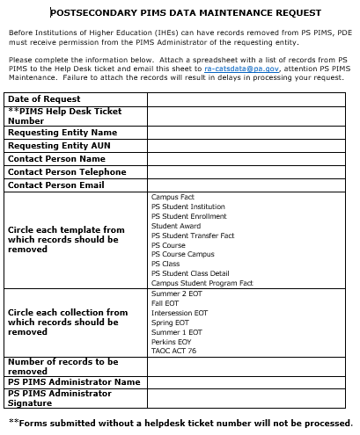
Data Deletion Form
Fill out the form completely!
Must have a PIMS Help Desk Ticket Number!
Indicate the template(s)
Indicate the Collection
Number of records to be deleted
If deleting individual/group records, attach an Excel spreadsheet with the records
Notes:
Here are couple of things to note about the form.
Please fill out the form completely!
Each from Must have a PIMS Help Desk Ticket Number! We can’t process your request without a ticket number.
Please indicate the template(s)
Please indicate the Collection
Please number of records to be deleted. If you wan to delete all data in PIMS, you are indicate the entire template.
If you are deleting individual/groups of records, attach an Excel spreadsheet with the records

Slide 63
Additional Supports
How can we support your data efforts?
Notes:
We are always looking for additional ways to support your data collection efforts. How can we help you?

Slide 64
Additional Support Ideas
Perkins Workgroup Webinars
  Topics
  Meeting Frequency
On-Site Conference Sessions
  Data Summit Conference (Spring)
Others?
Notes:
We recently started a PIMS CTE Workgroup for the Secondary and Adult CTE Collections. Would a Perkins Workgroup be beneficial? What topics would you like covered? How often do you want to meet? – Every other month, once a quarter.
We also recently started a CTE Track at the Data Summit. For the most part this covers, Secondary and Adult data topics. Would you find it beneficial to have Postsecondary sessions at the Data Summit?
The 2027 Data Summit is March 22-24, 2027 at the Hershey Lodge and Convention Center.

Slide 65
Contact/Mission
For more information or assistance on the PIMS Perkins Postsecondary Perkins EOY Data Collection, please contact PDE’s Data Quality Office at ra-catsdata@pa.gov
Notes:
For more information or assistance on the PIMS Perkins Postsecondary Perkins EOY data collection, please contact PDE’s Data Quality Office at ra-catsdata@pa.gov

