Slide 1
Long-Term Care (LTC) Application Process and Pending Documentation
Office of Income Maintenance

Slide 2
Purpose
This presentation will:
Review information found in the Long-Term Care Facility Application Checklist, including:
  an overview of the LTC application process.
  an overview of LTC Pending Documentation.
Provide information for becoming a COMPASS Community Partner.

Slide 3
LTC Application Process

Slide 4
LTC Application Process
Functional Eligibility
  Must meet Nursing Facility Level of Care
  Verified by completion of questions 21 and 22 on MA 51 for LTC facility
  Verified by the PA 1768, HCBS Eligibility/Ineligibility/Change form for HCBS
Non-Financial Eligibility
  Citizenship, Identity, Enumeration, Residency
Income
  Gross income is used to determine eligibility for LTC services
  300% of the Federal Benefit Rate (FBR)
  If gross monthly income exceeds 300% of the FBR, then semi-annual income after deducting semi-annual medical expenses cannot exceed $2,550 (LTC facility)
Resources
  $2,000 (with a standard $6,000 disregard) if income is equal to or less than 300% of the FBR
  $2,400 if income exceeds 300% of the FBR
More info at: http://services.dpw.state.pa.us/oimpolicymanuals/ltc/index.htm

Slide 5
LTC Application Process
The LTC application process begins with an Application for Benefits.
  Must be signed to be considered complete.
Applications can be submitted in four ways:
  ONLINE – applicants can go to www.dhs.pa.gov/COMPASS to apply.
  PHONE – applicants can call Consumer Service Center at 1-866-550-4355 to have a representative complete the form with them.
  IN PERSON* – applicants can drop off an application at the CAO.
  MAIL* – applicants can mail an application to their local County Assistance Office (CAO).
    *Medical Assistance (Medicaid) Financial Eligibility Application for Long-Term Care, Supports, and Services (PA 600 L)
Applications can be submitted by the applicant or anyone representing the applicant.
Submit all available documentation with the application.

Slide 6
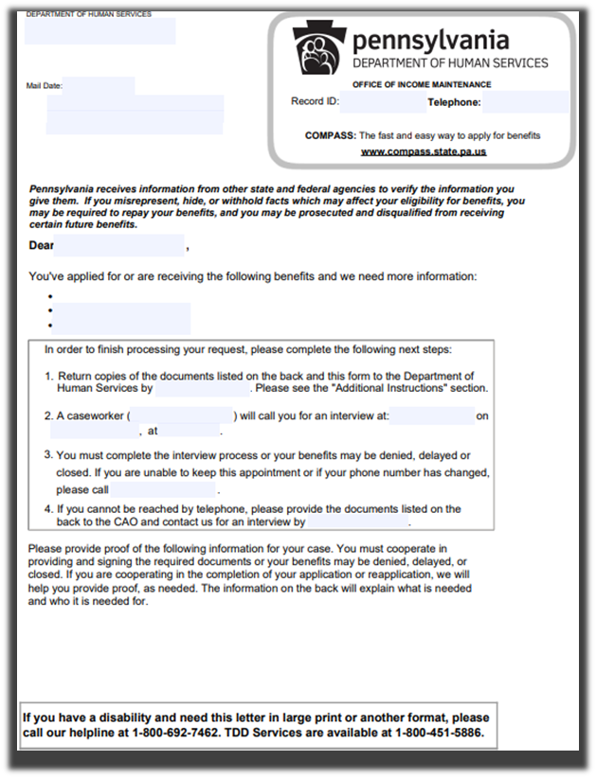
LTC Application Process
The LTC application process continues with the CAO reviewing the application and documents provided.
The CAO will request additional documentation via a Pending Verification letter (PA 253)
  PA 253 lists the due date (15 days from 253 mailing date).
Applicants or their representatives can request additional time to submit documentation by calling the Customer Service Center at 1-877-395-8930 or 1-215-560-7226 (for Philadelphia residents) before the due date.

Slide 7
LTC Application Timeframes
LTC application processing timeframes are determined by policy found in the LTC Handbook.
Submit applications as soon as possible with all available documentation.
The CAO will process in 30 days.
  15 additional days to gather and submit documentation will be granted to the applicant when requested prior to verification due date.
See the LTC Handbook for more information about retroactive coverage and application submission time frames.

Slide 8
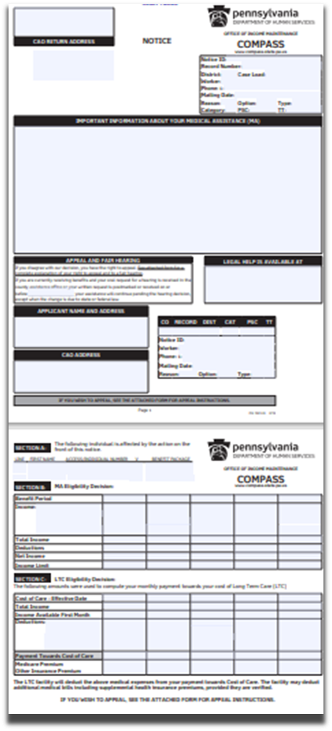
LTC Application Process
The LTC application process continues with an eligibility determination.
The CAO will send a notice of eligibility or ineligibility.
  Eligible applicants receive a notice that includes the LTC facility services effective date.
  Ineligible applicants receive a notice providing the reason for ineligibility.

Slide 9
LTC Application Process
Ineligibility Options:
Request Reconsideration
  Contact the CAO within 60 days from the application denial date.
    If ineligible for failure to provide documentation, all documents must be submitted within the 60 days.
Appeal
  Submit within 30 days from the date on the ineligibility notice.
Application for Undue Hardship Waiver (PA 1872)
  Only applies for ineligibility due to transferred or gifted resources without fair consideration.
  Submit within 30 days from the date on the ineligibility notice.

Slide 10
LTC Application Pending Documentation

Slide 11
LTC Application Pending Documentation
Remember the LTC application process begins with submitting an application and continues with the CAO reviewing the application and documents provided.
The CAO compares the application to other information available, including:
  Case record info
  Verifications submitted
  Electronic data source
If all required documentation is submitted, an eligibility determination will be made.
If more documentation is needed, the CAO will request additional via a Pending Verification letter (PA 253)

Slide 12

LTC Application Pending Documentation
The Pending Verification (PA 253) letter is the official request from the Department

Slide 13
LTC Application Pending Documentation
Functional Eligibility
PA 600L- (Medical Assistance (Medicaid) Financial Eligibility Application for Long-Term Care, Supports, and Services)
  Completed and signed.
  A paper PA 600L may be submitted to the CAO or the applicant/applicant’s representative may apply online at www.dhs.pa.gov/COMPASS or by calling the Consumer Service Center at 1-866-550-4355. Please complete all questions on the application. Incomplete applications may cause a delay in the eligibility determination.
MA 51- (Medical Evaluation Form)
  Submitted by Aging Well or the Department’s designee.
  The MA 51 is provided directly to the CAO by the LTC facility or the agency that assesses the applicant’s functional eligibility.

Slide 14
LTC Application Pending Documentation
Functional Eligibility, cont.
MA 103- (Long Term Care Admission and Discharge Transmittal Form)
  Completed and submitted by the LTC facility.
  The MA 103 is provided directly to the CAO by the LTC facility.
PA 1572- (Resource Assessment Form)
  If the applicant is married (including separated) and a Resource Assessment has not already been completed.
  A PA 1572 is needed for all married and/or separated applicants. The Resource Assessment form is included in the Admissions Notice Packet (MA 401) provided to all individuals upon admission to a LTC facility. If a married or separated applicant does not have a copy of the Resource Assessment, one will be provided by the CAO after the paper PA 600L, or online application is received.

Slide 15
LTC Application Pending Documentation
Non-Financial
Power of Attorney or Guardianship document.
Divorce decree if the applicant has been divorced within the last five years.
If not a United States (U.S.) citizen, verification of Alien Registration Number and Immigration and Naturalization Services or U.S. Citizenship and Immigration Services documents.

Slide 16
LTC Application Pending Documentation
Income
Monthly gross income for the applicant and/or spouse, including but not limited to:
  Social Security
  Supplemental Security Income
  Pensions
  Annuities
  Rental income
  Dividends
  Interest
  Wages, etc.

Slide 17
LTC Application Pending Documentation
Resources
Deed to residential property owned by the applicant and/or spouse.
Deed to non-residential property (rentals, condo, time share, etc.) owned by the applicant and/or spouse.
Burial account/agreement (irrevocable and revocable) owned by the applicant and/or spouse to include statement of irrevocability, value, and date created.
Face values and cash values of all life insurance policies owned by the applicant and/or spouse.
  Current cash values of all life insurance policies owned by the applicant and/or applicant’s spouse must be provided. For married applicants, the values of all life insurance policies as of the LTC facility admission date listed on the completed PA 1572 must also be provided.
Registrations to all vehicles owned by the applicant and/or spouse.

Slide 18
LTC Application Pending Documentation
Resources, cont.
Monthly financial statements* for the most current two years of the look-back period for the applicant and/or spouse, from ___________ to ___________.
Semi-annual financial statements* (ex. January and June) for the additional three years of the look-back period for applicant and/or spouse, from ____________ to ______________.
  * See next three slides for additional details regarding financial accounts

Slide 19
LTC Application Pending Documentation
Resources- Financial Account Info.
Financial accounts include, but are not limited to, investment accounts, bank accounts, Certificates of Deposit, stocks and bonds.
The start date of the look-back period is based on whether the individual is a current MA recipient.

Slide 20
LTC Application Pending Documentation
Resources- Financial Account Info, cont.
For new applicants, the look-back period begins five years prior to the application date.
  Example: A new MA LTC facility applicant applies on May 20, 2025. The look-back period will run from May 20, 2020, through May 20, 2025.
    The client must provide as many monthly financial statements as possible for the most current two years of the look-back period of January 2024 through May 2025.
    The client must provide semi-annual financial statements for the additional three years of the look-back period from May 2020 through December 2023 (example, account statements for June 2020, January 2021, June 2021, January 2022, June 2022, January 2023, and June 2023).

Slide 21
LTC Application Pending Documentation
Resources- Financial Account Info, cont.
For current MA recipients, the look-back period begins five years prior to the admission to the LTC facility.
  Example: A current MA recipient is requesting LTC facility services. The individual was admitted to the LTC facility on May 20, 2025. The look-back period is May 20, 2020, through May 20, 2025.
    The client must provide as many monthly financial statements as possible for the most current two years of the look-back period of January 2024 through May 2025.
    The client must provide semi-annual financial statements for the additional three years of the look-back period from May 2020 through December 2023 (example, account statements for June 2020, January 2021, June 2021, January 2022, June 2022, January 2023, and June 2023).

Slide 22
LTC Application Pending Documentation
Resources, cont.
Financial statements for all accounts owned by the applicant and/or spouse to verify account values as of the LTC facility admission date, if married and a Resource Assessment has not already been completed.
  For all married or separated applicants, financial statements to verify all account values for all financial accounts owned by the applicant and/or applicant’s spouse must be verified as of the LTC facility admission date listed on the completed PA 1572.

Slide 23
LTC Application Pending Documentation
Resources, cont.
Verification of all financial accounts closed since ______________ (five years prior to the admission date or application date) to include date(s) closed, value(s) at time closed, and where the money was deposited or how it was spent.
  For current MA recipients, documentation of all financial accounts closed for the five-year period prior to the admission date must be provided.
  For new applicants, documentation of all closed accounts for the five-year period prior to the application date must be provided. Verification of the date the account was closed, closing balance and where the money was deposited or how it was spent should be provided for each closed financial account.
Retirement account statement, 401K for applicant and/or spouse.

Slide 24
LTC Application Pending Documentation
Expenses
Expenses of the spouse residing in the community.
  Verification of shelter costs: mortgage(s), rent, utilities, homeowner’s insurance, etc.

Slide 25
LTC Application Summary

Slide 26
Additional Information – Other Communications
Text Messages
Must opt-in
Opt-in instructions at www.dhs.pa.gov/text
Recipients can receive additional reminders and information through electronic communications:
Emails
Must opt-in
Opt-in via COMPASS at www.dhs.pa.gov/COMPASS
eNotices
Must opt-in
Opt-in via COMPASS at www.dhs.pa.gov/COMPASS

Slide 27
Additional Information – COMPASS Community Partners
If an agency or entity would like to help complete MA applications/renewals via COMPASS, they can sign up to become a Community Partner.
To register as a Community Partner, visit: COMPASS Account Management - CP Registration Selection [AMCPP]
There is a COMPASS Community Partner Online Self-Registration Quick Reference Guide which walks through the registration process.
Once registered, the COMPASS Community Partner Quick Reference Guide is available to assist you in the use of COMPASS online services as a COMPASS Community Partner.
For more helpful Community Partner resources please visit the Important Links tab on the COMPASS Homepage.

Slide 28
Additional Information – COMPASS Community Partners
Benefits of registering as a COMPASS Community Partner:
  Applications can also be submitted on behalf of individuals
  Application status can be viewed
  Applications can be stopped and saved for up to six months
  Verification documents can be scanned or imported to be submitted electronically
  Ability to look up renewal dates for active recipients
  Renewals can be e-signed
  Ability to pull basic statistical reports
  Access to program information, forms, and policy handbooks

Slide 29
Helpful Links
PA DHS Website
Long-Term Care Website
Long-Term Care Handbook
Medical Assistance Eligibility Handbook
COMPASS

Slide 30
Key Takeaways
This is a general guide.
More information: http://services.dpw.state.pa.us/oimpolicymanuals/ltc/index.htm.
Submit applications as early and complete as possible.
Submit all relevant documents as soon as possible.
Know the timelines and request more time if needed.
Know the options if determined not eligible.
Become a COMPASS Community Partner.

