Slide 1
Welcome to Dentists and Public Health Dental Hygiene Practitioners (PHDHP) Enrollment Training

Slide 2
Topics
Primary topics:
Affordable Care Act Overview
Accessing the Enrollment Application
Enrollment Application Completion
Resume Application
Check Application Status
Change Request
Resources

Slide 3
ACA - Overview
In accordance with federal Medicaid requirements at 42 CFR §§ 438.602(b) and 438.608(b), relating to state responsibilities and program integrity requirements under the contract, with regard to the screening, enrollment and revalidation of providers, a provider must be enrolled in the MA Program as a condition of being enrolled in a managed care network
Dentists and Public Health Dental Hygiene Practitioners (PHDHP) who wish to participate as MCO network providers to render services to MA beneficiaries under the MA managed care delivery system must be enrolled in the MA Program
The ACA and implementing regulations require states to revalidate the enrollment of providers every five years
Please Note: This training does not address MCO credentialing or contracting questions or concerns

Slide 4
Dentist Enrollment Requirements
Provider Type – 27 Dentist
Specialty Codes
270- Endodontist
271- General Dentistry
272 – Oral/Maxillofacial Surgeon
273 – Orthodontist/Dentofacial Orthopedist
274 – Pediatric Dentist
275 – Periodontist
276 – Oral Pathologist
277 – Prosthodontist
278 – Oral/Maxillofacial Pathologist
279 – Oral/Maxillofacial Radiologist
282 – Dental Public Health
283 – Cleft Palate
284 – Dental Anesthesiologist, APU
285 – Dental Anesthesiologist, AP1
286 – Dental Anesthesiologist, AP2
370 – Tobacco Cessation

Slide 5
PHDHP Enrollment Requirements
MA Bulletin 10-17-01 - Public Health Dental Hygiene Practitioner Enrollment in the Medical Assistance Program
PHDHPs are licensed dental hygienists who are certified by the Pennsylvania State Board of Dentistry and may render certain services without the direct supervision of a dentist including cleaning teeth, taking x-rays, polishing fillings, identifying cavities, making molds for dental prosthetics, evaluating patients and educating patients about oral health.
Provider Type 10 – Mid-Level Practitioner
Specialty Code 269 - Public Health Dental Hygienist

Slide 6
Accessing Enrollment Application
Dentists and PHDHPs wishing to enroll will need to complete a new enrollment application
Step 1:
Go to the Landing page of the PROMISe™ Portal
website: promise.dpw.state.pa.us
Step 2:
Select “New Application” from the Provider Enrollment Section of the Landing Page
Step 3:
Complete the application using the Dentist’s or PHDHP’s information and submit

Slide 7
Accessing Enrollment Application

Slide 8
Application Tracking Number (ATN)
Each online provider enrollment application is assigned a unique Application Tracking Number (ATN)
An email containing the 10-digit ATN will be sent to the email address entered in the Contact Information
Additionally, the ATN will display at the top of the application
The ATN is required to resume or check the status of the application

Slide 9
Email Notifications
The electronic enrollment system will send email notices to providers at key points during the application submission and determination process. The emails will be generated from a ‘do not reply’ email address. The following are the types of emails generated:
Online Application Initiated
Online Application Submitted
Online Application Returned to Provider for Revisions
Online Application Initiated – Expiring
Online Application Returned to Provider – Expiring

Slide 10
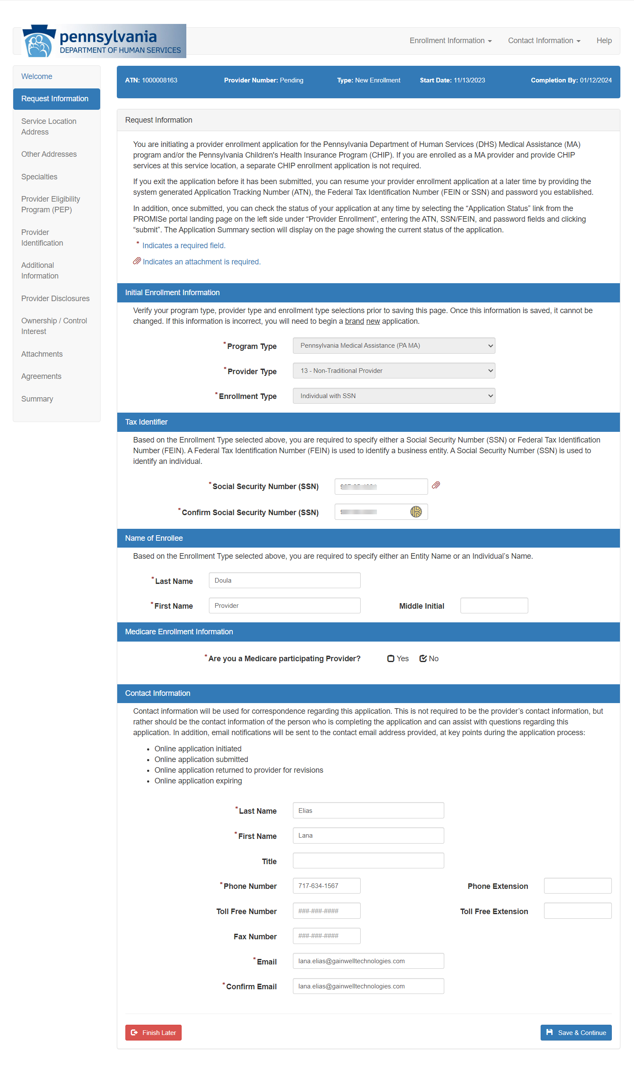
Request Information Page

Slide 11
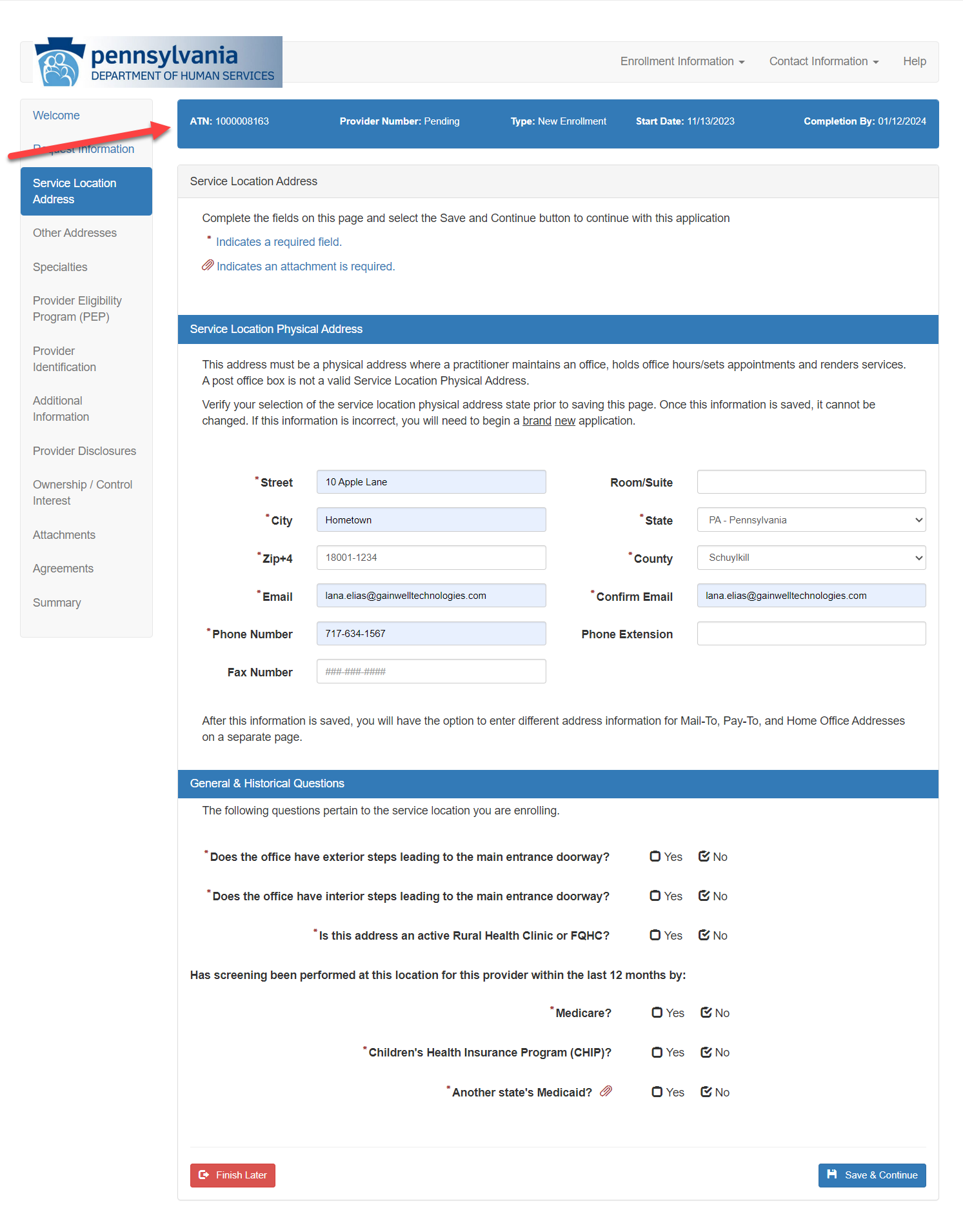
Service Location Address Page

Slide 12
Public Health Dental Hygiene Practitioners Enrollment Application

Slide 13
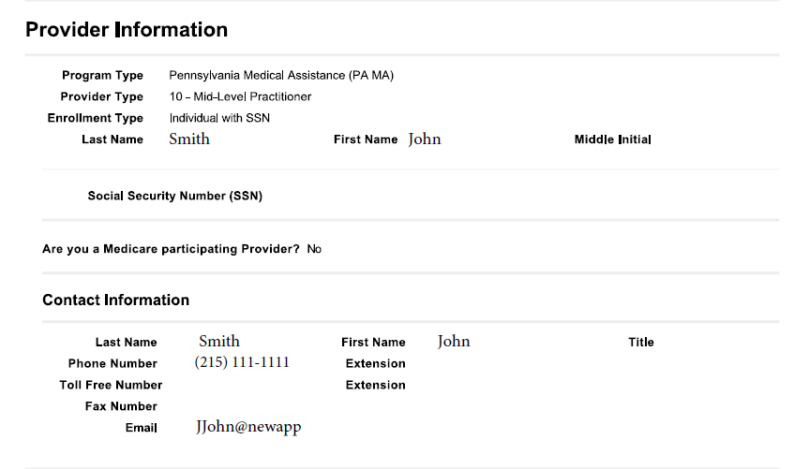
Provider and Contact Information

Slide 14
Service Location Information

Slide 15
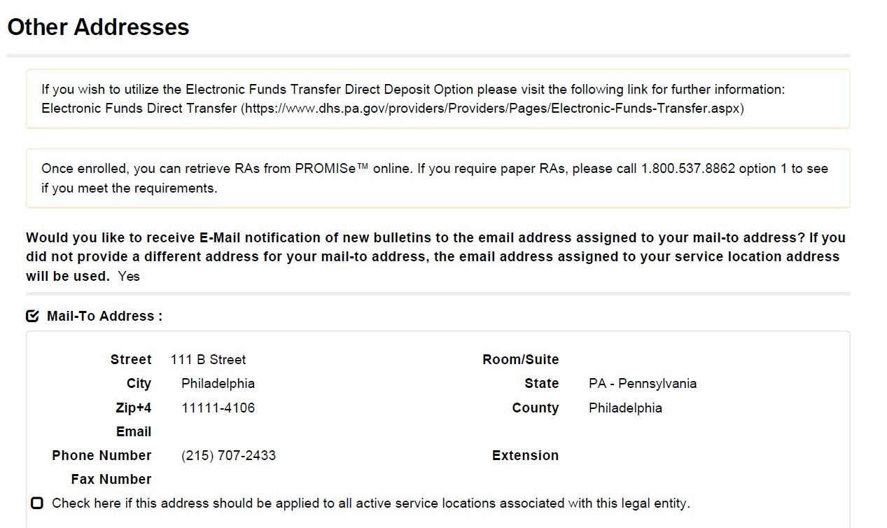
Other Addresses

Slide 16
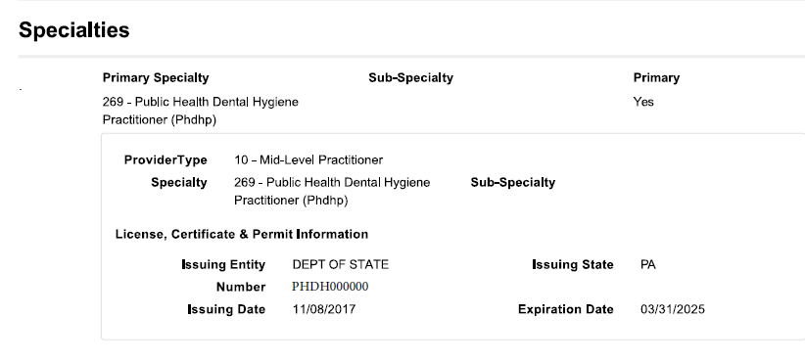
Specialties

Slide 17
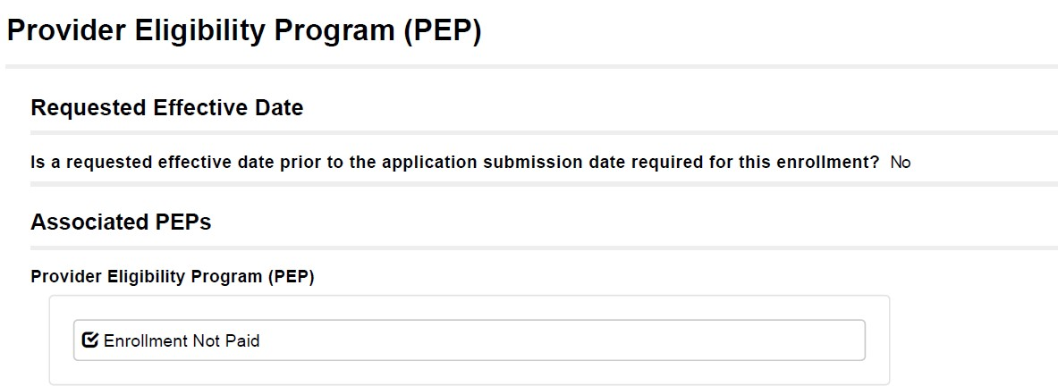
Provider Eligibility Program (PEP)

Slide 18
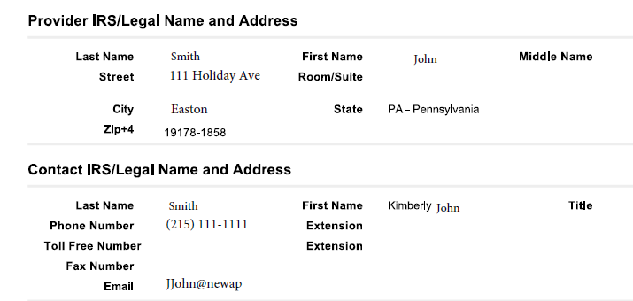
Provider Identification

Slide 19
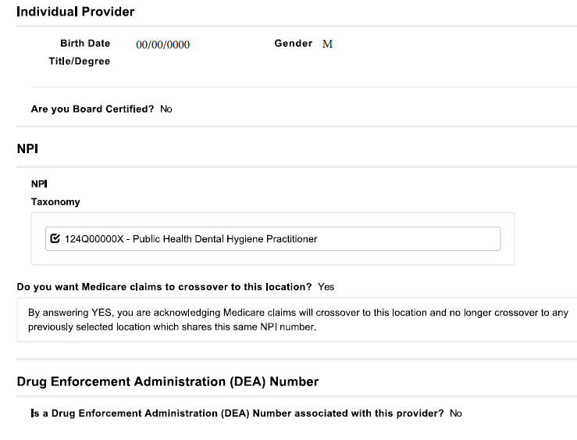
Provider Identification

Slide 20
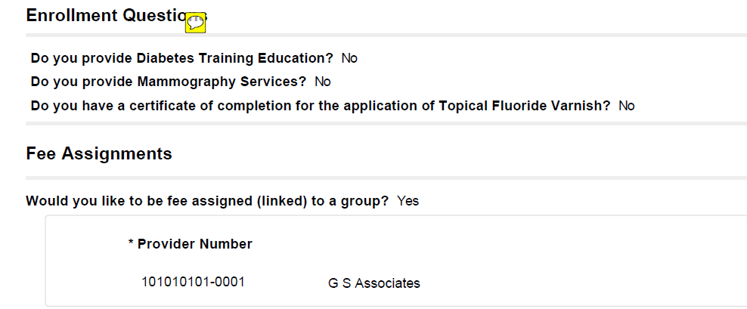
CLIA Certification/Enrollment Question

Slide 21
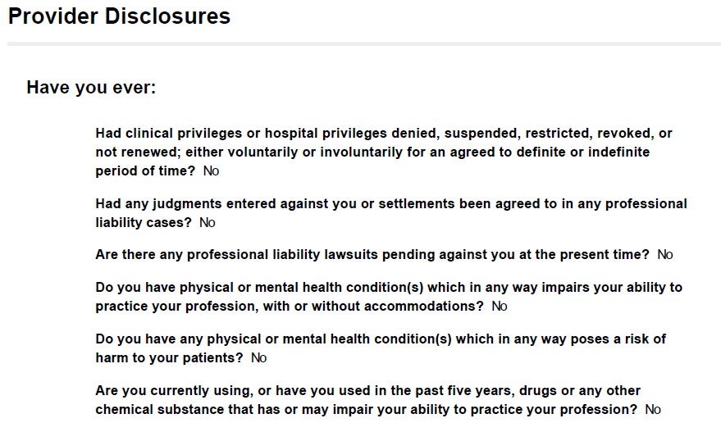
Provider Disclosures

Slide 22
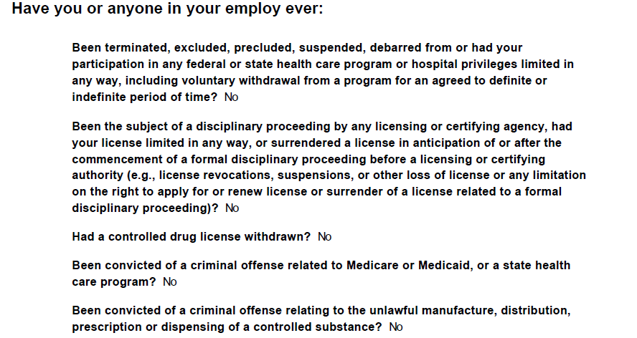
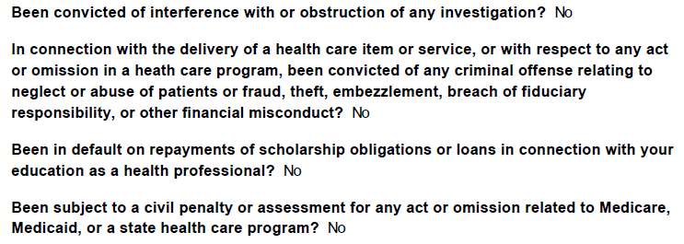
Provider Disclosures (cont.)

Slide 23
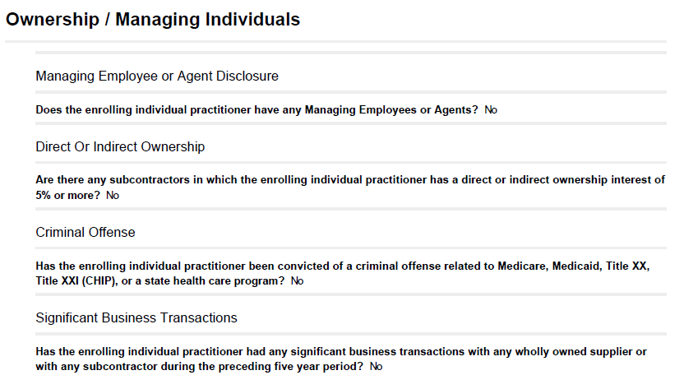
Ownership/Managing Individuals

Slide 24
Attachments

Slide 25
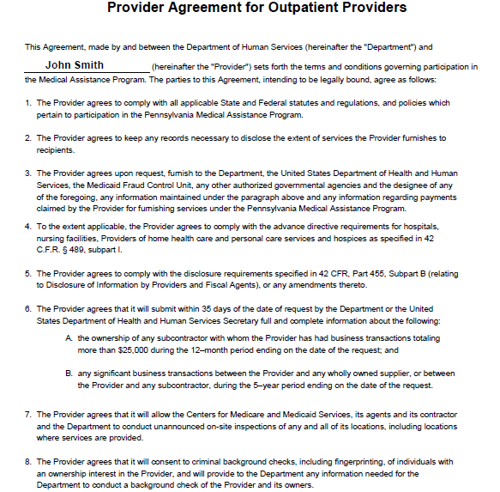
Provider Agreement

Slide 26
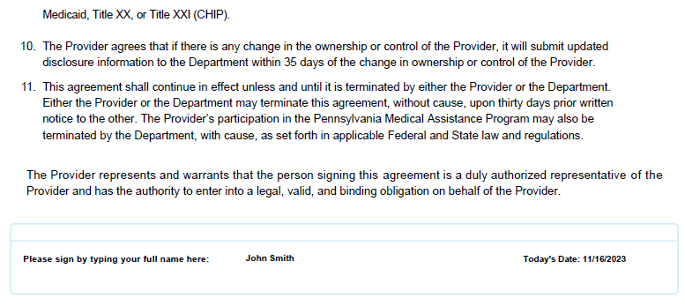
Provider Agreement (cont.)

Slide 27
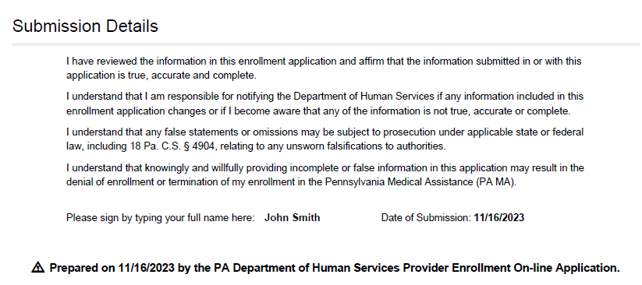
Submission Details

Slide 28
Individual Dentist New Enrollment

Slide 29
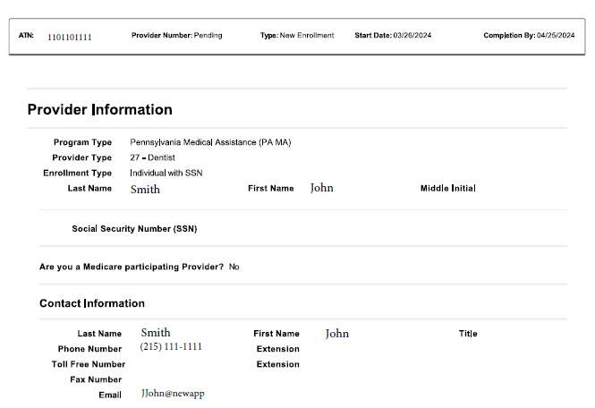
Provider and Contact Information

Slide 30
Service Location Information

Slide 31
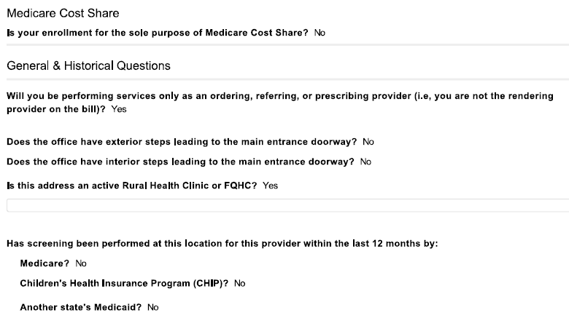
General & Historical Questions

Slide 32
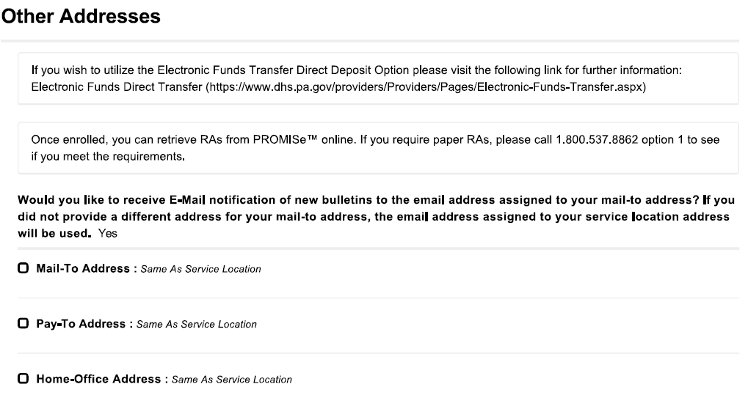
Other Addresses

Slide 33
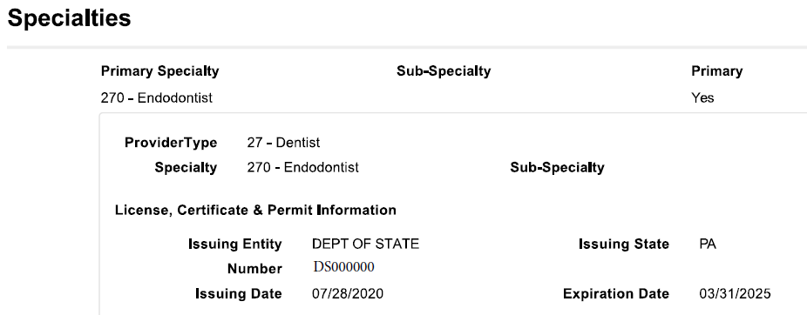
Specialties

Slide 34
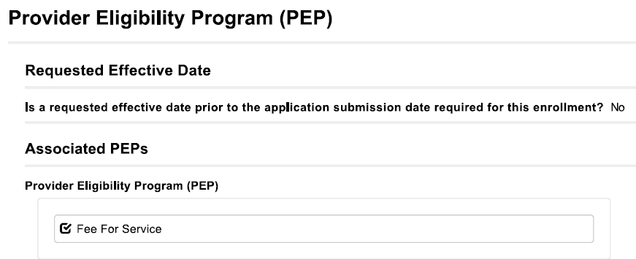
Provider Eligibility Program (PEP)

Slide 35
Provider Identification

Slide 36
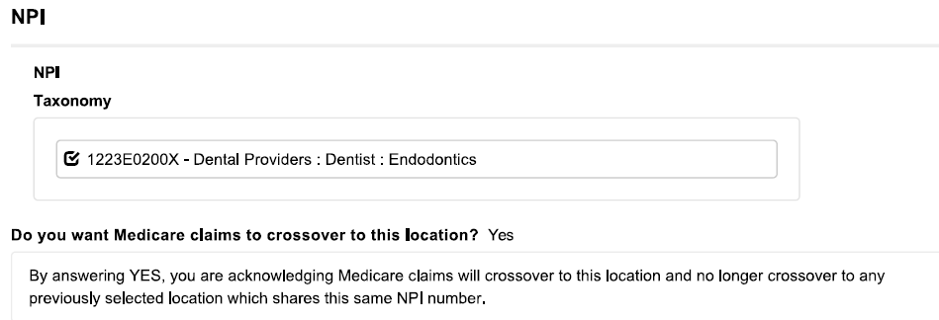
Provider Identification

Slide 37
Enrollment Questions

Slide 38
Provider Disclosures

Slide 39
Provider Disclosures (cont.)

Slide 40
Ownership/Managing Individuals

Slide 41
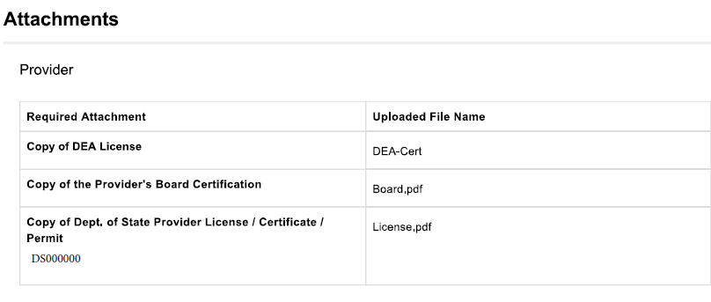
Attachments

Slide 42
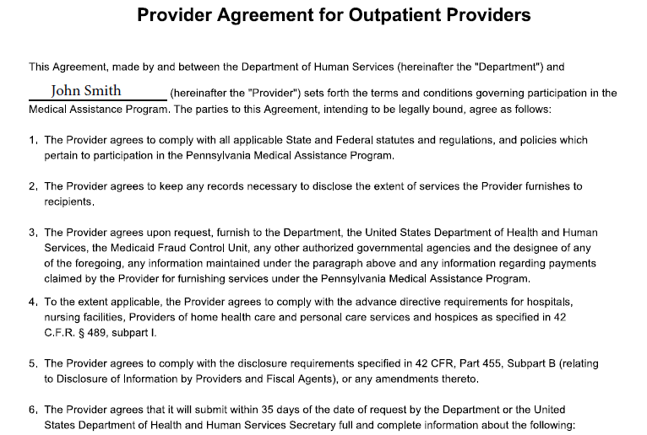
Provider Agreement

Slide 43
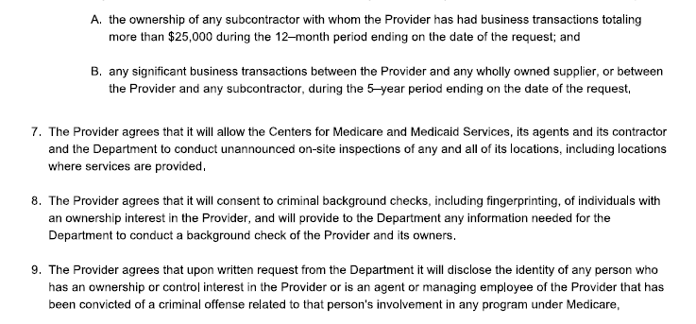
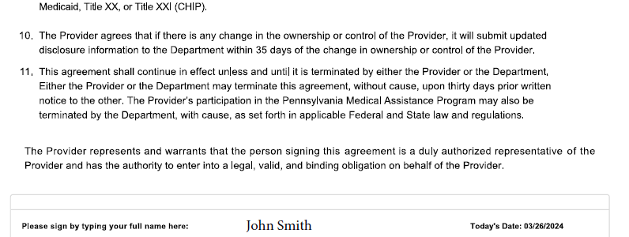
Provider Agreement cont.

Slide 44
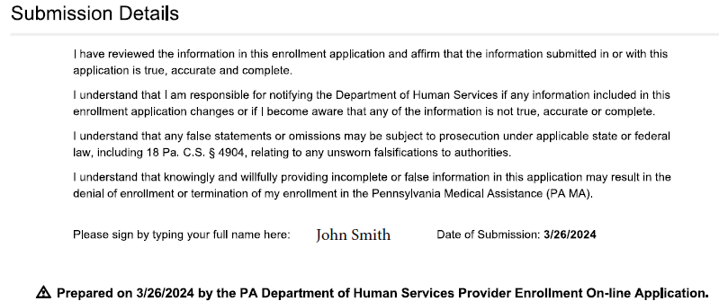
Submission Details

Slide 45
Dentist Group / Revalidation

Slide 46
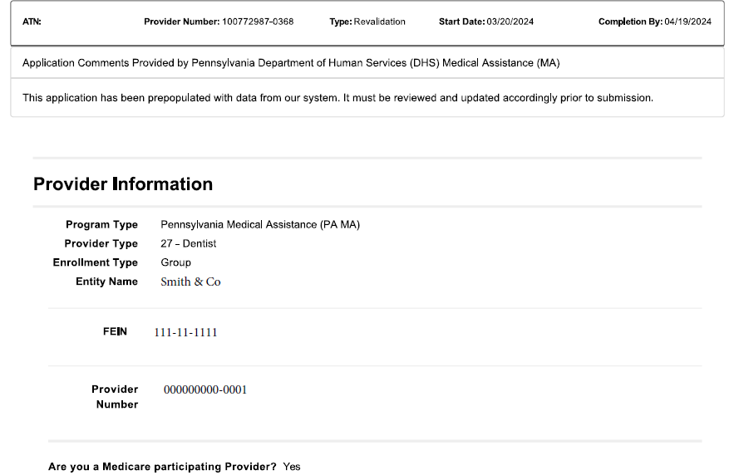
Provider Information

Slide 47
Contact and Service Location Information

Slide 48
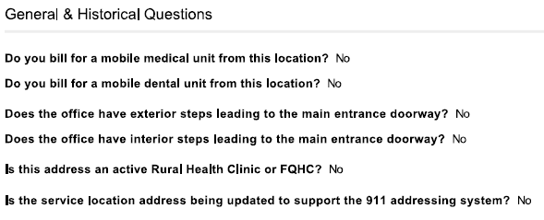
General & Historical Questions

Slide 49
Other Addresses

Slide 50
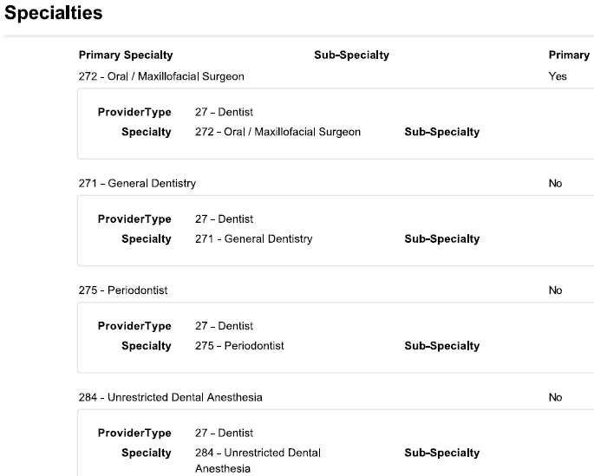
Specialties

Slide 51
Provider Eligibility Program (PEP)

Slide 52
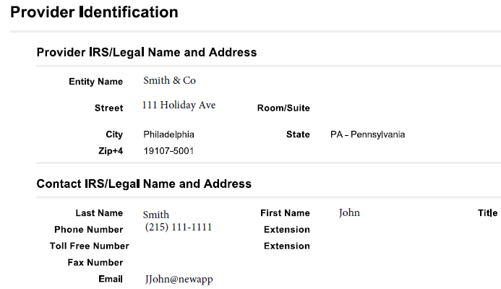
Provider Identification

Slide 53
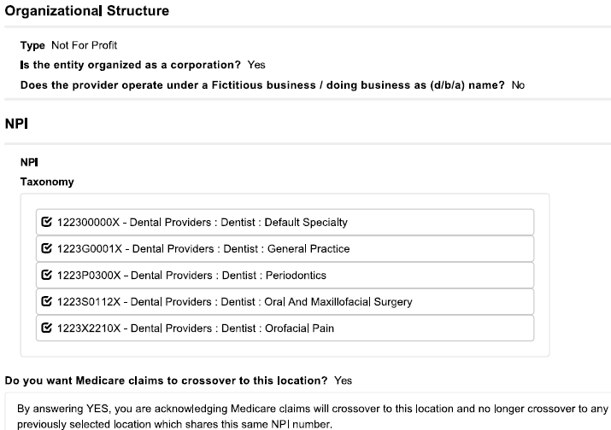
Provider Identification cont.

Slide 54
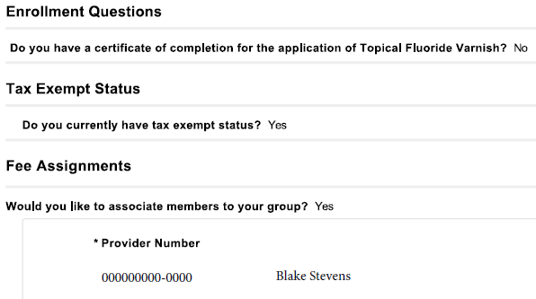
Enrollment Questions

Slide 55
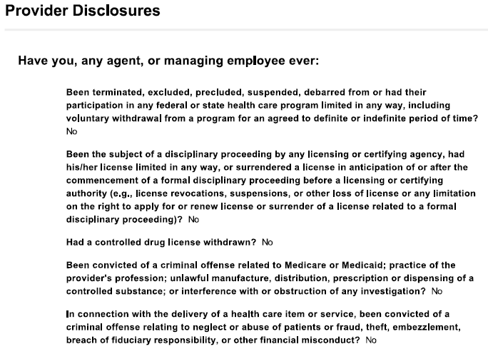
Provider Disclosures

Slide 56
Provider Disclosures (cont.)

Slide 57
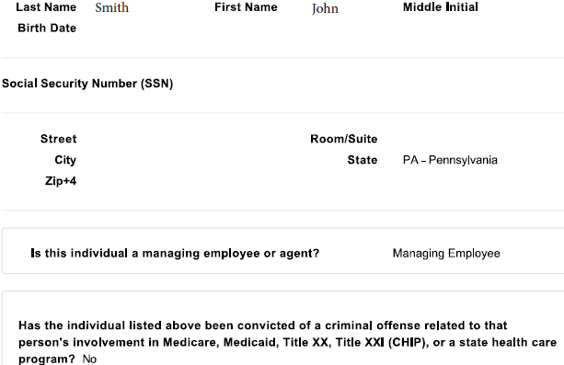
Ownership/Managing Individuals

Slide 58
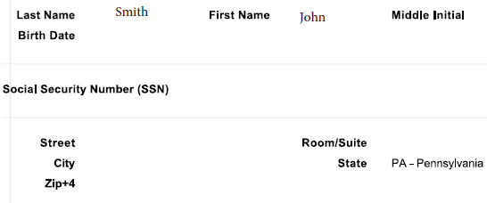
Ownership/Managing Individuals

Slide 59
Ownership/Managing Individuals

Slide 60
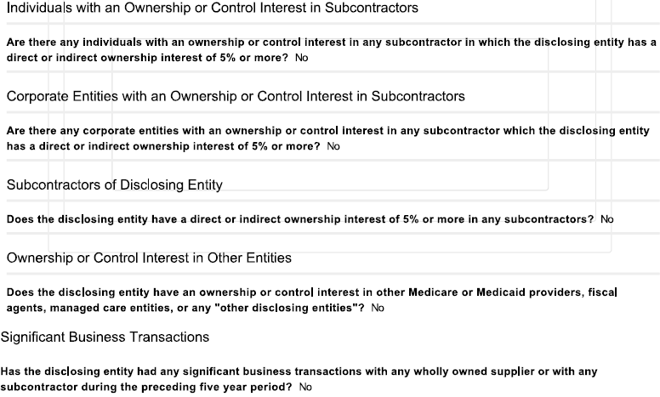
Ownership/Managing Individuals

Slide 61
Additional Revalidation

Slide 62
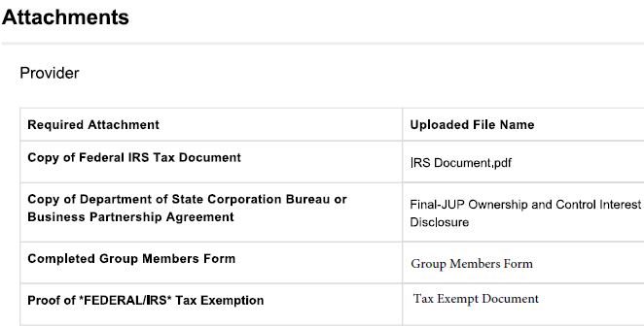
Attachments

Slide 63
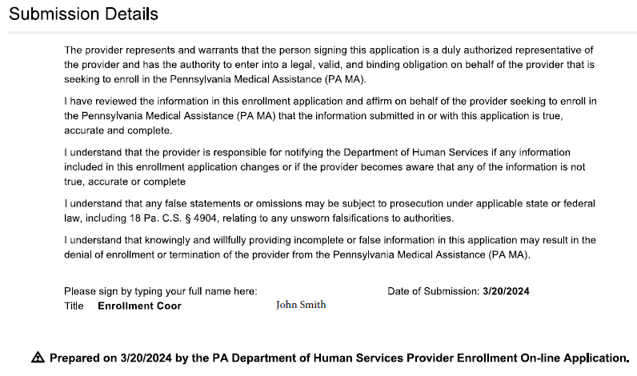
Submission Details

Slide 64
How to Resume or Check Enrollment Application Status

Slide 65
Resume Application
Resume application
Allows a provider to resume an application that has been started but not yet submitted
Or resume an application that was returned to the provider for corrections
Items needs to Resume Application
Application Tracking Number (ATN)
FEIN or SSN of provider on the application
Password created when saving the application

Slide 66
Resume Application
To resume an application
Step 1:
Go to the Landing page of the PROMISe™ Portal
website: promise.dpw.state.pa.us
Step 2:
Select “Resume Application” from the Provider Enrollment Section of the Landing Page
Step 3:
This link opens a window requesting the Application Tracking Number (ATN), Tax Id or SSN and Password
Once supplied and verified, the provider can resume an application that has not been submitted or resume and application that has been returned for corrections

Slide 67
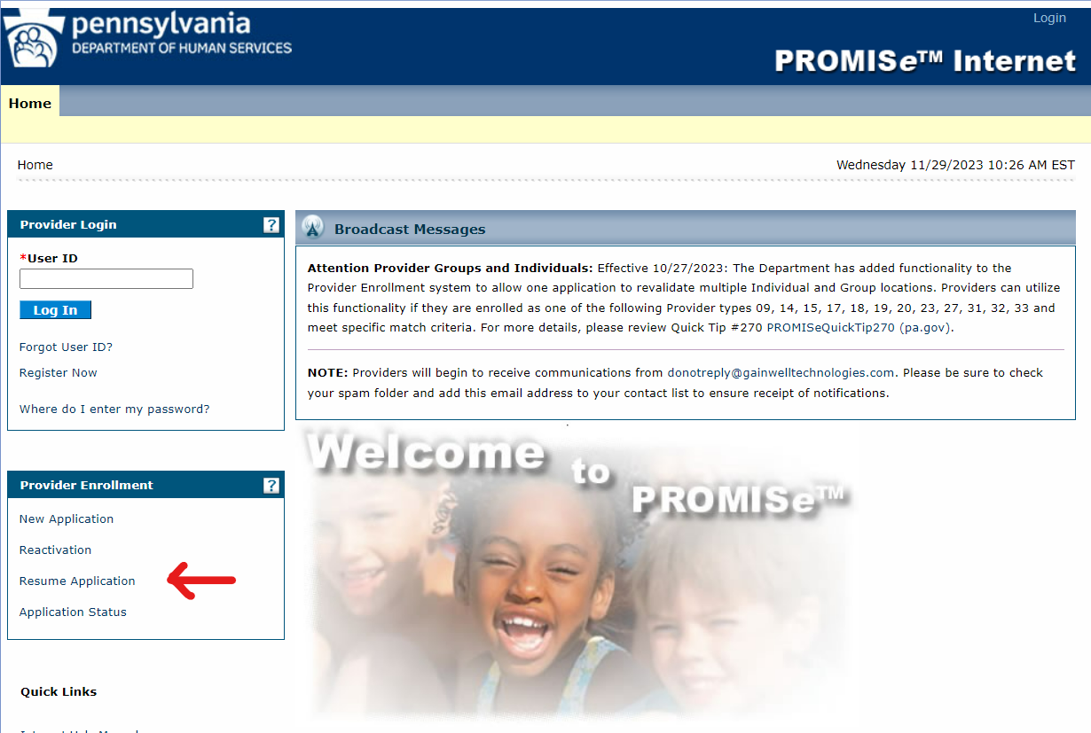
Resume Application

Slide 68
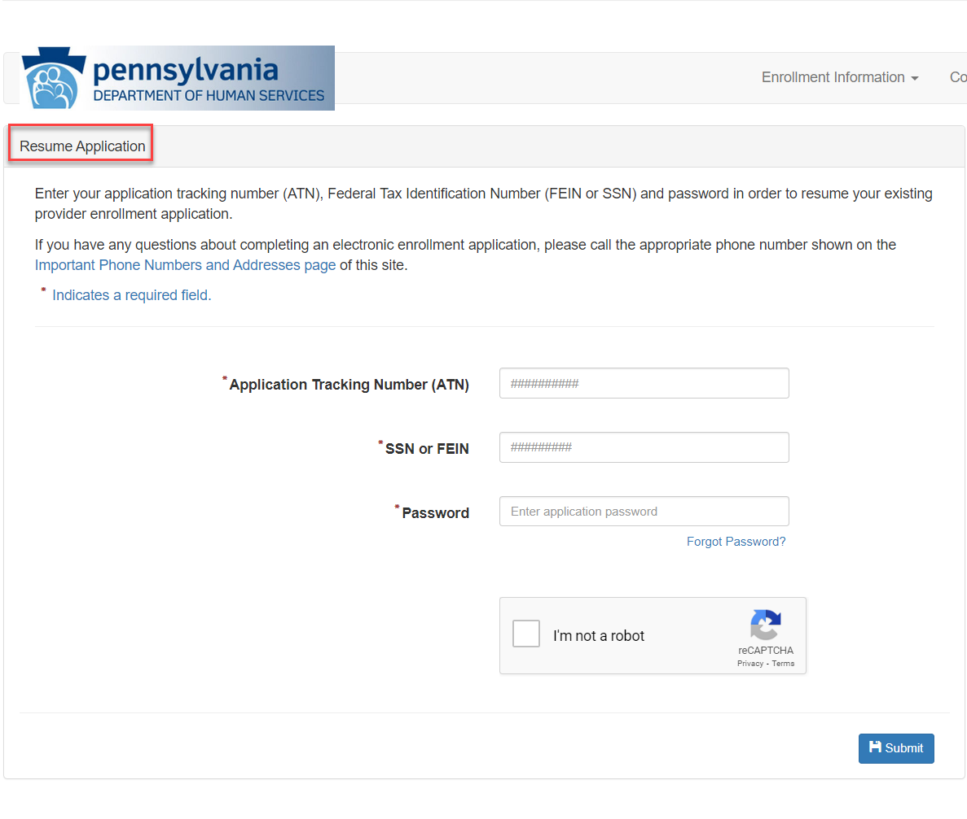
Resume Application

Slide 69
Application Status
Application Status
Allows a provider to check on the status of an existing application either submitted or incomplete
Items needs to check Application Status
Application Tracking Number (ATN)
FEIN or SSN of provider on the application
Password created when saving the application

Slide 70
Application Status
To check the status of a submitted application
Step 1:
Go to the Landing page of the PROMISe™ Portal
website: promise.dpw.state.pa.us
Step 2:
Select “Application Status” from the Provider Enrollment Section of the Landing Page
Step 3:
This link opens a window requesting the Application Tracking Number (ATN), tax Id or SSN and Password
Once supplied and verified, the provider can view the status of a current application whether submitted or not. The provider can also view the application PDF of a submitted application from this page

Slide 71
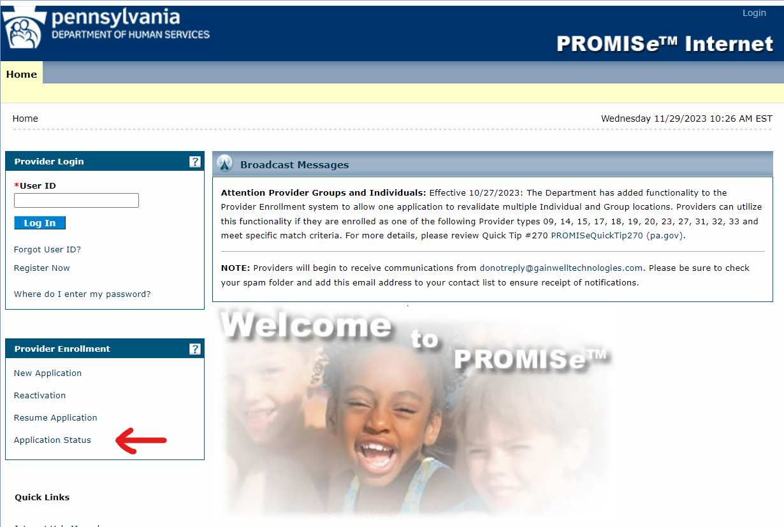
Application Status

Slide 72
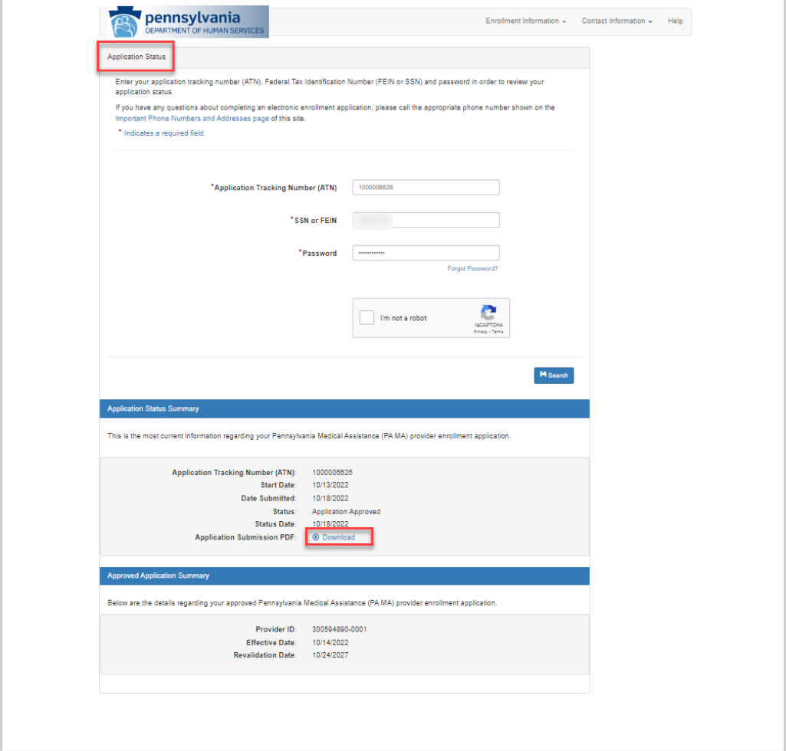
Application Status

Slide 73
Change Request

Slide 74
When to use a Change Request
When to submit a Change Request
Change Request allows the provider to change specific enrollment information through the electronic enrollment portal
Update Group Member Information
To close an existing service location
To change a Mail-To, Pay-To, or Home Office address for an existing service location
To change an IRS address for an existing Provider ID
To change an e-mail address for an existing service location
To terminate association (fee assignment) with a Provider Group by an Individual
To add or terminate a specialty code for an existing service location
A Change Request is the fastest way to have these tasks completed

Slide 75
Accessing a Change Request
How to submit a Change Request
Step 1:
Go to the Landing page of the PROMISe™ Portal
website: promise.dpw.state.pa.us
Step 2:
Logon to the PROMISe™ Portal
Step 3:
Select “Change Request” from the Provider Services Section of the “My Home” page

Slide 76
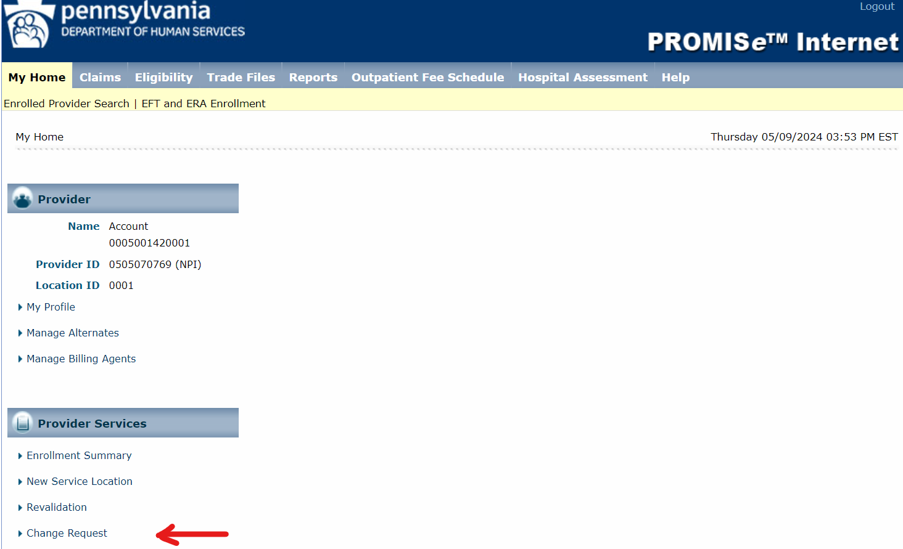
Change Request

Slide 77
Resources

Slide 78
Resources
Electronic Provider Enrollment Application
https://promise.dpw.state.pa.us
Provider Enrollment Information
Enrollment Information (pa.gov)
Includes information regarding requirements for each Provider Type
Provider Enrollment and Screening Requirements of the Affordable Care Act
ACA Information for Providers | Commonwealth of Pennsylvania (pa.gov)
Includes the most current information from the Department relating to the ACA federally mandated regulations
Medicaid Information
Medicaid | Medicaid
Provides information about the ACA federally mandated regulations and how they relate to the Medicaid program

Slide 79
Resources (continued)
DHS Provider Services Center – 800/537-8862 Enrollment press option 2; then option 4
Department of Human Services Website
http://www.dhs.pa.gov/
Provider Quick Tip
#265 - How to Check the Status of Your Electronic Provider Enrollment Application/Actions to Take if Your Application Was Returned for Additional Information
Medicaid/Medical Assistance Provider Quick Tips | Commonwealth of Pennsylvania (pa.gov)
Medical Assistance Bulletins
MAB 10-27-01 – Public Health Dental Hygiene Practitioner Enrollment in the Medical Assistance (MA) Program
MAB 99-16-10 – Revalidation of Medical Assistance (MA) Providers
Bulletin Search | Commonwealth of Pennsylvania (pa.gov)

Slide 80
Questions

