Slide 1
Third Thursday Webinar
July 18, 2019

Slide 2
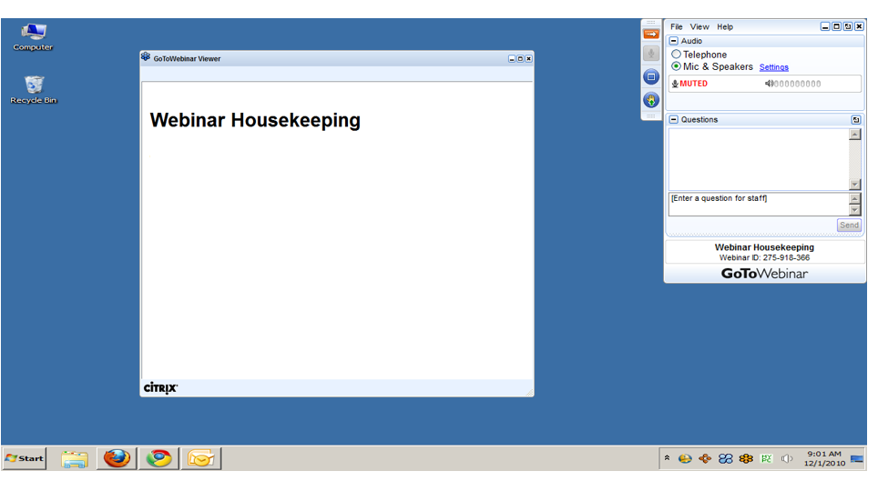
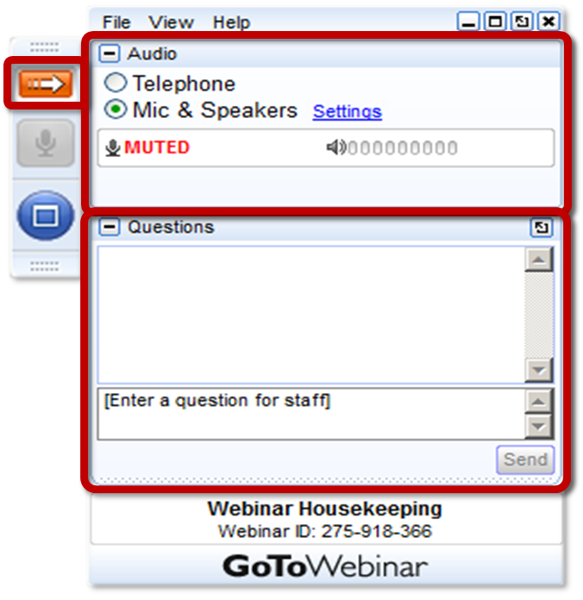
GoToWEBINAR HOUSEKEEPING: What Attendees See
Notes:
Before we get started, I’d like to go over a few items so you know how to participate in today’s event:
Here is a screen shot of the Attendee interface. This is what you should see on your desktop.
In the center of the screen is the GoToWebinar Viewer where you will see the presentation.
In the upper right hand corner is the GoToWebinar control panel where you can ask questions and select audio mode.
If the Control Panel is closed you will see a slim red rectangle. Click on the red arrow to expand the Control Panel.
5. You will be listening to the presentation via your computer's speaker system by default. If you prefer to join by phone, select the “Telephone” button in the audio pane and the dial-in information will be displayed. This will place you in the “listen only” mode to hear the presentation.
You may submit questions (via text) by typing your questions into the “Questions” pane of the control panel. You may send in your questions at any time during the presentation.
Note: The attendee control panel will collapse automatically when not in use. To keep it open, click the “View”, menu, and uncheck “Auto-hide Control Panel”.

Slide 3
AGENDA
Department of Human Services (DHS) Resource & Referral (R&R) Tool
Waiver Enrollment Process And Assessment Data

Slide 4
HCBS Waiver Enrollment Process
And Assessment Data
Tyrone Williams/Chief, Assessments Unit
Amy High/Chief, Enrollment Unit
Office of Long-Term Living
Department of Human Services
Notes:
Welcome to Pennsylvania Individualized Assessments Overview Webinar

Slide 5
HCBS Waiver Enrollment Process

Slide 6
Key Definitions
IEB-Independent Enrollment Broker
FED-Functional Eligibility Determination
PIA-Pennsylvania Individualized Assessments
PC-Physician Certification
NFCE-Nursing Facility Clinically Eligible
CAO-County Assistance Office
HCBS-Home and Community Based Services

Slide 7
Flow Shapes Legend
Terminator-The start and stop points in a process
Process- A process or Action Step
Decision-Indicates a question in the process flow

Slide 8
PIA Assessments Process
IEB creates/updates applicant profiles
IEB (Maximus)
FED Requests
FED Results
PIA
The PIA system is used to request and complete the FED assessments
FED Requests
FED Results
IAE (Aging Well)
IAE through contracted FED assessors create applicant profiles and do FED Assessments

Slide 9
HBCS Waiver Eligibility FED Assessment Process
Applicant contacts IEB
IEB Starts application
IEB concurrently request FED assessment through PIA to FED assessor and sends PC to applicant’s physician.
FED Assessor schedules and conducts FED within 10 business days
FED assessor submits FED results to the IEB via PIA
IEB receives PC
No MA at referral: application starts upon receipt of PA 600L or COMPASS Application

Slide 10
HCBS Waiver Eligibility Enrollment process
CAO sends written notice to applicant informing of ineligibility w/right to appeal
No
IEB retrieves NFCE Result
NFCE Matches PC?
IEB conducts in-home visit (MCO choice counseling)
IEB issues approval to CAO
CAO does financial Review
Applicant Financially eligible?
CAO issues notice to participant
Yes
Yes
CAO updates DHS database and IEB and MCO are notified
No
Yes
Medical Director Review Requested
Medical Director Agrees with NFCE Result?
OLTL sends written notice to applicant informing of ineligibility w/ right to appeal
No
• PC, FED and any other additional information is reviewed.
• Medical history as well as doctor’s recommendation is used to determine appropriate level of care for NFCE.

Slide 11
Level of Care Assessment Data

Slide 12
Level of Care Assessments-All Program Types

Slide 13
Level of Care Assessments-All Program Types

Slide 14
Level of Care Assessments-All Program Types

Slide 15
Level of Care Assessments-HCBS Enrollment

Slide 16
Level Of Care Assessments-HCBS Enrollment

Slide 17
Level of Care Assessments-HCBS Enrollment

Slide 18
QUESTIONS

