Slide 1
Professional Evaluations

Slide 2
Why?
The purpose is to evaluate Professionals regarding their performance throughout the Project and to use their evaluation as criteria for selections of Professionals on future projects.
Tool to help ensure that we are selecting quality Professionals.
A means to reward Professionals that excel.
A tool to communicate with the Professional on whether they are meeting our expectations.

Slide 3
What?
The following key performance indicators will be evaluated:
    Timeliness
    Quality
    Negotiations
    Invoices
    Budget
    Communication
    Sufficient Alternatives
    Project Procedures Manual (Rules)
    Estimating
    Magnitude of addenda
    Bid extensions
    Coordination
    Representation
    Site visits & reports
    Submittals
    Responsiveness
    e-Builder proficiency

Slide 4
When?
Within 2 weeks of the following Project milestones:
  Completion of Negotiations
  DGS’s approval of 50% Design
  DGS’s approval of 100% Design
  Bid Opening – Upon commencement of the Fiscal Analysis (FA) Process
  The elapse of 50% of the original Construction duration
  The last Final Inspection on the Project
  BOC will evaluate at the elapse of 25% and 75% of the original Construction duration. However, the evaluations at these intervals will not contribute to the Professional Evaluation score.

Slide 5
How?
The Bureau of Capital Projects Design’s evaluations will utilize a grade of 1, 3, or 5 to measure the Professional’s performance in relation to specific criteria. The Design Project Manager (DPM) will perform the evaluations during pre-construction. The Professional will receive a score for each criterion as follows:
  1 – Unsatisfactory
  3 – Satisfactory
  5 – Excellent

Slide 6
How?
The Bureau of Construction’s evaluations will utilize a grade of 1, 3, or 5 to measure the Professional’s performance in relation to specific criteria. The Assistant Project Coordinator (APC) will perform the evaluations during construction. The Professional will receive a score for each criterion as follows:
  1 – Unsatisfactory
  3 – Satisfactory
  5 – Excellent

Slide 7
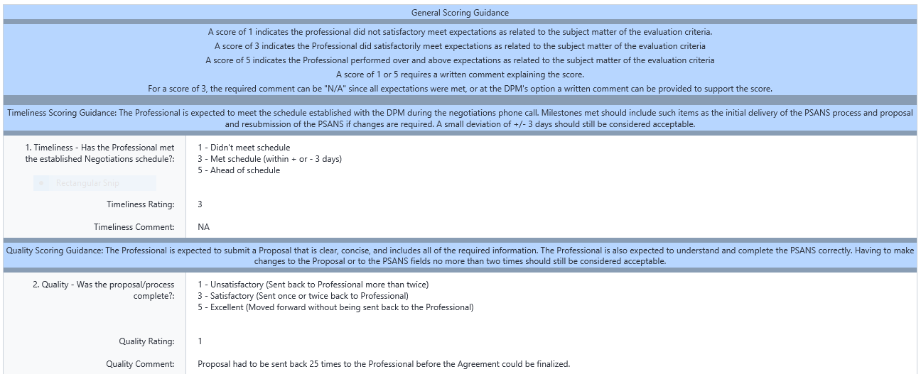
Where? Forms
General Scoring Guidance
Specific Scoring Guidance
Required Comment Field

Slide 8
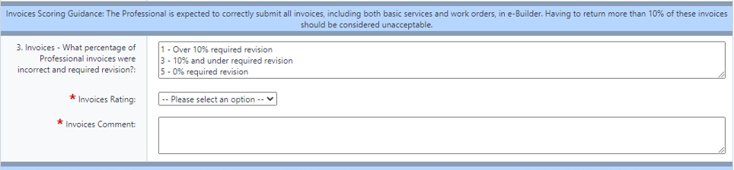
Where? Forms
Example Question #1

Slide 9
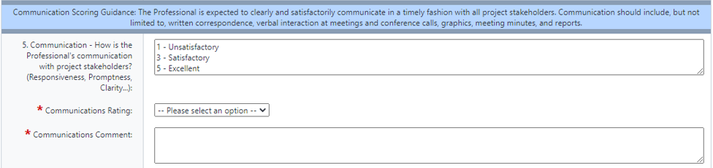
Where? Forms
Example Question #2

Slide 10
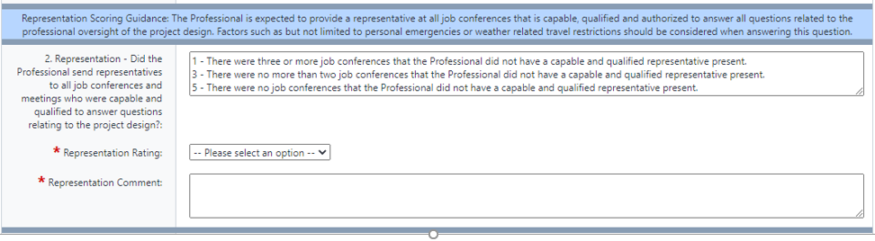
Where? Forms
Example Question #3

Slide 11
Professional Evaluations

Slide 12
Professional Evaluations

Slide 13
Professional Evaluations

Slide 14
Professional Evaluations
Phase | Possible Score
Negotiations | 15
50% Design | 31
100% Design | 31
Bidding & Award | 18
Pre-Construction Subtotal | 95
50% Construction | 29
100% Construction | 29
Construction Subtotal | 58
Pre-Construction & Construction Total | 153
A Professional receiving satisfactory ratings for all criterion will be awarded 100 Points.
Evaluation Percentage | Points Awarded
0-27% | 0
28-31% | 10
32-35% | 20
36-39% | 30
40-43% | 40
44-47% | 50
48-51% | 60
52-55% | 70
56-59% | 80
60-63% | 90
64-72% | 100
73-78% | 120
79-84% | 140
85-90% | 160
91-96% | 180
97-100% | 200
A Professional who has never worked on a DGS Project will be awarded 100 Points.
Satisfactory rating

Slide 15
Professional Evaluations
Scoring Example
Phase | Professional’s Score Project X | Professional’s Score Project Y | Possible Score
Negotiations | 11 | 13 | 30
50% Design | 25 | 27 | 62
100% Design | 27 |  | 31
Bidding & Award | 16 |  | 18
50% Construction | 25 |  | 29
100% Construction
Pre-Construction & Construction Total | 104 | 40 | 170
Evaluation Percentage | Points Awarded
0-27% | 0
28-31% | 10
32-35% | 20
36-39% | 30
40-43% | 40
44-47% | 50
48-51% | 60
52-55% | 70
56-59% | 80
60-63% | 90
64-72% | 100
73-78% | 120
79-84% | 140
85-90% | 160
91-96% | 180
97-100% | 200
The Professional in the example above has just completed 50% Construction on Project X and 50% Design on Project Y. The Professional’s Scores for each project are added together 104 + 40 = 144 and divided by the Possible Score of 170 and multiplied by 100 to get the Evaluation Percentage. 144/170 = 0.847 X 100 = 84.7 or 85% The Evaluation Percentage of 85% equates to 160 Points
Rating

Slide 16
Professional Evaluation Reports
Professional XYZ
3 Year Period
Negotiations
100% Design
50% Construction
50% Design
Bidding & Awards
100% Construction
Negotiations
100% Design
50% Construction
50% Design
Bidding & Awards
100% Construction
Negotiations
100% Design
50% Construction
50% Design
Bidding & Awards
2020
2021
2022
2023
2024
Project #1
Project #2
Project #3

Slide 17
When?
Implementation Plan
Start collecting data in forms – July 2020
Start reporting – August 2020
Selections Applications due – August 5th, 2020
Governors Committee Meeting – September 10th, 2020
After this Webinar, the Forms will be posted to:
https://www.dgs.pa.gov/Design-and-Construction/Design

Slide 18
Questions ?

