Slide 1
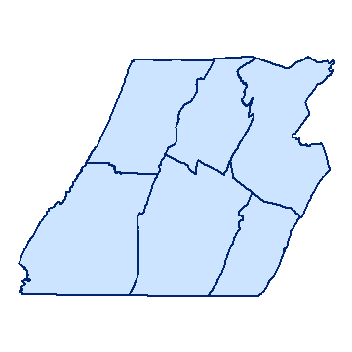

Southern Alleghenies Planning & Development Commission

Slide 2
History/Background
SAP&DC was incorporated in 1967
Board of Directors is comprised of County Commissioners from each of the six (6) member counties and private sector representatives
Other representatives provide valuable guidance through participation on advisory committees

Slide 3
SAP&DC’s mission is to address human resource development, encourage the creation and retention of jobs, and to improve the quality of life for residents of the Southern Alleghenies Region.
Workforce Development
Business Development
Business Lending Services
Planning & Community Development

Slide 4
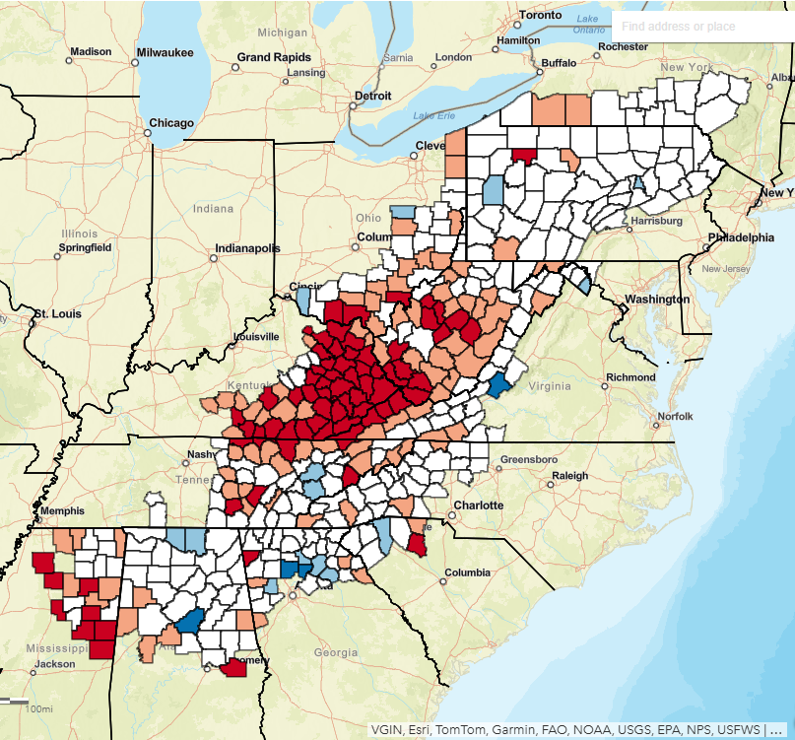
Appalachian Regional Commission (ARC)
The Appalachian Regional Commission (ARC) is an economic development partnership agency of the federal government and 13 state governments focusing on 423 counties across the Appalachian Region. ARC’s mission is to innovate, partner, and invest to build community capacity and strengthen economic growth in Appalachia.

Slide 5
ARC Investment Goals
Goal 1: Building Businesses
Goal 2: Building Workforce Ecosystems
Goal 3: Building Community Infrastructure
Goal 4: Building Regional Culture and Tourism
Goal 5: Building Community Leaders and Local Capacity

Slide 6
ARC Grants and Opportunities
Programs that we typically work with:
Area Development Program
Local Access Road Program
POWER
ARISE
INSPIRE
Other Programs/Initiatives:
Workforce Opportunity for Rural Communities
Appalachian Regional Energy Hub Initiative
Access to Capital Projects
Broadband Projects
READY Appalachia
Academies and Institutes

Slide 7
Area Development Program
Bottom-up Approach: Projects are developed and designed at the local level in collaboration with other local partners and the ARC State Program Manager.
Two Investment Areas:
  Critical Infrastructure – water and wastewater systems, transportation networks, broadband, and other projects anchoring regional economic development
  Business and Workforce Development – entrepreneurship, worker training and education, food systems, leadership, and other human capital development

Slide 8
Area Development Program Cont’d.
Projects can request up to $1M in funding
A 50% match is required (for Transitional Counties)
Eligible applicants include Local Development Districts (LDDs), county or municipal governments, institutions of higher education, non-profit organizations

Slide 9
Project Examples
Developing a comprehensive tourism strategic plan to identify and connect existing assets, explore business growth opportunities and prioritize future investments.
Creating a network of arts, crafts or food tourism trails (activities could include research and data collection, site documentation, web portal and visitor itinerary development, etc.).
Conducting market analysis and business planning to assess the financial viability of a tourism-related construction project.
Developing a tourism-based entrepreneurship training program to improve artisans’ business and marketing skills.
Implementing innovative technologies that create new visitor experiences.
Restoration of a historic theatre or upgrade to a public amphitheater, museum or arts space with the goal to bring more foot traffic to the downtown business district. Note: Any space improved with ARC funds must remain under public ownership.

Slide 10
Important Things to Keep in Mind:
Read the Guidelines!
Develop your Project Plan!
Don’t hesitate to reach out!

Slide 11
Any Questions?
Zachary Lee
Community and Economic Development
Program Manager
(814) 949-6532
zlee@sapdc.net
Online Resources:
https://sapdcprojects.org/
https://www.arc.gov/grants-and-opportunities/
https://www.arc.gov/applicant-resources/
https://www.arc.gov/resource/application-guidance-by-project-type/

