Slide 1




Slide 2


Slide 3


Pennsylvania SBDC
Helping Businesses START, GROW and PROSPER!
No Cost / Low Cost
Live
Virtual
On Demand
No Cost
Confidential
Databases
Guides
Forms
Templates
PENNSYLVANIA SMALL BUSINESS DEVELOPMENT CENTERS

Slide 4

Special Programs
Centers of Excellence
AG & SEO
Product Development
Services
Environmental Management Assistance Program
EMAP
Workforce & Economic Development Network
(WEDnet)
International
Trade
Government
Procurement
(APEX)

Slide 5

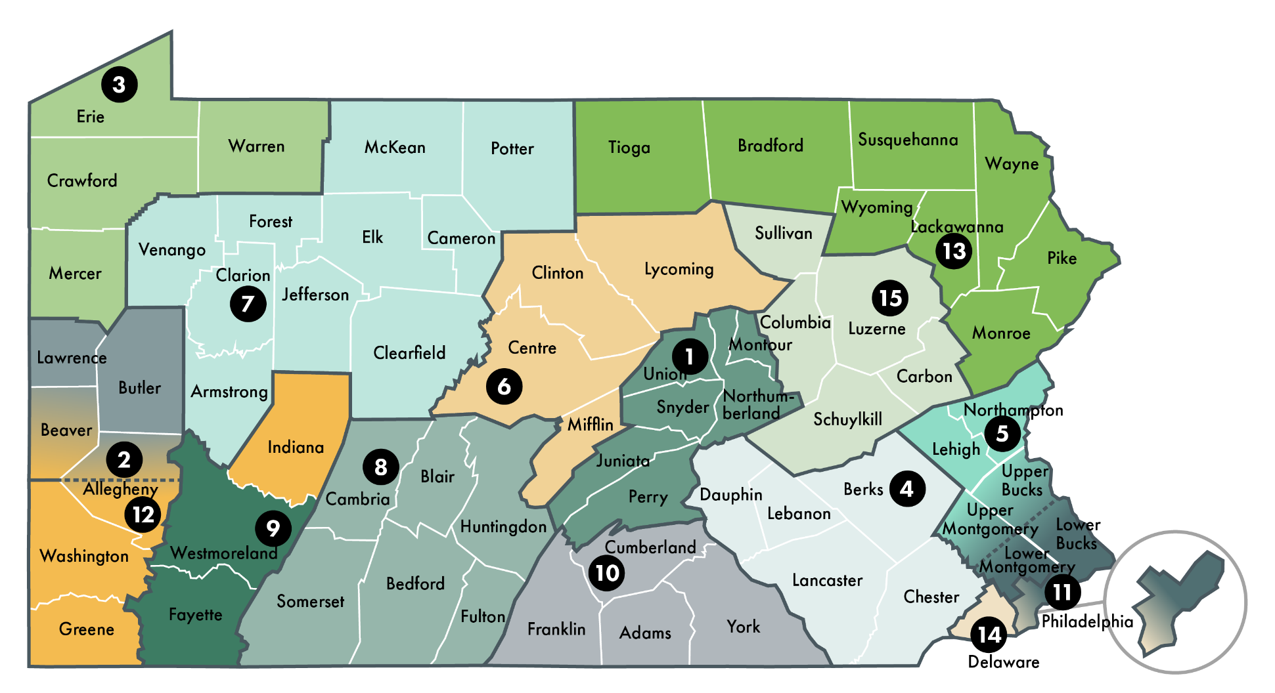
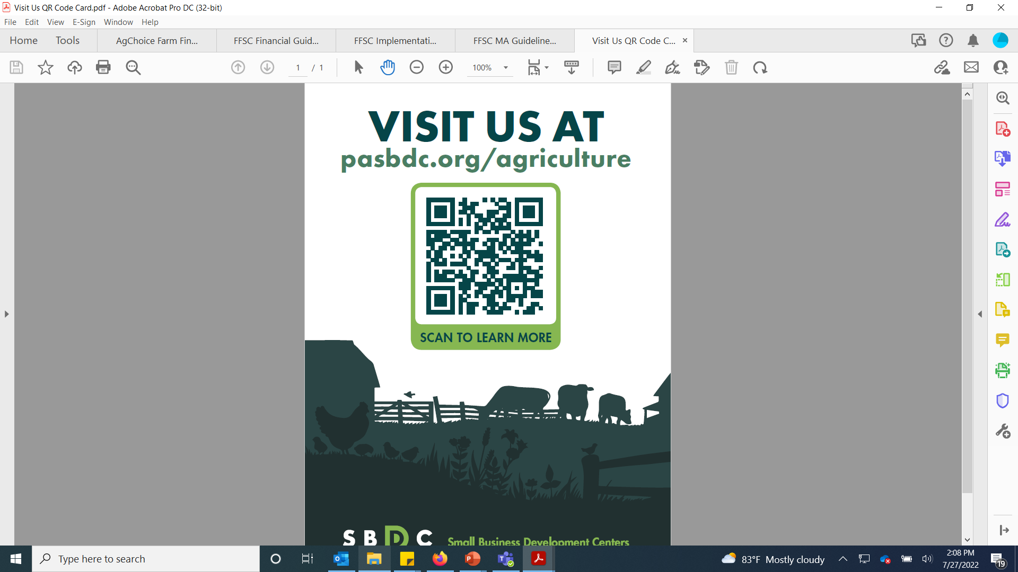

pasbdc.org/agriculture
AG Specialized Services:
* PASBDC Lead Office
* Penn State University SBDC
* The University of Scranton SBDC
* PennWest University-
Clarion SBDC
Funded in part by

Slide 6






PennWest Clarion SBDC
Consultants including Director and Assistant Director
  Includes a QuickBooks ProAdvisor
Fiscal Technician
6-8 Students
  GREAT EXPERIENCE – Internship Opportunities

Slide 7
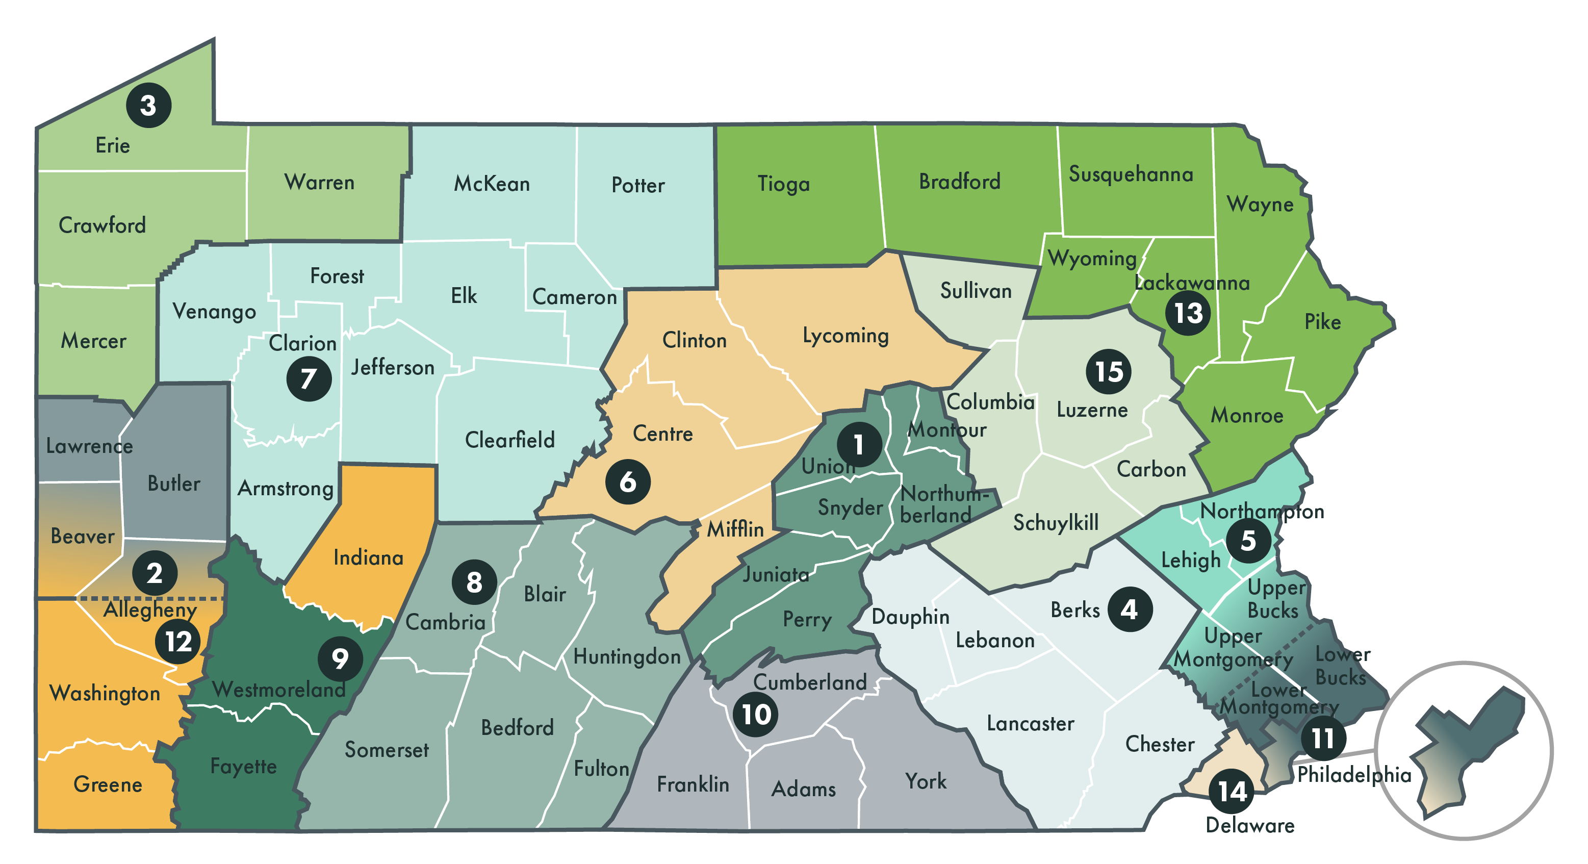



The Pennsylvania SBDC is a network of 15 centers
that serve small businesses in all 67 counties.
Bucknell University
Duquesne University
Gannon University
Kutztown University
Lehigh University
Penn State
PennWest University Clarion
St. Francis University
St. Vincent College
Shippensburg University
Temple University
University of Pittsburgh
University of Scranton
Widener University
Wilkes University
Funded by:

Slide 8
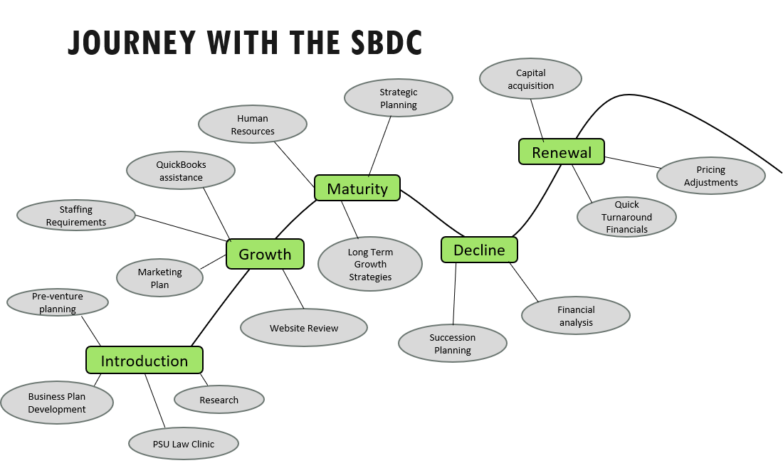

Slide 9






WE OFFER No Cost or Low Cost
Upcoming events:
http://www.pasbdc.org/pennwest-clarion
http://www.pasbdc.org/
Training

Slide 10

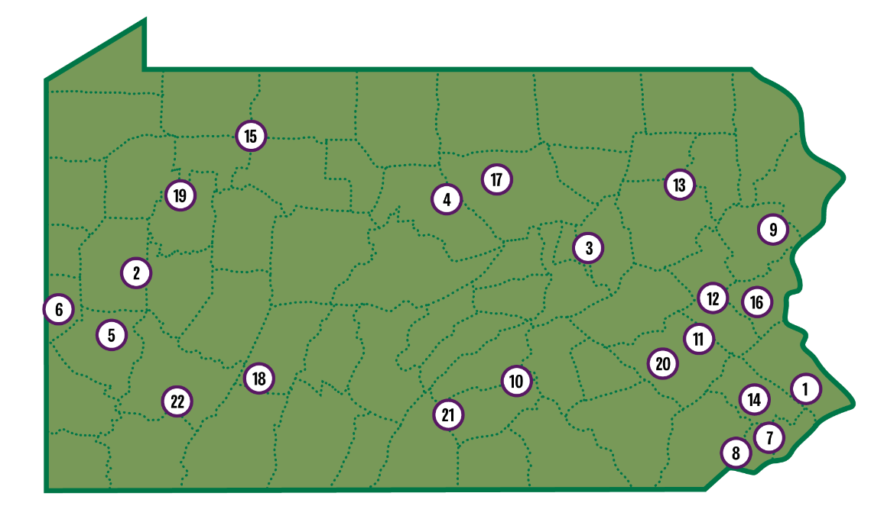
WEDnetPA
1.
2.
3.
4.
Inquire here: https://wednetpa.com/

Slide 11


CONNECT WITH US
www.pasbdc.org/pennwest-clarion | (814) 393-2060 | sbdc@pennwest.edu
TWITTER
FACEBOOK
@ClarionSBDC
@PASmallBusiness
PennWest University
Small Business Development Centers
@sbdcclarion
INSTAGRAM
@PASBDC
LINKEDIN
Office Location:
PennWest Clarion
9 Suites on Main South
840 Wood Street
Clarion, PA 16214
PennWest University
Small Business Development Centers
Notes:
To change the image behind the Mock up.
Select the layer - > Right Click -> Send to Back -> Delete the image -> Drag & Drop your Own Picture -> Send to Back (again)

