Slide 1
Department of
Community & Economic Development
PROGRAMS OVERVIEW
GRANT AND LOAN
OPPORTUNITIES
Paul Macknosky
DCED Northeast Office

Slide 2
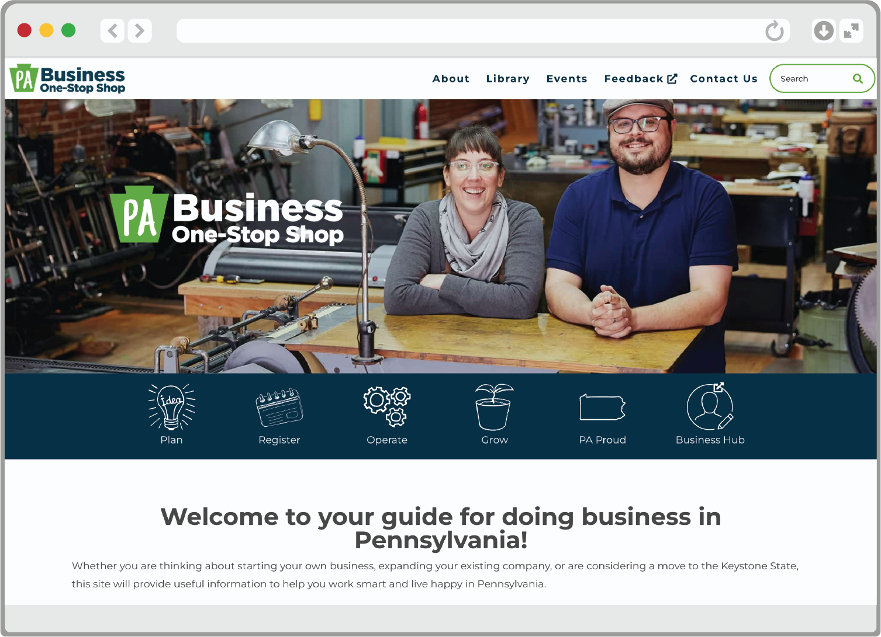

PA Business One-stop SHOP
The PA Business One-Stop Shop can guide businesses through all stages of development — from planning and startup to operating and expanding.
The One-Stop Shop offers dedicated resources and assistance for diverse businesses (including minority-owned, women-owned, and veteran-owned businesses), including how to register as a small diverse business, and training and best practices on important business topics including eCommerce.
The One-Stop Shop can also help connect you with specific opportunities and partner networks for one-on-one counseling, training, and business assistance.
MORE INFO
business.pa.gov
Notes:
We created the PA Business One-Stop Shop a few years ago to guide businesses through all stages of development — from planning and startup to operating and expanding.
The One-Stop Shop offers dedicated resources and assistance for diverse businesses (including minority-owned, women-owned, and veteran-owned businesses), including how to register as a small diverse business, and training and best practices on important business topics including eCommerce.
The One-Stop Shop can also help connect you with specific opportunities and partner networks for one-on-one counseling, training, and business assistance.
The One-Stop Shop can connect you with the most appropriate resources no matter the stage or size of your business. If you’re ever unsure about where to begin in terms of accessing DCED’s services, the PA Business One-Stop Shop is the best place to start. I’ll give a brief overview of a few of our business services programs now – all of which can be found through the PA Business One-Stop Shop.
To access the One-Stop Shop, go to business.pa.gov.

Slide 3
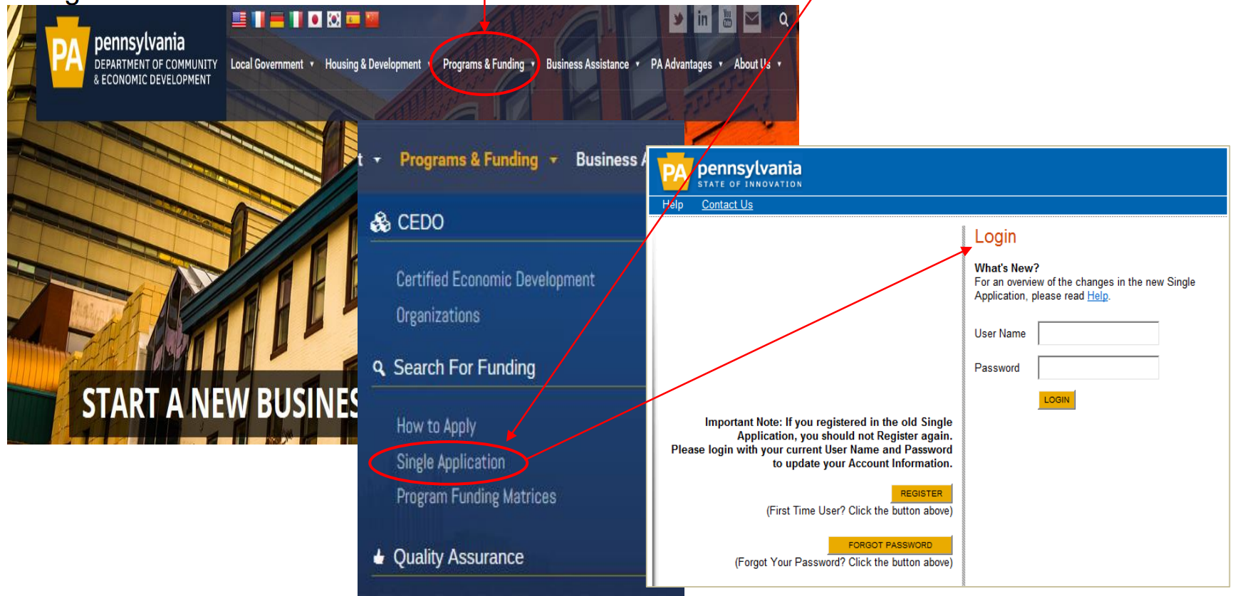
Online Application process
Login using PA Powerport Login
  Page includes a link to register or request a forgotten password.
  For login assistance, contact DCED’s Customer Service Center at 1-866-466-3972
Where to begin:
Access ESA, the web application, from DCED’s website dced.pa.gov

Slide 4
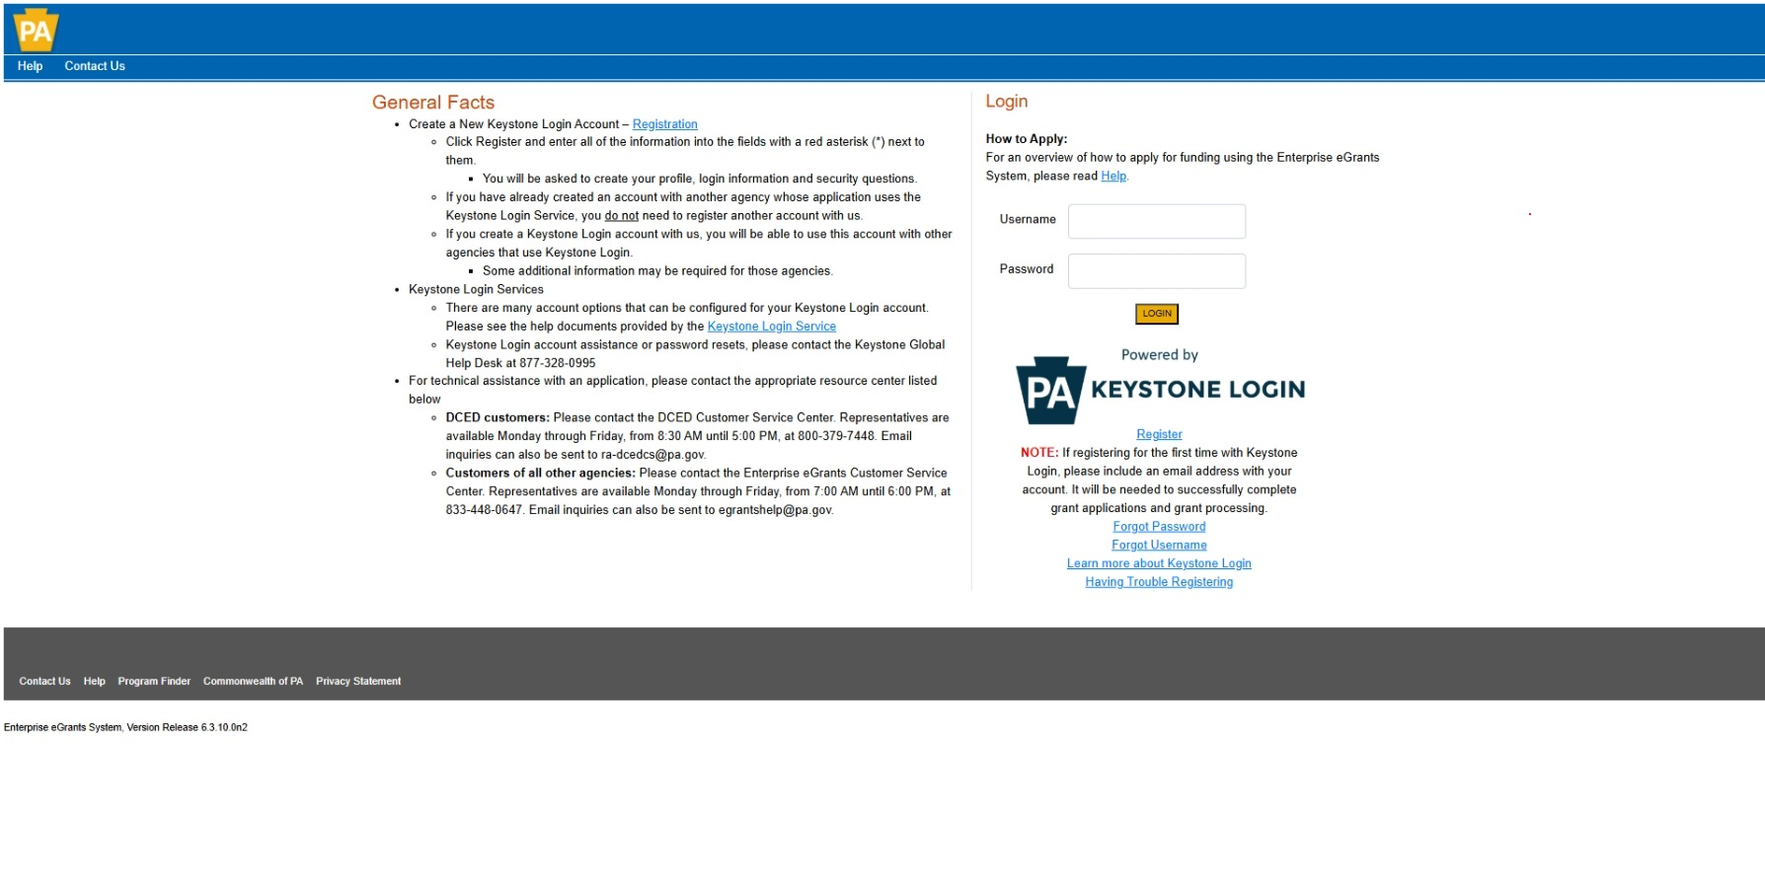
https://grants.pa.gov/Login.aspx

Slide 5
Guidelines
Know the Rules
Each program has separate guidelines which define:
  Eligibility
  Uses
  Program requirements
  Funding limits
  Reporting-Community Impact
  Application process and window (if applicable)

Slide 6
Funding Types
GRANTS
TAX CREDITS
LOAN
LOAN GUARANTEE
BONDS
GOVERNMENT ASSISTANCE

Slide 7
Commonwealth Financing Authority
(CFA)
The Commonwealth Financing Authority (CFA) was established in 2004 as an independent agency of the Department of Community and Economic Development (DCED)
ACT 13
PA Small Water and Sewer
Local Shares Account
Multimodal Transportation Fund

Slide 8
ACT 13 Programs
Application Window 2/1-5/31
Abandoned Mine Drainage Abatement & Treatment Program
Baseline Water Quality Data Program
Flood Mitigation Program
Greenways, Trails, & Recreation Program
Orphan or Abandoned Well Plugging Program
Sewage Facilities Program
Watershed Restoration & Protection Program

Slide 9
CFA Application & Approval Schedule
PROGRAM NAME APPLICATION PERIOD
Act 13 Programs (7 Programs). . . . . . . . . . . . . . . . . . . . . . . . . . . . . . . . . . . . . . 2/1 – 5/31 Annually
Alternative Clean Energy (ACE) . . . . . . . . . . . . . . . . . . . . . . . . . . . . . . . . . . . . . . . . . . . . . Closed
Building PA . . . . . . . . . . . . .. . . . . . . . . . . . . . . . . . . . . . . . . . . . . . . . . . . . . . . . . . . . . . Closed
Business in Our Sites. . . . . . . . . . . . . .. . . . . . . . . . . . . . . . . . . . . . . . . . . . . . . . . . . . . . . Closed
H20 PA Programs . . . . . . . . . . . . . . . . . . . .. . . . . . . . . . . . . . . . . . . . . . . . . . . . . . . . . . . Closed
LSA Luzerne. . . . . . . . . . . . . . . . . . . . . . . . . . . . . . . . . . . . . . . . . . . . . . . . . . 7/1 – 9/30 Annually
LSA Monroe & Contiguous Counties . . . . . . . . . . . . . . . . . . . . . . . . . . . . . . . . . . 7/1 – 9/30 Annually
LSA Northampton & Lehigh . . . . . . . . . . . . . . . . . . . . . . . . . . . . . . . . . . . . . . . . 7/1 – 9/30 Annually
Mixed-Use Development Program . .. . . . . . . . . . . . . . . . . . . . . . . . . . . . . . . . . . . . . . . . . . . . TBD
Multimodal Transportation Fund . . . . . . . . . . . . . . . . . . . . . . . . . . . . . . . . . . . . 3/1 – 7/31 Annually
New PA Venture Capital Investment . . . .. . . . . . . . . . . . . . . . . . . . . . . . . . . . . . . . . . . Always Open*
PA Small Water and Sewer . . . . . . . . . . . . . . . . . . . . . . . . . . . . . . . . . . . . . . . . . . . . . . . . . Closed
Pipeline Investment . . . . . . . . . . . . . . . . . . . . . . . . . . . . . . . . . . . . . . . . . . . . . . . . . Always Open*
Public School Facility Improvement Grant Program. . . . . . . . . . . . . . . . . . . . . . . . . . . . . . . . . . . TBD
Renewable Energy Program . . . . . . . . . . . . . . . . . . . . . . . . . . . . . . . . . . . . . . . . . . . . . . . . Closed
Second Stage Loan Guarantee. . . . . . . . . . . . . . .. . . . . . . . . . . . . . . . . . . . . . . . . . . . Always Open**
Solar Energy Program . . . . . . . . . . . . . . . . . . . . . . . . . . . . . . . . . . . . . . . . . . . . . . . . . . . . Closed
Statewide LSA . . . . . . . . . . . . . . . . . . . . . . . . . . . . . . . . . . . . . . . . . . . . . . . . 9/1 - 11/30 Annually
Tax Increment Financing Guarantee . . . . . . . . . . .. . . . . . . . . . . . . . . . . . . . . . . . . . . . Always Open*
* Applications must be received 60 days prior to the scheduled board meeting
** Applications must be received 30 days prior to a scheduled board meeting

Slide 10
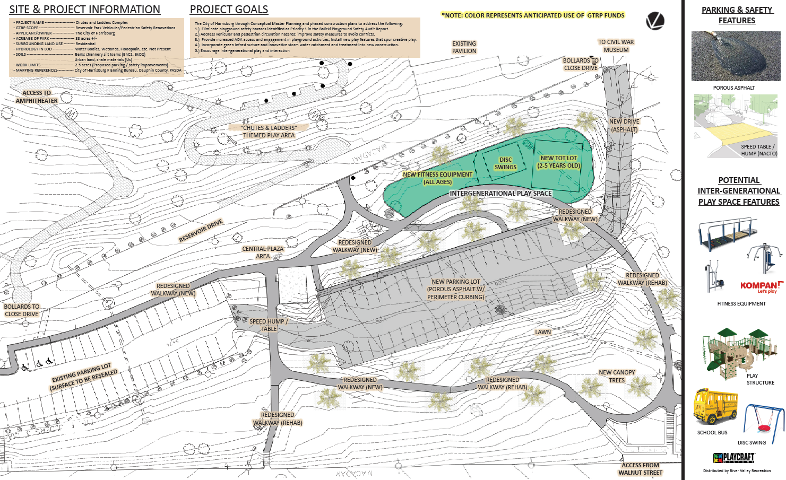
Greenways, Trails and Recreation Program
Application window 2/1 – 5/31
Uses: Parks, trails, greenways, river conservation
Funds: Used for planning, acquisition, development, rehabilitation and repair of greenways, recreational trails, open space, parks and beautification projects
Eligible Applicants: For-Profit Businesses, Municipalities, Councils of Governments, Authorized Organization, Institution of Higher Education, Watershed Organization
Maximum Award: $250,000 - Match Requirement: 15% of total project cost

Slide 11
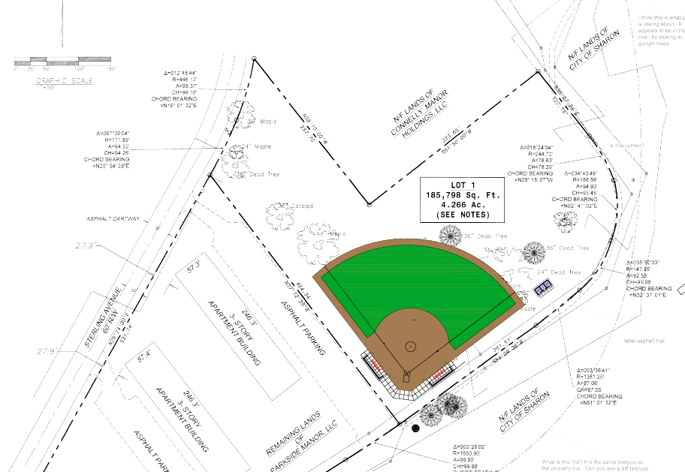
Local Share Account – Statewide
Application Window 9/1-11/30
*Projects in the public interest*
Eligible applicants include:
  Pennsylvania Counties
  Municipalities
  Municipal Authorities
  Economic Development Agencies
  Redevelopment Authorities
  Land Banks
  Councils of Government

Slide 12


Projects may not start prior to approval
Administrative costs – 5% of the grant request
Contingencies – 5% of the construction/infrastructure costs
Program details - Eligibility
Statewide LSA
Projects may not start prior to approval
Request/Award Limitations:
  $25,000 minimum
  $1,000,000 maximum
  Budgetary Caps:
  Engineering, design, fees – 10% of the grant request
  Administrative costs – 5% of the grant request
  Contingencies – 5% of the construction/infrastructure costs
Acquisition
Construction
Fixed equipment
Site prep – demo, assessment/ remediation, etc.
Signage
Landscaping
Streetscape amenities
Engineering/design
Fees for securing financing
Interest on borrowed funds
Public relations
Outreach
Communications
Lobbying
Litigation
Application preparation

Slide 13
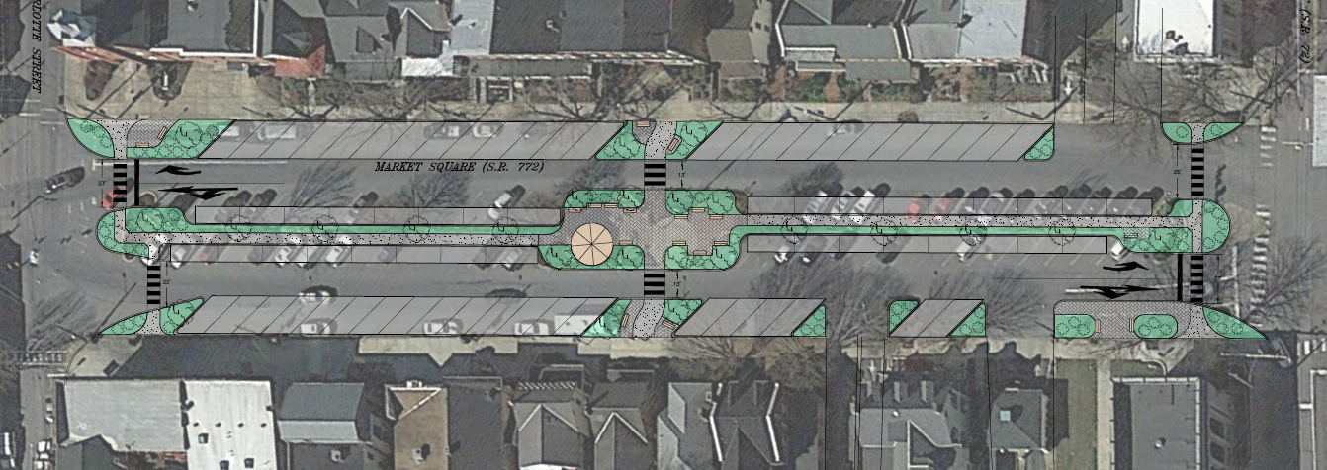
Multimodal Transportation Fund
  Application window March 1 and July 31
Bridges
Sidewalks
Paving
Streetscape
Bike Lanes
Railroad
Funds may be used for the development, rehabilitation and enhancement of transportation assets.
Project Cost: $100,000+ Maximum Award: $3,000,000
Eligible Applicants: Municipalities, Councils of Governments, Businesses, Economic Development Organizations, Public Transportation Agencies, Ports-Rail/Freight

Slide 14

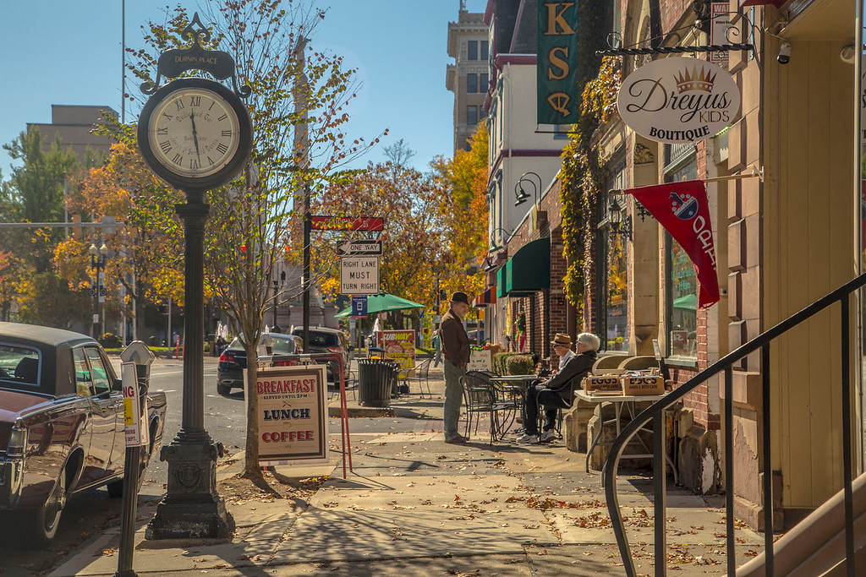
MAIN STREET MATTERS
$25 million
for the Main Street Matters program, to support small businesses and commercial corridors that are the backbone of communities across our Commonwealth
Planning Grants
Façade Grants
Business Improvement Grants
District Development Grants
Accessible Housing Grants
Implementation Grants

Slide 15
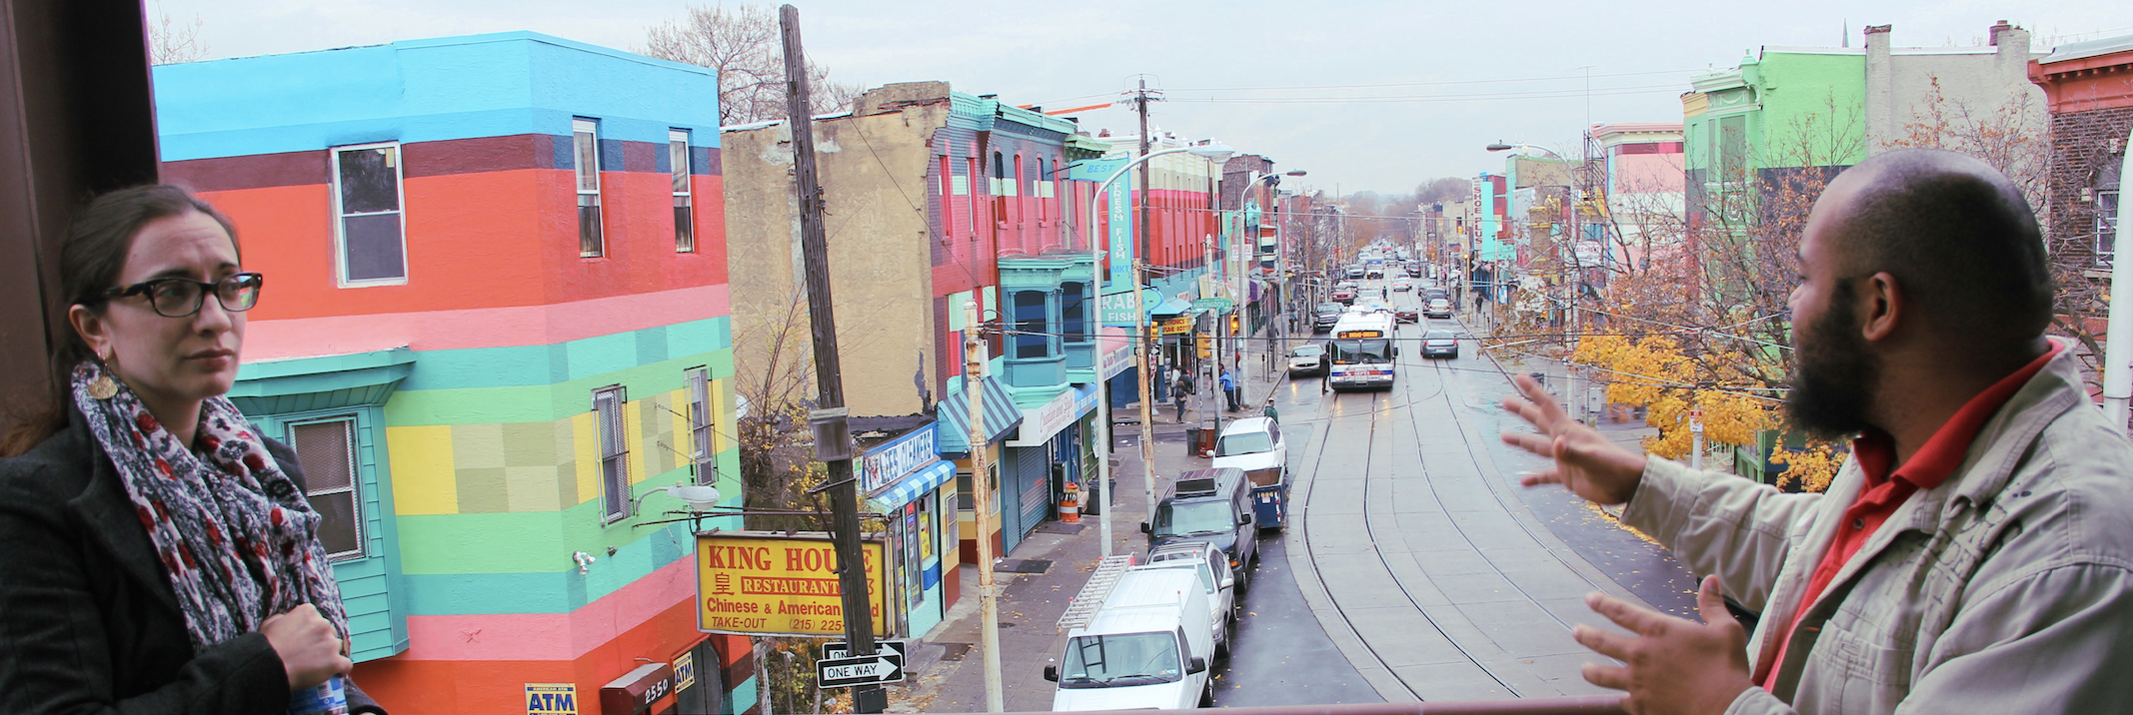

NAP Program Overview
Eligibility
Neighborhood non-profits
Assistance
$72 million in tax credits available annually
More information
dced.pa.gov/nap
NAP helps non-profit organizations and businesses with collaboration to improve the conditions for low-income populations in communities throughout Pennsylvania.

Slide 16
General requirements
Beneficiaries
Low Income Community is defined as a census tract where the median family income does not exceed 80% of the state-wide median family income.
Distressed Area
A distressed area must demonstrate a high incidence of one or more of the following demographic factors:
Persistent unemployment or underemployment,
Dependence upon public assistance,
Overcrowded, unsanitary, or inadequate housing,
Crime and delinquency,
School dropouts or other evidence of low educational attainment,
Vacant and dilapidated properties, blight, or
Other generally accepted indicators of widespread
social problems
DCED ELIGIBLE DESIGNATIONS:
Enterprise Zones
Keystone Opportunity Zones
Keystone Opportunity Expansion Zones
Keystone Opportunity Improvement Zones
Keystone Communities
Keystone Main Streets
Keystone Elm Streets
Keystone Communities Enterprise Zones
Act 47 Municipalities
Cities of the First-class, Cities of the Second-class, Cities of the Second-class A or Cities of the Third-class

Slide 17
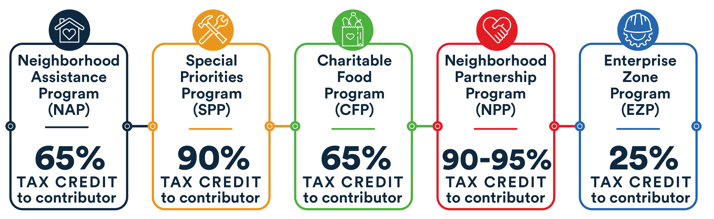
Tax Credits Per Sub-Program
DCED does not offer actual dollars for funding. Funding is between contributor and awardee.

Slide 18
Programs & Funding
If you’re seeking funding for a business expansion, a community project or site revitalization in Pennsylvania, DCED offers a variety of programs to help.
https://dced.pa.gov/programs-funding/

Slide 19
REDEVELOPMENT ASSISTANCE CAPITAL PROGRAM (RACP)
BUSINESS/INDUSTRY
Wide variety of industries, but project must have a cultural, civic, historical, or regional impact and generates substantial increases in employment, tax revenues or other measures of economic activity.
ASSISTANCE
Grant
MAXIMUM AMOUNT
No set maximum
MORE INFO
racp.pa.gov
RACP is a grant program administered by the
PA Office of the Budget for the acquisition and construction of economic
development, cultural,
civic, recreational, and historical improvement projects.
A project is eligible for RACP funding only if that project fits within one of the categories listed in the PA Capital Budget Project Itemization Act.
16

Slide 20
Questions and Next Steps
Paul Macknosky pmacknosky@pa.gov
570-963-4122
PAGetsItDone.com

